Slide 1
Programming 4
Lecture 10: Manual Scrolling Tile Map
Semester 1, 2020
Kaiako: Grayson Orr
Te Kura Matatiniki Otago, O ̄tepoti, Aotearoa
Wednesday, 25 March

Slide 2
Scrolling
The world can be much larger than what is shown on our screens
In a scrolling game, the tile mapping technique is the same
Except the map is bigger than the screen

Slide 3
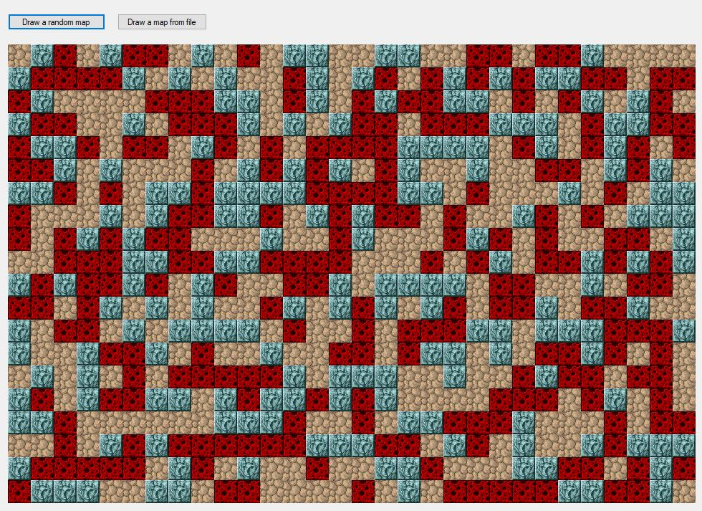
Scrolling

Slide 4
Example world
Super Mario Bros (NES)
SMB uses 16x16 pixel tiles
SMB uses a world that is very wide, but only one
screen high (211 tiles wide and 14 tiles high)

Slide 5
Example viewport
Viewport is 18 tiles wide and 14 tiles high

Slide 6
Coordinate systems
(0,0) in Viewport coordinates
(screen coordinates)
(100, 100) in World
coordinates
(0, 0) in
World
coordinates

Slide 7
Coordinate systems
(0,0) in Viewport coordinates
(screen coordinates)
(300, 200) in World
coordinates
(100, 100) in World
coordinates
(0, 0) in
World
coordinates
(200, 100) in Viewport
coordinates

Slide 8
Coordinate systems
(262, 0) in World
(0, 0) in Viewport
(0, 0) in World
World continues…
(300, 200) in World
(38, 200) in Viewport

Slide 9
Creating a world
Your world needs to be big
Extend your TileMap to be much larger than
your screen dimensions
Viewport
World TileMap

Slide 10
Viewport class
Your Viewport class needs to know:
It’s location in the World
It’s row and column dimensions
The world TileMap to work from
The Graphics canvas to draw to

Slide 11
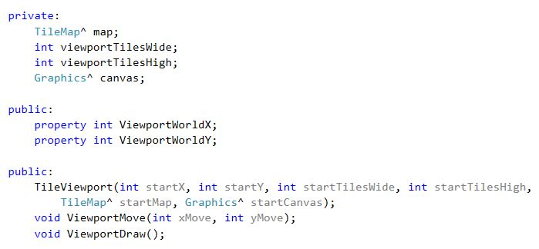
Viewport class

Slide 12
How the Viewport draws itself
Draw all the world tiles that are in the Viewport’s area
We must be able to:
Start at the upper left location of the Viewport (in the world)
Double for loop over all rows and columns of the Viewport
Get each TileBitmap
Figure out where to draw it on the canvas

Slide 13
1. Iterate over the Viewport
Pseudocode:
For all rows r of the Viewport (in the world)
For all the columns c of the Viewport (in the world)
Get the bitmap for the tile at (r, c) in the world TileMap
Figure out where it goes on the screen
Draw it there

Slide 14
2. What Tile to start on?
The world has two units of measurement for location:
Pixel locations – e.g. Sprite and Viewport upper left corner positions
Row, column locations – tiles in the tile map background
The Viewport stores the pixel location of its upper
left corner
We need the tile location of the Viewport’s upper
left corner
We must translate from pixel (x, y) location to tile
map (row, column) location

Slide 15
2. What Tile to start on?
If an object is at pixel location pixelX, pixelY, what
is its row, column location?
viewportTileX = ViewportWorldX / tileSide;
viewportTileY = ViewportWorldY / tileSide;

Slide 16
3. Getting a TileBitmap => data chain
Given a row, column location in the world
TileMap, how does the Viewport know what
Bitmap^ to draw?
Passes world row and column
Passes int from map array...
Indexes into Tile^ array...
Viewport
TileMap
TileSet
Tile
Bitmap^
Bitmap^
Bitmap^

Slide 17
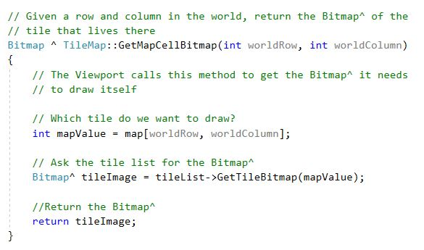
New TileMap method needed

Slide 18
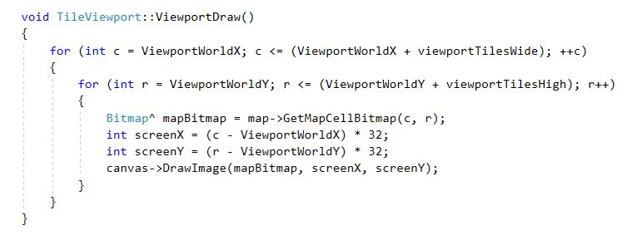
The double for loop
Note this is not the final code…

Slide 19
Where to draw on the screen
Place the upper left tile at 0,0 on the canvas
and iterate as normal using the loop driver variables
What if your Viewport edge is not on a tile boundary?
You need to start drawing in the middle of a tile
Two steps:
Figure out how many pixels you are from the tile boundary
Shift your drawing location that many pixels to the left
viewportOffsetX = ViewportWorldX % tileSide;
viewportOffsetY = ViewportWorldY % tileSide;
DrawImage happy to take a negative pixel position

Slide 20
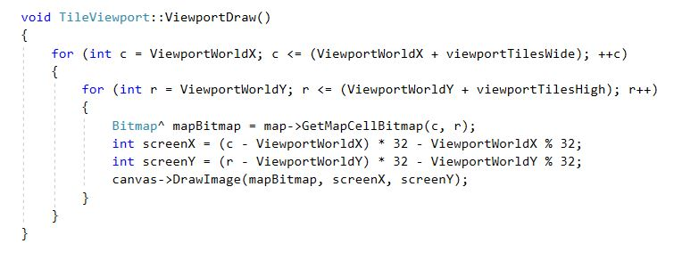
Where to draw on the screen

Slide 21
Moving the Viewport
Adjust ViewportWorldX and ViewportWorldY
Add bounds checking

