Slide 1
Programming 4
Lecture 11: NPC Collision
Semester 1, 2020
Kaiako: Grayson Orr
Te Kura Matatiniki Otago, O ̄tepoti, Aotearoa
Wednesday, 15 April

Slide 2
Types of collision detection
Sprite to sprite
Checking for collisions with other sprites
Sprite to terrain
Moving sprites (e.g. player character, NPCs) checking
for collisions with objects in the tile map
Notes:
We use different techniques for these two kinds
For the first, we need to compare the locations of the two sprites, and how we define ‘location’ we will see is important
For the second, we need to add properties to our tiles to indicate that they represent solid objects
We’ll do this next time

Slide 3
Before vs. after
Before
Compute where everyone will go
Deal with any collisions that will occur
Instantiate only legal moves
After
Move everyone
Deal with any collisions that occurred
Move anyone back who is in an illegal spot
Notes:
Two algorithms for collision detection
A priori = “before” A posteriori = “after”
We will use a combination of the two approaches – a priori for terrain and a posteriori for sprite-to-sprite

Slide 4
Number of comparisons
Two objects, Sprite A & Sprite B
One comparison – A to B
Three objects, Sprite A, Sprite B & Sprite C
Three comparisons – AB, AC, BC
Four objects, Sprite A, Sprite B, Sprite C & Sprite D
Six comparisons
Twenty objects – 190 comparisons
1000 objects – 499500 comparisons
Notes:
Collision detection, as we will see, is mathematically straightforward – nothing tricky involved
The more interesting technical problem is how to control the computational demands
In our little desktop game, it really makes no difference, of course, but consider the issue in an MMORPG with thousands of sprites moving around at any one game cycle, and you can see that things can get fairly demanding
The difficulty is in the way that the number of comparisons required increases as we increase the number of sprites involved
Doubling the number of objects on the screen roughly quadruples the number of tests you must perform
This mathematical relationship – how many pairs can you make from a given number of objects – is an example of the operation known as ‘n choose k’. We say ‘1000 choose 2’ = 499,500
Formula: n! / (n-k)! * k!

Slide 5
Reducing the number of comparisons
Game rule elimination
When a collision between two objects is not relevant to the
game, don’t test for it
Spatial elimination
When two objects are so far apart (in world coordinates) that
they can’t collide, don’t test them.
Sort all objects according to their position on one axis.
Only making comparisons between objects that are close enough to each other that they could collide.
Extra computation for maintaining sorted lists needs to be less than the extra computation required for collision detection
Notes:
To improve performance, therefore, we want to reduce the number of comparisons
There are several ways this can be done
Remember that you have to write all the code for this stuff
Game rule elimination: Some objects can’t collide, or it doesn’t matter if they collide, so don’t check them
For example, in Mario-type games, the various baddies often walk past each other with no effect. You can skip all those comparisons
Or if you’re making a space-shooter where enemy missiles don’t destroy each other, there’s no need to check if they have collided
Spatial elimination: Some objects are physically incapable of colliding, so don’t check them
Sort by location
Only compare neighbours (within some distance) in the list. Quit comparing when you get width pixels (if sorted on x axis) or height pixels (if sorted on y axis) apart
Spatial elimination requires extra computation to sort the various objects and perform additional bookkeeping
It is better suited for games in which a large number of objects are active at once. If a game has only a few objects, there aren't many potential collision tests to eliminate, and the added bookkeeping can exceed the gain

Slide 6
Determining collisions
Notes:
Given that you have decided which pairs to test, how do you programmatically determine if a collision has occurred?
Have these two objects collided?
It depends.....

Slide 7
Determining collisions
Notes:
Have these two objects collided?
It depends
If you look at them, it appears that they have not. However, if you check for overlap of, for example, their bitmaps, you will determine that they have

Slide 8
Determining collisions
Fast methods
Accurate methods
Notes:
You have two choices:
Fast but inaccurate
Accurate but slow

Slide 9
Accurate collision detection
Pixel-based detection
For each Pixel pa of Sprite1
For each Pixel pb in Sprite2
If pa is not Sprite1’s transparent colour and
If pb is not Sprite2’s transparent colour and
They are at the same pixel location in the world
Collision = true;
Notes:
This computation (double for loop) is O(n2) in the number of pixels. Terrible speed, but it is very accurate

Slide 10
Accurate collision detection
Collision map
For each sprite, construct a grid of bits the same size as
the image in pixels
Bit = 1 if the corresponding pixel is solid
Bit = 0 if the corresponding pixel is transparent
Comparison uses logical AND
Notes:
An interesting technique
A collision map can speed up this process
Set it up in the sprite’s constructor
Here you don’t have to keep calling the GetPixel method and comparing the colours all the time, you just grab the bit
Still O(n**2) though

Slide 11
Accurate collision detection
Bounding areas
Notes:
Only need to determine if the rectangles overlap
This situation will return true
The monster on the left will be annoyed
Nonetheless, this is what we will use – but we will use a slightly souped up version, as we will see in a few minutes

Slide 12
Collision using bounding rectangles
Assume Sprite1 and Sprite2
Notes:
Basic approach: Compare edges (demonstrate on board or with much pointing)
Assume collision, and test the four conditions that would falsify that assumption
If Sprite1’s Left is > Sprite2’s Right, they can’t have collided, no matter where they are on the y-axis
Similarly, if Sprite1’s Bottom is higher than Sprite2’s Top, they can’t have collided
Same switching Sprite1 and Sprite2
You thus need to make only four comparisons:

Slide 13
Collision using bounding rectangles
collided = true
if Sprite1’s BottomEdge < Sprite2’s TopEdge Collided = false
if Sprite1’s TopEdge > Sprite2’s BottomEdge Collided = false
if Sprite1’s RightEdge < Sprite2’s LeftEdge Collided = false
if Sprite1’s LeftEdge > Sprite2’s RightEdge Collided = false
return collided
Notes:
This is a common Boolean pattern: Start in the more probable state. Check the conditions that falsify it. Return the outcome
For readable code, get all those bottom edges and right edges into variables before doing the comparisons, don’t do the height and width additions inside the Booleans, it will be too busy
Yes, there are built-in methods in .NET you could use, but you should write your own so that you know how if you are ever working in a language that doesn’t have them.

Slide 14
Whose method is it?
bool Sprite::CollidedWithMe(Sprite^ otherSprite)
Notes:
This should be a method of Sprite, since he has the most direct access to his location and dimensions
Because there are two sprites involved, you will need to call the method on one instance and pass the other instance in
Pass your Sprite the other guy and ask him if he and the other guy have collided

Slide 15
What about SpriteList?
Sprite^ SpriteList::CheckCollisions(Sprite^ otherSprite)
Traverse the list, passing otherSprite to the CollidedWithMe method of each Sprite in the list
Return the first Sprite hit, or null if there are no collisions
Notes:
What about when we have a list of sprites to compare?
For example, we might want to compare the player character against all the enemies
It is easier to pass one guy into the list than to query the list for each element and pass it to the one guy
Yes, this will not be perfect if there are two simultaneous collisions
If it’s critical, you could write the code to build and return a linked list of collidedWith
The approach illustrated here is acceptable for our purposes

Slide 16
Improving bounding rectangle detection
Notes:
Most sprites have a large rectangular border of transparent pixels
These will cause false alarms in a simple collision detection algorithm
Improve them by comparing, not the image borders, but some proportional reduction (10% to 30% usually, depending on your sprites)
Each sprite needs its own reduction term depending on its images, so you will need to add it as a class property
Don’t bring it in too much, or you’ll miss
Make the proportional reduction a parameter to the collide method (left as an exercise)
Experiment to find the correct proportional reduction

Slide 17
Combining approaches
Use bounding Rectangles to determine image overlap
Use pixel comparisons to determine real overlap if
step two indicates a collision
Notes:
As you are trying to balance computational load and accuracy, you may consider an intermediate approach
For the actual requirements of this class, bounding rectangle with reduction is good enough

Slide 18
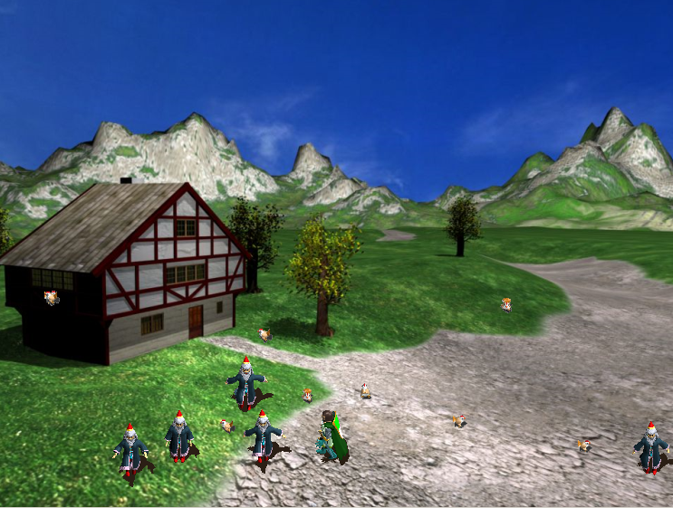
Practical
Notes:
Build an application with a player character under keyboard control, and a list of NPC sprites
Program some observable behaviour on collision
If you have already implemented sprite-to-sprite collision detection, refactor your architecture to remove any coupling or lack-of-cohesion cohesion problems.
DO NOT JUST STUFF THE COLLISION DETECTION CODE INTO THE MOVE. Use the architecture as described. Remember “it works” is no longer enough. It also has to be right

