Slide 1
Programming 4
Lecture 12: Terrain Collision
Semester 1, 2020
Kaiako: Grayson Orr
Te Kura Matatiniki Otago, O ̄tepoti, Aotearoa
Friday, 17 April

Slide 2
Types of collision detection
Sprite to sprite
Checking for collisions with other sprites
Sprite to terrain
Moving sprites (e.g. player character, NPCs) checking
for collisions with objects in the tile map

Slide 3
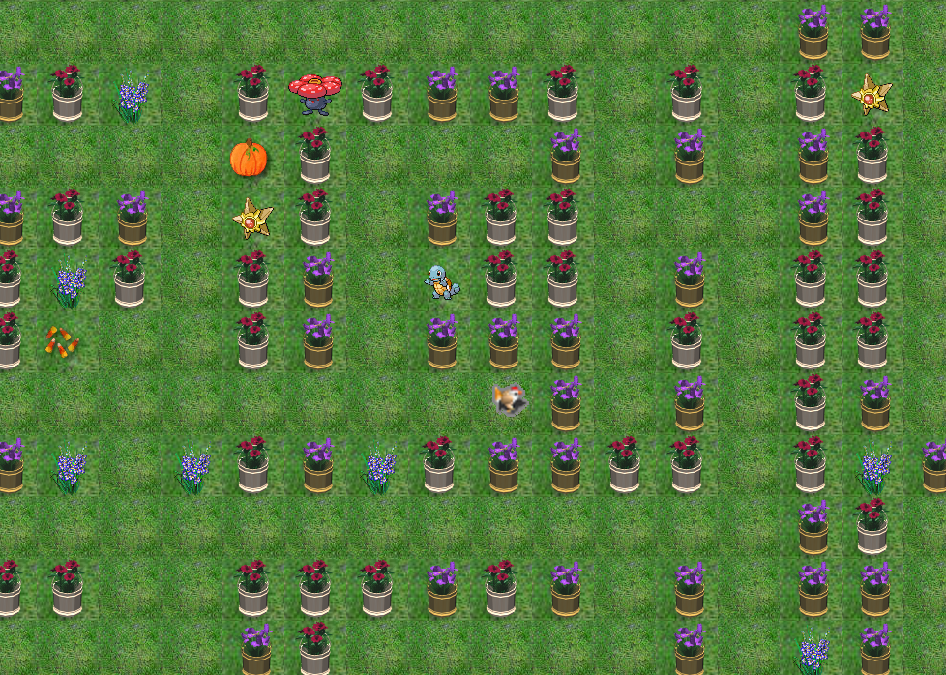
Terrain collision detection

Slide 4
Algorithm
When the sprite moves:
Determine what tile the sprite will move onto
Determine if that tile is walkable
If so, move the sprite. If not, don’t move the sprite

Slide 5
Problems
Figuring out which tile the sprite will move onto
Figuring out if it is walkable

Slide 6
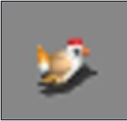

Which tile?
xTile = xPos / TILE_SIDE
yTile = yPos / TILE_SIDE
(xPos, yPos)
Collision point

Slide 7




Which tile?
North
East
South
West
If the SpriteDirection is... | Look at this corner
North | Upper left
East | Lower right
South | Lower left
West | Lower Left

Slide 8
How to get a walkable tile?
Sprite ↔ TileMap ↔ TileList ↔ Tile
Therefore, the Sprite class must now hold a pointer
to its TileMap
col, row
index
get or property
isWalkable
isWalkable
isWalkable

Slide 9
Change to the engine
Add a TileMap^ class data member to class Sprite, (passed into the constructor)
Add appropriate method(s) to the Sprite class to compute what tile column and row it is going to step onto if it moves
Add appropriate methods to Tile, TileList and TileMap
to support step 2
Adjust Sprite::Move so that xPos and yPos are only changed if the new Tile turns out to be walkable

Slide 10
Logic for “after” movement
Determine what the next xPos and yPos would be,
and store these values in local variables
(e.g. nextXPos and nextYPos)
Determine what Tile nextXPos and nextYPos would
land on
Determine whether that Tile is walkable
Only if it is, copy nextXPos into the real xPos and nextYPos into the real yPos

Slide 11
Practical
Build a world with a player character who doesn’t
walk through the walls
Images and small and large map files on the I: drive
(or make your own)
Optional extension: Include pickup sprites and use
your sprite to sprite collision detection as well

