Slide 1
Programming 4
Assessment 01: Roguelike Algorithms
Semester 1, 2020
Kaiako: Grayson Orr
Te Kura Matatiniki Otago, O ̄tepoti, Aotearoa

Slide 2
Functionality
Procedural dungeon generation
Combat
Notes:
Two important bits of logic for roguelikes
Today we will talk about very basic algorithms for this functionality. These are the minimum requirements for the assignment
There are many, many more complicated ways to do both, and you are free to explore and experiment

Slide 3
Procedurally generated dungeons
Rooms, corridors between rooms, a stairway or other portal
Requirement: From any room, there must be some
path to every other room. (These paths may pass through multiple other rooms on the way)
Simplest algorithm:
Randomly generate a set of non-overlapping rooms
Connect the rooms with corridors in such a way as
to meet the requirement
Notes:
This is an absolute requirement. Since the stairway is randomly placed, this requirement must be fulfilled, or it could potentially be impossible to get to the next level

Slide 4
Procedurally generated dungeons
Display must be implemented via a scrolling tile map
Tiles for floor, corridor, wall, door, empty (dirt)
Algorithmically generate the locations of rooms, walls, corridors and doors (see next slides)
Translate your dungeon representation into some form that can be used by your TileMap class
You will need to add multiple classes to your existing game engine architecture in order to generate
dungeons
Maintain high cohesion and low coupling
Notes:
We’ll look at the algorithm in detail in just a second
Many architectures are possible. Plan carefully. See Planning Document requirement in assignment handout

Slide 5
Procedurally generated dungeons
Making the rooms
Determine the number of rooms to make
For each room,
Repeat until you find space
Randomly select the height and width (in tiles)
within some sensible range (include walls)
Randomly select a location for the upper left tile of the room
Check if the entire required area is empty
When you find space, record the room in some way in an appropriate data structure. (Remember the walls.)
Notes:
Number of rooms should be random within some range
Two phases: First make the rooms, then connect them with corridors
You will need some way to keep track of what locations in the world you have assigned to be room and wall. Later, you will arrange for these to be translated into a 2D-integer array that the TileMap can use

Slide 6
Procedurally generated dungeons
Making the corridors:
Assume the rooms are contained in a linear data structure
Walk the structure, connecting each neighbouring pair of
rooms (0&1, 1&2, 2&3, 3&4...) with corridor. Horizontal
and vertical stretches may both be required
To make a corridor between two rooms:
Find the centre points of the two rooms (in row, column units)
Place the horizontal leg of the corridor from the centre column
of the first room to the centre column of the
second room
If necessary, continue the vertical leg of the corridor to
the centre row of the second room
Notes:
Note that if the rooms are aligned on one axis, the complementary segment of corridor will be length 0
You need to work out carefully the order of the corridor legs
I always draw from west to east, then go either up or down, depending on the placement of the rooms
Assuming that rule, you will have situations like this....

Slide 7
Procedurally generated dungeons
R1
R2

Slide 8
Procedurally generated dungeons
R2
R1

Slide 9
Procedurally generated dungeons
R2
R1

Slide 10
Procedurally generated dungeons
Where corridors are on top of walls, place a door
Where corridors are on top of floor, just leave it
as floor
Corridors are permitted to intersect and overlap
Check bounds carefully so you don’t try to write
off the edge of your array(s)

Slide 11
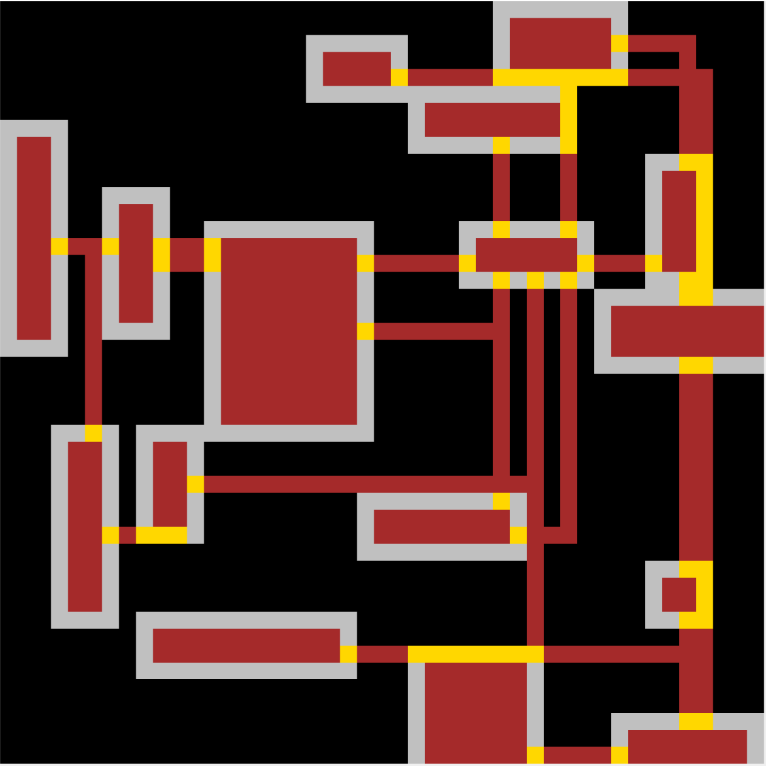
Procedurally generated dungeons
Notes:
This is a sufficient dungeon (yellow = door)
Note that where wall and corridor overlap, you get door, making some of these rooms actually alcoves. That is fine
Note also that we don’t worry about walls at the edges – some of these rooms have dirt walls. That’s also fine.
The point is that floor, door and corridor are walkable. Wall, dirt and edge of the world aren’t

Slide 12
Combat
Easiest = turn-based, fight-to-the-death, no ranged weapons
When two enemies collide, they commence battle
Battle is a series of attacks, with each combatant attacking
in turn
Battle continues until one combatant is defeated
Characters need:
Some measure of health
Some hit probability
(Optionally) some “amount of damage” function
Feedback should show the health of both characters at each turn (text is fine)
Notes:
Stuff it all into a while loop
So char1 hits with some probability and takes some amount of health from char2 if the hit lands
Then player 2 gets his turn
Then player 1, and so forth until someone’s health goes to 0, at which point, it is dead
Possible extensions include line of sight (e.g. in mine, when the player enters the a room where there is an enemy, the enemy moves toward him) fleeing, chasing, hiding and ranged weapons. Enjoy

