Slide 1

CIS565 Final Project
Alpha Stage Presentation

Slide 2

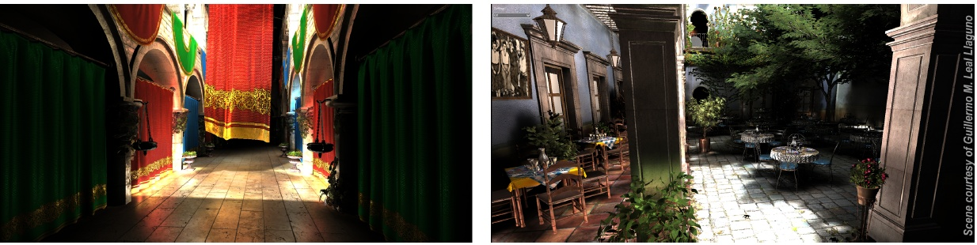
Fast geometry voxelization using graphics hardware.
Reduce memory footprint by organizing voxels into a sparse voxel octree (SVO).
  Dynamic inesrt & remove node
Real-time indirect lighting using voxel cone tracing with SVO.
Cyril Crassin et al., Pacific Graphics 2011

Slide 3

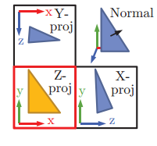

Utilize GPU hardware rasterizer
One draw call to voxelize the whole scene into a 3D texture
Orthographically project each triangle
  Along the dominant axis of its plane normal
  Done in geometry shader
Notes:
Turnoff depth test, back face culling, and color mask

Slide 4
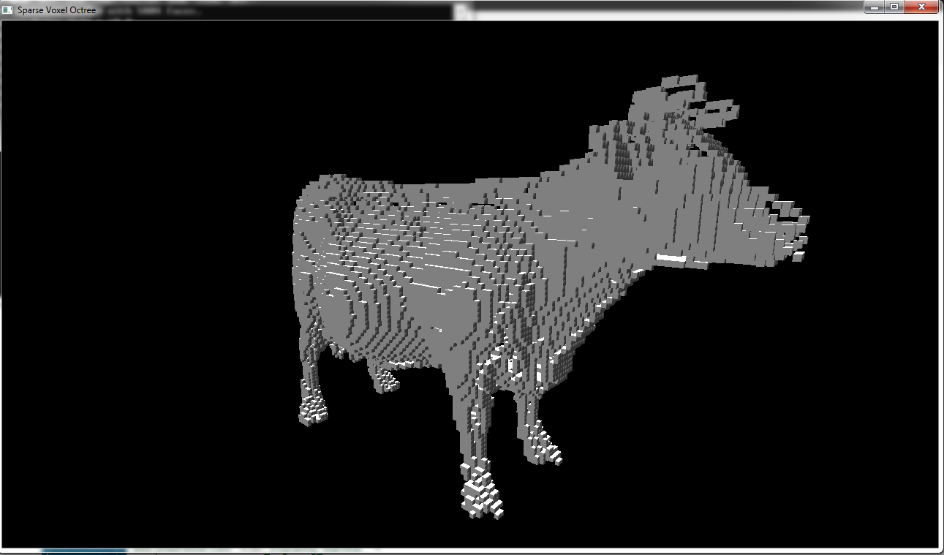
In fragment shader, determine which 3D texel the fragment belongs to
ImageStore (OpenGL 4.2 and later)
Fragments might fall in the same texel
  Use atomic operations

Slide 5

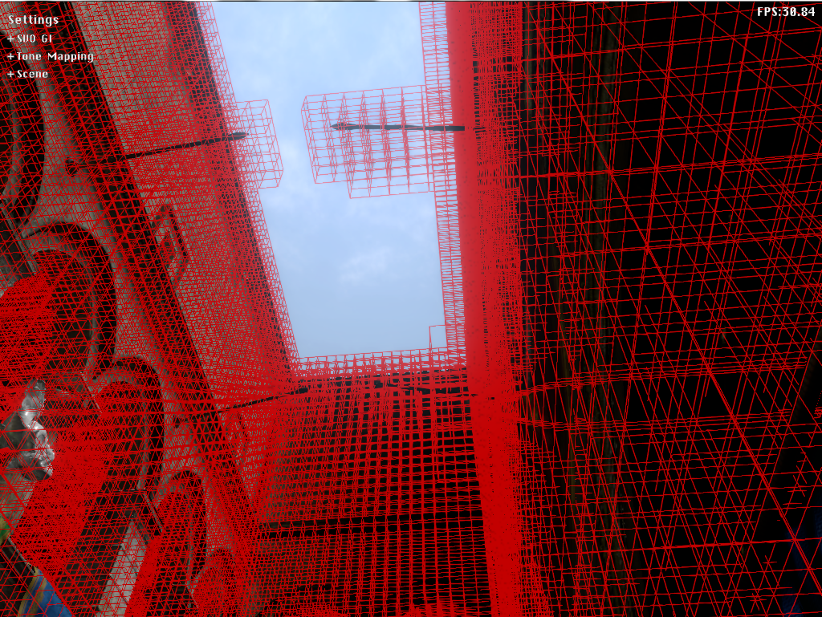
Construct the voxels into an octree, in GPU
Store only the voxels that meet triangles
Scene from Simon Yeung’ SVO demo

