Slide 1
FARGATE
Infrastructure Architecture
CI/CD Proof of Concept — AWS ECS Fargate
9 Architecture Diagrams

Slide 2
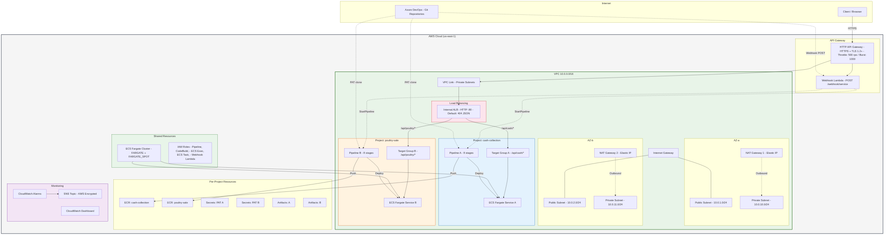
01
High-Level Infrastructure Overview
Fargate — High-Level Infrastructure Overview
1 / 9

Slide 3
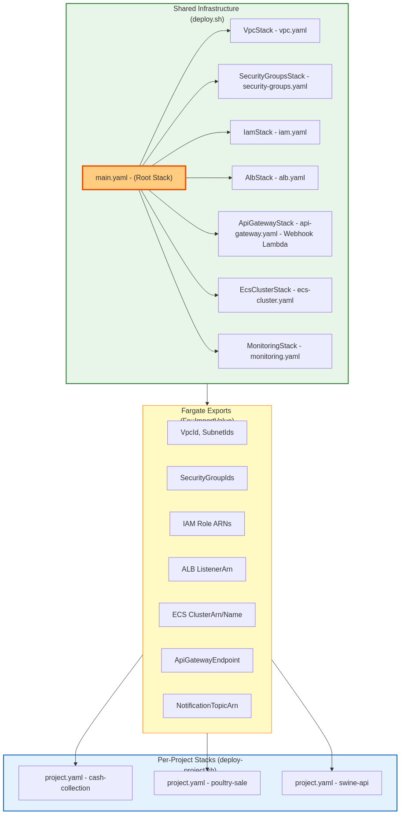
02
Deployment Model (Two-Tier Architecture)
Fargate — Deployment Model (Two-Tier Architecture)
2 / 9

Slide 4
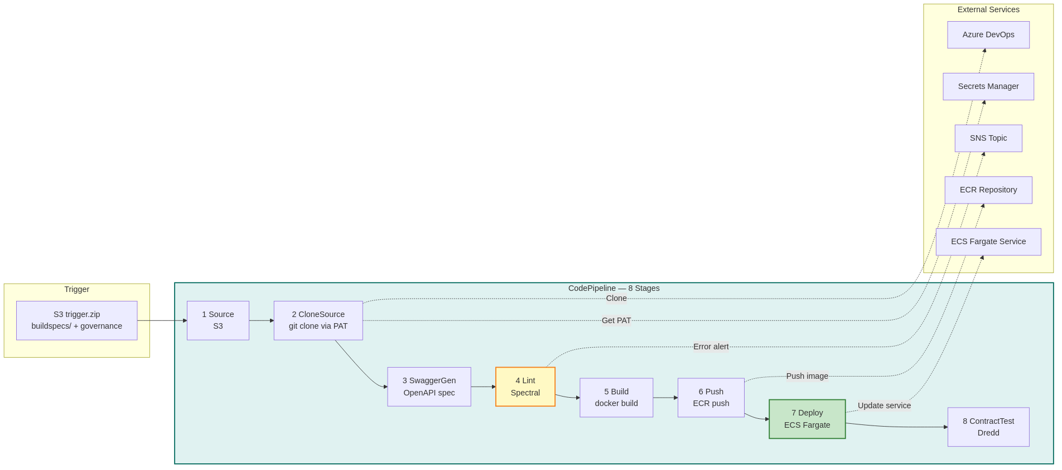
03
CI/CD Pipeline Flow (8 Stages)
Fargate — CI/CD Pipeline Flow (8 Stages)
3 / 9

Slide 5
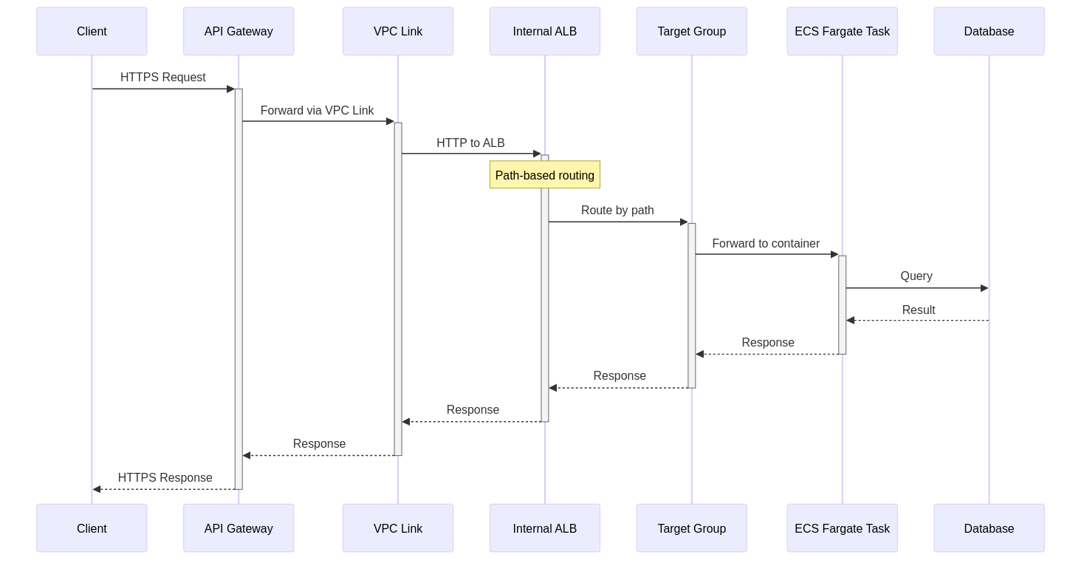
04
Request Flow
Fargate — Request Flow
4 / 9

Slide 6
05
Security Groups Chain
Fargate — Security Groups Chain
5 / 9

Slide 7
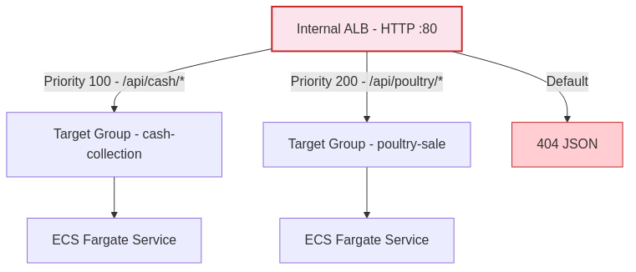
06
ALB Path-Based Routing
Fargate — ALB Path-Based Routing
6 / 9

Slide 8
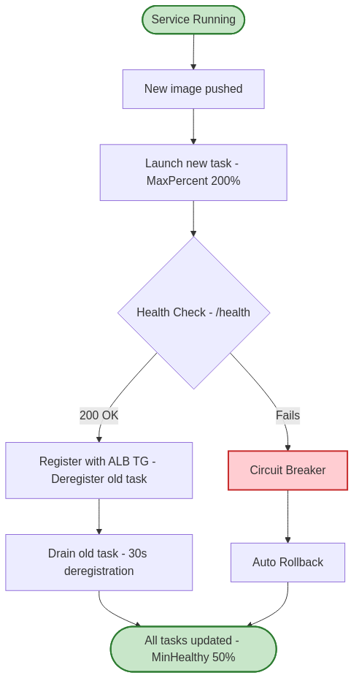
07
ECS Deployment Strategy
Fargate — ECS Deployment Strategy
7 / 9

Slide 9
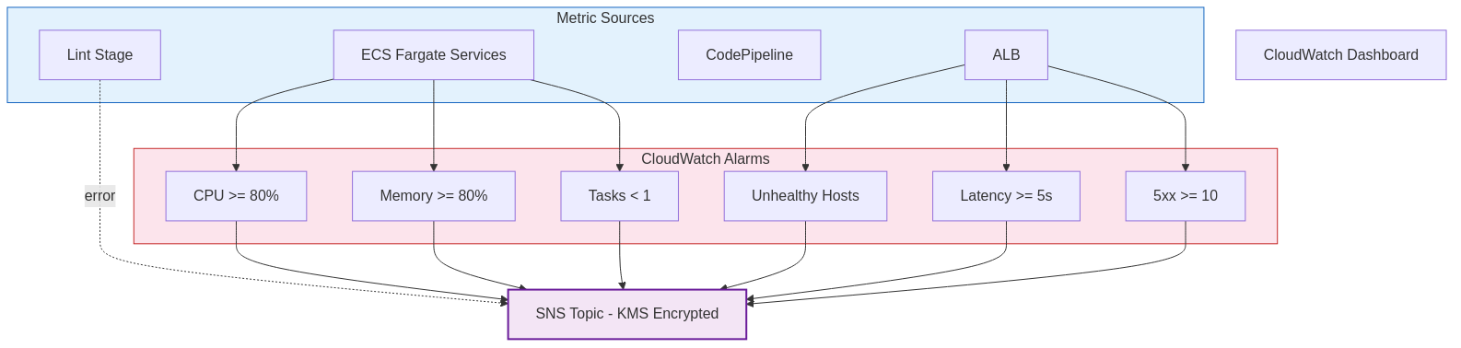
08
Monitoring & Observability
Fargate — Monitoring & Observability
8 / 9

Slide 10
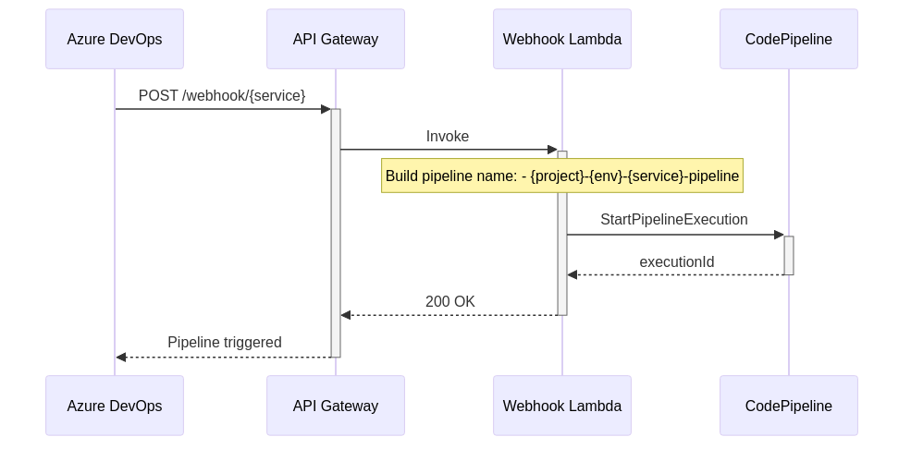
09
Webhook Integration (Azure DevOps → AWS)
Fargate — Webhook Integration (Azure DevOps → AWS)
9 / 9

