Slide 1

WINDCREST RESEARCH HOSPITAL
D(a)t(a) Shoe(s)

Slide 2
AGENDA
Member introduction
About Windcrest
Required Record
E/R Diagrams
Data Demos
Challenges
Lesson
Questions
Notes:
Aki

Slide 3





THE TEAM MEMBERS
Andrew Huynh
Eve Fabre
Aki Otsuka
Junior, CIS Major
Senior, DBA Major
Senior, BDA Major
Omar Tanimu
Shri Harish Sankaradass
Junior, CIS Major
Junior, BDA Major
Notes:
Aki

Slide 4

OUR
PROJECT
Our mission was to create a database for a double blind depression drug study conducted by Windcrest Research hospital.
Notes:
Omar

Slide 5



ABOUT WINDCREST
Windcrest Research Hospital Conducting a double blind depression drug research.
Symptoms are recorded at each visit to determine effectiveness
Drug Study Only two supervisors know which drug were used
Numbers
20 doctors
40 patients per doctor
20 rotating nurses
2 supervisors(include 1 pharmacist)
Notes:
Omar

Slide 6

Required Records
Appointments and follow ups
Patients and their medical history
Doctors and availability
Appointment Day & Time
Patient
Doctor
Nurse
Personal information
Medical history
Family’s medical history
Symptoms
follow up records
Dr’s name
speciality
available appointment time
Nurses’, Managers’ information
Drug dispensed and study drugs
Nurse’s name
Capacity
Manager’s name
Position
Drug name
Placebo
Notes:
Omar

Slide 7
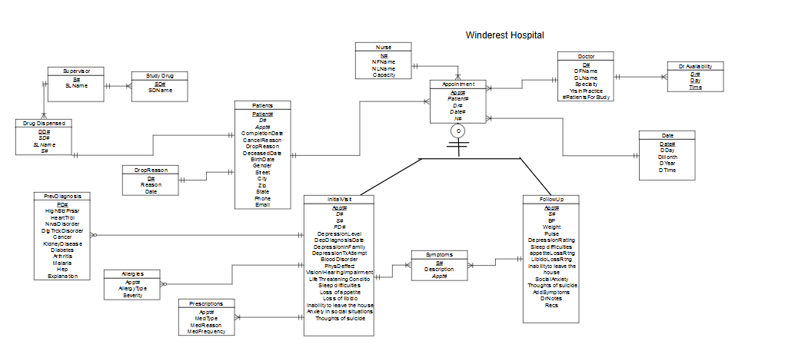
ERD BEFORE
Notes:
Eve

Slide 8
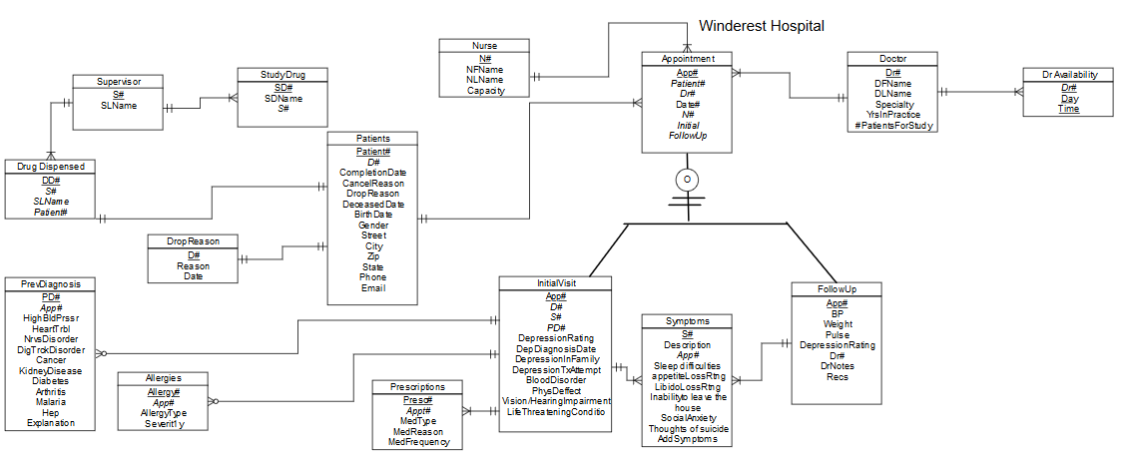
ERD AFTER
Notes:
Eve

Slide 9


SAMPLE DATA
Basic Patient Information
Allergies, Prescriptions Used, Previous Diagnosis of illness, Initial Symptoms
Notes:
Eve & Aki

Slide 10

SAMPLE DATA CONT.
Monitoring patient symptoms according to the study
we are looking mostly at the depression related symptoms to determine effectiveness
Notes:
Eve & Aki

Slide 11
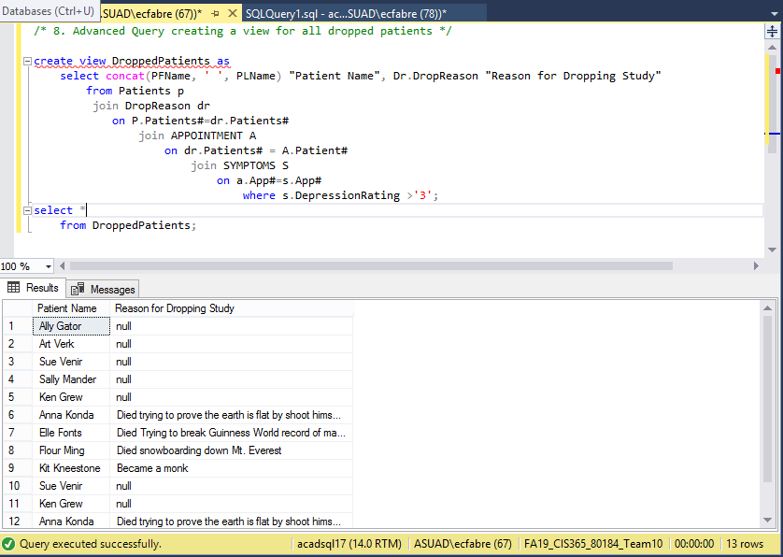
ADVANCED QUERIES & RESULT
Creating a view to see all patients that have dropped the study
Notes:
Eve

Slide 12
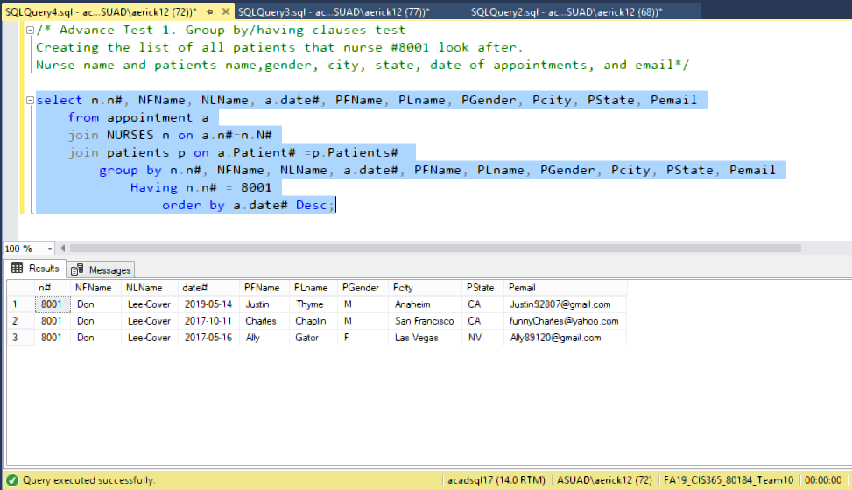
ADVANCED QUERIES & RESULT
Group by / Having clauses
Notes:
Aki

Slide 13
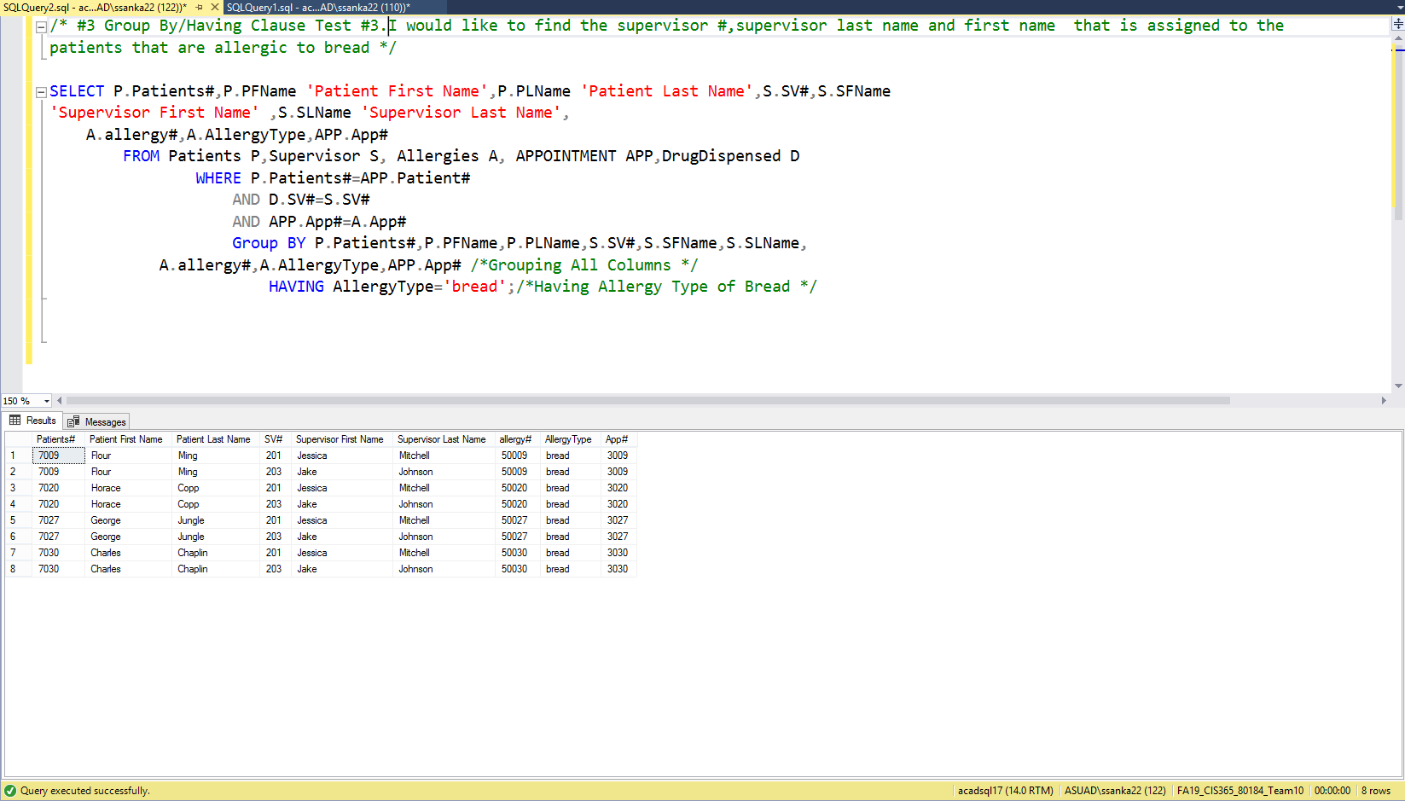
Advanced Queries & Result
Group By/Having Queries
Notes:
Harish

Slide 14
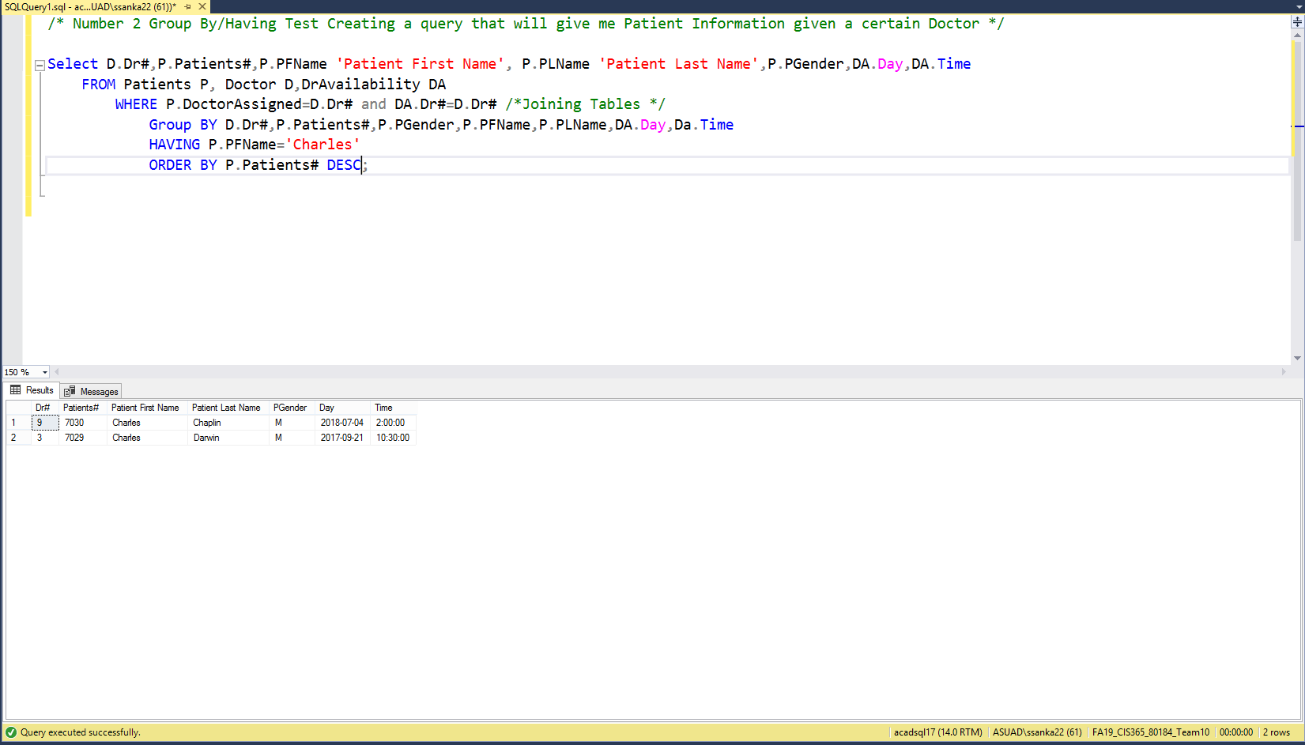
Advanced Queries & Result
Group By /Having Queries
Notes:
Harish

Slide 15
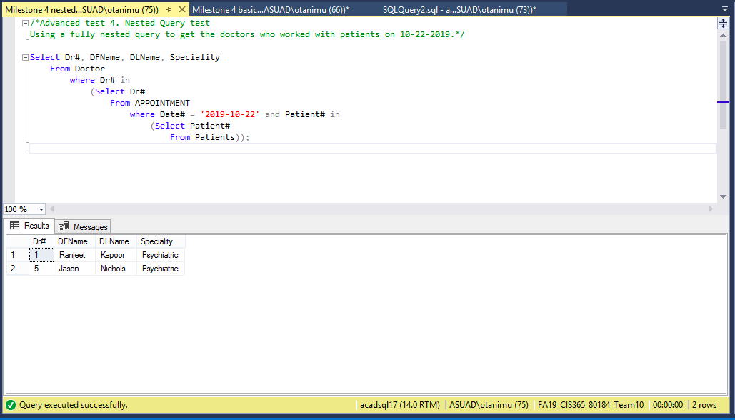
ADVANCED QUERIES & RESULT
Fully Nested Queries
Notes:
Omar

Slide 16
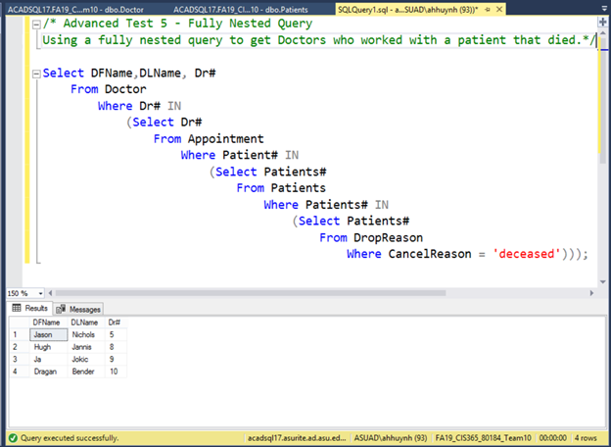
ADVANCED QUERIES & RESULT
Fully Nested Queries
Notes:
Andrew

Slide 17
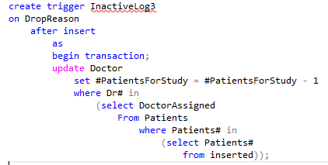
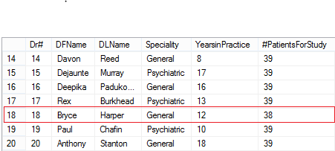
TRIGGER
Purpose: Remove 1 patient from the #PatientsAssigned in the Doctor table, every time a patient is entered in the DropReason Table
Method: Result:
Notes:
Eve

Slide 18
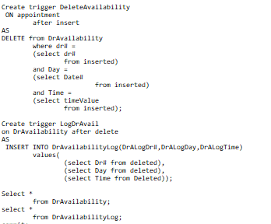
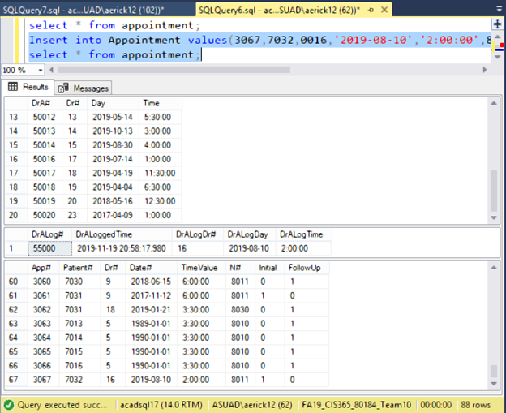
TRIGGER
Purpose: When adding a new patient to the study, add a new medical-history record to the appointments and all other necessary records to the appropriate tables (drug dispersed, etc.), and modify the doctor’s availability to reflect that the doctor is no longer available at that date/time.
Method: Result:
Notes:
Aki

Slide 19
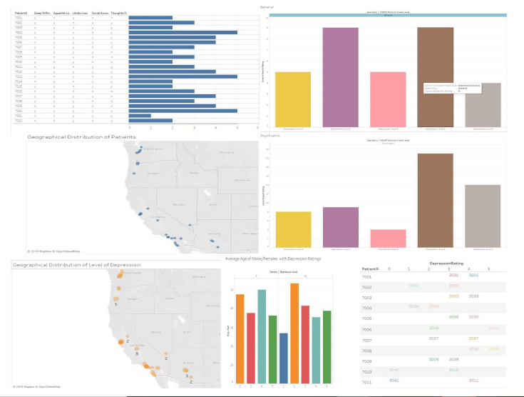
VISUAL ANALYTIC DASHBOARD
Depression Ratings per patient compared to location, symptoms, drug used
Notes:
Harish

Slide 20
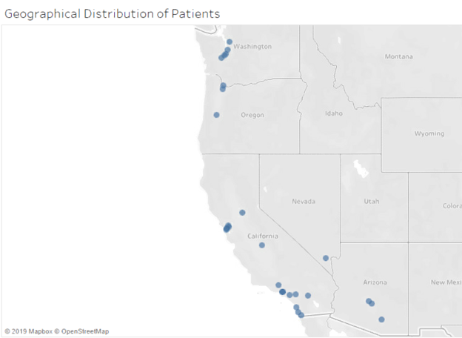
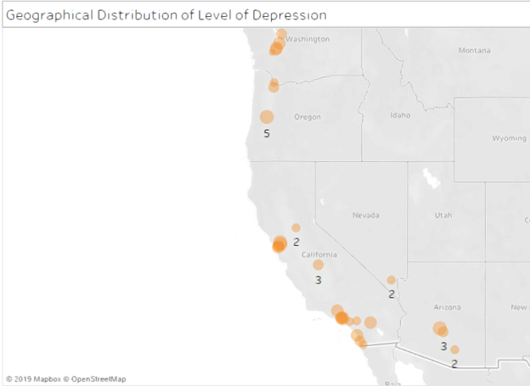
VISUAL ANALYTICS - Geographical
Notes:
Harish

Slide 21
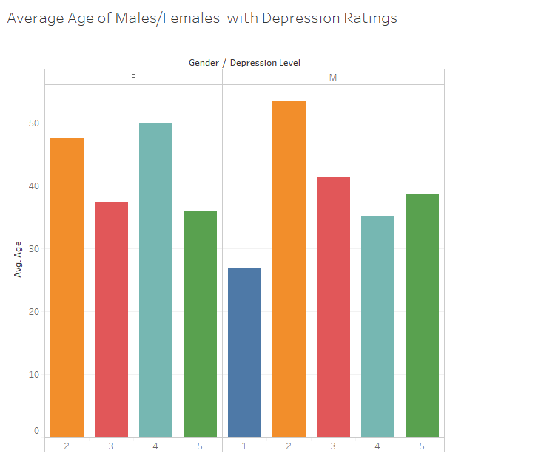
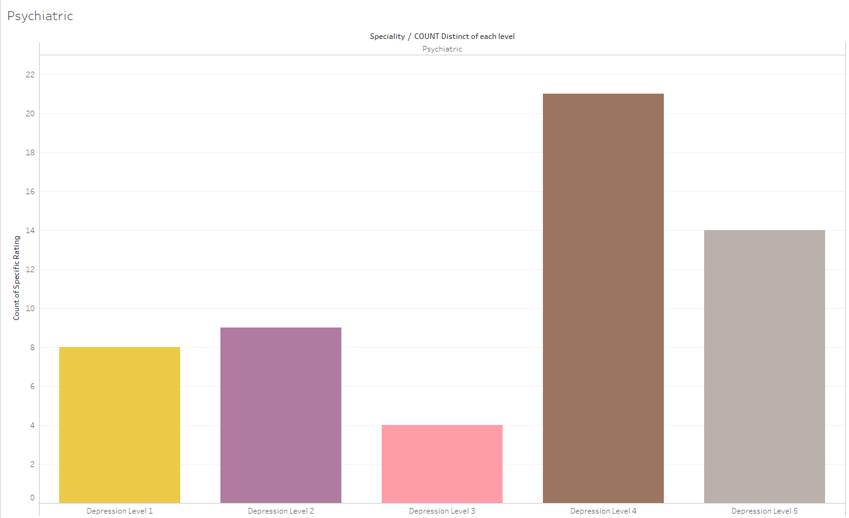
VISUAL ANALYTICS - Depression Rating
Notes:
Andrew

Slide 22



CHALLENGES
ERD
Create table and Inserting data
Connecting tables
Our data types for Primary and Foreign keys did not correspond with each other when we started constructing queries.
Some Tables could not be joined especially from Initial Visit and the Follow Up until we created either new table or added a new column.
There is a ton of medical records and patient information to keep of. The distribution of that data throughout the various tables made it confusing.
Small details were necessary to ensure that all bases were taken care of.
Having a hospital as a client made the construction of the ERD complicated due to the myriad of records and departments that need to keep track of the data.
The order of tables we inserted has to be precise because child-parent relationship in the center of the database.
We had a lot of syntax errors that needed to be fixed to put into Microsoft SQL Server.
The order of how we created our tables in order to ensure that the foreign keys were in working order.
Notes:
Andrew

Slide 23





LESSON LEARNED
Andrew
Eve
Aki
Harish
Omar
Realize how much work goes into the minute details
Understanding how to relate tables in a DB
Create clear vision to what do you want with your data.
Making sure that we have all the information we need in the data
All the necessary steps to create a stable database
Success
Notes:
Everyone - Say a word of advice that would help future teams.

Slide 24

THANK YOU
Any questions?

