Slide 1

Protein Prediction 2
Exercise
Team 6
05.12.2013

Slide 2
Previously
Serialized HPO-Tree
Merge multiple trees into a big tree
Filter resultant trees

Slide 3
New
Medians for blast and hhblits
  e-value
  percentage
Implemented performance-indicators

Slide 4
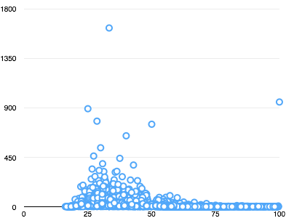
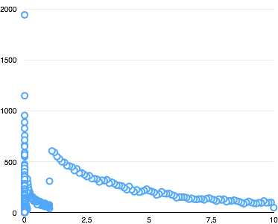
blast
Percentage
e-Value
Mean: 34.85
Mean: 0.9
Median: 30.08
Median: 0.0003

Slide 5
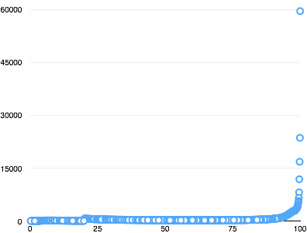
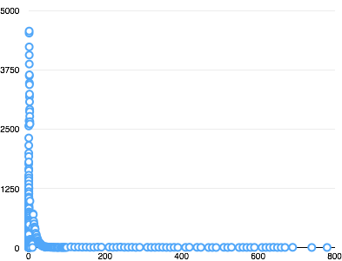
hhBlits
Percentage
e-Value
Mean: 77.0
Mean: 0.81
Median: 94.0
Median: 0.0004

Slide 6
hhBlits

Slide 7
DEMO
Call by
  python match-test.py <sequence> <# of hits>

