Slide 1

Protein Prediction 2
Exercise
Team 6
19.12.2013

Slide 2
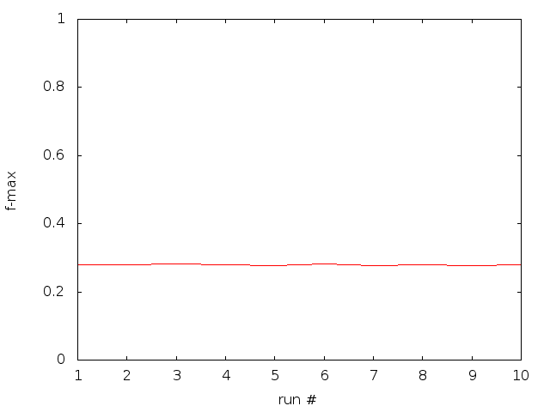
Cross Validation Results
F-max over 10 runs:
Average F-max: 0.278975

Slide 3
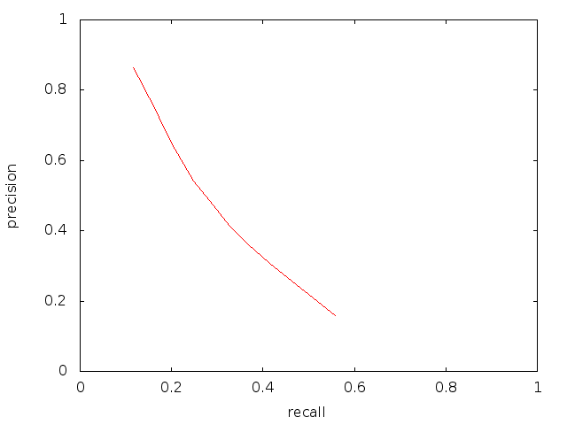
Cross Validation Results
Precision-recall curve for 1 run:

Slide 4
CLI / Web Interface
DEMO

