Slide 1

Protein Prediction 2
Exercise
Team 6
19.12.2013

Slide 2
Merging Method
Using blast “score” value
Score is added for a term seen more than once
Score normalized [0, 1]
Testing over whole training set
Testing variables:
  Hits N (4 → 10)
  Threshold T (0.0 → 1.0)

Slide 3
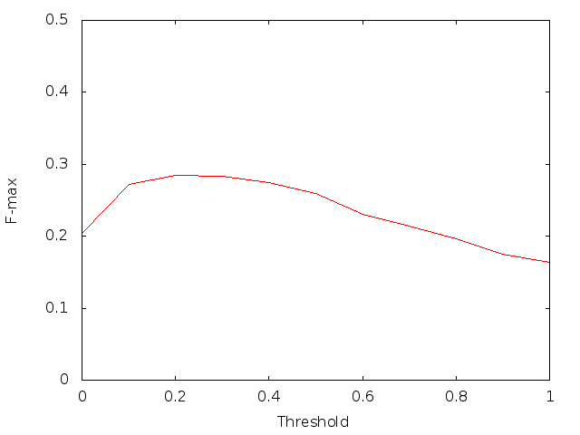
Results
Best result at N=7, T=0.2, F-max=0.2842

Slide 4
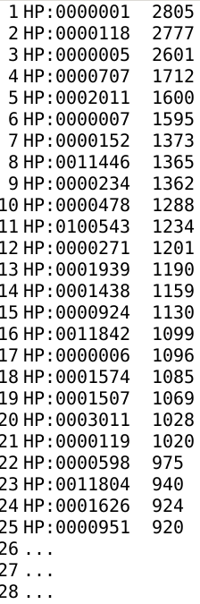
“No hits” problem
Training set: 89 / 2805
Targets set: 1008 / 20257
Statistics from training set:
  Average terms per sequence: 73
  Top occurring terms
“Default” tree with top 73 sequences
F-max 0.2736 → 0.2842

Slide 5
Thank you

