Slide 1

Protein Prediction 2
Exercise
Team 6
19.12.2013

Slide 2
Merging Method
Using blast “score” value
Score is added for a term seen more than once
Score normalized [0, 1]
Testing over whole training set
Testing variables:
  Hits N (4 → 10)
  Threshold T (0.0 → 1.0)

Slide 3
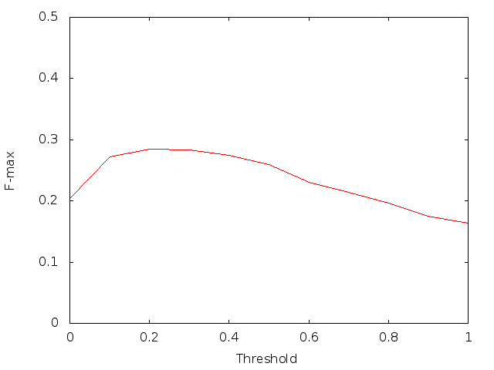
Results
Best result at N=7, T=0.2, F-max=0.2842

Slide 4
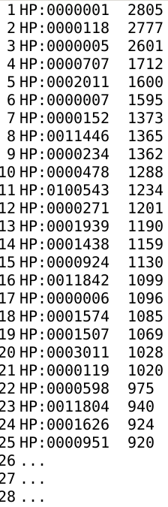
“No hits” problem
Training set: 89 / 2805
Targets set: 1008 / 20257
Statistics from training set:
  Average terms per sequence: 73
  Top occurring terms
“Default” tree with top 73 terms
F-max 0.2736 → 0.2842

Slide 5
K-fold Validation
10 folds: 9 for training, 1 for evaluation
Randomized and tested 10 times
Results:
Average F-max: 0.278975
1 | 2 | 3 | 4 | 5 | 6 | 7 | 8 | 9 | 10
0.279015 | 0.279688 | 0.280946 | 0.278366 | 0.278326 | 0.280913 | 0.276893 | 0.279788 | 0.277170 | 0.278645

Slide 6
Thank you

