Slide 1

Protein Prediction 2
Exercise
Team 6
05.12.2013

Slide 2
Automated Testing
Picking 100 random sequences from annotated sequences
Query blast for top 5 hits
Create tree for each hit
Merge trees using one of the defined merging algorithm
Apply thresholds from 0 to 1.0 with a step of 0.1
Calculate precision, recall and f-max with each threshold

Slide 3
Results 1
Using the same 100 sequences
The maximum f-max achieved by each merging algorithm averaged over the 100 sequences:
Algorithm | F-max
Naive | 0.215747
Frequency-based | 0.340929
Percentage-based | 0.320319

Slide 4
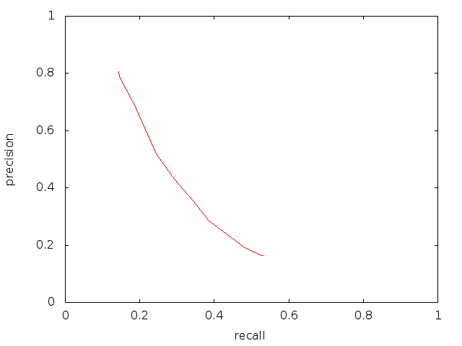
Results 2
Using the same 100 sequences
The precision-recall curve averaged over the 100 sequences:

