Slide 1


Bacchus Case Study
7/17/2022
Caleb Rummel, James Bailey, Joel Mardock, Nicholas Werner

Slide 2


Introduction
For our group project, we chose the Bacchus Winery Case Study. We approached this project by carefully analyzing the study. Then we compiled a list of tables with potential data descriptions that we believed would help us to create a compelling narrative. We continuously re-evaluated our tables and ended up revising their structure several times. This increased our ability to create informational reports.

Slide 3
Study Description
The new owners of Bacchus Winery are modernizing their business. They need to generate some reports on the state of the winery. By utilizing the information stored in their databases, the reports can be created accurately. The following reports will help the new owners understand the current state of their business:
1. Distribution Report
2. Incoming Supplies Report
3. Employee Hours Report

Slide 4
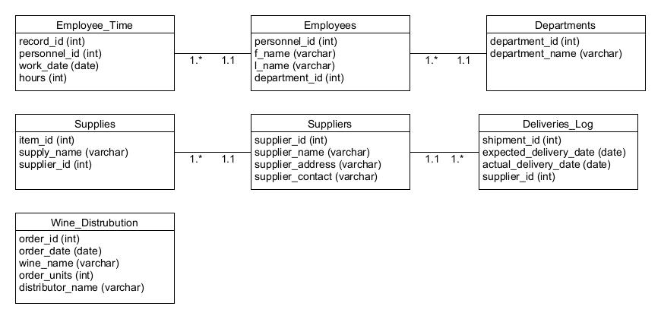
ORD

Slide 5
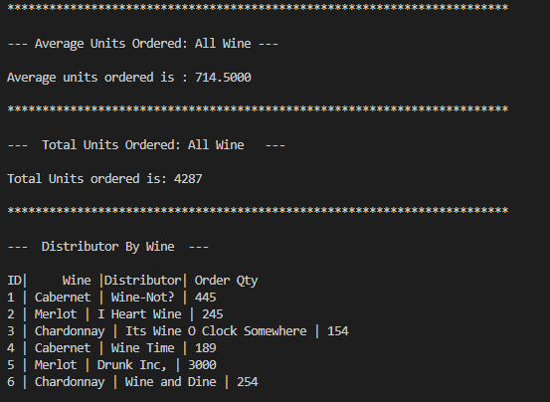
Distribution Report
This report contains important information that can help Bacchus Winery learn about its sales. It contains both the average and total amount of units ordered. It also shows which distributors are ordering each type of wine.

Slide 6
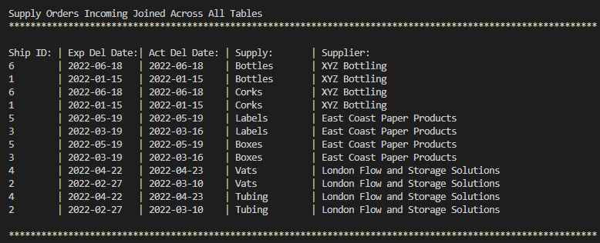
Incoming Supplies Report
Showing incoming supplies arriving from suppliers including the shipment identifier, expected delivery date, actual delivery date if delivered, the supply being delivered and the supplier shipping the supply

Slide 7
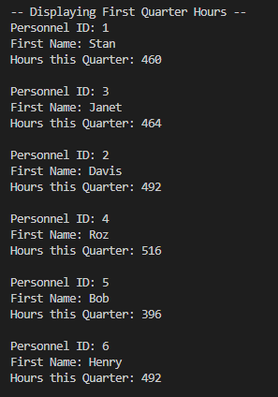
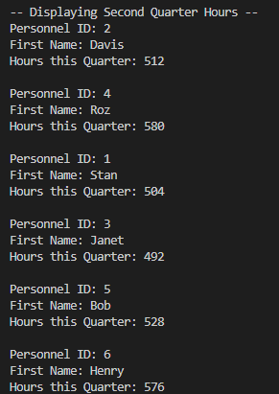
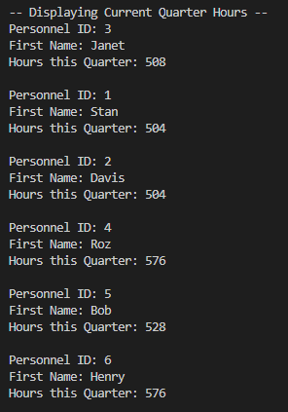
Employee Hours Report
The Employee Hours report shows the employee’s ID, first name, and the total of all their hours worked during the quarter.

Slide 8
Case Study Assumptions
1. We assumed that the Employee table would only contain identity information and would relate to any other tables that provide work data through a unique personnel number.
2. We assumed that Bacchus was nearing its fourth quarter, thus the Hours Reports were for the previous three quarters. This would be important so that they could make changes before the fiscal year was over.
3. We assumed that each portion of the case study would likely need multiple tables. We created many at the beginning so that we would not run into data constraints. Aggressively splitting the data up helped us implement quick adjustments to our reports as well.

