Slide 1
1st attempt at a procedure for incorporating matrix pooling.

Slide 2
Strategies:
1: Single sample testing
2: Traditional pooling
3: Matrix pooling

Slide 3
Strategy selection
- Single sample testing is reserved for samples with the highest expected prevalence or for retesting samples.
- 2 or 3 sample traditional pooling is for medium expected prevalence.
- Matrix pooling is for low expected prevalence.

Slide 4
Strategy selection cont.
To reduce complexity, remove traditional pooling as a consideration entirely. And perhaps reintroduce it when one is more comfortable and confident with execution.
High risk populations + Retests → Single sample testing
Low risk populations → Matrix pooling

Slide 5
Plating
Constraint is a 96 well plate, arranged 12x8, with 2 wells reserved for controls.
How to allocate wells for matrix pooling intelligently such that
1: Pipetting remains a low-error process.
2: Quickly and confidently identify samples to be retested.

Slide 6
Plating cont.
The plate can be arranged such that there are three sections.
1: Controls
2: Matrices
3: Single sample tests
These sections must be uninterrupted. Otherwise the pipetter would have to frequently switch between two different pipetting methods. To mix sections will result in great confusion.

Slide 7
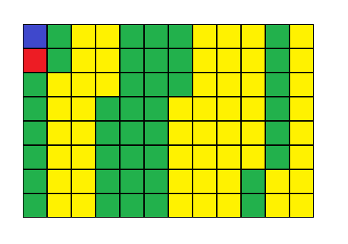
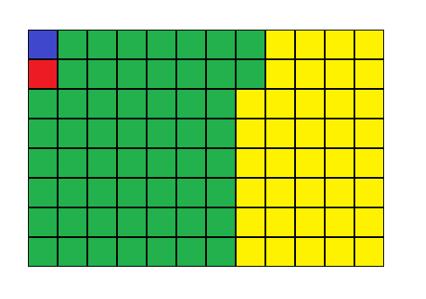
Plating cont.
Confusing Less Confusing

Slide 8
Plating cont.
The requirement for uninterrupted sections presents a challenge when many small patient populations are presented which alternate between high and low risk.
It is also confusing to jump between accession numbers to compose uninterrupted sections.
Data entry and specimen delivery should not be expected to compensate for this.
I do not have a solution here.

Slide 9
Plating cont.
If possible, it would be ideal to have entire plates filled only with matrices, or single sample tests. This would reduce operator error from having to switch mental models mid-plate.
I cannot think of great solutions without machine assistance.

Slide 10
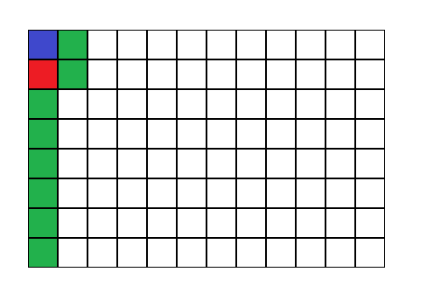
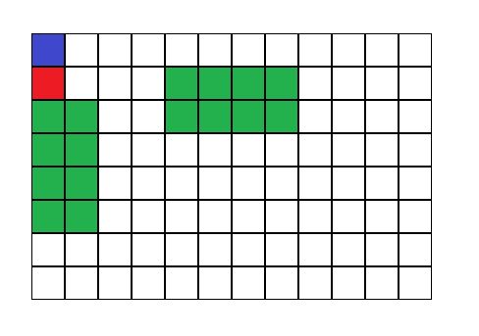
Optimizing pipetting
I think it is desirable to have matrices be plated as a single running line, rather than with a more visually flashy style.
Using 4x4 matrix as an example:
Yes No

Slide 11
Optimizing pipetting cont.
The argument is that although a line may be harder to conceptualize for pipetting, it is not worth the confusion of interpreting the results which are given in plate order (A1, A2, … H11, H12). Thus we should follow plate order.

Slide 12
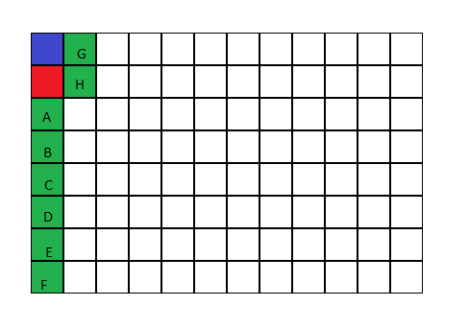
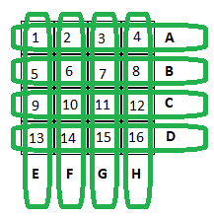
Optimizing pipetting cont.
Imagine the green squares in this picture as representing the 8 pools of a 4x4 matrix. I will refer to the squares in order following the controls (blue and red) with the letters A B C D E F G H. [A, D] will be the horizontal pools and [E,H] will be the vertical pools.

Slide 13
Optimizing pipetting cont.
Here is the pattern of operation if you can follow.
It may look intimidating but this just happens to be the easiest way to communicate it. If you spend some time parsing and keep an eye out for the pattern. Numbers represent the sample, and Letters represent the pool the samples are pipetted to.
1 → A | 1 → E | 2 → A | 2 → F | 3 → A | 3 → G | 4 → A | 4 → H
5 → B | 5 → E | 6 → B | 6 → F | 7 → B | 7 → G | 8 → B | 8 → H
9 → C | 9 → E | 10 → C | 10 → F | 11 → C | 11 → G | 12 → C | 12 → H
13 → D | 13 → E | 14 → D | 14 → F | 15 → D | 15 → G | 16 → D | 16 → H

Slide 14
Optimizing pipetting cont.
Those operations can be reordered freely and will still produce a valid matrix, but it appears to me that that specific pattern should be the easiest to follow.
The benefit of that order is that it keeps samples in order so the operator will not need to change between samples when pipetting.

Slide 15
Identification
The matrices have been organized and the test has finished running as the computer reports positive pools.
How do we quickly identify which samples need retesting by intersecting positive pools?
Ideal solution: Input positive pools and immediately output sample numbers to retests. Numbers then referenced by eye with appropriate sample accession number. Easily achievable with a little bit of programming.
getRetests(4<matrixsize>, [A,C,D,F]) → NO RETESTS, Positives {2, 10, 14}
getRetests(4, [A,B,F,H]) → 4 RETESTS {2, 4, 6, 8}
*if letters are too hard, numbers can be valid input too with 1:A 2:B etc.

Slide 16
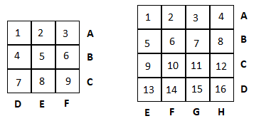
Identification
In the interim until this programming is complete, we shall rely on the following paper and finger method.
Keep these diagrams on a wall somewhere
Upscale so each cell is wide as a finger
Use your fingers and mark intersections
as retests.

Slide 17
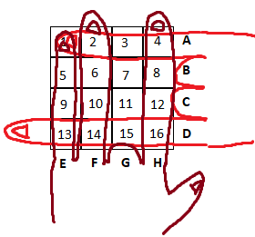
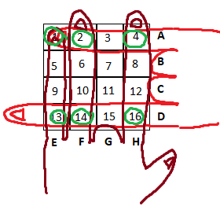
Identification
Example: in a 4x4 matrix, pools A, D, E, F, and H are positive.
Retests are: 1, 2, 4, 13, 14, and 16.
As a sanity check, the product of extended fingers on both hands should equal the number of retests.
(3 x 2 = 6)

Slide 18
Identification
The only other things to keep in mind are
1. If one hand has only a single finger raised, all intersections are positive and not retests.
2. If only one hand is used, then all pools under each finger of that hand must be retested and suggests an error in pipetting.

Slide 19
Suggestions
I recommend for an initial test run to allocate one single matrix on a plate.
This matrix should be doubly testing samples already on the plate, preferably single sample tests so that if matrix execution is incorrect the results of those samples can still be salvaged.

Slide 20
Rudimentary comparison of 16 samples being tested in a 4x4 matrix vs eight 2-sample pools.

