Slide 1


PIZZA DELIVERED QUICKLY
FACTORY LOCATOR SUBSYSTEM
KOD Inc

Slide 2
OUTLINE
Problem Description
Project Management
The Solution
Features
Demo

Slide 3
Problem Description

Slide 4
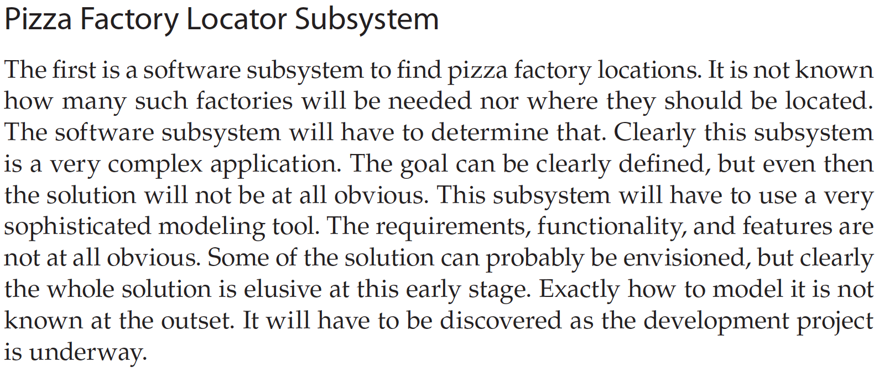
Problem Description

Slide 5
Project Description
Determine the optimal location for a new factory
Return closest factory to customers’ order
Provide location of existing factories

Slide 6
Problem Description (contd.)
Considerations
Big Data Processing
Fault-Tolerance
Scalability

Slide 7
Project Management

Slide 8
Initiating Processes
Develop project charter
Identify stakeholders

Slide 9
Planning Processes
Collect requirements
Define scope
Create WBS
Plan communication management
Plan risk management

Slide 10
Executing Processes
Acquire resources
Manage communication
Direct and manage project work

Slide 11
Monitoring and Controlling Processes
Monitor and control project work
Perform integrated change control
Valid scope
Control scope
Monitor communication

Slide 12
Closing Processes
Close project

Slide 13
The Solution

Slide 14
The Solution
Erlang-Powered, multithreaded, big-data processing application
https://github.com/otboss/PDQ-Pizza-Factory-Locator-Subsystem

Slide 15

The Solution (contd.)
Erlang Introduction
Created in 1986 by Ericsson
Erlang is widely used in the telecommunications industry
Massively scalable applications
Built upon concurrency, processes inside the VM are isolated

Slide 16

The Solution (contd.)
Big-Data processing can be tricky..

Slide 17
The Solution (contd.)
Data Processing Strategy
The total number of relevant records in the database are considered
The total number of CPU threads are considered
Ranges for each CPU thread are created by dividing the number of relevant records by the number of CPU threads

Slide 18
The Solution (contd.)
Relevant records are read from the database in chunks by each thread and processed
During processing each thread changes a large, random numerical value in shared memory. If this value does not change after (x) seconds then all threads are finished
The result from each thread is combined and the final solution is calculated on a single thread

Slide 19
The Solution (contd.)
Deployment Architectures
Central
Partially Central
Distributed

Slide 20
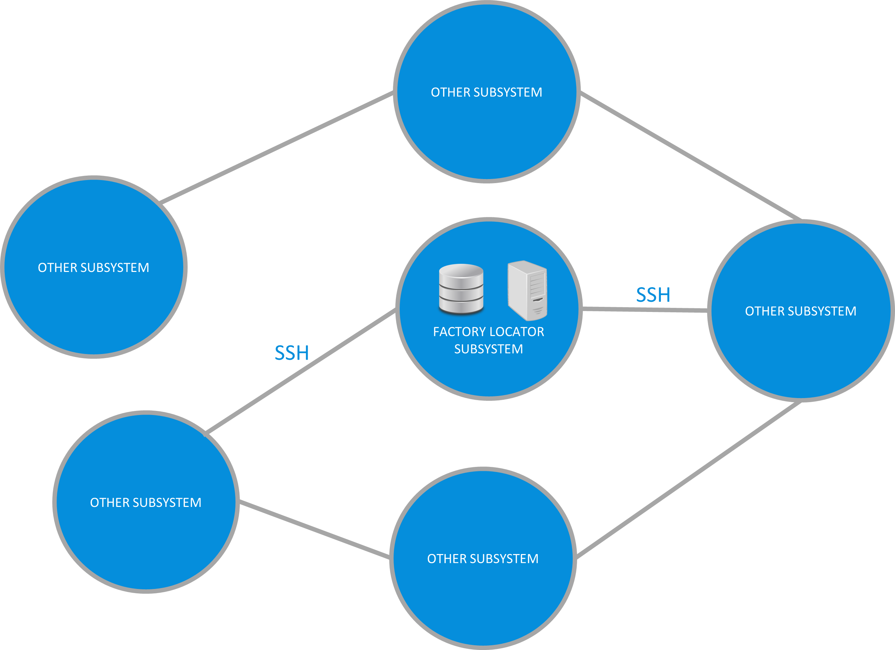

The Solution (contd.)
Central Architecture
- Factory Locator Subsystem Module

Slide 21
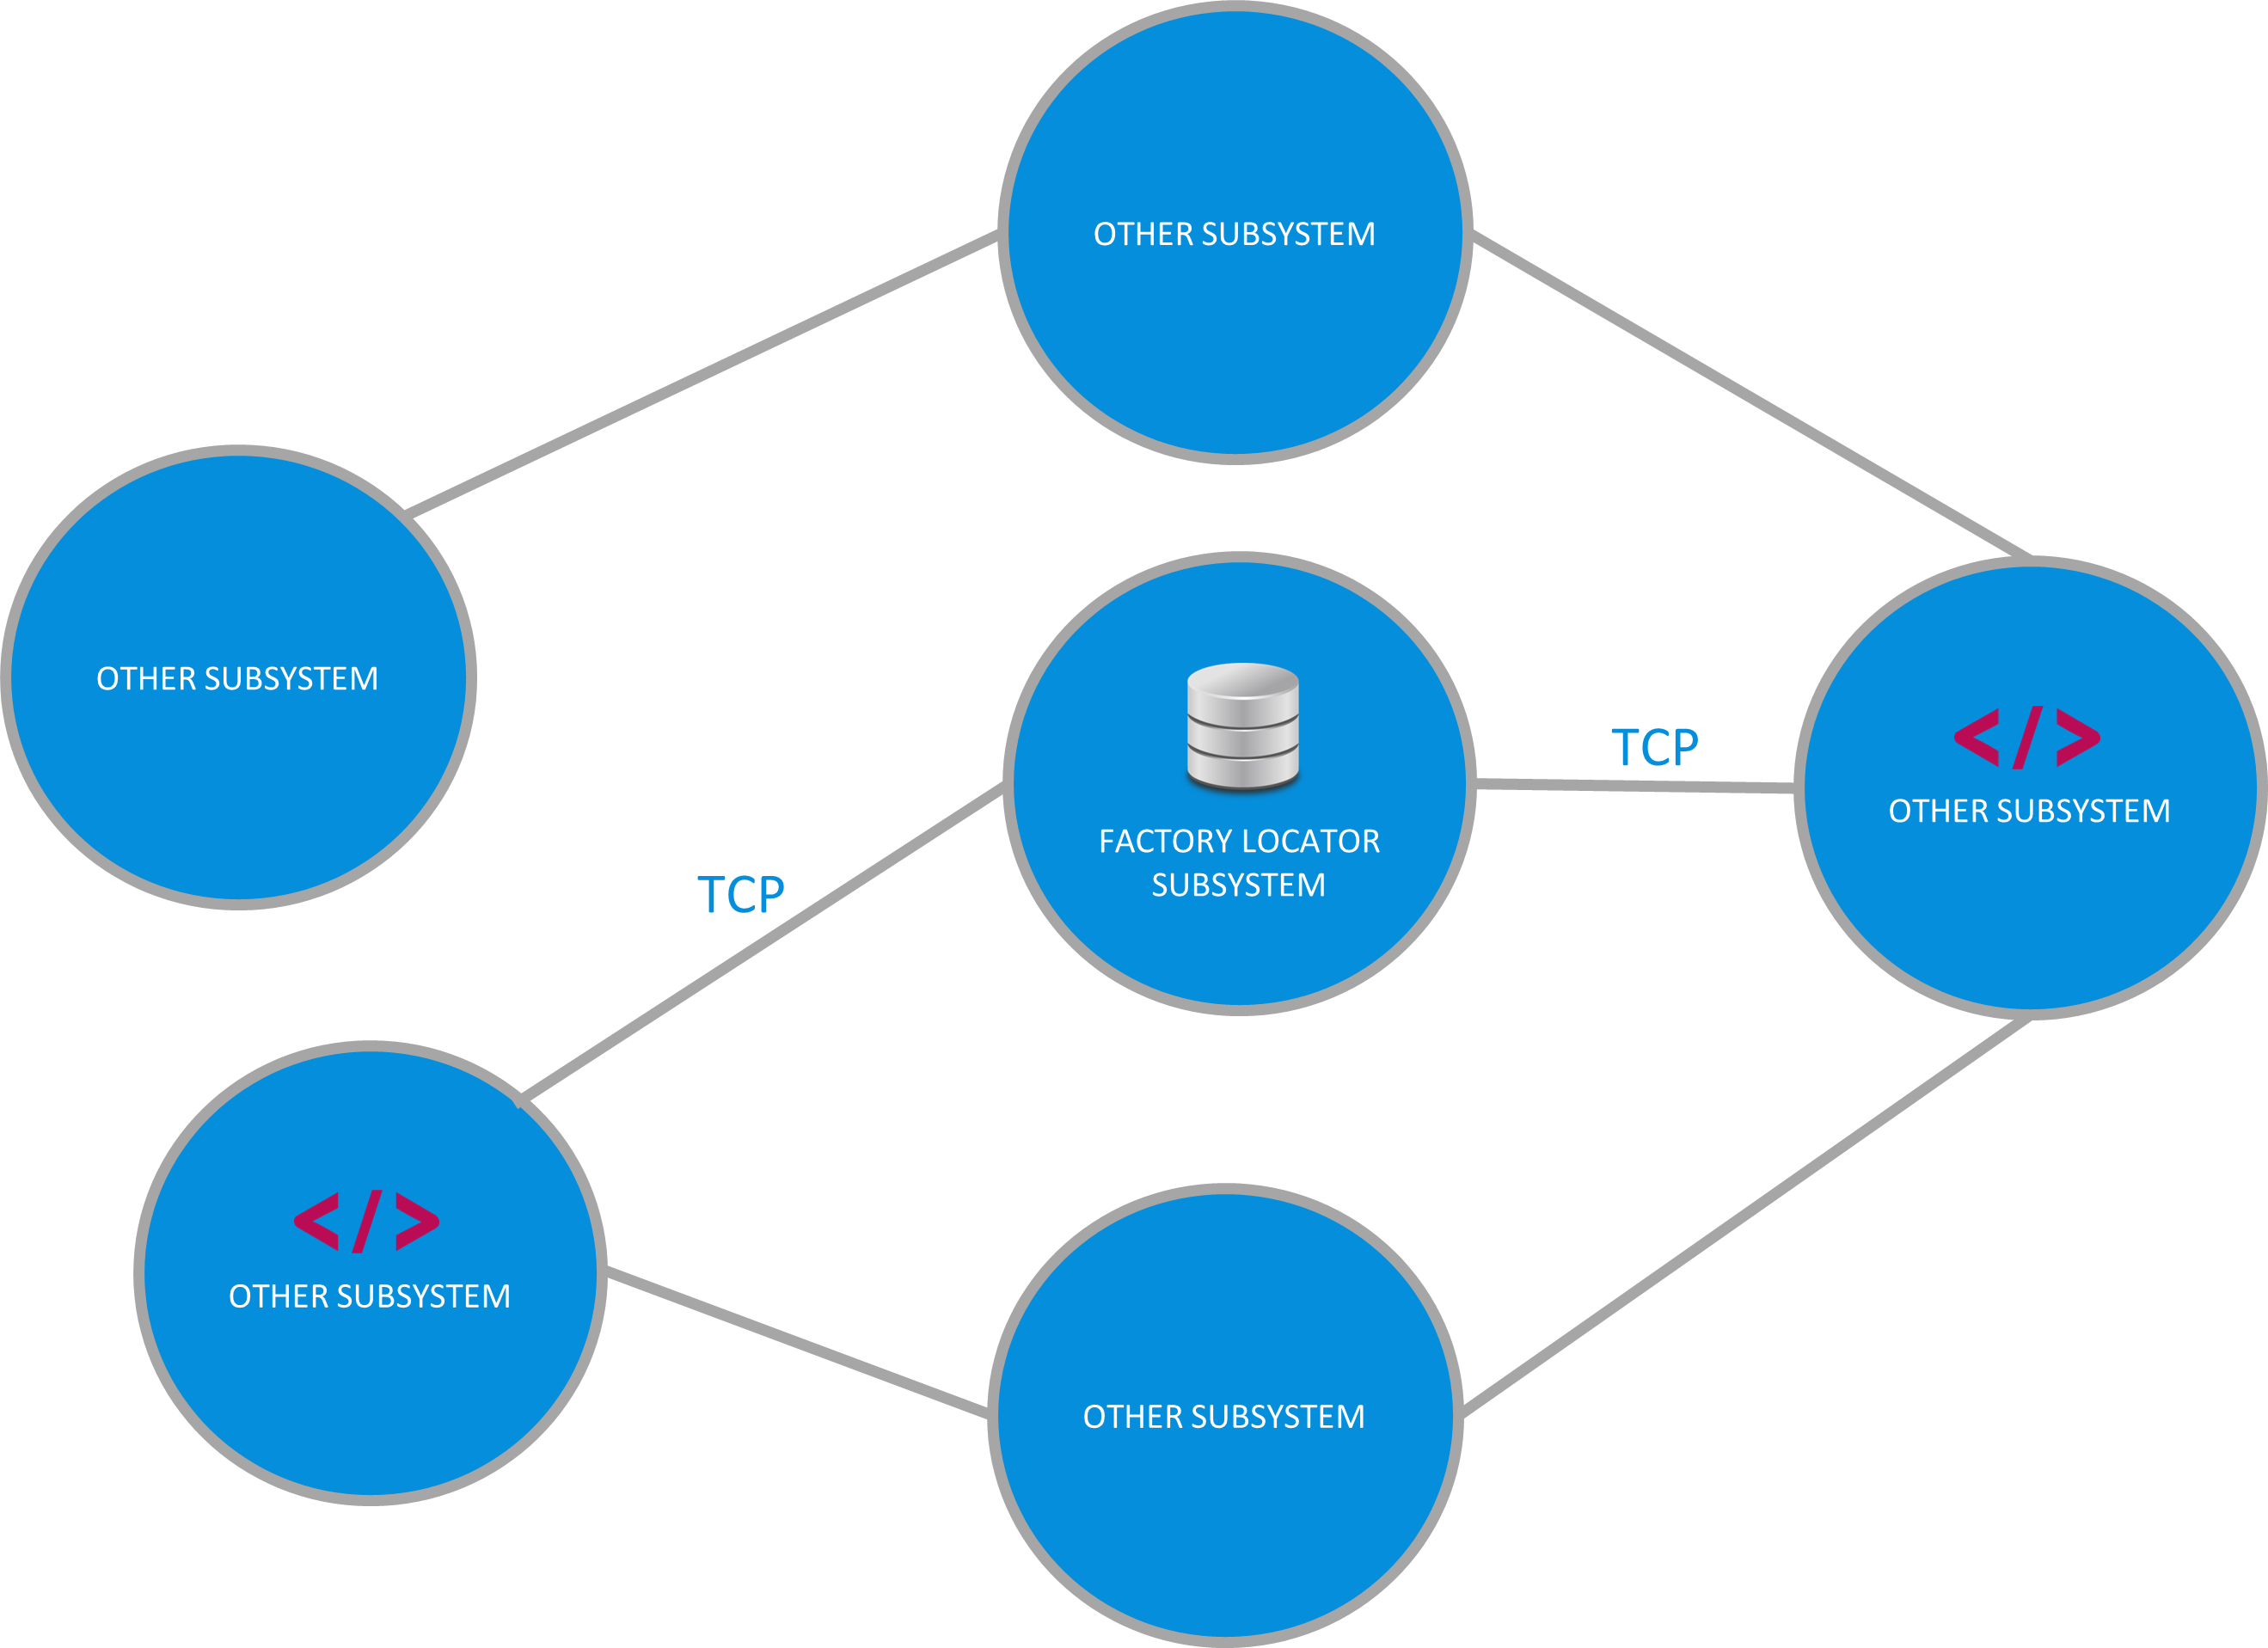
The Solution (contd.)
Partially Central
Architecture

Slide 22
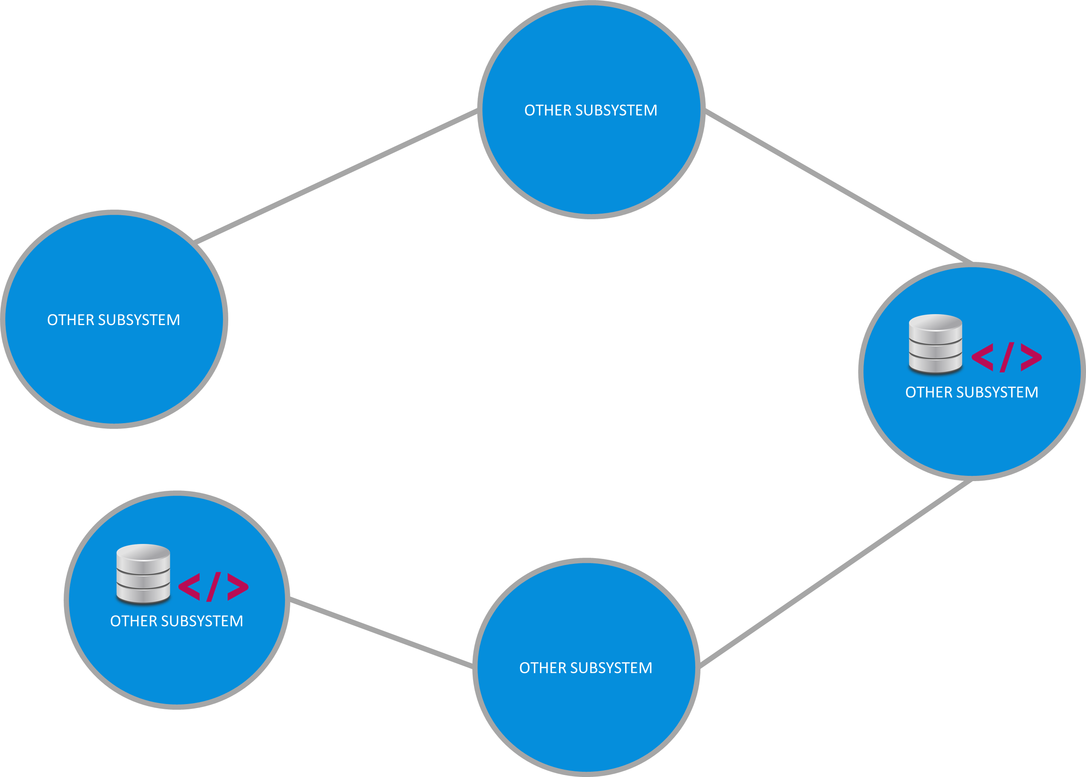
The Solution (contd.)
Distributed Architecture
(Replica Set)

Slide 23
The Solution (contd.)
CLI Supported Platforms
Linux
Mac OS
Windows

Slide 24
The Solution (contd.)
Other Platforms
Elixir Interactive Shell (Erlang/OTP)
Docker (Mounting the Linux CLI Folder)

Slide 25
Features

Slide 26
Features
CLI Features
Set the configuration of the database (MongoDB)
Get the database Configuration
Save order to the database
Save a factory to the database

Slide 27
Features
CLI Features
Determine the new factory location
Get the closest factory to coordinates
Get factories from the database
For more info see the application's documentation at:
https://github.com/otboss/PDQ-Pizza-Factory-Locator-Subsystem/blob/master/README.md

Slide 28
Demo

Slide 29
Thank You

Slide 30
References
https://erlang.org/download/armstrong_thesis_2003.pdf
https://people.uwec.edu/sulzertj/Teaching/is455/Resources/PizzaDeliveryQuickly_Case_Study.pdf

