Slide 1
Automotive Message Broker
Purpose
Design
Schedule

Slide 2
Purpose: Problems to Solve
Problems:
Vehicle networks contain critical information apps need
Vehicle network protocols are many
Vehicle message payloads are private
How do applications get to this information?
Automotive-message-broker abstracts the details of the network away from applications
and provides a standard API for applications to easily get the required information.

Slide 3
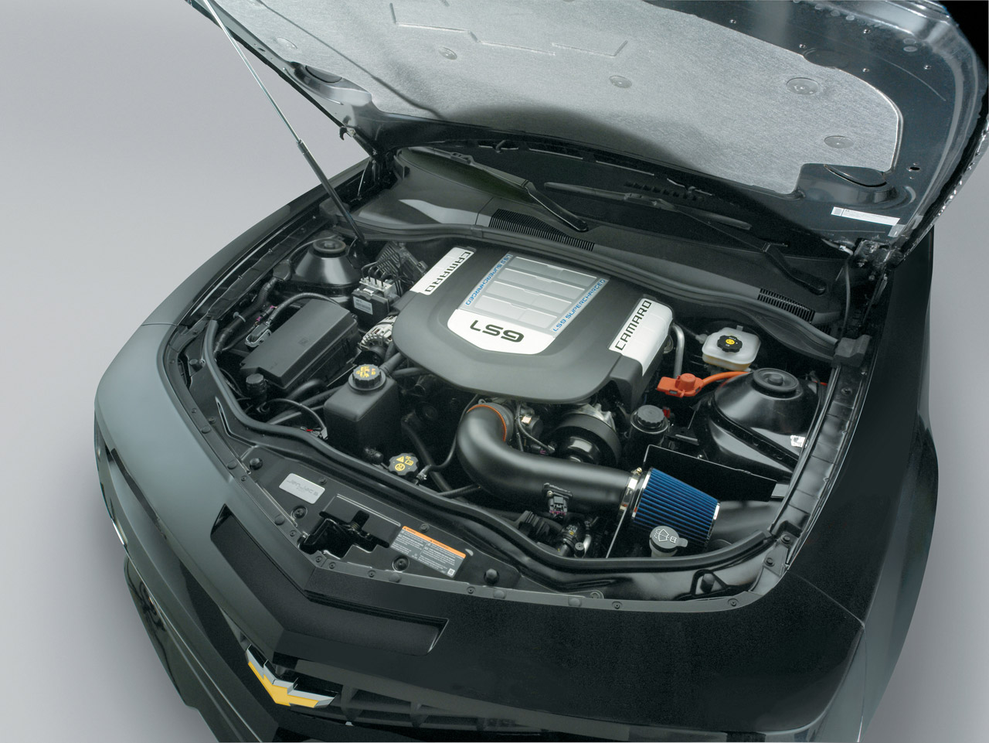
Design: Components
Provided by amb:
Source plugin infrastructure
Abm core daemon
Sink plugin infrastructure
DBus
Source plugin
Sink plugin
amb-core
Proprietary
plugin
DBus
plugin

Slide 4
Design: Flexibility
amb-core
Applications
Proprietary
plugin
DBus
System #1
TCP Sink
Ethernet link
amb-core
TCP Source
DBus
System #2

Slide 5
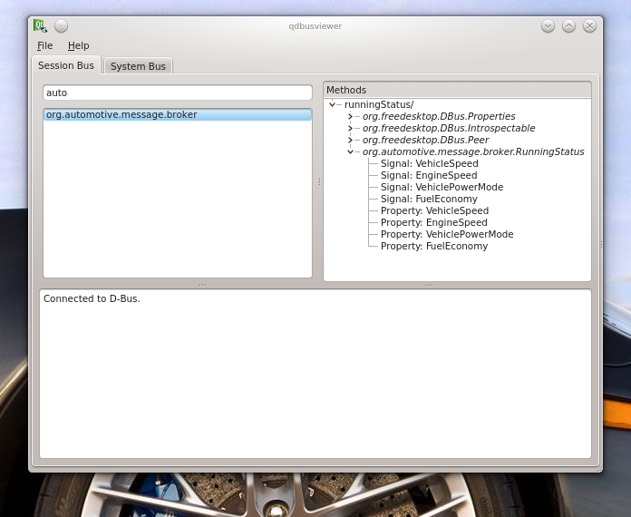
Design: Interface System

