Slide 1


OpenTelemetry
Industrial
Community Overview & Technical Vision
Lukasz Ciukaj
github.com/otel-industrial

Slide 2
Today's Discussion
Agenda
OpenTelemetry Industrial
Integration Models
01
04
Community overview, mission & projects
How industrial data reaches OpenTelemetry
Community Resources
OpenTelemetry Collector
02
05
GitHub, Slack, projects
Architecture and data flow
Roadmap
Semantic Conventions
03
06
Vision and future direction
Standardizing industrial telemetry

Slide 3
Community Overview
What is OpenTelemetry Industrial community?
Community Status
Founded May 2026
Our Mission
Community-led initiative
We operate as a user group. The concept of 'user groups' is not yet formalized in OpenTelemetry (this is actively being discussed).
Monthly community calls, open to all.
github.com/otel-industrial/ otel-industrial-community
60+ members
CNCF Slack: #otel-industrial
A small but active core contributing receivers, docs, and community resources.
github.com/otel-industrial
Industrial Observability
Build an open, vendor-neutral ecosystem for industrial observability through OpenTelemetry, bringing together end users, vendors, and the open source community.
Notes:
OTel is the answer to vendor lock-in. Instrument once, send anywhere.

Slide 4
Community Resources
OpenTelemetry Industrial Resources
May 2026
60+
#otel-industrial
Founded
CNCF Slack members
CNCF Slack channel
GitHub
Get Involved
otel-industrial-resources
Documentation, reference materials, project catalog, and learning resources.
otel-industrial-community
Community meetings, roadmap, presentations, working groups, and collaboration.
CNCF Slack: #otel-industrial
Most active discussion happens here
Monthly community calls
Open to all — check GitHub for schedule
Contribute code, documentation, testing, and ideas
All skill levels welcome
Notes:
OTel has won. The question is how fast to adopt, not whether.

Slide 5
Community Projects
OpenTelemetry Industrial Projects
PROJECT | DESCRIPTION | STATUS | AUTHOR
Modbus Receiver | OTel Collector receiver for Modbus devices and industrial equipment. | Experimental | lukaszciukaj
OPC UA Receiver | OTel Collector receiver for OPC UA servers and industrial systems. | Experimental | bruegth
MQTT Sparkplug Receiver | MQTT Sparkplug protocol support for OpenTelemetry Collector. | Active Dev | jmacd
mqtt2otel (bridge app) | MQTT-to-OTel bridge that transforms MQTT messages into OTel metrics and logs. | Experimental | OSgAgA
EtherNet/IP Receiver | OTel Collector receiver for EtherNet/IP | Work in Progress | Community
Notes:
Slow spans are immediately visible. The Gantt view makes root cause obvious.

Slide 6
OpenTelemetry Industrial Vision
Where We Are Headed
Receivers for Popular Protocols
OTel Industrial Collector Distribution
Stable OpenTelemetry Collector receivers for OPC UA, MQQT Sparkplug, Modbus, EtherNet/IP, Profinet and other popular industrial protocols.
A purpose-built OpenTelemetry Collector with industrial receivers pre-packaged. Easy to deploy at the factory edge.
Become an official part of OpenTelemetry
OTel Documentation for Industrial
Formalize as an official part of OpenTelemetry project.
A dedicated section on opentelemetry.io covering industrial use cases, onboarding guides, and protocol recipes.
Notes:
OTel has won. The question is how fast you adopt it.

Slide 7
Integration Models
Three Ways to Bring Industrial Data to OTel
Model 1
Model 2
Model 3
OTel SDK + OTLP
Industrial Protocol Receivers
Bridge Application
Industrial app or device uses the OTel SDK directly.
Sends telemetry via OTLP to a standard OTel Collector.
Best for modern, programmable edge devices with runtime SDK support.
Requires SDK integration in the application or device. Best suited for modern, programmable systems.
Dedicated receivers on the OTel Collector translate industrial protocols into OTel signals.
No SDK changes needed in devices. The Collector performs the translation.
Ideal for legacy or proprietary systems where SDK integration is not possible.
A separate bridge application reads industrial protocol data and converts it to OTLP.
Forwards to any standard OTel Collector.
Works with any backend, any protocol if library for industrial protocol is available.
Ideal when a native Collector receiver is unavailable or custom processing is required.
Notes:
Mix all three. Start with auto-instrumentation, add manual spans for business logic that matters.

Slide 8
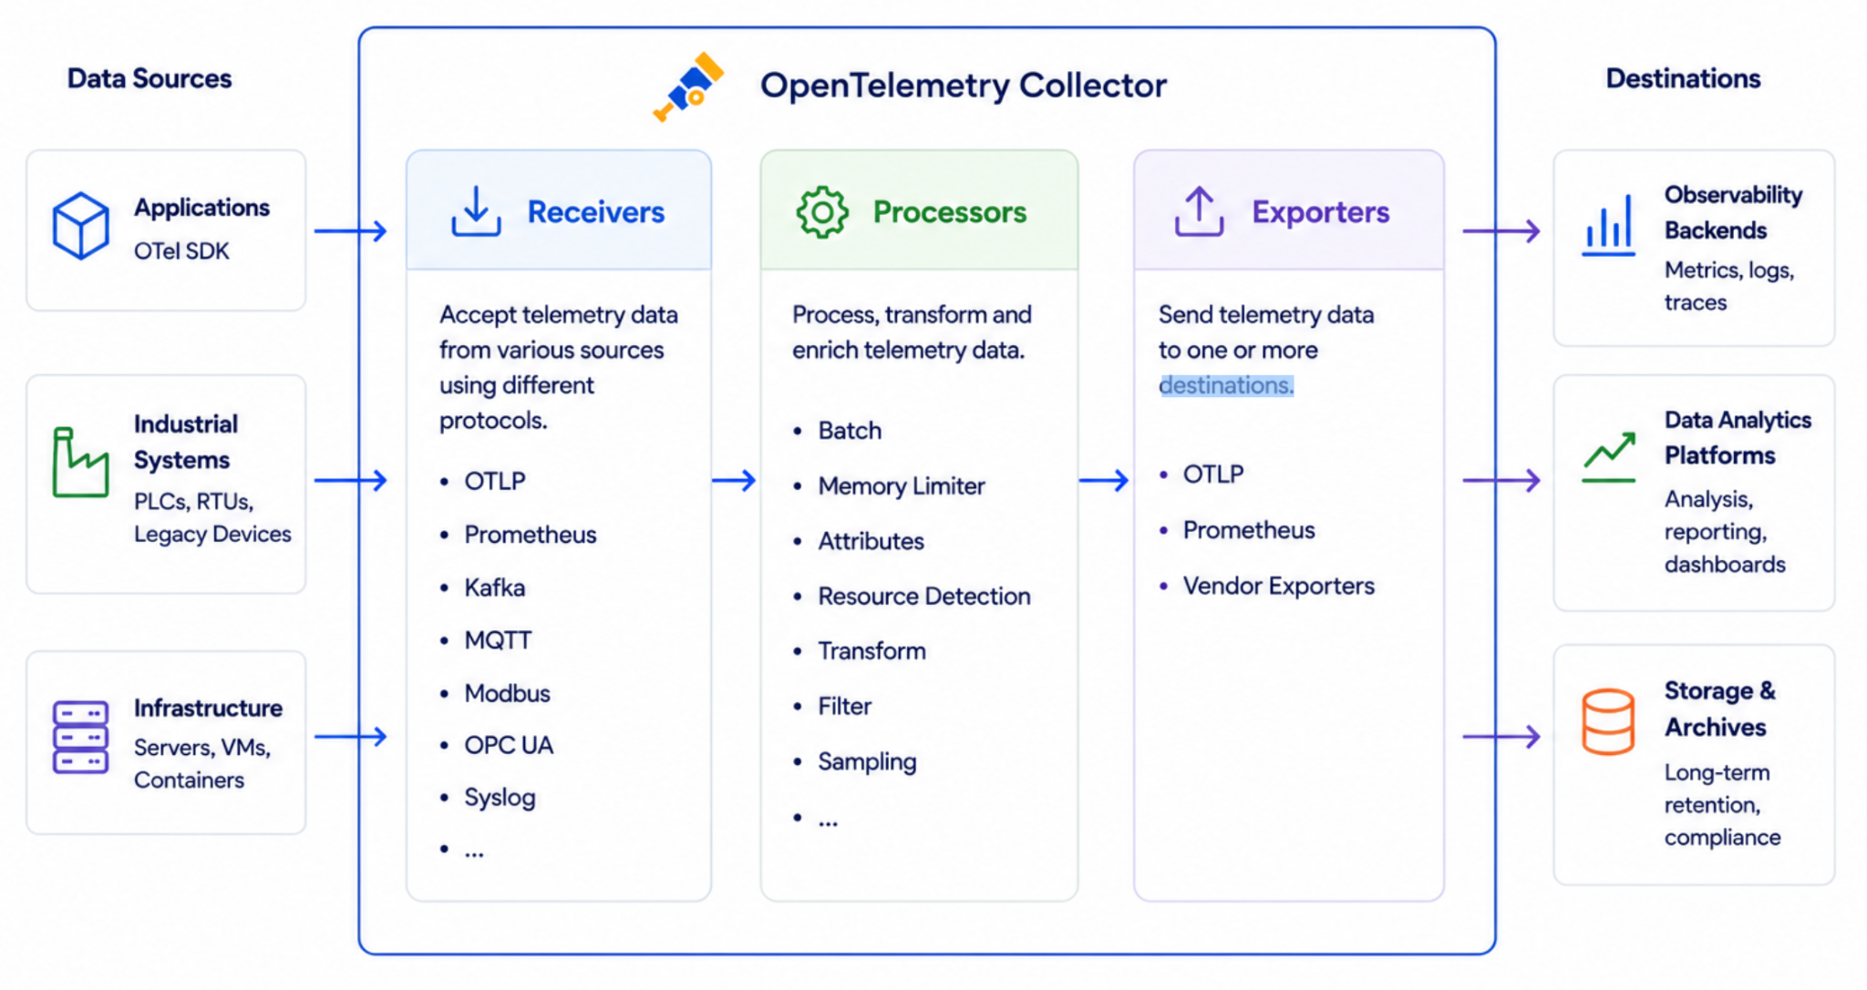
Collector Architecture
OpenTelemetry Collector
Notes:
The Collector decouples instrumentation from backends. Fan out to multiple destinations simultaneously.

Slide 9
Semantic Conventions
Industrial Semantic Conventions
What are Semantic Conventions?
Why It Matters for OpenTelemetry Industrial
A shared vocabulary for telemetry that defines what data is called, what it means, and how it is represented. Semantic conventions ensure telemetry is consistent and understandable across applications, systems, and observability tools.
Enable vendor-neutral industrial telemetry
A common data model allows telemetry from different industrial protocols and vendors to be represented consistently.
Build reusable OpenTelemetry integrations
Receivers, processors, exporters, dashboards, and tooling can work across industrial technologies without protocol-specific customizations.
Build once, use everywhere
Defining conventions early helps avoid incompatible implementations as OpenTelemetry adoption grows across industrial environments.
Examples
Telemetry Concept Semantic Convention
Service name service.name
Service version service.version
Host name host.name
Cloud provider cloud.provider
HTTP method http.request.method
https://opentelemetry.io/docs/specs/semconv/general/
Notes:
Semantic conventions are what make OTel more than an API. They enable out-of-the-box insight in any backend.

Slide 10
Community
Where We Need Your Help
1
2
3
Industrial Domain Expertise
Vendor Resources & Testing Environments
End-user Adoption & Test Sites
We need contributors and reviewers with hands-on experience in industrial automation, OT environments, and industrial protocols to ensure high-quality implementations.
We need access to industrial hardware, software, simulators, and vendor expertise to develop, validate, and test receivers and integrations in realistic environments.
We need organizations willing to provide local test environments for validating receivers and deployment patterns, and to share real-world feedback and use cases.
Notes:
Start with auto-instrumentation + Collector + Jaeger locally. Expand from there.

Slide 11

Whitepaper
Industrial Observability 2026
Industrial Observability 2026
The first edition provides an overview of:
Industry trends and challenges
OpenTelemetry in industrial environments
Reference architectures
Community opportunities
Future directions
Industrial Observability 2027
A community-driven whitepaper, likely maintained under the OpenTelemetry Industrial project.
https://github.com/lukaszciukaj/industrial-observability-whitepaper
Notes:
Start with auto-instrumentation + Collector + Jaeger locally. Expand from there.

Slide 12
Thank You!
Questions & Discussion
Notes:
Open the floor. Common Q's: Do I need the Collector? (want it, not need it). OTel vs Prometheus? (complementary). Sampling? (great follow-up topic).

