Slide 2
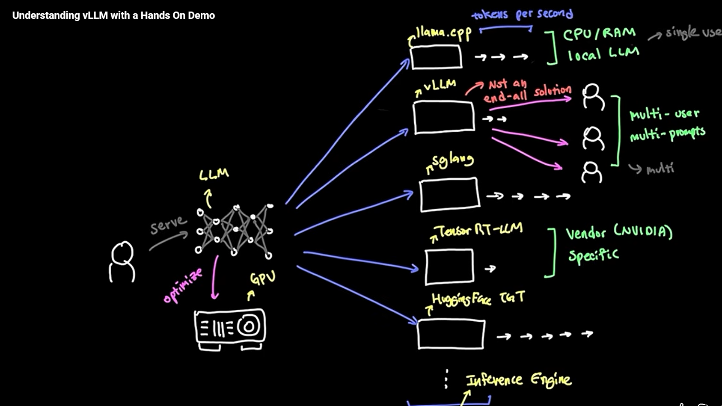
Component | Role | When to Use | User Mode | Notes
Local LLM | Runs on CPU/RAM or a single GPU locally | Offline, privacy‑sensitive, small models | Single user | Ideal for experimentation or edge AI
LLM API | Hosted model via REST/gRPC | SaaS, enterprise apps, multi‑tenant | Multi‑user | Scalable, managed by provider
vLLM | Open‑source high‑performance inference engine | When you need fast, cost‑efficient serving on GPUs | Multi‑user / batch | Uses PagedAttention and dynamic batching for high throughput
TensorRT‑LLM | NVIDIA‑optimized runtime for LLMs | When you need maximum GPU performance and low latency | Multi‑user / real‑time | Vendor‑specific, tightly integrated with CUDA
Vendor Runtime | Proprietary cloud runtime (AWS Inferentia, Azure ML) | Cloud‑specific optimization | Multi‑user | Tied to vendor ecosystem
Jupyter Notebook | Interactive dev environment | Research, fine‑tuning, testing | Single user | Ideal for data scientists
Source Engine | Custom orchestration layer (Python, LangChain, FastAPI) | Integrating LLMs with business logic | Depends on architecture | Used for agentic AI and orchestration

Slide 3
Feature | vLLM | TensorRT‑LLM
Developer | Open‑source (UC Berkeley) | NVIDIA
Focus | Efficient memory management & batching | GPU‑level optimization
Best For | Multi‑tenant inference, cost efficiency | Real‑time, latency‑critical workloads
Hardware | Any CUDA‑enabled GPU | NVIDIA GPUs only
Integration | Hugging Face, FastAPI, LangChain | Triton Inference Server, CUDA
Scalability | Excellent for concurrent users | Excellent for high‑performance clusters

Slide 4
Left Column: Agent Maturity Stages | ➔ | Right Column: 6-Layer Architecture Mapping
1. Stateless & Stateful (The Core) • Zero/Few-shot prompts • Context windows, RAG, Memory | ➔ | Layer 3: Inference & Serving (Raw LLMs) Layer 4: Data & Protocols (Vector DBs, MCP)
2. Planners (Reasoning) • Chain-of-Thought, Tree-of-Thought • Tool selection & execution | ➔ | Layer 5: Orchestration & Agents • Reasoning loops, Task Decomposition
3. Learners (Self-Improvement) • RLHF, Fine-tuning • Drift detection & Evals | ➔ | Layer 2: Model Training & Dev Side Panel: Governance & Observability
4. Orchestrators (The Horizon) • Multi-agent systems (A2A • Synthetic environments | ➔ | Top of Layer 5 & Layer 6 • Autonomous Swarms & Copilots

Slide 5
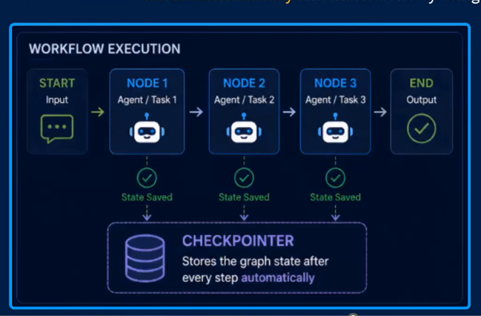
Checkpointer is like auto save feature

Slide 6
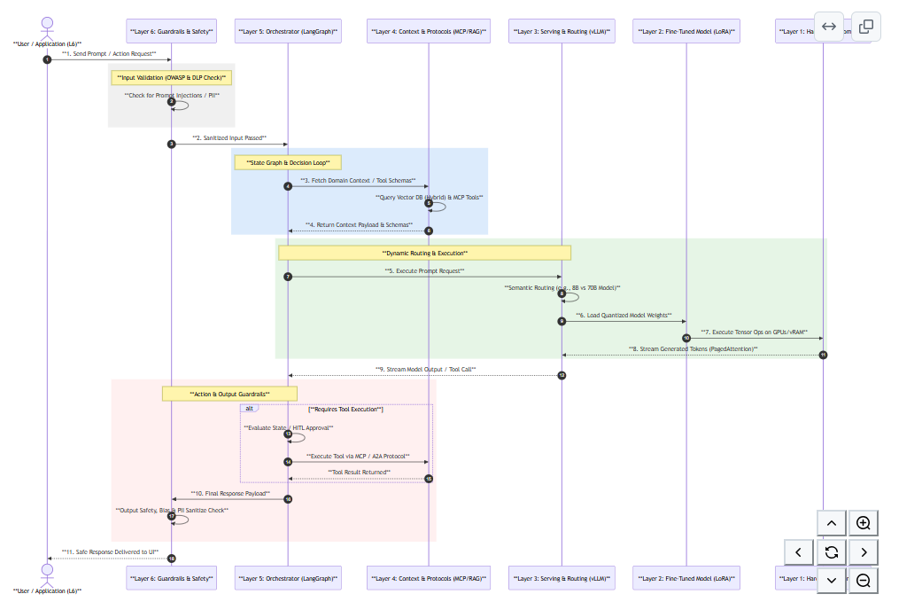

Slide 7
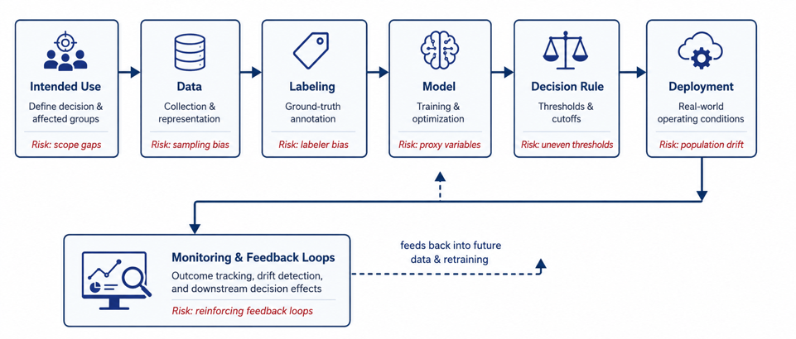
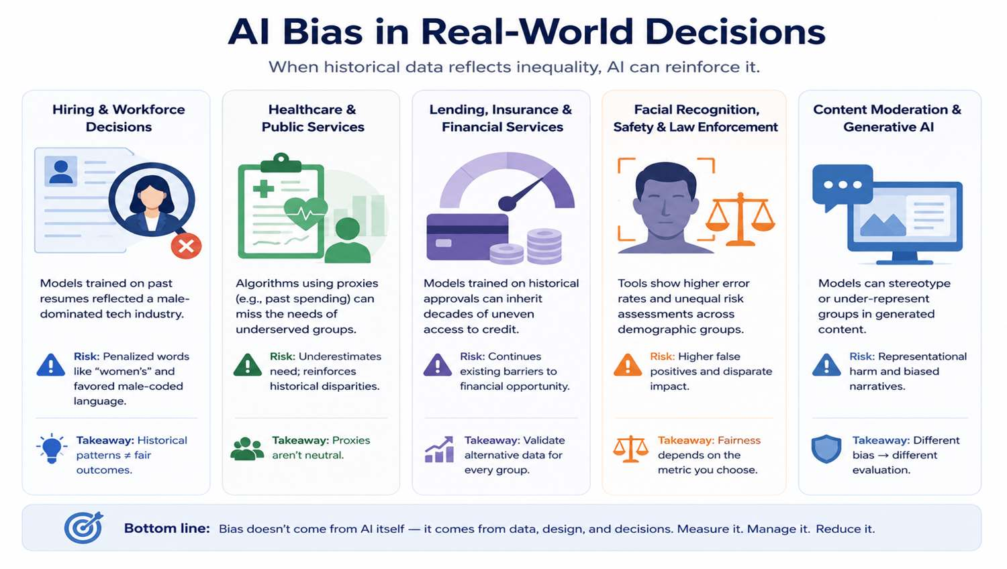
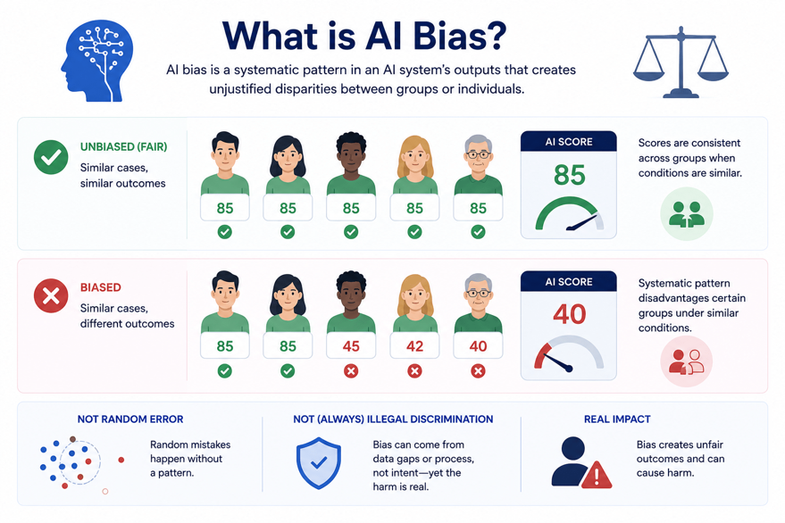

Slide 8
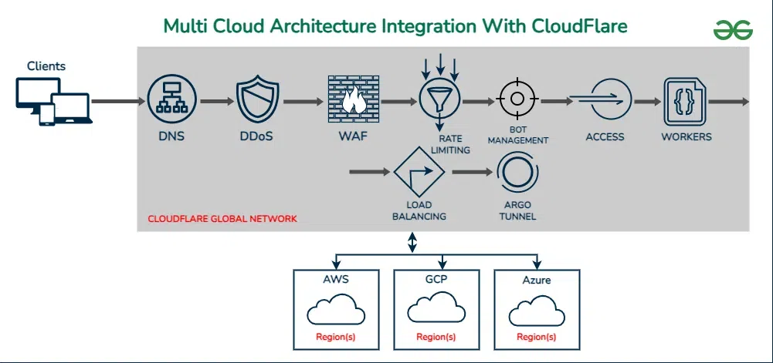
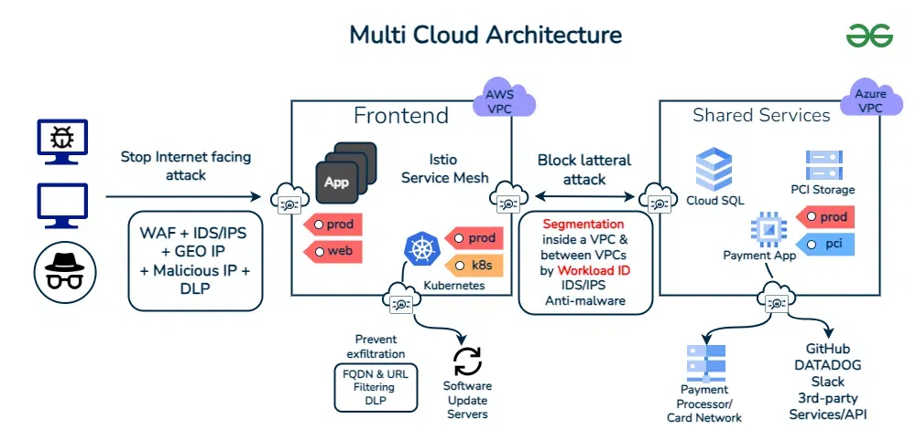

Slide 9
Python Cloud Architecture for LLMs
Layer | Technology | Purpose
API Gateway | FastAPI | Async routing, request handling
Inference Engine | vLLM / TensorRT‑LLM | High‑throughput GPU inference
Caching Layer | Redis | Store prompt‑completion pairs, reduce latency
Containerization | Docker / Kubernetes | Scalability, portability
Monitoring | Prometheus / Grafana | Observability, performance tracking
Security | Zero Trust principles | Identity, runtime security, compliance
Scalability: Supports hundreds of concurrent requests with GPU batching.
Performance: Quantization + caching reduce latency dramatically.
Flexibility: Python ecosystem allows rapid prototyping and integration with AI frameworks.
Security: Zero‑trust and container isolation align with enterprise governance.

Slide 11
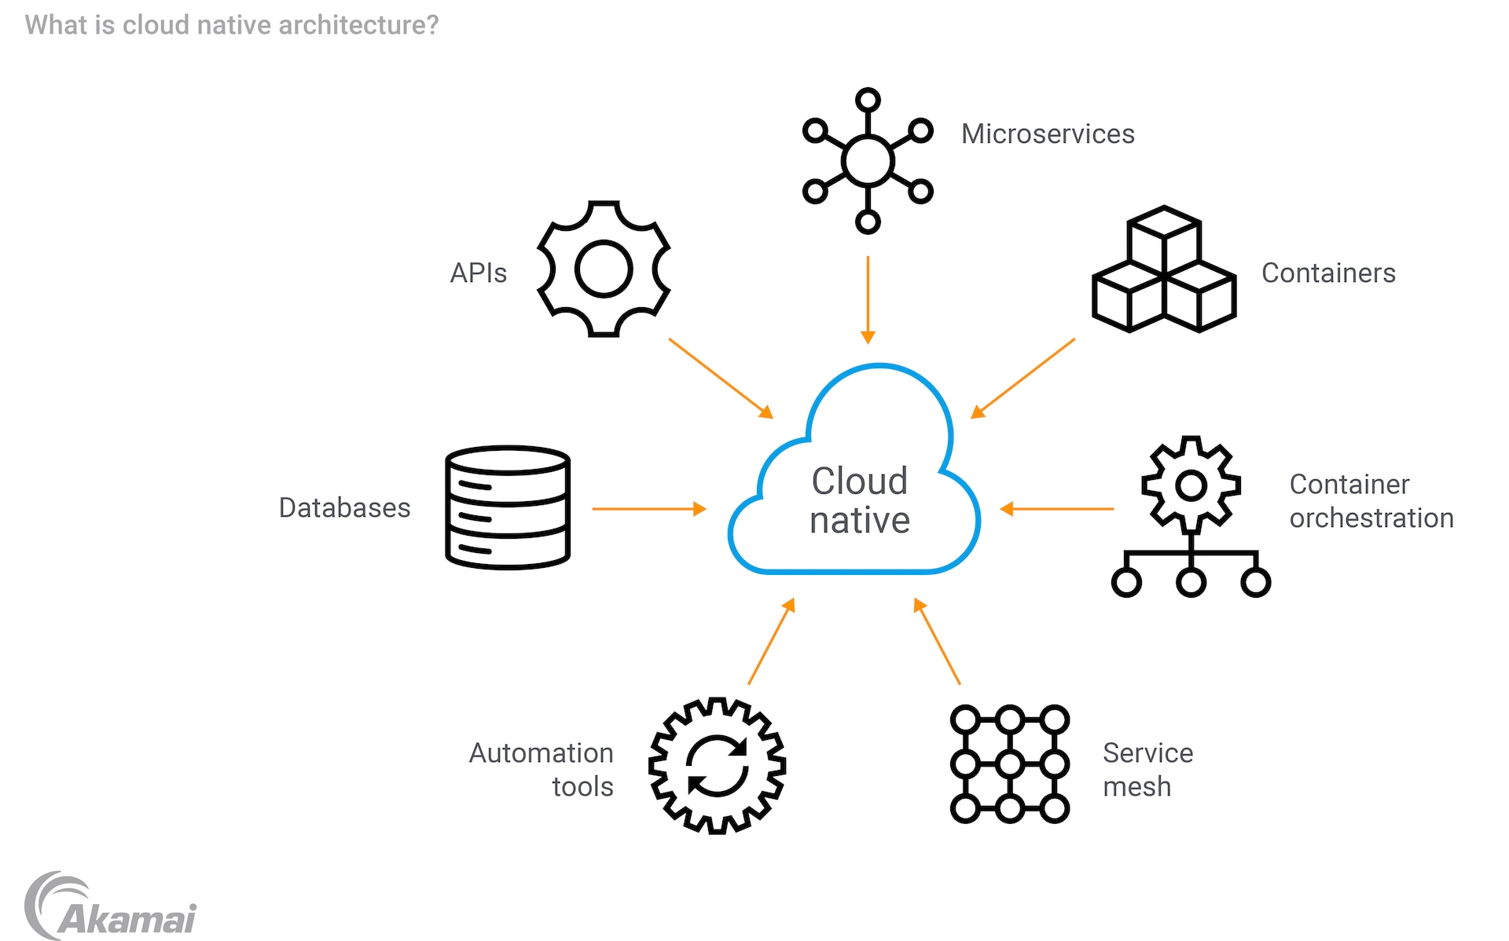
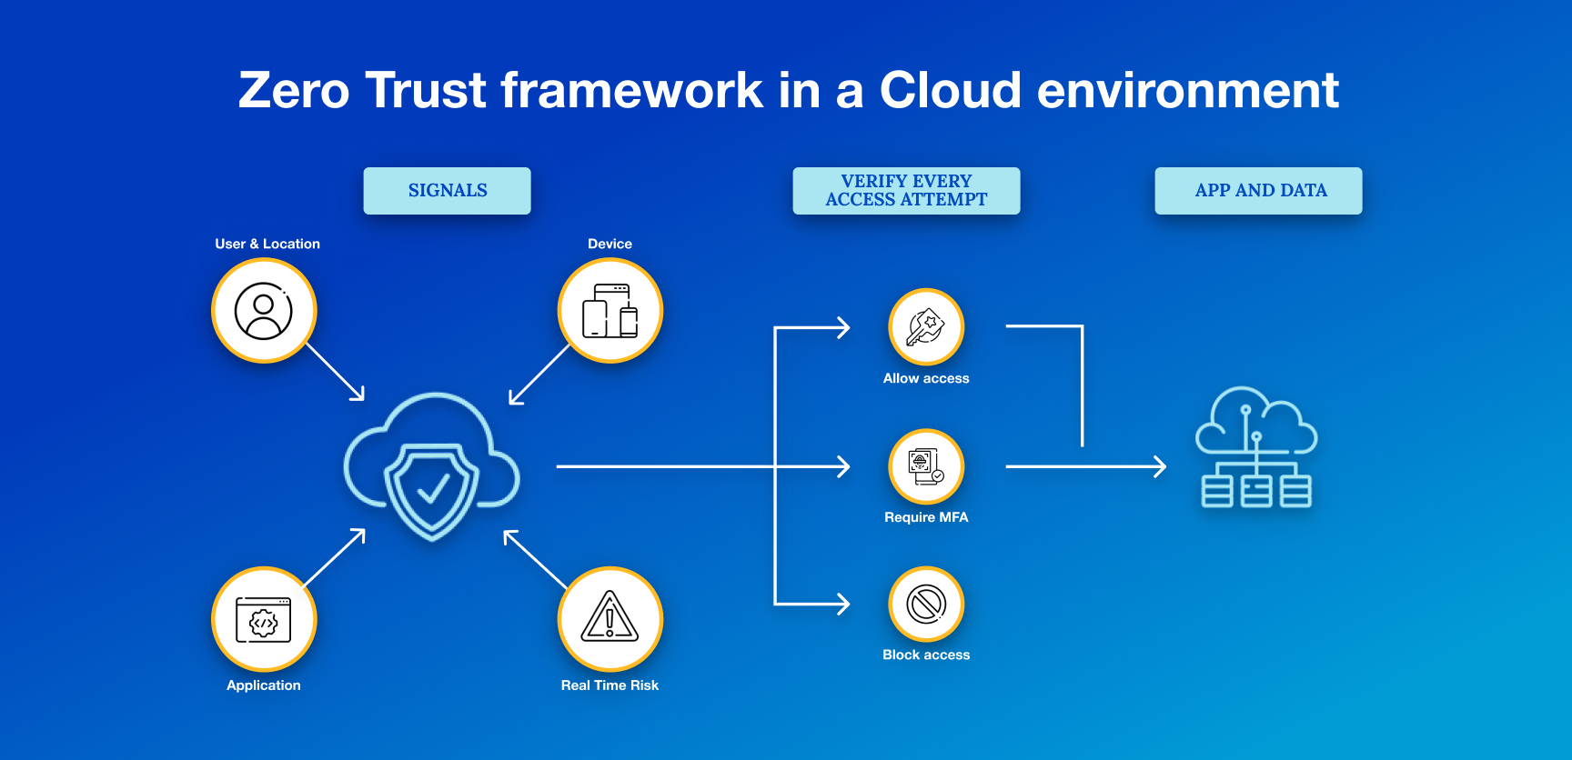
S1 Cloud Native — Security Overview

Slide 12
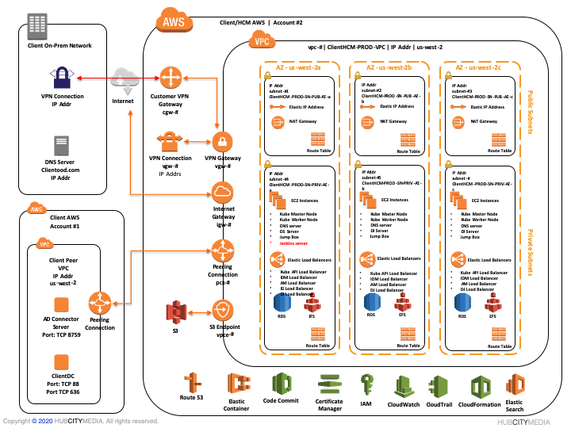

Slide 13
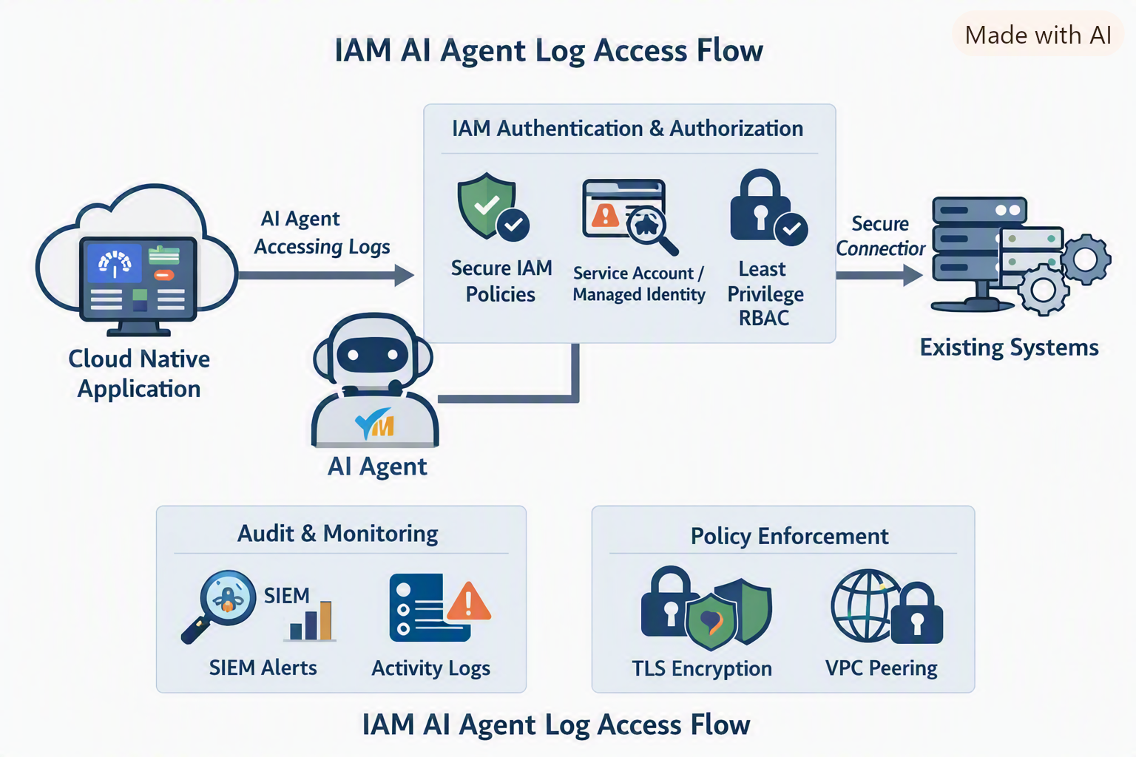
IAM ensures the AI agent is authenticated, authorized, and monitored
IAM & Agent Security Flow
AI Agent Authentication
  The agent (Python LLM auto‑ticket bot) must authenticate via cloud IAM (AWS IAM, Azure AD, GCP IAM).
  Use service accounts or managed identities with scoped permissions.
Authorization & Least Privilege
  Agent only allowed to fetch logs/metrics from observability sources.
  RBAC ensures it cannot escalate into unrelated systems (e.g., DB writes, admin actions).
Secure Connectivity
  If connecting to existing systems (e.g., legacy monitoring, ITSM), enforce:
    Private endpoints / VPC peering
    TLS mutual authentication
    API gateway policies
Audit & Monitoring
  Every agent action (fetch log, raise ticket) logged in SIEM.
  Alerts for unusual behavior (e.g., agent fetching data outside CPU/RAM scope).
Domain | Key Controls | Example Tools
Identity & Access | Cloud‑native IAM, least‑privilege roles, MFA | Azure AD / AWS IAM
Data Protection | TLS everywhere, encryption‑at‑rest, CSPM (Cloud Security Posture Management) | Prisma Cloud / Defender for Cloud
Network Security | Segmentation, private endpoints, firewall rules | VPC Security Groups / NSGs
Monitoring & Threat Detection | SIEM integration, anomaly detection, audit logs | Sentinel / Splunk / Dynatrace
Compliance & Governance | ISO 27001, SOC 2 Type II alignment | Automated policy checks via CSPM
Cloud Native App →
AI Agent (Python LLM) →
IAM Authentication →
Existing System Logs →
Auto Ticket Resolution
Security overlays: IAM, RBAC, TLS, SIEM.

Slide 14
S1 Cloud Native — Security Architecture & Governance
AI Agent (Python LLM)
↓ Authenticates via Managed Identity
Azure AD / Entra ID
↓ Authorized by RBAC (Log Analytics Reader)
Azure Monitor / Log Analytics
↓ Fetches Logs Securely (TLS)
↓ Creates Auto Ticket (ServiceNow API)
Sentinel SIEM → Monitors + Audits Actions

Slide 15
Step | Component | Purpose
1. Create Managed Identity | Assign a system‑managed identity to your Python LLM agent (running in AKS, VM, or Function App). | Enables secure authentication without storing credentials.
2. Define RBAC Roles | Use Azure RBAC to grant least‑privilege access (e.g., “Log Analytics Reader”). | Restricts agent to read‑only log access.
3. Secure API Access | If the agent calls APIs (e.g., ServiceNow, Dynatrace), use Azure API Management with OAuth2/JWT. | Ensures secure, token‑based communication.
4. Encrypt Data in Transit | Enforce TLS 1.2+ for all outbound connections. | Protects log data during transfer.
5. Monitor & Audit | Integrate with Microsoft Sentinel or Defender for Cloud. | Tracks agent actions, anomalies, and ticket creation events.
6. Automate Alerts | Use KQL queries in Sentinel to detect unusual agent behavior (e.g., excessive log fetches). | Enables proactive threat detection.

Slide 16
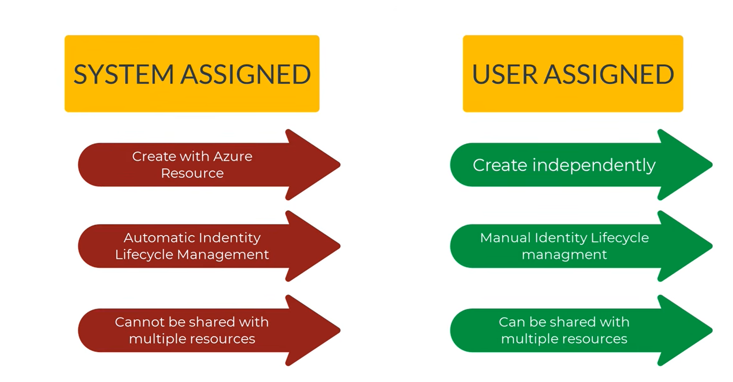
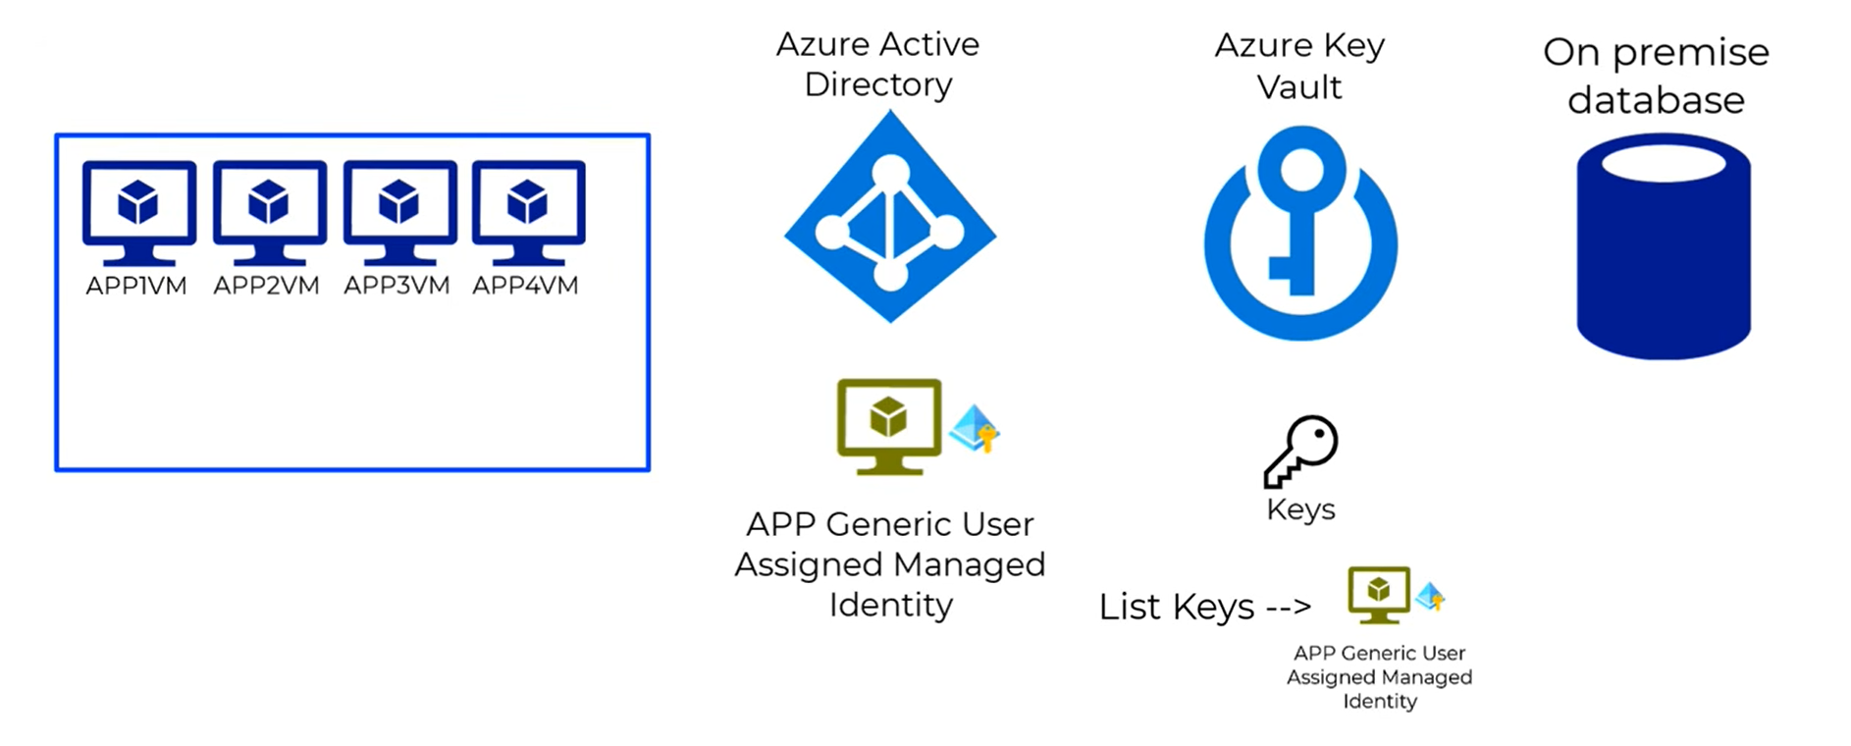
“In S1 Cloud Native, our AI agent runs inside your cloud tenant. It authenticates with Entra ID, operates under least‑privilege RBAC, and every action is monitored in Sentinel. This ensures secure, compliant auto‑ticketing without disturbing your production workloads.”
Cloud Native Application
↓ Metrics/Logs → Azure Monitor / Log Analytics
AI Agent (Python LLM)
↓ Authenticates via Managed Identity
Azure Entra ID (IAM)
↓ Authorized by RBAC (Log Analytics Reader)
↓ Secure TLS Connection
Fetch Logs → Auto Ticket (ServiceNow API)
Sentinel SIEM → Audit + Alerts

Slide 17
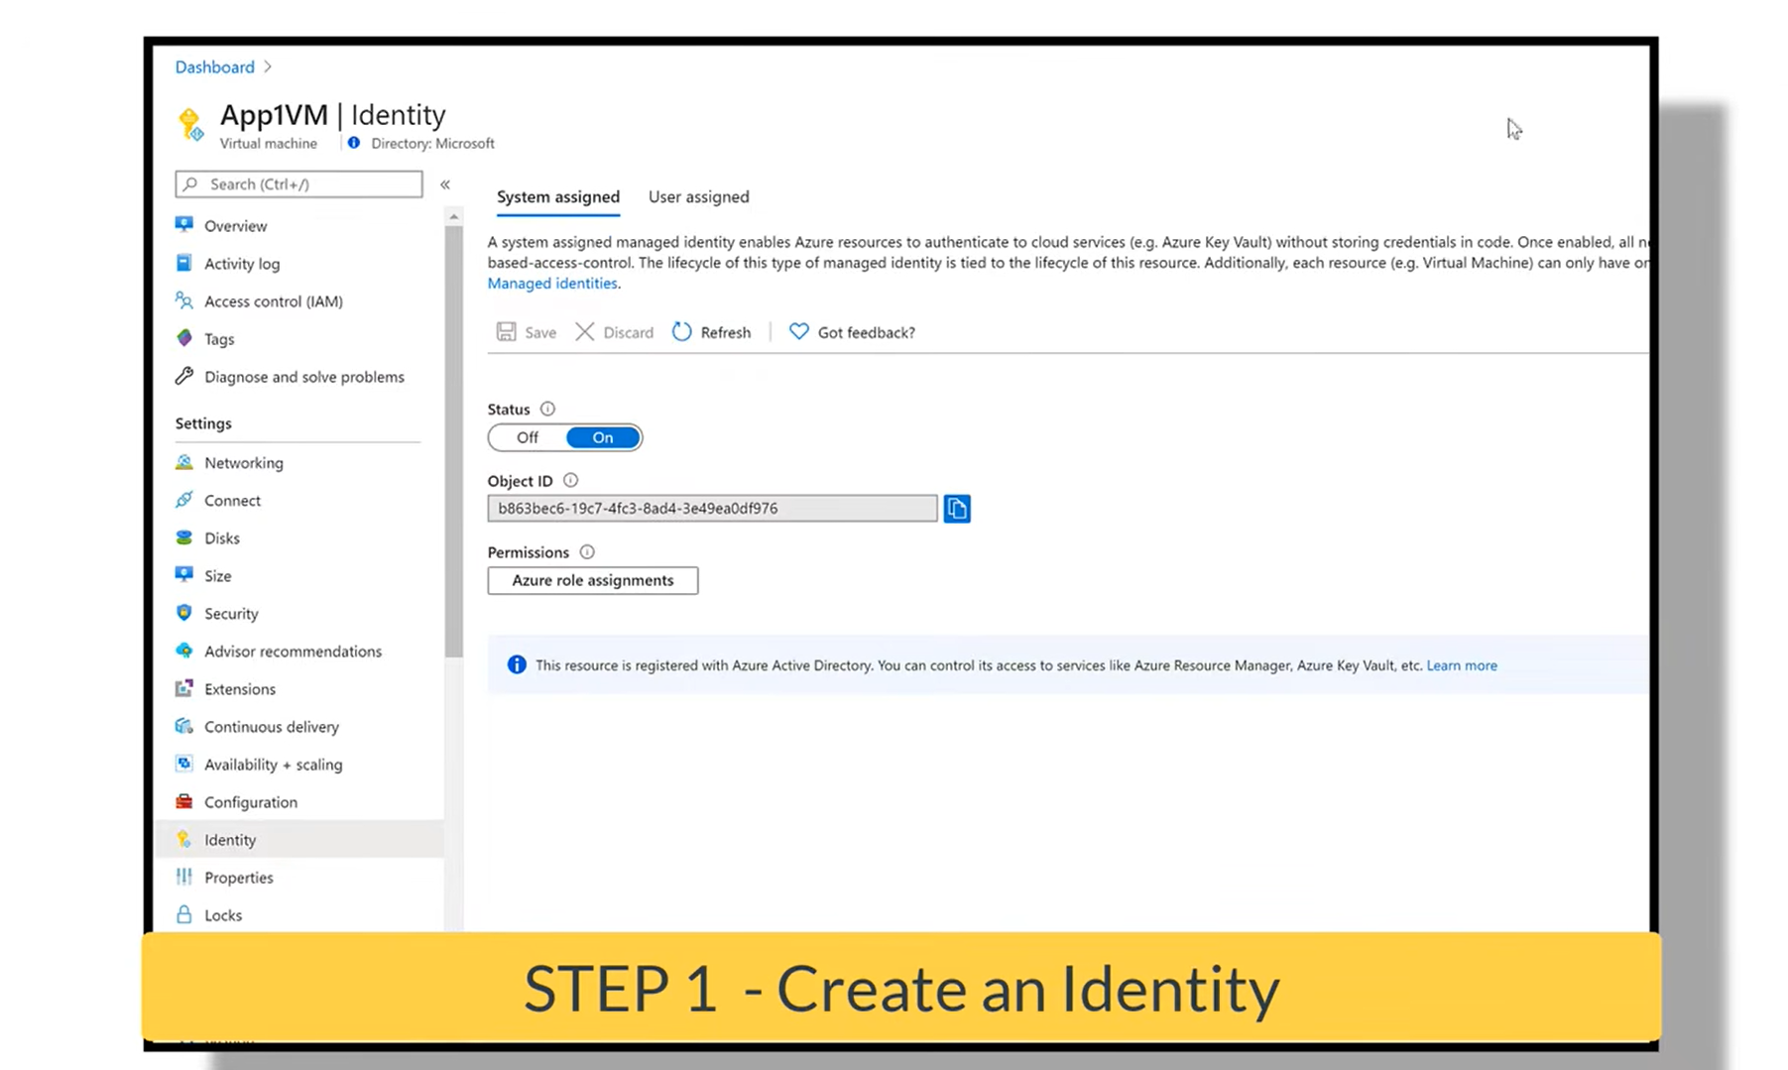
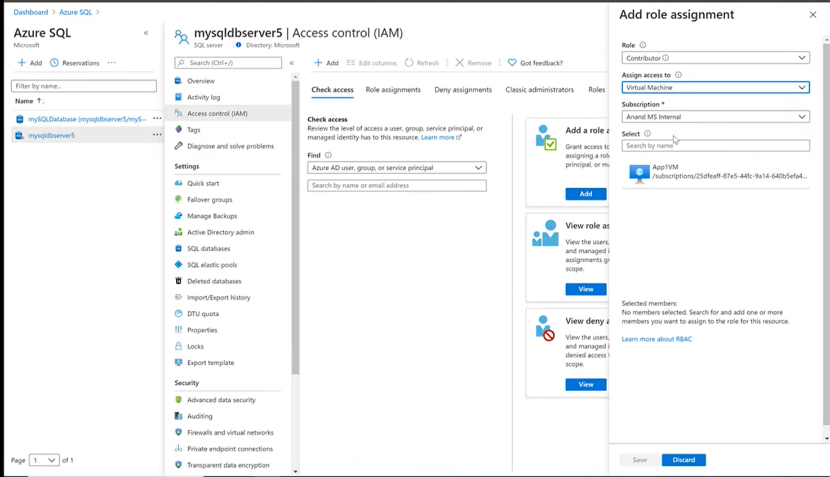
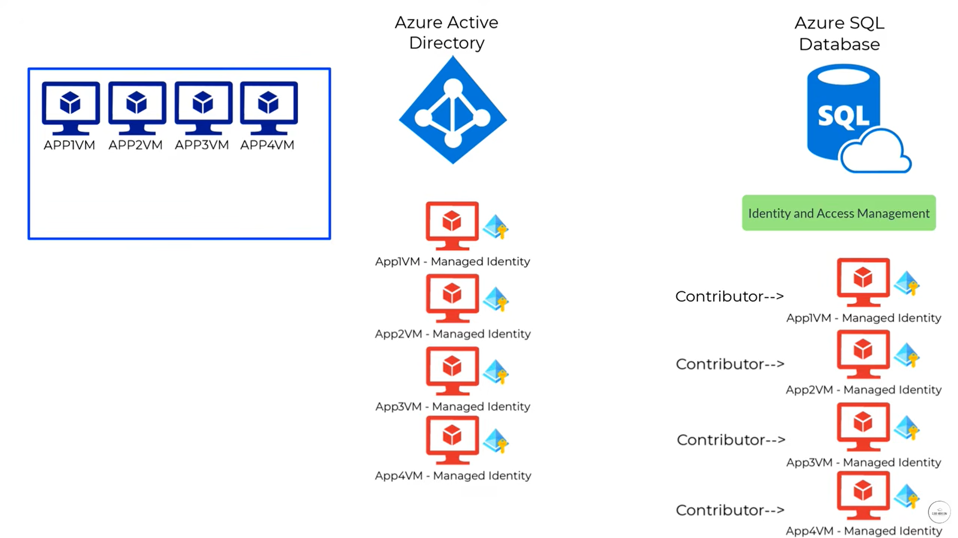

Slide 18
Our AI agent authenticates using a customer‑controlled Managed Identity — no credentials stored, no external access. The customer defines RBAC and Key Vault permissions, ensuring full governance and auditability.
🧩 Managed Identity — What It Really Means Here In Azure, a Managed Identity is a secure way for your application (like your Python LLM‑based AIOps agent) to authenticate without storing credentials. It’s not a breach — it’s actually the Microsoft‑recommended best practice for intra‑cloud authentication. Here’s how it works: Your LLM‑based Python app runs inside the customer’s cloud tenant (VM, AKS, or App Service). It’s assigned a User‑Assigned Managed Identity (created by the customer). That identity is registered in Azure Entra ID (formerly AD). When your app needs to access logs or secrets (e.g., Key Vault), Azure automatically issues a token for that identity — no passwords, no keys. Access is governed by RBAC and Key Vault policies that the customer controls. So, the agent authenticates via Managed Identity, but authorization is entirely under the customer’s control. | Why Customers Usually Allow This No credential exposure: No hard‑coded secrets or service‑account passwords. Full control: They can revoke or rotate permissions anytime. Auditability: Every token request and Key Vault access is logged in Azure Monitor and Sentinel. Compliance alignment: Managed Identity is compliant with ISO 27001, SOC 2, and GDPR standards. | When Customers Might Deny It They could hesitate if: Their security policy forbids any external code running under their tenant’s identity. They require air‑gapped or on‑prem isolation (then you’d move to S4/S5 scenarios). They prefer API‑based integration instead of direct identity federation. In those cases, you can propose alternatives: Use Azure AD App Registration with OAuth2 client credentials (customer‑approved). Or deploy your agent in a separate VNet (S2 VPC Peering) with controlled API access.

Slide 19
🧩 1️⃣ Data Security
Aspect | Control | Azure Component
Data at Rest | Encrypt all logs, metrics, and tickets using Azure Storage Encryption or Key Vault‑managed keys. | Storage Account, Key Vault
Data in Transit | Enforce TLS 1.2+ for all API calls between the AI agent, Log Analytics, and ServiceNow. | Azure Front Door, Private Endpoints
Data Access Governance | Apply RBAC and Access Policies to restrict who can view logs or tickets. | Entra ID + Azure Policy
Data Masking | Redact sensitive fields (IP, hostnames, user IDs) before sending to LLM or ticketing system. | Python middleware / Azure Functions
Communication Security
Channel | Control | Purpose
Agent ↔ Azure Monitor | Private Endpoint + TLS | Prevents public exposure of telemetry.
Agent ↔ Key Vault | Managed Identity token + RBAC | Secure secret retrieval without credentials.
Agent ↔ ServiceNow API | OAuth2 client credentials + API Management policy | Ensures scoped, auditable ticket creation.
Agent ↔ Sentinel SIEM | Syslog over TLS / Event Hub integration | Enables audit and anomaly detection.
3️⃣ Compliance & Auditability
ISO 27001 / SOC 2 Type II — Encryption + access control alignment.
GDPR / HIPAA — Data masking and retention policies.
Continuous Audit — Sentinel KQL queries to detect unauthorized log fetches or ticket escalations.

Slide 21
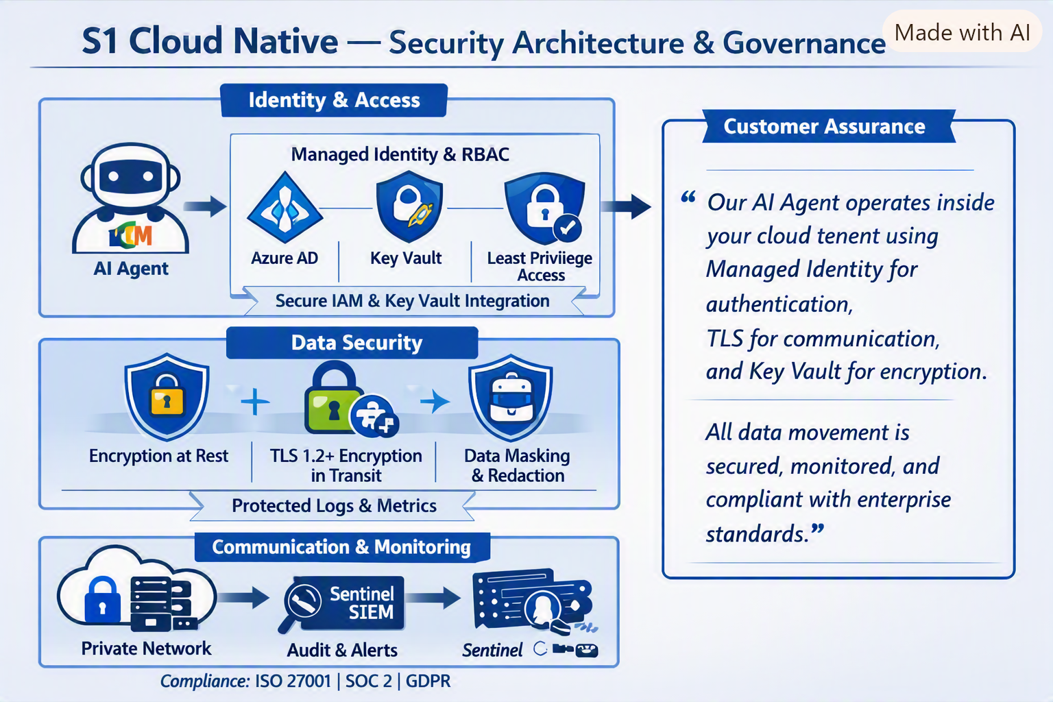
🧩 Slide Title
S1 Cloud Native — Security Architecture & Governance
🔐 Visual Layout Structure
Top Section — Identity & Access
  Icons: Azure Entra ID (Azure AD), Managed Identity, Key Vault.
  Flow:
    AI Agent (Python LLM) → Authenticates via Managed Identity → Authorized by RBAC (Log Analytics Reader).
    Key Vault integration for secret retrieval (no stored credentials).
  Caption: “Customer‑controlled Managed Identity ensures secure authentication and governance.”
Middle Section — Data Security
  Icons: Storage Encryption, TLS Lock, Data Masking.
  Flow:
    Logs and metrics encrypted at rest (Key Vault keys).
    TLS 1.2+ for all API calls between AI Agent, Log Analytics, and ServiceNow.
    Sensitive fields redacted before LLM processing.
  Caption: “End‑to‑end data protection across observability and ticketing flows.”
Bottom Section — Communication & Audit
  Icons: Private Endpoint, Sentinel SIEM, Audit Trail.
  Flow:
    Private network communication within same tenant.
    Sentinel monitors agent activity and auto‑ticket events.
    Compliance alignment (ISO 27001, SOC 2, GDPR).
  Caption: “All actions authenticated, authorized, and monitored for audit and compliance.”
Right Sidebar — Customer Assurance
  Quote‑style text:
  “Our AI agent operates inside your cloud tenant using Managed Identity for authentication, TLS for communication, and Key Vault for encryption. All data movement is secured, monitored, and compliant with enterprise standards.”

Slide 22
Once AI agent is deployed, you can prove its security posture and operational integrity using Azure Sentinel and Key Vault governance visuals.
Use a simple query to demonstrate that every log fetch and auto‑ticket action is monitored:
AzureActivity
| where Caller == "AI-Agent-ManagedIdentity"
| where OperationNameValue in ("ReadLogs", "CreateTicket")
| project TimeGenerated, Caller, OperationNameValue, ResourceGroup, Status
| order by TimeGenerated desc
Purpose:
Shows authenticated actions by the Managed Identity.
Confirms that only approved operations (log read, ticket create) occurred.
Provides audit trail for compliance and customer assurance.
AI agent authenticates via Managed Identity.
Key Vault issues a token only for Get Secret — no write/delete.
Customer admin retains full control of policies.
Sentinel ingests Key Vault audit logs to detect anomalies (e.g., agent requesting secrets outside scope).
2️⃣ Key Vault Access Policy Diagram
Visualize how secrets are protected and accessed:
AI Agent Managed Identity → “Get Secret” permission only.
Customer Security Admin → “List Keys” + “Set Policy.”
Azure Monitor Service → “Read Logs” permission.
Sentinel SIEM → “Audit Access” permission.

Slide 23
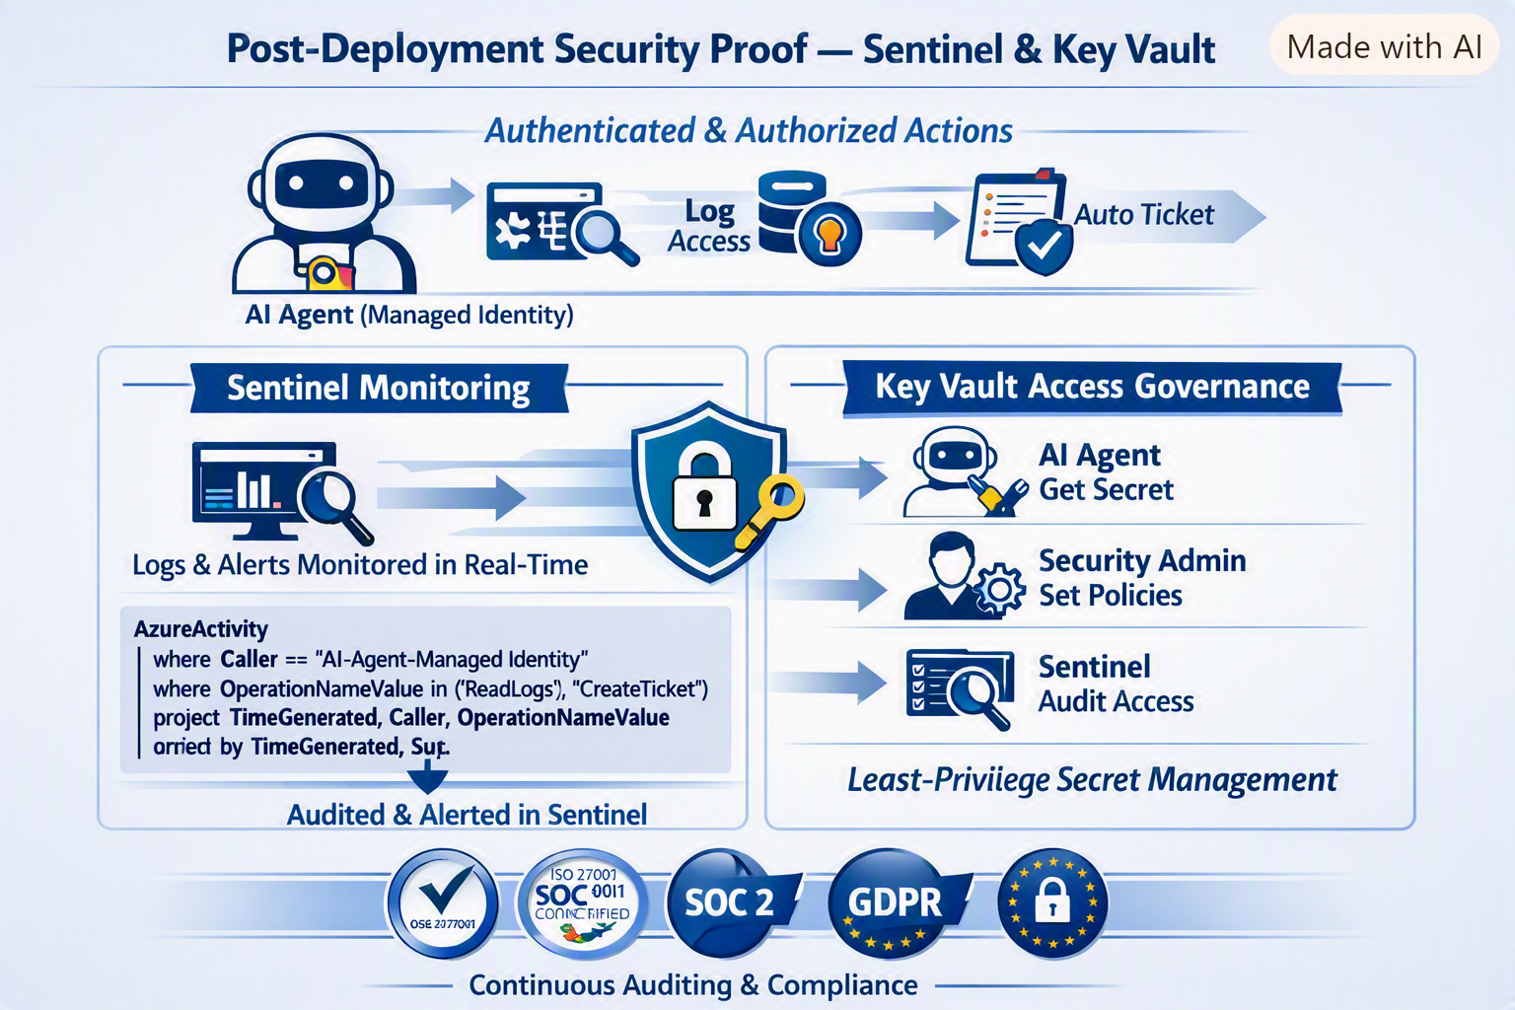

Slide 24
🧩 S2 Cloud Native — VNet Peering Security Model
Layer | Description | Azure Component
Network Isolation | Deploy AI agent in a new VNet (Solution VNet) separate from production. | Azure Virtual Network
Secure Connectivity | Establish VNet Peering between Solution VNet and Production VNet. | VNet Peering
Controlled Access | Restrict traffic using NSGs and Route Tables — only allow log/metric ports. | Network Security Groups
Identity & Access | Continue using Managed Identity + RBAC for authentication and authorization. | Entra ID (Azure AD)
Data Protection | TLS 1.2+ for all traffic; Key Vault for secret management. | Key Vault + Private Endpoints
Monitoring & Audit | Sentinel SIEM tracks all cross‑VNet activity. | Microsoft Sentinel

