Slide 1
Process Mining
Multi-Source Root-Cause Analysis | From scattered logs to a diagnosed incident - with the proven fix.
Notes:
When production breaks, the answer is usually already in the logs - just scattered across systems no one watches. This platform assembles it automatically.

Slide 2
The Problem
Clues scattered across Appian, Mule, infrastructure - no single tool sees the whole picture
3-4 teams spend hours manually correlating dashboards
'How we fixed it last time' lives in people's heads
Result: slow MTTR, repeated firefighting, tribal knowledge
Notes:
Relatable example: a credit-check outage where each system shows only a fragment.

Slide 3
The Solution
Scattered logs in -> one diagnosed incident with the root cause, the proven fix, and a ready ServiceNow ticket out
Ingests all sources
Correlates related problems into ONE incident
Diagnoses the root cause across layers
Recommends & files the fix; remembers how it was resolved
Notes:
This is the elevator pitch. Pause here.

Slide 4
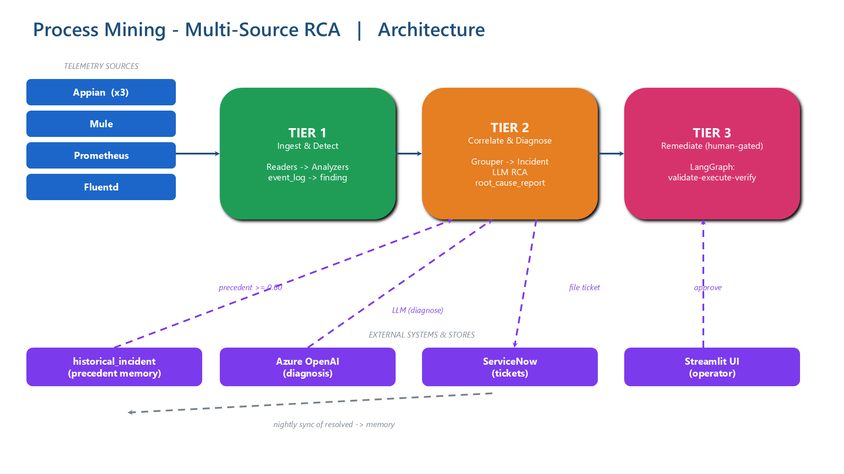
Architecture
Notes:
Walk left to right: sources -> ingest/detect -> correlate/diagnose -> remediate. Two feedback loops: ServiceNow precedent in, approvals from the UI.

Slide 5
How It Works - 6 Steps
1. Ingest - all sources into one store
2. Detect - flag problems per source (rule-based)
3. Correlate - group into ONE incident, across systems
4. Diagnose - AI root cause (Mule + infra + past incidents)
5. Act - recommend fix + file ServiceNow ticket
6. Learn - resolved ticket becomes precedent
Notes:
Emphasize 3 (the engine) and 6 (compounding value).

Slide 6
Mule Pinpoints WHERE It Failed
Appian / infra see THAT it is unhealthy; Mule sees WHERE
SocketTimeout -> the downstream service did not respond
flow.error before any call -> Mule itself
Turns 'integration unhealthy' into 'credit-bureau is down - page them, do not retry our side'
Notes:
Diagnosis shifts from probable to definitive.

Slide 7
Institutional Memory (Precedent)
Finds similar PAST incidents + their fixes, scored by confidence
e.g. INC0009999 - credit-bureau-prod - 98% - 'paged vendor, restarted gateway'
Threshold: >= 0.60 confidence to surface; stays silent when unsure
Recommends an action based on the proven fix, citing the ticket
Notes:
Gets smarter every time. Confidence + silence-when-unsure = trust.

Slide 8
Remediation - Human in the Loop
AI recommends; a human approves in the UI
Approved fixes run a workflow: validate -> execute -> verify -> report
Allow-list gates commands; progress posted to the ServiceNow ticket
Never auto-remediates without approval
Notes:
Stress safety: deterministic gate + human approval + verify.

Slide 9
Live Demo - Real Data, End to End
188 events from 6 sources
-> 10 findings -> 3 incidents
-> cross-pillar root cause (Appian + Mule + Prometheus + Fluentd in ONE incident)
-> matching precedent at 98%, recommended fix, auto-ticketed
Notes:
Real numbers from the actual pipeline, not a mockup.

Slide 10
The Value
Faster MTTR - minutes, not hours
Right team, right fix - downstream vs our side
Institutional memory - proven fixes reused, confidence-scored
Trustworthy - cites evidence; silent when unsure; human-gated
Notes:
Tie each row to a moment they saw in the demo.

Slide 11
Why It Is Trustworthy
Detection & correlation are deterministic - not the AI guessing
The AI only narrates given evidence; cites real ticket numbers
Honest confidence - cautious with one pillar, confident when layers agree
No precedent below 60%; no remediation without approval
Notes:
Pre-empt the 'is the AI hallucinating?' question.

Slide 12
Roadmap
Real-time streaming connectors (live Anypoint / Appian)
Embedding-based precedent reranking (semantic match)
Native ServiceNow approval workflow
Desktop-activity pillar (Soroco / ActivTrak)
Notes:
More pillars = higher confidence; this is where it grows.

Slide 13
Thank You
Logs in -> diagnosed incident, proven fix, ready ticket - getting smarter every time.
Notes:
Close on the one-liner. Offer to show the live UI.

