Slide 1
Ilista A MADT 6114 Project
Dogukan Karayilanoglu C0755495
Rosette Lopez Pardillo C0768425

Slide 2
overview
ILISTA application is a simple note application implemented using react
There may be several note applications available in Application stores but the sole purpose for this project is to showcase each members learnings on 6114 class
ILISTA has basic features which a note taking app has and will soon be upgraded for the Capstone project
The team has chosen to implement a note taking application because we can conclude that we have acquired the fundamentals of the technology if we can implement a note application. A note application although may appear to be simple but it is full packed with functionalities to support such as event handlers, list manipulation, applying CRUD, object oriented, Et al.

Slide 3
ILISTA features
NOTE DISPLAY
The home page, or main page shows all the list of notes created by the user.
ADDING OF NOTES
A button is available for user to add a new note. Upon adding, user will be navigated to another page where the user can input title and contents of notes
UPDATING OF NOTES
The user will have the option to modify existing notes from his/her list
DELETING OF NOTES
The user has the option to delete a note from the note list.

Slide 4


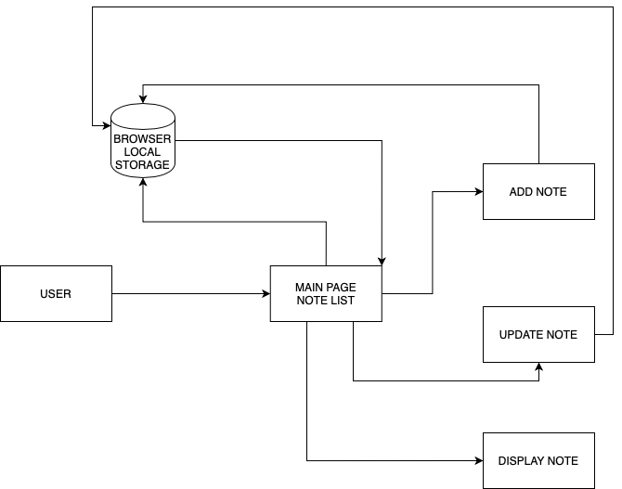
UML

Slide 5
OBJECT DIAGRAM

Slide 6
Live Long & Prosper

