Slide 1
Week 5 : Create graphical display (practice objects and basic data types)

Slide 2
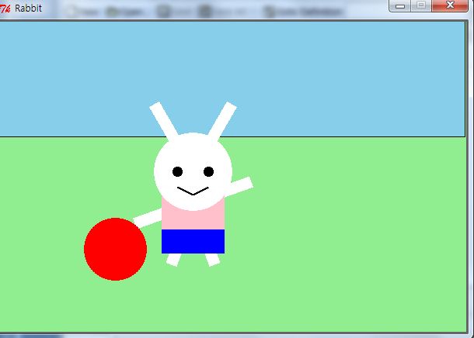
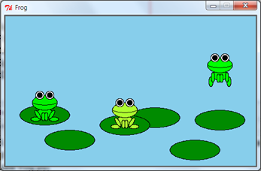
Today’s Topic
Playing with graphics objects
  Canvas
  Drawable Objects
  Operations on Drawable Objects
  Layer
  Animation
Help function

Slide 3
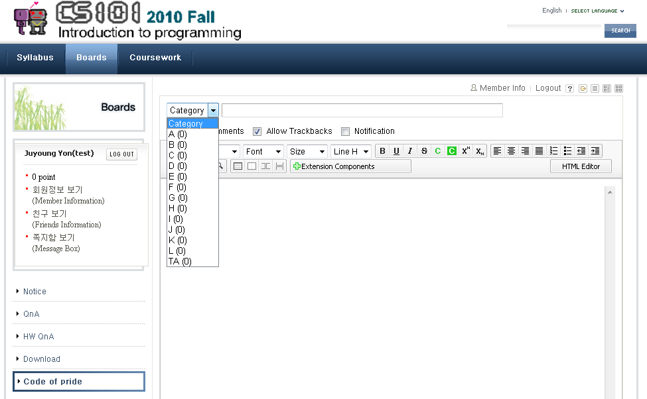
Practices
Animal Animation
  After you finish, upload your file on the CS101 webpage.
  On the “Code of pride” board (자랑질 게시판)
Help!
Select your section

Slide 4
Task | Animal Animation
Implement a function ‘draw_animal’ that draws an animal of your choice.
  Your animal should be drawn on a layer
  You must be able to move the entire animal by only moving the layer.
  The animal must also have some moving parts, such as legs, wings, or flippers.
Write functions to change the position of these moving parts.
Write a function ‘show_animation’ that shows an animation of your animal.
  It should move around and its moving parts should be moving.
You can choose others if it has some moving parts.
  Ex) Cartoon character, Car, Airplane

Slide 5
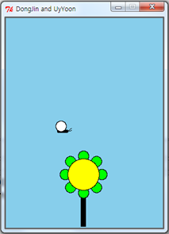
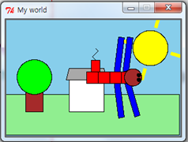
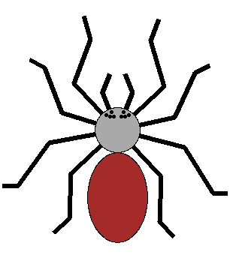
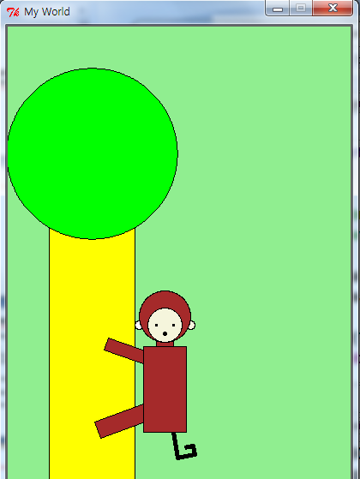
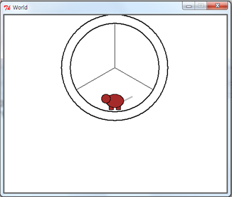
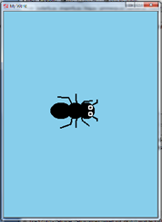
Examples

Slide 6
Tips
After you choose an animal, simplify it and decide moving parts.
When you decide moving parts, think about the functions you can use.
Be Creative!
Not Recommended:
  Make more than 2 animals (If you have a lot of time, it will be okay.)
  Choose an animal which it is hard to simplify
    Ex) Hedgehog (고슴도치), Specific person or job (a figure skater)
  Implement too simple thing.

Slide 7
Useful cs1graphics Functions
Objects
  Canvas, Layer
  Circle, Ellipse, Square, Rectangle, Polygon, Path, Text, …
Object methods
  Color
    setBorderColor, setFillColor
  Move
    move, moveTo
  Depth
    setDepth
  Others
    rotate, scale, flip
  Reference Point
    getReferencePoint, adjustReference

Slide 8
Task | Help!
There are hundreds of pre-defined functions.
How can programmer remember everything?
  It’s impossible. We can ask for help!
Function help()
  Try help(‘print’)
  Try help(‘math.sin’)

Slide 9
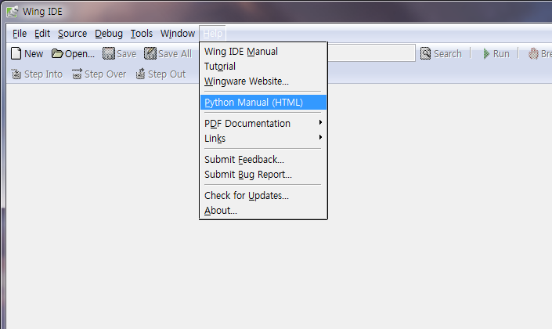
Help-system in Wing IDE

Slide 10
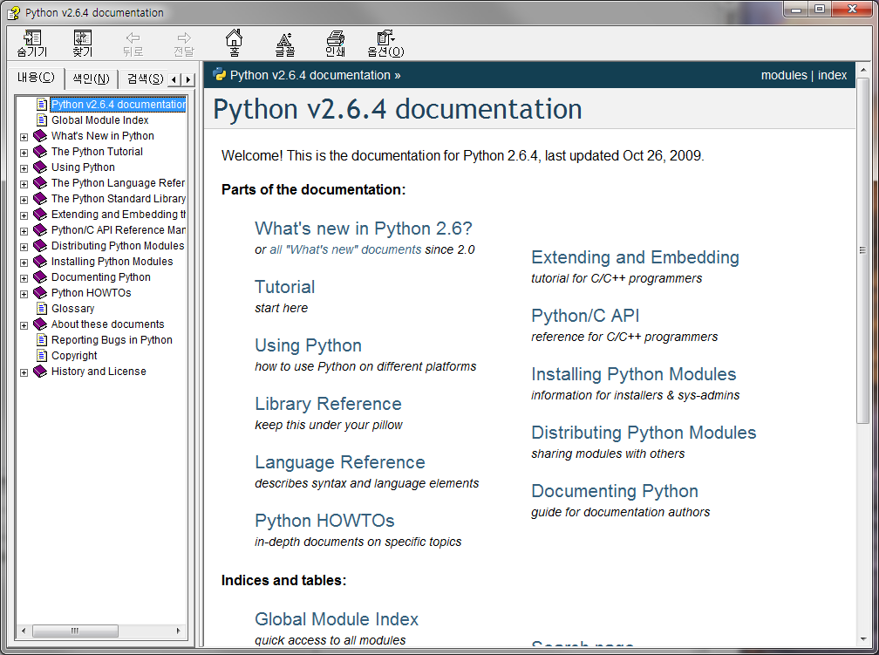

Help-system in Wing IDE

Slide 11
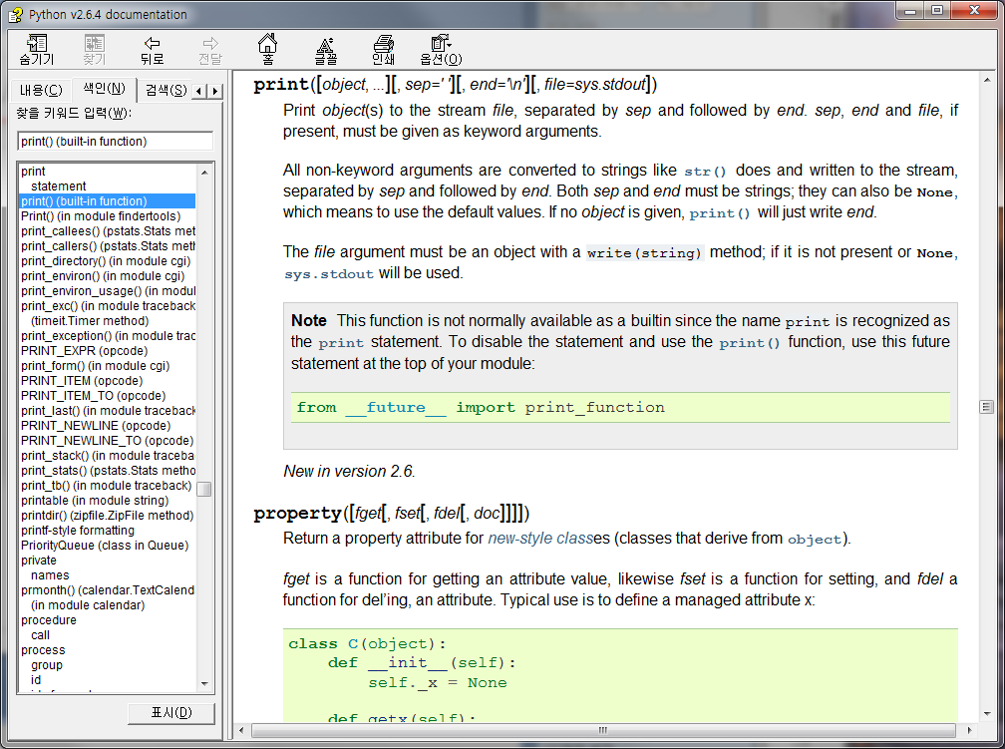
Help-system in Wing IDE
1. Click ‘Index’
2. Type function
name
3. Choose function
4. Try ‘log’
& ‘random’

Slide 12
Help-system for modules
We can also use ‘help function’ for special modules.
Try!
  cs1robots
    help(‘cs1robots’)
    help(‘cs1robots.Robot’)
    help(‘cs1robots.Robot.turn_left’)
    help(‘cs1robots.create_world’)
  cs1graphics
    help(‘cs1graphics.Ellipse’)
    help(‘cs1graphics.Color’)
    help(‘cs1graphics.Text’)
    help(‘cs1graphics.Square.rotate’)

Slide 13
Be Creative!

