Slide 1
Week 6 : Sequences: lists, strings, and tuples

Slide 2
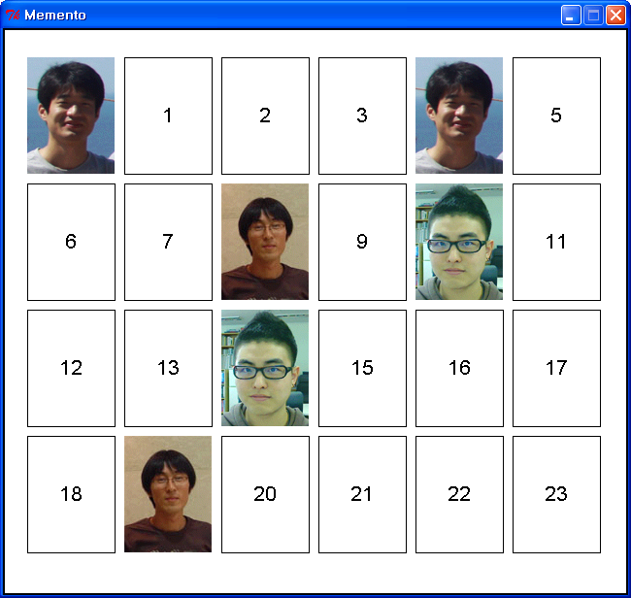
Today’s topic
Today we’ll make a Memory test game, “Memento”
Python shell
### Welcome to the Python Memento game!!! ###
1st try. You got 0 pairs.
Input the first card number : 0
Input the second card number : 4
Correct!
2nd try. You got 1 pairs.
Input the first card number : 10
Input the second card number : 19
Wrong..........
3rd try. You got 1 pairs.
Input the first card number : 8
Input the second card number : 19
Correct!
4th try. You got 2 pairs.
Input the first card number : 10
Input the second card number : 14
Correct!
……. Game goes on ………

Slide 3
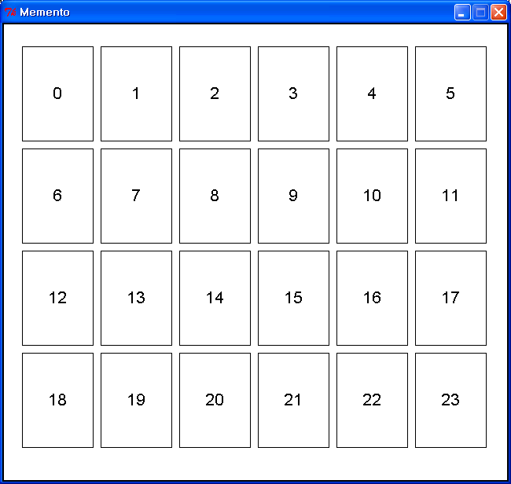
The flow of the Memento game
There are 24 number pads at first time.
The user have to input 2 card numbers.
The screen shows two pictures you indicated
If the card numbers(indices) indicate the
same picture,
then show “Correct!” message and add
2 numbers to correct number list, and
show all the picture pairs which you have
founded.
If not, show “Wrong……” message and
return the screens before.
The game finishes when all pairs are
founded.
>>> [evaluate memento.py]
### Welcome to the Python Memento game!!! ###
1st try. You got 0 pairs.
Input the first card number :

Slide 4
Let’s make the game! - Initialization
All images should be copied in “C:/CS101/images/”
  Only absolute address works in ‘cs1graphics.Image’
Make the list of number pads
  The size of each rectangle should be (width = 90, height = 120)
  Make a layer and add a rectangle and a number.
Use random library to shuffle all the cards.
  Import random
  random.shuffle()

Slide 5
Let’s make the game! – Main loop
Use while-loops & its appropriate condition
  Print messages and get two numbers using get_numbers() function
  Search the numbers in the correct_list
  Show the appropriate screen using print_card() function

Slide 6
Let’s make the game! – functions
get_numbers()
  print message “n-th try. You got N pairs”
    Add –st,-nd,-rd to 1,2,3 and –th to numbers after 4
  should check a number is in range or not.
print_card()
  Print 6 x 4 card array using number pads and cards list.
  Use tuple element in cards list to visualize the picture according to its name(or index number).
Image | Image | Image | Image | Image | Image | Image | Image | Image | Image
name | name | name | name | name | name | name | name | name | name

Slide 7
Rock and Roll!

