Slide 1
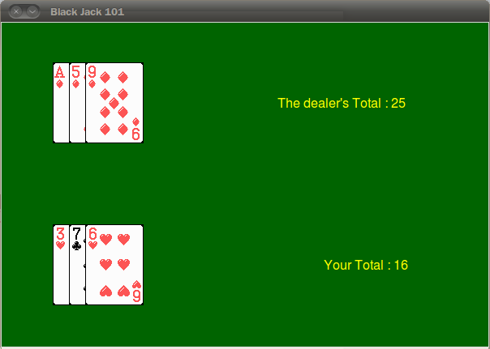
Week 8 : User-Defined Objects
(Simple BlackJack Game)

Slide 2
Today’s Task
Memento2 based on user-defined object
  Rewrite a code using user-defined object instead of List
Simple Black Jack
  Refer to lecture note for week 9
  Rules of Black Jack
    Winner is either a player or a dealer who has as high a score as possible without going over 21.
Download the lab8.zip from Download board and decompress it to the C:/cs101/

Slide 3





Task 1: memento2
Download memento_template.py from the Download board
  Rewrite a code using user-defined object instead of List
List
The list “cards”
....
before
Hyungkyu.jpg
Jinki.jpg
Juyoung.jpg
YeongJae.jpg
True
True
True
True
False
The list “cards”
class Card:
…
card = Card()
card.img = Image(..)
card.name = …
card.state = …
class Card:
…
card = Card()
card.img = Image(..)
card.name = …
card.state = …
class Card:
…
card = Card()
card.img = Image(..)
card.name = …
card.state = …
....
after

Slide 4
Task 2 | Black Jack
Download bj_template.py from the Download board
Understand the main() function
Have to define Card class
  It has 5 attributes that are suit,face,value,img and state
    suit : suit name
    face : face name
    value : the value of cards
    img : image object for graphic
    State : whether to be hidden or not (True/False)
Implement the following functions
  create_deck()
  hand_value(hand)
  card_string(card)
  ask_yesno(prompt)
  draw_card(dealer,player)

Slide 5
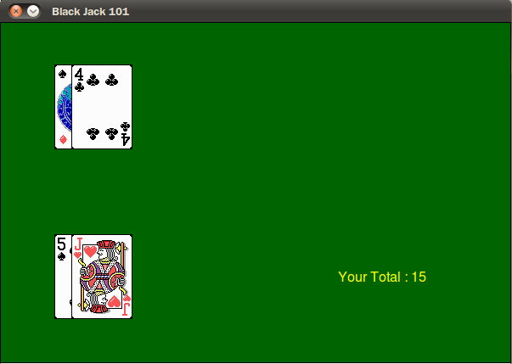
A run of the game(Example)
Welcome to Black Jack 101!
You are dealt a 5 of Spades
Dealer is dealt a hidden card
You are dealt a Jack of Hearts
Dealer is dealt a 4 of Clubs
Your total is 15
Initial prompt
Initial two drawers
Dealer
A Hidden Card
Player

Slide 6
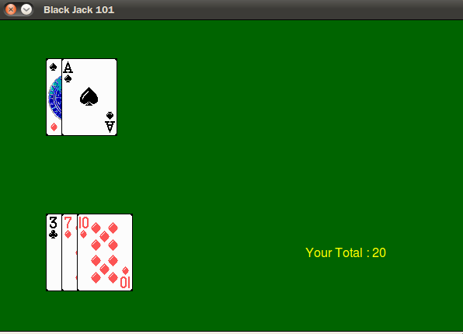
A run of the game(Example)
Would you like another card? (y/n) ne
I beg your pardon!
Would you like another card? (y/n) y
You are dealt an Ace of Diamonds
Your total is 20
Would you like another card? (y/n) n
Report an error if your input
is not correct
Type “y” if you want to have another
card, otherwise type “n”

Slide 7
A run of the game(Example)
The dealer's hidden card was an Ace of Diamonds
Dealer is dealt a 9 of Diamonds
The dealer's total is 25
Your total is 16
The dealer's total is 25
The dealer went over 21! You win!
Play another round? (y/n) n
When your turn is finished,
the dealer draws until the
score reached 17.
Show your scores and decide who wins.
The game should go on unless typed “n”

Slide 8
Any Questions?

