Slide 1
Week 9 : Text processing
(Reading and writing files)

Slide 2
Today’s Tasks
Task 1 – Handle coordinate information from a file
Task 2 – Handle temperature information from a file
Task 3 – Extract some parts from an HTML source

Slide 3
Task 1 (1/2)
Handle countries’ (center) coordinate information
  4 sub-tasks.
1-1. Read and print data from the file ‘average-latitude-longitude-countries.csv’
  Each line (except for the head) contains country code, country name, latitude and longitude, which are comma-separated
    e.g.) "KR","Korea, Republic of",37,127.5
    -90.0° ≤ latitude ≤ 90.0 °, -180.0 ° ≤ longitude ≤ 180.0 °
    Caution: Several country names contain comma
  Make two lists and print them
    List of tuples ( country code, country name )
    List of tuples ( country code, (latitude, longitude) )
    Strip double quotation marks (“”) from both sides of a string
1-2. Print the names of all countries whose location lies south of the equator

Slide 4
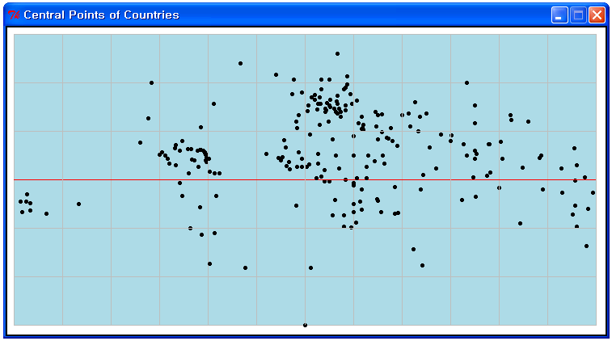
Task 1 (2/2)
1-3. Let the user enter a country code, and then print the full name of corresponding country.
1-4. Plot all central points on a rectangular ‘map’
  You can use ‘t1_4_plot_coutries_template.py’
Put longitude 0 at horizontal center

Slide 5
Task 2 (1/2)
Handle England’s monthly temperature information for the years 1723~1970
  2 sub-tasks
2-1. Read the data and print average winter and summer temperatures for each year
  Winter average = ( January’s + February’s ) / 2
  Summer average = ( July’s + August’s ) / 2
  Print every year and summer and winter average temperatures in a nicely formatted table
    e.g.)
…
1737: 5.2/15.6
1738: 4.6/16.2
1739: 5.4/15.4
1740: -2.2/15.0
1741: 3.1/16.1
1742: 2.8/15.8
1743: 4.5/15.9
…

Slide 6
Task 2 (2/2)
2-2. Write the contents in another format
  To the file ‘C:/CS101/tpmon.csv’
  Each year and its 12 monthly averages in one line
  write in CSV format (i.e. comma-separate the data)
  Try to open the file in Excel
1723,1.1,4.4,7.5,8.9,11.7,15.0,15.3,15.6,13.3,11.1,7.5,5.8
1724,5.6,4.2,4.7,7.2,11.4,15.3,15.0,16.2,14.4,8.6,5.3,3.3
1725,4.4,3.3,5.0,8.1,10.8,12.2,13.8,13.3,12.8,9.4,6.9,3.9
1726,1.1,4.2,4.2,8.4,13.4,16.4,16.0,15.6,14.7,10.2,6.1,1.8
1727,4.2,5.0,5.1,9.2,13.6,14.9,16.9,16.9,14.4,10.8,4.7,3.6
1728,3.9,2.4,7.1,8.3,12.5,16.4,16.9,16.0,12.8,9.1,7.2,1.6
1729,1.2,2.3,2.8,7.1,10.3,15.1,16.8,15.7,16.6,10.1,8.1,5.0
1730,4.1,4.7,6.2,8.7,12.4,14.0,15.3,16.3,15.3,10.9,9.2,3.4
1731,1.9,2.2,6.0,6.8,12.1,15.6,16.3,16.7,15.3,12.3,7.8,5.2
1732,2.4,6.4,6.1,8.9,11.4,14.6,16.0,16.6,14.5,10.9,6.3,2.2
1733,6.9,6.0,5.9,10.0,11.2,15.2,18.3,16.1,12.8,9.1,6.5,7.6
1734,4.3,6.4,8.1,9.3,11.1,14.1,16.2,16.2,13.3,8.4,6.2,4.0
…
…

Slide 7
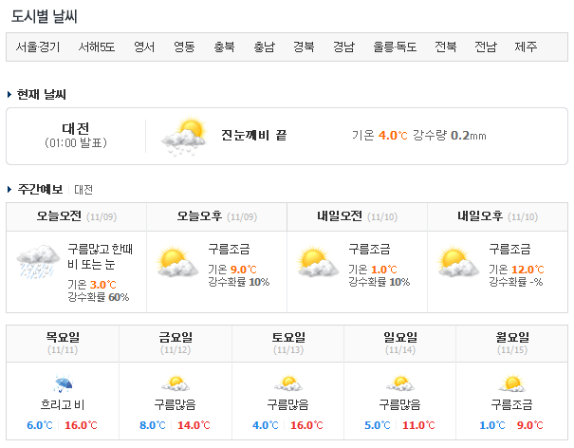
Task 3 (1/2)
Extract date and temperature information from an HTML source
  Run ‘get_weather.py’ to get an HTML source from an URL
    Open the HTML file in an web browser. Then it will show you …

Slide 8
Task 3 (2/2)
  Extract date and temperature information from the HTML source
    Note that HTML source is a text file that contains such information
  Print the information in a nicely formatted table
    e.g.)
… …
<th >목요일<br><span>(11/11)</span></th>
<th >금요일<br><span>(11/12)</span></th>
<th >토요일<br><span>(11/13)</span></th>
<th >일요일<br><span>(11/14)</span></th>
<th class="line">월요일<br><span>(11/15)</span></th>
… …
11/11 : 6.0 ~ 16.0
11/12 : 8.0 ~ 14.0
11/13 : 4.0 ~ 16.0
11/14 : 5.0 ~ 11.0
11/15 : 1.0 ~ 9.0

Slide 9
Any Questions?

