Slide 1
Week 10 : Practice Everything!

Slide 2
Today’s Tasks
‘Burger K’ manager program
Download the lab10.zip from Download board and decompress it to the C:/cs101/

Slide 3
Burger K (1/3)
Download BKmanager.py and BurgerK.py from the Download board
Have to implement Food, Order classes
  Food class has 3 attributes:
    menu - String
    price – Integer
    stock - Integer (-1 means infinity)
  Food class has constructor and string converter
  Order class has 2 attributes
    foods – list of Food objects
    pocket_money - Integer
  Order class has constructor and string converter

Slide 4
Burger K (2/3)
Have to implement BurgerKManager class
  Attributes
    menu_canvas, order_canvas – cs1graphics.Canvas object
    menu_text, order_text – cs1graphics.Text object
    foods – list of Food object
    tackings - Integer
  Constructor
    – Create Food objects from the files
  String Converter
    – Show (menu, price, and stock) or plus (tackings)
  check_out
    – Save menu, price, remaining stocks and today’s tackings to the file.
  take_an_order
  refresh
  close

Slide 5
Burger K (3/3)
take_an_order(self, order) method
If there is the wrong menu, then indicate it.
If some menu is sold out, then indicate it.
If customer has lack of money, then indicate it.
If there is no problem, then show the result.
Whenever changing the order_text, use order_canvas.wait()
make_orders(input_str, is_file=True) method
If is_file is True, then input_str is file_path
  Open the file, create Order objects, and make the list
  File format: ‘CHEESE BURGER\tCORN SALAD\tSPRITE\t10000’
If is_file is False, then input_str is menus and pocket money
  String format: ‘cheese burger,corn salad,sprite,10000’

Slide 6
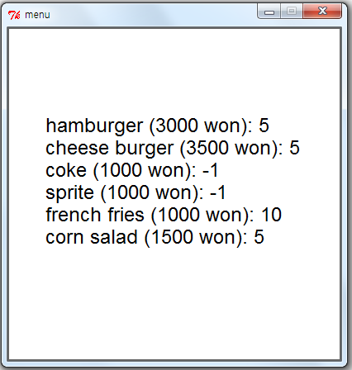
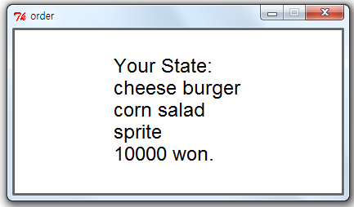
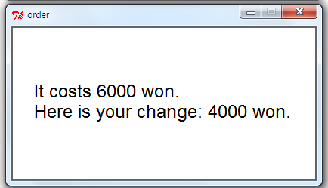
A run of the program(Example)
Do you want to finish this program?n
Do you have the list of orders?y
Enter the file name of orders: order1.txt
order1.txt
CHEESE BURGER CORN SALAD SPRITE 10000
CHEESE BURGER FRENCH FRIES COKE 7000
CHEESE BURGER SPRITE FRENCH FRIES ICECREAM 10000
CHEESE BURGER FRENCH FRIES SPRITE 7000

Slide 7
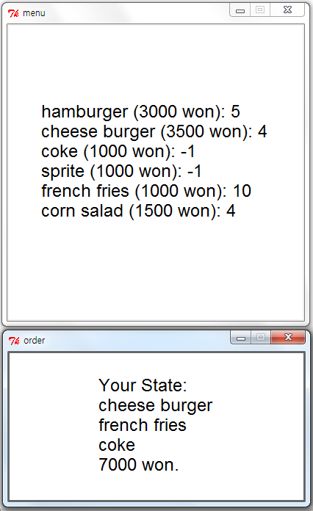
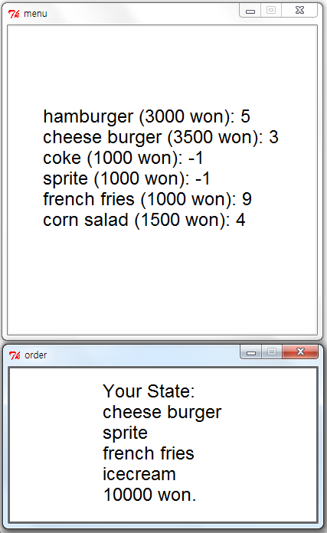
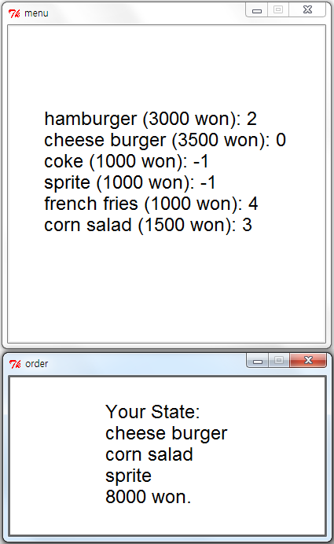
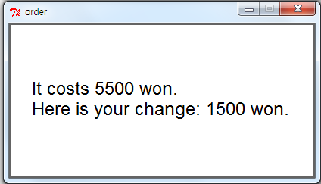
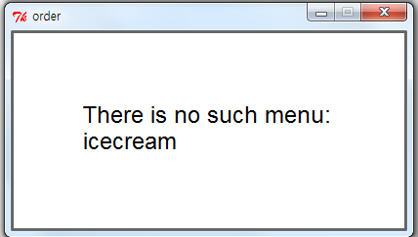
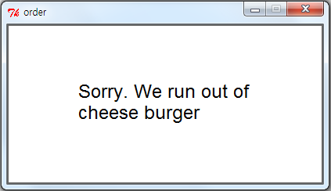
A run of the program(Example)

Slide 8
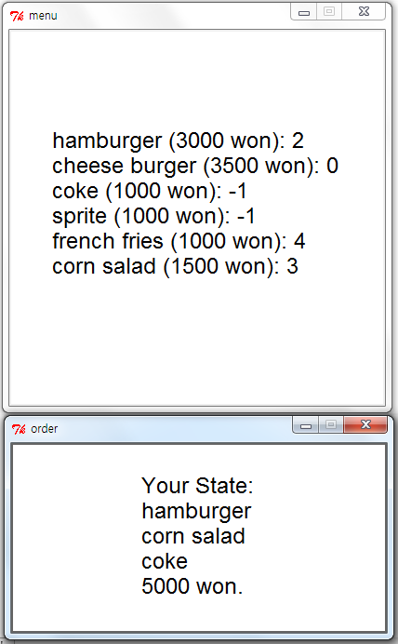
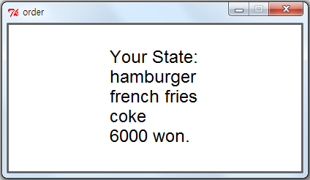
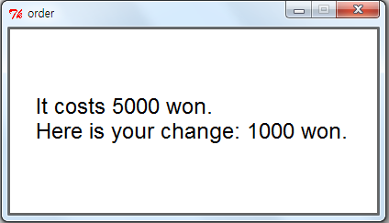
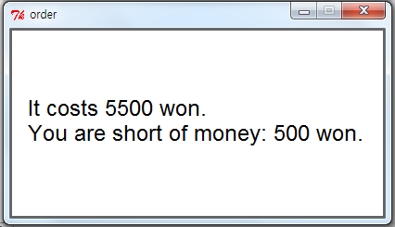
A run of the program(Example)
Do you want to finish this program?n
Do you have the list of orders?n
What do you want to order?hamburger,french fries,coke
How much money do you have?6000
Do you want to finish this program?y
------------< Today's total >--------------
hamburger (3000 won): 1
cheese burger (3500 won): 0
coke (1000 won): -1
sprite (1000 won): -1
french fries (1000 won): 3
corn salad (1500 won): 3
Today's takings: 97000
You can see this result also in the output file.

Slide 9
Any Questions?

