Slide 1

Function + Module + Class & Regular expression Python хэлний үндэс
Py4Econ
UB, 2021

Slide 2
Week 3: Learning objectives
Functions
Module (+search path)
Class (Objected Oriented Programming or OOP)
Regex
Additional
One-liner & lambda
Exception handling
Debugging

Slide 3
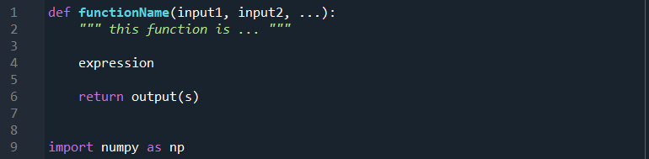
Function
Not to repeat one action again and again, we use functions in any scientific field

Slide 4
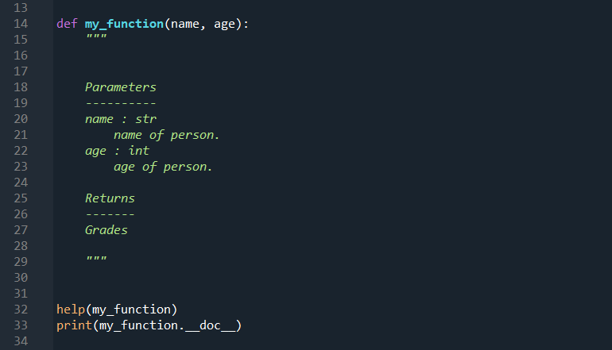
Documenting a function is crucial!
Prototype of docstring

Slide 5
Documenting a function is crucial!
Prototype of docstring

Slide 6
Function arguments
Positional (“input”) and Default (“input=value”) arguments
Optional (arbitrary) arguments - *args, **kwargs

Slide 7
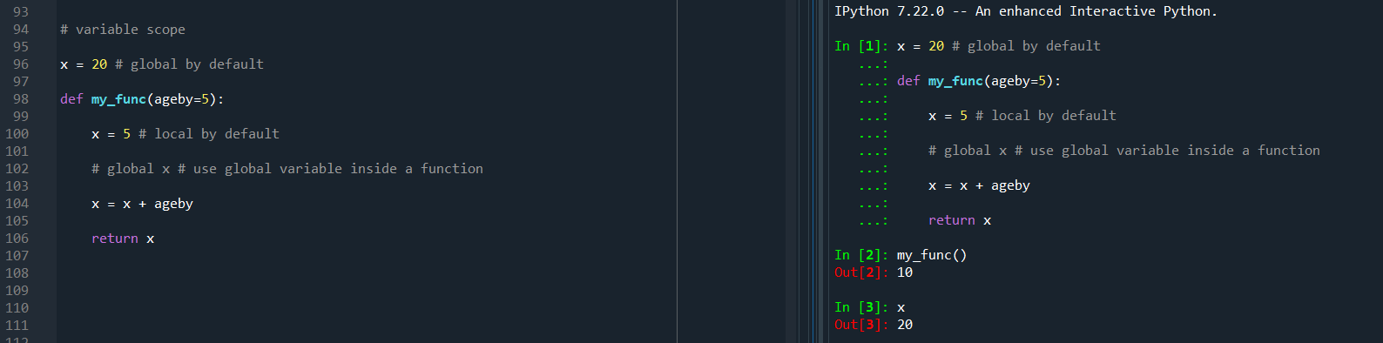
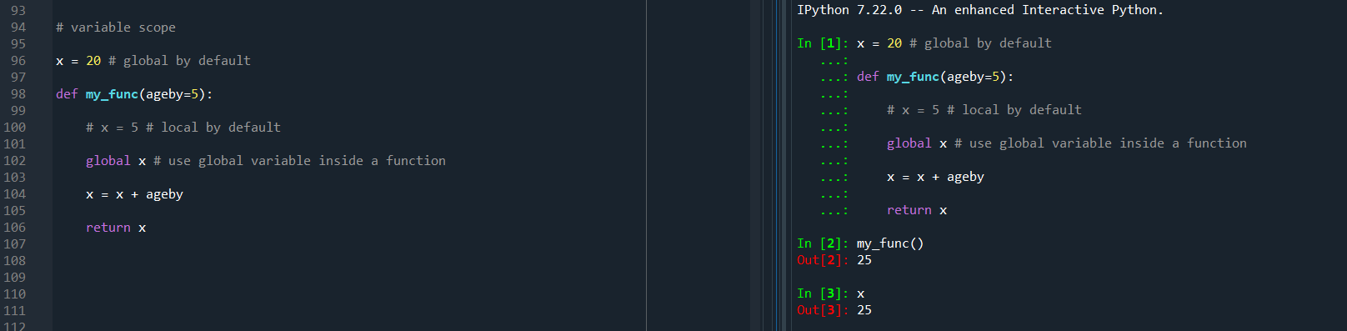
Scope of variable

Slide 8
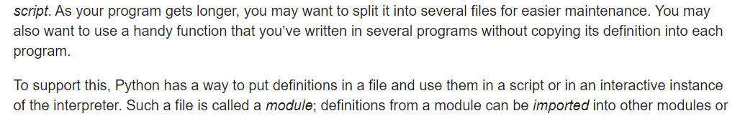
Module

Slide 9
Class – OOP philosophy
Important concepts:
Object (instance)
Method
Instantiation of object
Inheritance (super, child classes)
Setters and getters
Variable accessibility – Public/Private/Protected

Slide 10
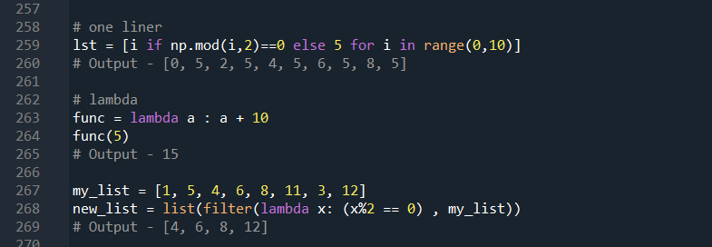
One liner and Lambda
Helpful for writing concise codes

Slide 11
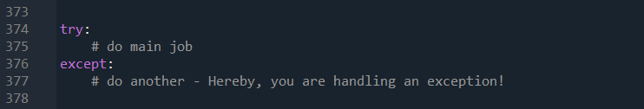
Exception handling
Exceptions occur from time to time in any sort of job. If you know what kind of errors could occur beforehand and implement “remedy(ies)” on it, it might save your life!

Slide 12
Debugging
VScode
Continue, step over, step into, step out
Break – expression, hit count, log message
Watch
Exceptions
pdb module
import pdb, pdb.set_trace()
Notes:
chrome-extension://efaidnbmnnnibpcajpcglclefindmkaj/viewer.html?pdfurl=https%3A%2F%2Fappletree.or.kr%2Fquick_reference_cards%2FPython%2FPython%2520Debugger%2520Cheatsheet.pdf&clen=171855&chunk=true

Slide 13
Regular expressions
Search “pattern” from text and do an action
Package “re”:
compile
findall – find all matches
match – match at the beginning of string
search – first match anywhere in string
split – split string into pieces at pattern points
sub – replace match by user input
group –
special characters

Slide 14
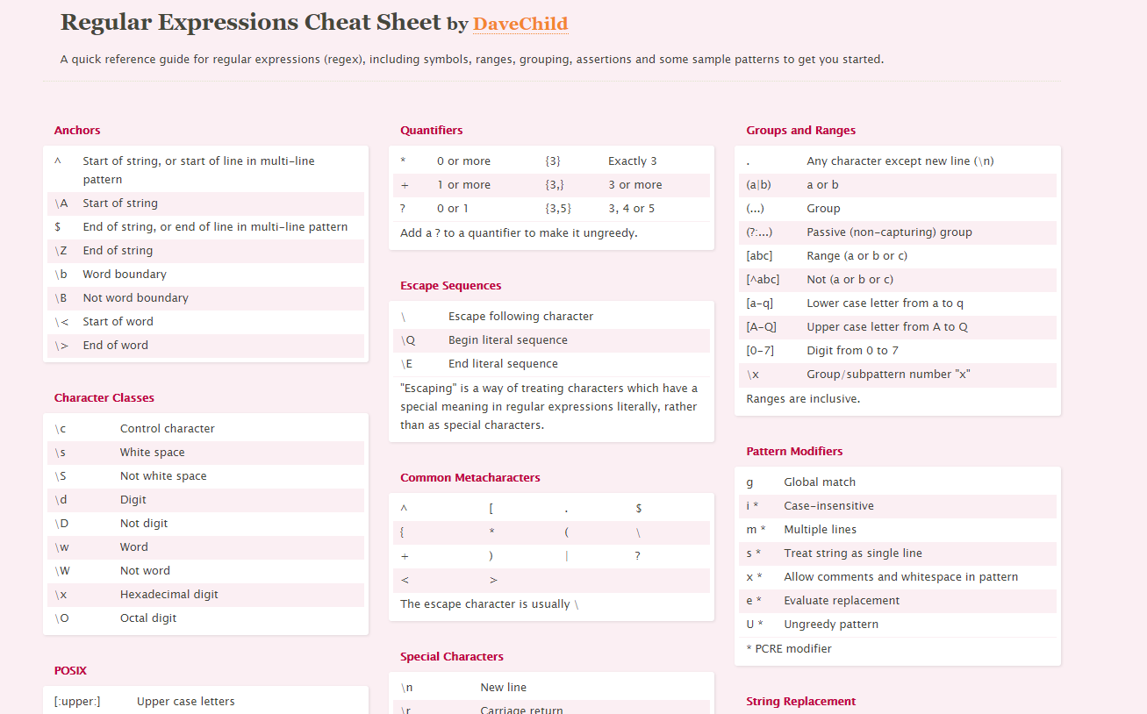
Regular expressions
Notes:
https://cheatography.com/davechild/cheat-sheets/regular-expressions/
https://www.rexegg.com/regex-lookarounds.html
https://www.dataquest.io/blog/regex-cheatsheet/
https://regex101.com/

Slide 15
Reading - Why is “class” useful?
https://stackoverflow.com/questions/33072570/when-should-i-be-using-classes-in-python - See most upvoted answer by dantiston

Slide 16
Homework Deadline: 28 Nov, 2021

Slide 17
Task 1 – Function arguments
Jupyter notebook дээр зөвхөн args, зөвхөн args=value, зөвхөн *args, зөвхөн **kwargs аргументуудтай (4 тусдаа функц) болон эдгээрийн холимог (2 функц) байгуулж, ажиллуулж үзүүл. Нийт 6 функц.

Slide 18
Task 2 - Class
Create a bank deposit class which you can withdraw money from, deposit and check the balance
Show on Jupyter notebook how it works
Examples:
https://www.engineeringbigdata.com/python-atm-code-for-account-balance-withdraw-and-deposit-functions/
https://www.geeksforgeeks.org/python-program-to-create-bankaccount-class-with-deposit-withdraw-function/
https://www.vtupulse.com/python-programs/python-program-using-classes-and-objects-to-deposit-and-withdraw-money-in-a-bank-account/
Tkinter GUI - https://www.youtube.com/watch?v=SF-enJWjekY&list=PLtMugc7g4GapTtbhzODIjw7FJK-xJEBEE&index=16
Notes:
https://www.engineeringbigdata.com/python-atm-code-for-account-balance-withdraw-and-deposit-functions/
https://www.geeksforgeeks.org/python-program-to-create-bankaccount-class-with-deposit-withdraw-function/
https://www.vtupulse.com/python-programs/python-program-using-classes-and-objects-to-deposit-and-withdraw-money-in-a-bank-account/

Slide 19
Task 3 - Exception
Generate array of 1000 random integers in numpy and create an array with only the negative even numbers.
Loop one by one through this array …
… when negative & odd, then raise “odd error” and continue to next loop,
… when even but positive, raise “sign error” and continue to next loop …
… when “negative even”, then append your list.

Slide 20
Task 4 - Debugging
Debugging гэж юу вэ?
Breakpoint – ийн ямар 3 төрөл (log message г.м) Vscode дээр байдаг вэ?
Debug-ийн step into, step over, stop out – ийн ялгааг тайлбарла.

Slide 21
Task 5 - Regex
Өөрөө зохиох эсвэл бэлэн текст интернетээс олж regex-ийн дараах үйлдлүүдийг ашиглан текстүүд гаргаж авах жишээнүүд үзүүл (нэг бүр дээр нь бус хамтад нь ашиглаж болно. Гэхдээ доорх бүх тэмдгээс ядаж 1 удаа ашиглаарай)
[a-zA-Z0-9], [a-z],[A-Z],[0-9]
\d, \D, \w, \W, \s
^, $, ?, *, +, .
{m,n}, {,n}, {m,}, {n}
Look behind, Look ahead, Negative look behind, Negative look ahead
Notes:
https://www.dataquest.io/blog/regex-cheatsheet/
https://www.rexegg.com/regex-lookarounds.html

Slide 22
Task 6 - Module
if __name__ == '__main__’:
do something
https://stackoverflow.com/questions/419163/what-does-if-name-main-do - See most upvoted answer by Mr Fooz
Даалгавар:
Өгсөн тоон list-ний нийлбэр, ялгавар, үржвэрийг олдог 3 тусдаа функц бүхий модуль файл үүсгэ.
Дээрх модульд “main” гэдэг функц нэм. Уг функц нь “жишээ” list-ний хувьд дээрх 3 функцийг ажиллуулан үр дүн гарч буйг хэвлэн гаргаж харуулдаг байна.
if __name__ == '__main__’: дотор main() функцийг ажиллуулна (do something-ийн оронд байршин)
python “yourModuleName”.py гэж terminal дээр уншуулахад гарах үр дүн юу вэ? (screenshot байхад болно)
Өөр файл дотроос “import yourModuleName” гэж импортлоход өмнөх хэсгийн үр дүнгүүд хэвлэгдэж гарахгүй байгаа. Яагаад?

