Slide 1
Chemical equilibrium

Slide 2


Reversible reactions
Not all reactions go to completion.
Oftentimes, reactions reach a state wherein the reverse reaction is more favorable than the forward reaction.
$$A+B→C+D$$
$$A+B⇌C+D$$

Slide 3

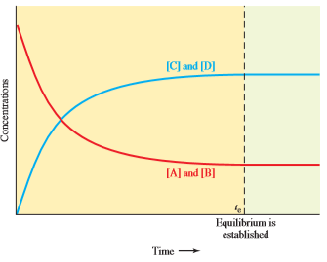
Kinetics of reversible reactions
The reactants will never be totally spent for a reversible reaction
What about for an irreversible reaction?

Slide 4

Reversible reactions
$$2{SO}_{2}+O_{2}⇌2{SO}_{3}$$
Consider the reversible reaction of sulfur dioxide with oxygen to form sulfur trioxide at 1500 K.
Suppose 0.400 mole of SO₂ and 0.200 mole of O₂ are injected into a closed 1.00-liter container. When equilibrium is established, we find that 0.056 mole of SO₃ has formed and that 0.344 mole of SO₂ and 0.172 mole of O₂ remain unreacted.

Slide 5
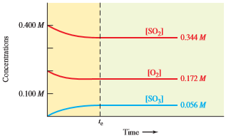
Concentration profile

Slide 6
Reversible reactions
$$2{SO}_{2}+O_{2}⇌2{SO}_{3}$$
In a similar experiment, 0.500 mole of SO₃ is introduced alone into a closed 1.00-liter container. When equilibrium is established, 0.076 mole of SO₃, 0.212 mole of O₂, and 0.424 mole of SO₂ are present.

Slide 7
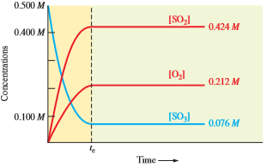
Concentration profile

Slide 8



The equilibrium constant
For the reaction:
We can define the rates of reaction as:
$$2A+B⇌A_{2}B$$
$$r_{f}=k_{f}{\left[A\right]}^{2}[B]$$
$$r_{b}=k_{b}[A_{2}B]$$

Slide 9



The equilibrium constant
At equilibrium:
$$r_{f}=r_{b}$$
$$k_{f}{\left[A\right]}^{2}\left[B\right]=k_{b}[A_{2}B]$$
$$K_{c}=\frac{k_{f}}{k_{b}}=\frac{\left[A_{2}B\right]}{{\left[A\right]}^{2}\left[B\right]}$$

Slide 10

The equilibrium constant
Determine the equilibrium constant $K_{c}$ for the previous examples

Slide 11
activities
Originally, activities are used instead of molarities
Activity (for an ideal mixture) is defined as the ratio of the actual concentration and a standard concentration (1 Molar)

Slide 12

Remember:
$K_{c}$ is constant for a certain temperature; it does not depend on initial concentrations.
If the temperature changes, then $K_{c}$ will also change according to Arrhenius’ equation

Slide 13
examples
Some nitrogen and hydrogen are placed in an empty 5.00-liter container at 500°C. When equilibrium is established, 3.01 mol of N₂, 2.10 mol of H₂, and 0.565 mol of NH₃ are present. Evaluate Kc for the following reaction at 500°C.

Slide 14

examples
We put 10.0 moles of N₂O into a 2.00-L container at some temperature, where it decomposes according to the reaction below. At equilibrium, 2.20 moles of N₂O remain. Calculate the value of K_{c} for the reaction.
$$2N_{2}O⇌2N_{2}+O_{2}$$

Slide 15
Variation of K_{c} with the balanced equation
Effect of reversing the equation
Effect of the stoichiometric coefficients

Slide 16




examples
You are given the following chemical equation and its equilibrium constant at a given temperature:
Write the expression for, and calculate the numerical value of, the equilibrium constant for each of the following at the same temperature:
$$2HBr+{Cl}_{2}⇌2HCl+{Br}_{2}$$
$$K_{c}=40000$$
$$4HBr+2{Cl}_{2}⇌4HCl+2{Br}_{2}$$
$$HBr+\frac{1}{2}{Cl}_{2}⇌HCl+\frac{1}{2}{Br}_{2}$$
$$3HCl+\frac{3}{2}{Br}_{2}⇌3HBr+\frac{3}{2}{Cl}_{2}$$

Slide 17
The reaction quotient, Q
K_{c} describes the condition of a reaction AT EQUILIBTRIUM ONLY, whereas Q describes the state of the reaction at any point.

Slide 18
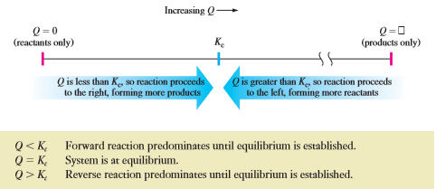
The reaction quotient, Q
Q can be a measure of the progress of a reaction:

Slide 19

examples
At a very high temperature, K_{c} = 65.0 for the following reaction:
The following concentrations were detected in a mixture. Is the system at equilibrium? If not, in which direction must the reaction proceed for equilibrium to be established? [HI] = 0.500 M, [H₂] = 2.80 M, and [I₂] = 3.40 M
$$2HI⇌H_{2}+I_{2}$$

Slide 20
Applications of K_{c}
The equation for the following reaction and the value of K_{c} at a given temperature are given. An equilibrium mixture in a 1.00-liter container contains 0.25 mol of PCl₅ and 0.16 mol of PCl₃. What equilibrium concentration of Cl₂ must be present?
PCl₃ + Cl₂ ⇌ PCl₅
K_{c}=1.9

