Slide 1
Gases and the Kinetic-Molecular Theory
From Chemistry (9th ed.) by Whitten et al.

Slide 2
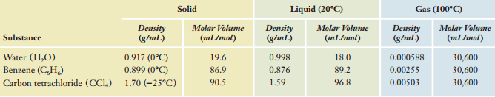
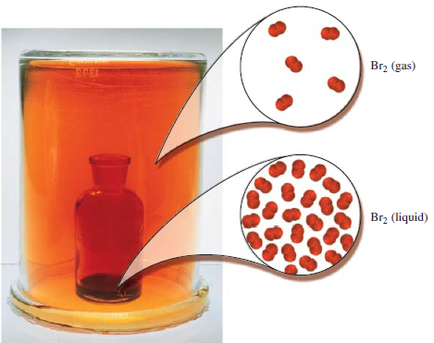
Solids vs. Liquids vs. Gases

Slide 3
Early observations about gases
They can be easily compressed
Gases exert pressure on their surroundings, and pressure must be exerted to confine gases
Gases expand without limits
Gases perfectly mix with other gases
A gas sample can be described using pressure, volume, temperature, and the number of moles

Slide 4
Pressure
Defined as the perpendicular force exerted per unit area
Can be expressed in various units:
Units of Pressure
Pascals (Pa) or Newtons per square meter (N/m²)
Milimeters of mercury (mmHg) or Torr
Pounds-force per square inch (psi)
Bars (bar) Atmospheres (atm)

Slide 5
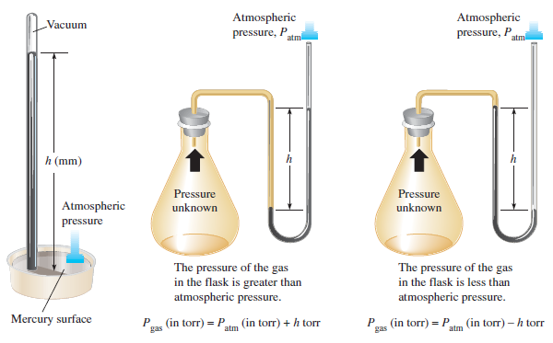
Pressure

Slide 6
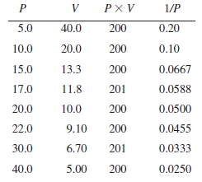
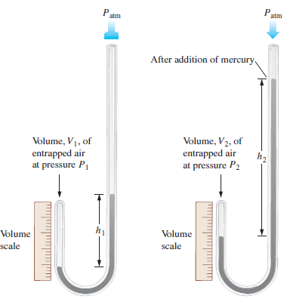
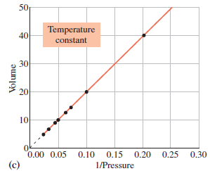
Boyle’s Law
Early experiments on gases were performed by Robert Boyle as shown:

Slide 7

Bolye’s Law
Therefore, the pressure vs. volume behavior of gases was defined as
$$PV=constant$$

Slide 8
Examples

Slide 9
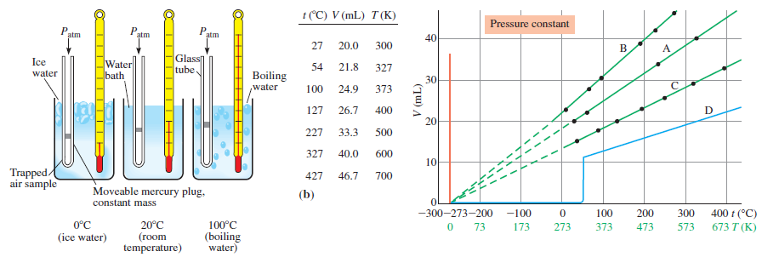
Charles’ Law or Gay-Lussac’s Law
Robert Bolye noticed that the volume of a gas changes with temperature, but did not further investigate.
Jacques Charles and Jean Gay-Lussac investigated volume versus temperature relationships in gases

Slide 10
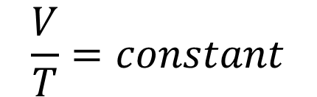
Charles’ Law
Therefore, the volume vs. temperature behavior of gases was defined as:
$$\frac{V}{T}=constant$$

Slide 11
Examples

Slide 12
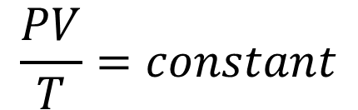
Combined Gas Law
A combination of Boyle’s and Charles’ Laws
$$\frac{PV}{T}=constant$$

Slide 13
Examples

Slide 14
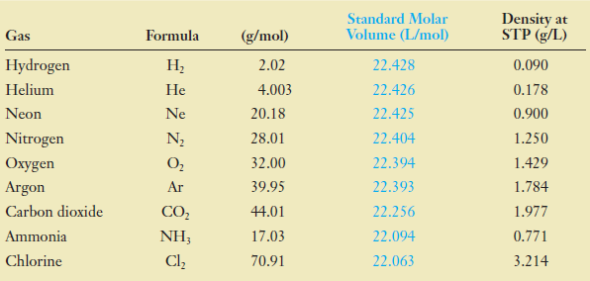
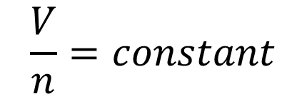
Avogadro’s Law
States that the volume occupied by a sample of gas is proportional to the number of moles
$$\frac{V}{n}=constant$$

Slide 15


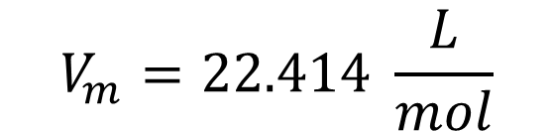
Standard Temperature and Pressure (STP)
Internationally agreed as
$$T=0℃=273.15 K$$
$$P=1 atm$$
$$V_{m}=22.414 \frac{L}{mol}$$

Slide 16

Example

Slide 17
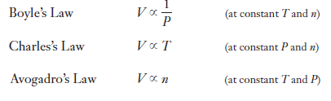
Ideal Gas Law

Slide 18
Examples

Slide 19
Review
Boyle’s Law
P is inversely proportional to V (const. T and n)
Charles’ Law
V is directly proportional to T (const. P and n)
Avogadro’s Law
V is directly proportional to n (const. P and T)
Combined Gas Law
P is directly proportional to T and inversely proportional to V (const. n)
Ideal Gas Law
PV=nRT

Slide 20
Application of gas laws
Determination of molecular weight
A 0.109-gram sample of a pure gaseous compound occupies 112 mL at 100°C and 750 torr. What is the molecular weight of the compound?
A 120-mL flask contained 0.345 gram of a gaseous compound at 100°C and 1.00 atm pressure. What is the molecular weight of the compound?
Additional analysis of the gaseous compound in the above example showed that it contained 54.5% carbon, 9.10% hydrogen, and 36.4% oxygen by mass. What is its molecular formula?

Slide 21
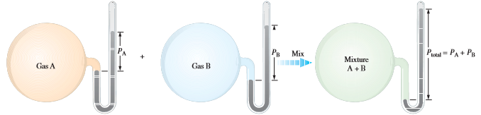
Dalton’s Law of Partial Pressures
States that the total pressure exerted by a mixture of gases is the sum of all the partial pressures of the components

Slide 22
Examples
A 10.0-liter flask contains 0.200 mole of methane, 0.300 mole of hydrogen, and 0.400 mole of nitrogen at 25°C. (a) What is the pressure, in atmospheres, inside the flask? (b) What is the partial pressure of each component of the mixture of gases?
The mole fraction of oxygen in the atmosphere is 0.2094. Calculate the partial pressure of O₂ in air when the atmospheric pressure is 760 torr.

Slide 23
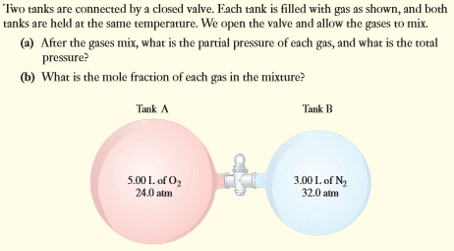
Examples

Slide 24

Applications in Stoichiometry
What volume of O₂ (STP) can be produced by heating 112 grams of KClO₃?

Slide 25
Examples
A 1.80-gram mixture of potassium chlorate, KClO₃, and potassium chloride, KCl, was heated until all of the KClO₃ had decomposed. After being dried, the liberated oxygen occupied 405 mL at 25°C when the barometric pressure was 745 torr. (a) How many moles of O₂ were produced? (b) What percentage of the mixture was KClO₃?

Slide 26
The Kinetic-Molecular Theory
Gases consist of discrete molecules. The individual molecules are very small and are very far apart relative to their own sizes.
The gas molecules are in continuous, random, straight-line motion with varying velocities.
The collisions between gas molecules and with the walls of the container are elastic; the total energy is conserved during a collision; that is, there is no net energy gain or loss.
Between collisions, the molecules exert no attractive or repulsive forces on one another; instead, each molecule travels in a straight line with a constant velocity.

Slide 27
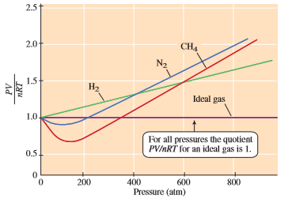
Deviations from Ideal Gas Behavior
Not all gases behave ideally

Slide 28

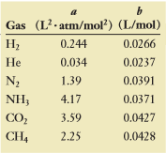
Van der Waals Equation
Used to account for non-ideality in gases

Slide 29
Example
Calculate the pressure exerted by 1.00 mole of methane, CH₄, in a 500-mL vessel at 25.0°C assuming (a) ideal behavior and (b) non-ideal behavior.

Slide 30

Molecular Speed
The root-mean-square speed (rms) of gas molecules can be computed using the equation below:
Calculate the root-mean-square speed of H₂ molecules in meters per second at 20°C.

Slide 31
Add to your PS1
A highly volatile liquid was allowed to vaporize completely into a 250-mL flask immersed in boiling water. From the following data, calculate the molecular weight of the liquid. Mass of empty flask = 65.347 g mass of flask filled with water at room temperature = 327.4 g mass of flask and condensed liquid = 65.739 g atmospheric pressure = 743.3 torr temperature of boiling water = 99.8°C density of water at room temperature = 0.997 g/mL.

