Slide 1
Lesson 10 – The Electronic Structures of Atoms
Engr. Kristopher Ray S. Pamintuan, M.Sc.

Slide 2
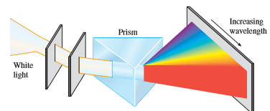
Is it a Particle or a Wave?
Is light a particle or a wave?
Are electrons considered as particles? Or as waves?

Slide 3
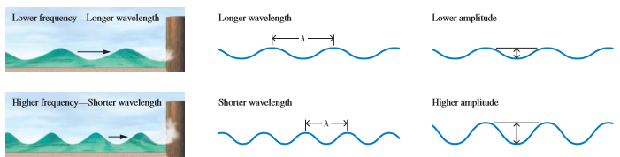

Waves
Waves can be described using two quantities:
Wavelength, $λ$
Frequency, $ν$

Slide 4
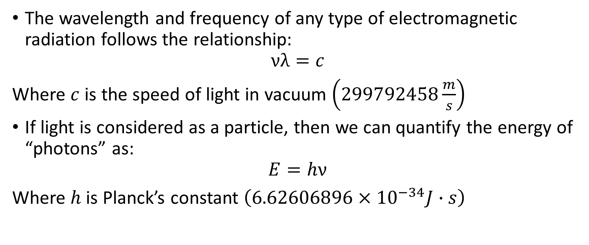
Waves vs. Particles
The wavelength and frequency of any type of electromagnetic radiation follows the relationship:
$$νλ=c$$
Where $c$ is the speed of light in vacuum $\left(299792458\frac{m}{s}\right)$
If light is considered as a particle, then we can quantify the energy of “photons” as:
$$E=hν$$
Where $h$ is Planck’s constant $\left(6.62606896×{10}^{−34}J∙s\right)$

Slide 5
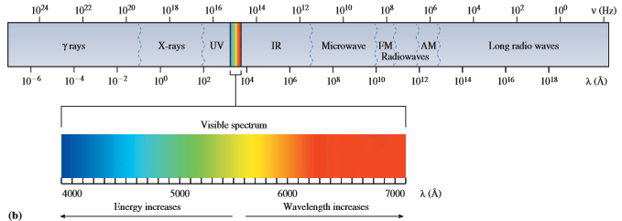
Electromagnetic Radiation
We know that visible light can be divided into seven colors: ROYGBIV
However, visible light is only a fraction of the whole electromagnetic spectrum, the rest of which we cannot see.

Slide 6
Examples
Light near the middle of the ultraviolet region of the electromagnetic radiation spectrum has a frequency of 2.73 x 10¹⁶ s⁻¹. Yellow light near the middle of the visible region of the spectrum has a frequency of 5.26 x 10¹⁴ s⁻¹. Calculate the wavelength that corresponds to each of these two frequencies of light.
Calculate the energy of a photon of: a.) UV light, b.) Yellow light.

Slide 7
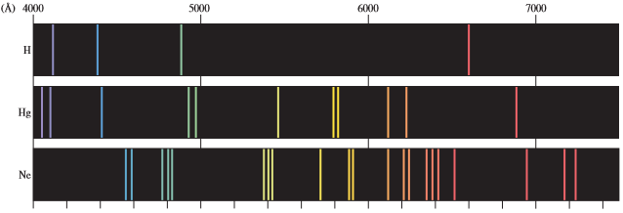
Emission Spectra
When atoms are excited (energy is added to atoms), they emit electromagnetic radiation, sometimes, in the form of visible light.
Example: A green line of wavelength 4.86 x 10⁻⁷ m is observed in the emission spectrum of hydrogen below. Calculate the energy of one photon of this green light. Also, calculate the energy released by one mole of hydrogen when excited.

Slide 8
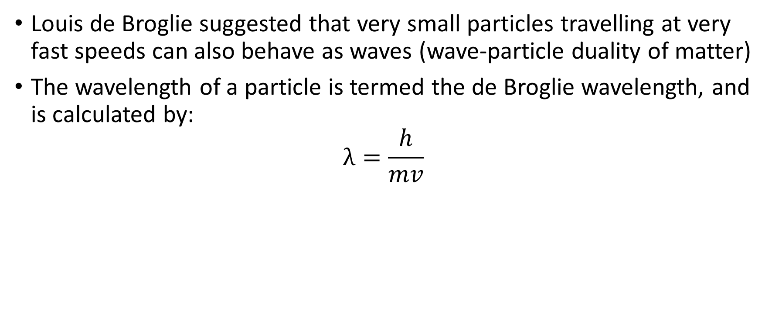
de Broglie Wavelength
Louis de Broglie suggested that very small particles travelling at very fast speeds can also behave as waves (wave-particle duality of matter)
The wavelength of a particle is termed the de Broglie wavelength, and is calculated by:
$$λ=\frac{h}{mv}$$

Slide 9
Examples
Calculate the wavelength in meters of an electron travelling at 4% of the speed of light
Calculate the wavelength of a 150-g baseball travelling at 150 kph.

Slide 10
Quantum Mechanics
Compare the solar system with an atom.
Miniscule particles can be better represented as waves using quantum mechanics.
This mainly focuses on the electrons of atoms.

Slide 11
Heisenberg Uncertainty Principle
It is impossible to determine both the position and the momentum of an electron simultaneously

Slide 12

Quantum Numbers
These are numerical representations of the allowable energy states of an atom.
Energy levels of electrons in an atom can also be solved mathematically using the Schrödinger’s equation, but it only yields an exact solution for the lone electron of a hydrogen atom

Slide 13
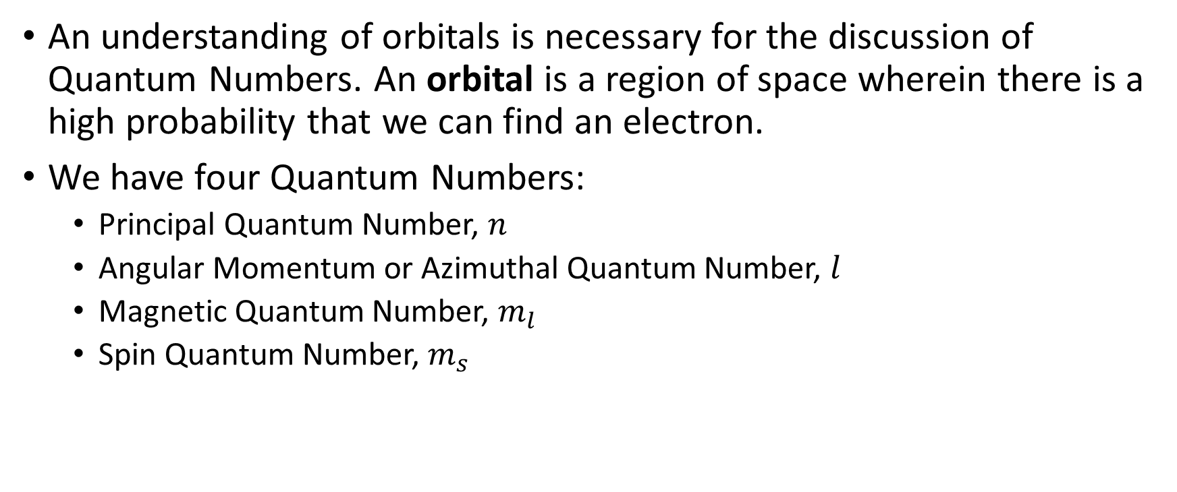
Quantum Numbers
An understanding of orbitals is necessary for the discussion of Quantum Numbers. An orbital is a region of space wherein there is a high probability that we can find an electron.
We have four Quantum Numbers:
Principal Quantum Number, $n$
Angular Momentum or Azimuthal Quantum Number, $l$
Magnetic Quantum Number, $m_{l}$
Spin Quantum Number, $m_{s}$

Slide 14
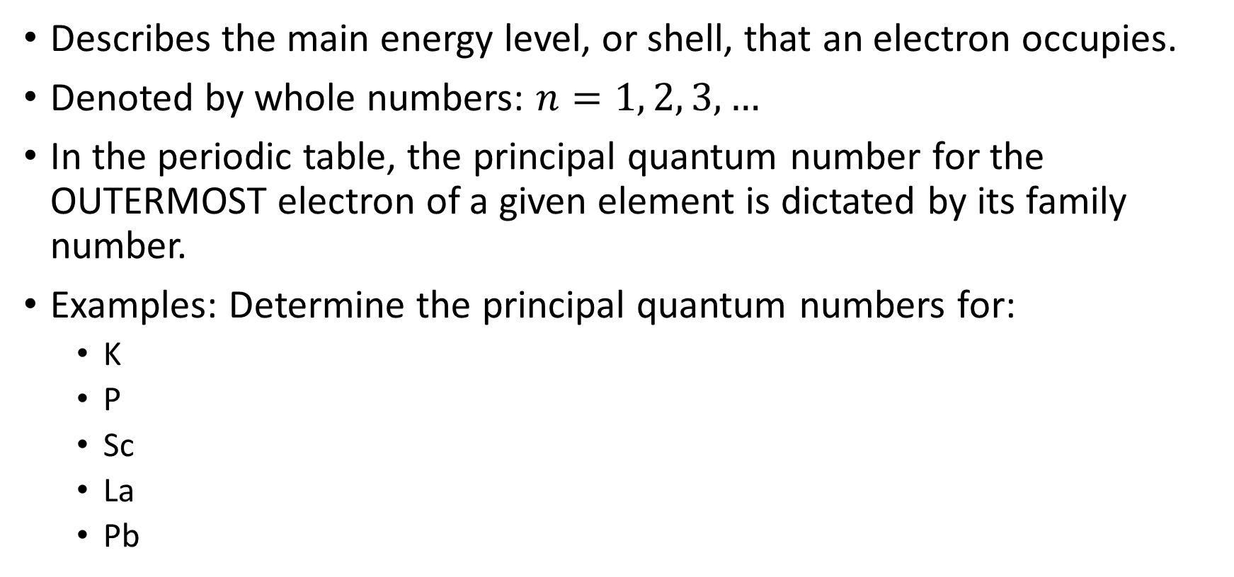
Principal Quantum Number
Describes the main energy level, or shell, that an electron occupies.
Denoted by whole numbers: $n=1, 2, 3, …$
In the periodic table, the principal quantum number for the OUTERMOST electron of a given element is dictated by its family number.
Examples: Determine the principal quantum numbers for:
K
P
Sc
La
Pb

Slide 15
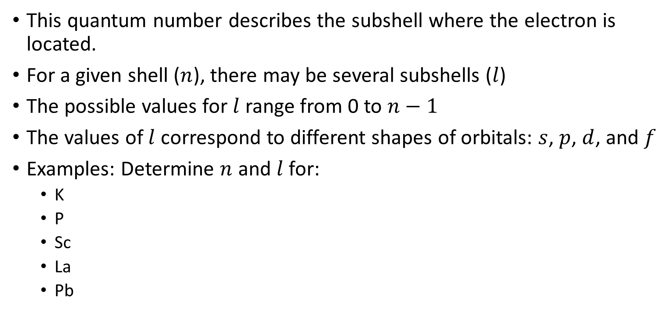
Angular Momentum Quantum Number
This quantum number describes the subshell where the electron is located.
For a given shell ($n$), there may be several subshells ($l$)
The possible values for $l$ range from 0 to $n−1$
The values of $l$ correspond to different shapes of orbitals: $s$, $p$, $d$, and $f$
Examples: Determine $n$ and $l$ for:
K
P
Sc
La
Pb

Slide 16
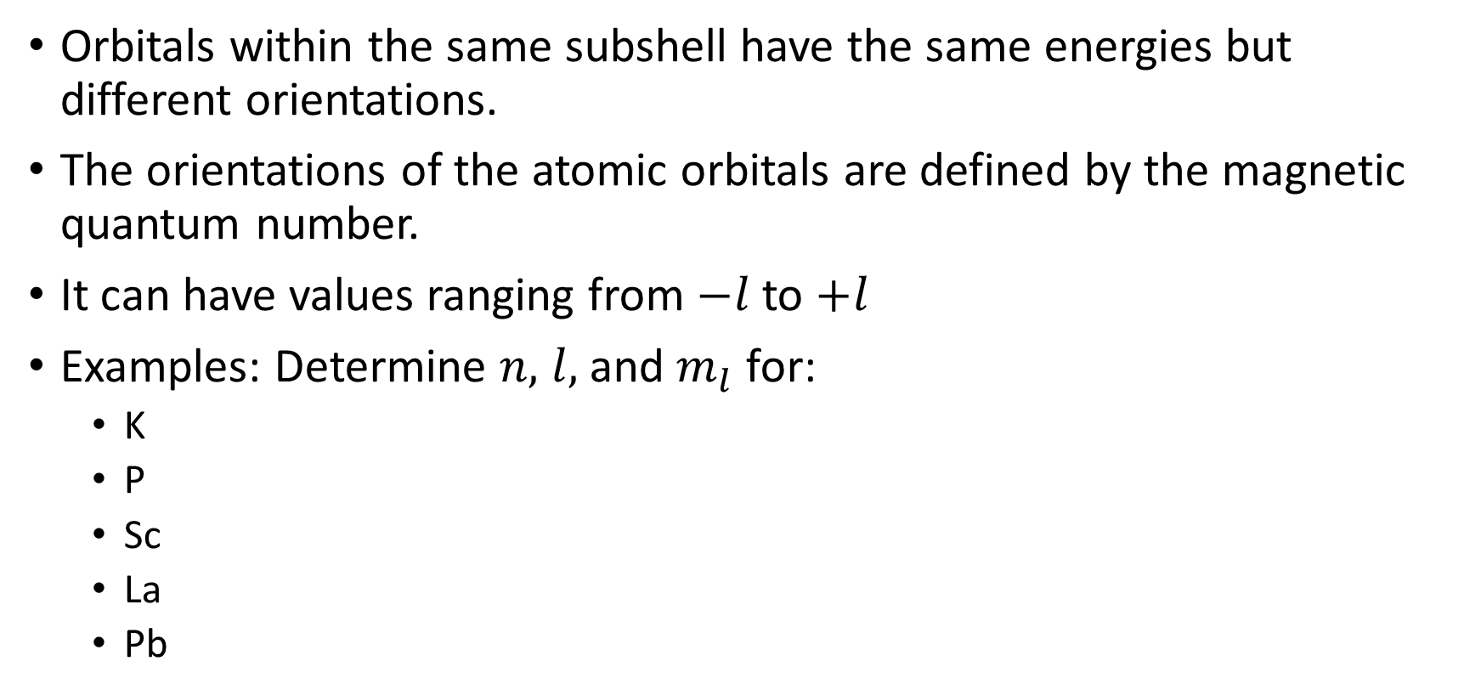
Magnetic Quantum Number
Orbitals within the same subshell have the same energies but different orientations.
The orientations of the atomic orbitals are defined by the magnetic quantum number.
It can have values ranging from $−l$ to $+l$
Examples: Determine $n,$ $l,$ and $m_{l}$ for:
K
P
Sc
La
Pb

Slide 17
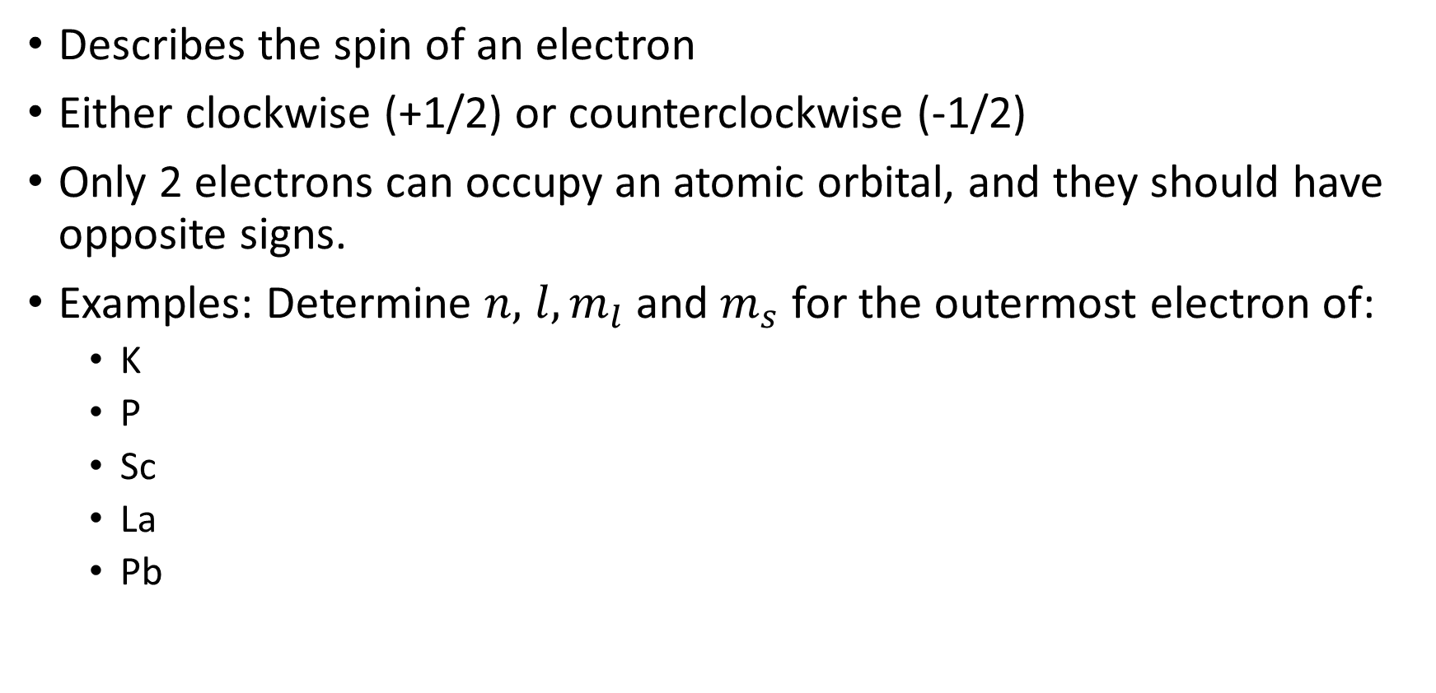
Spin Quantum Number
Describes the spin of an electron
Either clockwise (+1/2) or counterclockwise (-1/2)
Only 2 electrons can occupy an atomic orbital, and they should have opposite signs.
Examples: Determine $n,$ $l, m_{l}$ and $m_{s}$ for the outermost electron of:
K
P
Sc
La
Pb

Slide 18
Electronic Configuration
Follows three principles:
Aufbau Principle
Electrons are distributed to give the lowest energy possible.
Hund’s Rule of Multiplicity
When assigning electrons to orbitals, all orbitals are first filled with one electron each before pairing them. The unpaired electrons have parallel spins
Pauli Exclusion Principle
No two electrons can have the exact same values for its quantum numbers.

Slide 19
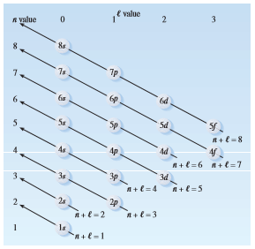
Aufbau order

Slide 20
Practice Sets
Write the electronic configuration for the following elements:
Be
C
O
Ne
Al
Ca
For the given elements above, draw the corresponding orbital diagrams.
Identify the quantum numbers of all of the electrons of the elements given above.

Slide 21
Paramagnetic and Diamagnetic Elements
Paramagnetic elements possess unpaired electrons. They are weakly attracted to a magnetic field.
Diamagnetic elements do not have unpaired electrons. They are weakly repelled by magnetic fields.

Slide 22
Periodic Trends
Atomic Radii
First Ionization Energy
Electron Affinity
Electronegativity

Slide 23
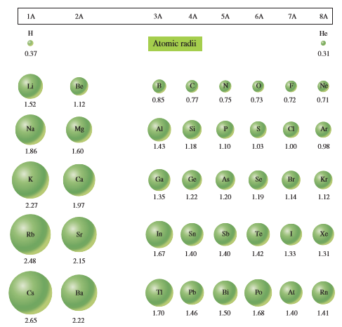
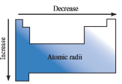
Atomic Radii
Elemental radius

Slide 24
Example
Arrange the following in order of increasing atomic radii:
Cs
F
K
Cl

Slide 25
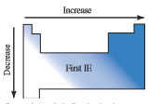
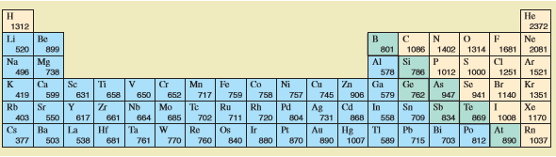
First Ionization Energy
The minimum amount of energy required to remove the outermost electron of an isolated atom of an element to form an ion with a +1 charge

Slide 26
Example
Arrange the following in order of increasing first ionization energies:
Na
P
Al
Si

Slide 27
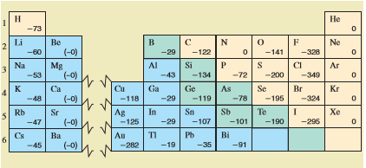
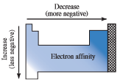
Electron Affinity
The energy change required to add an electron to the outermost shell of an isolated atom of an element to form an ion with a -1 charge

Slide 28
Example
Arrange the following in order of increasing electron affinity
K
Br
Cs
Cl

Slide 29
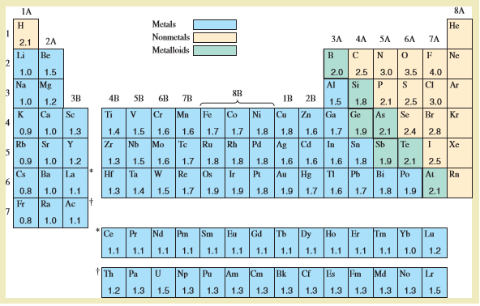
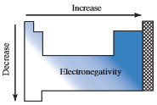
Electronegativity
The tendency of an atom to attract an electron to itself when it is covalently bonded to another atom.

Slide 30
Example
Arrange the following in order of increasing electronegativity:
B
Na
F
O

