Slide 1
Solutions and their properties

Slide 2
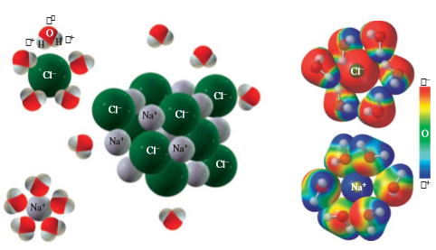
Solubility
The ability of a solute to dissolve in a solvent
Largely dictated by intermolecular forces of attraction between solute and solvent molecules

Slide 3

Solubility

Slide 4
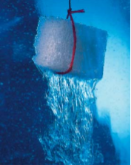
Dissolution of solids in liquids
We call this solubility
The degree of dissolution depends on the properties of both the solute (the dissolving specie) and the solvent (the agent of dissolution)

Slide 5
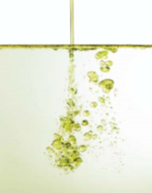
Dissolution of liquids in liquids
We call this miscibility
Same working principle with the dissolution of solids in liquids

Slide 6
Dissolution of gases in liquids
We call this solubility
Again, it follows the same principles with the other two: the most important determining factor are intermolecular forces of attraction

Slide 7
Types of solutions
Based on the amount of solute dissolved in solvent
Saturated – maximum solute that a solvent can dissolve
Unsaturated – less solute than saturated
Supersaturated – more solute than saturated

Slide 8
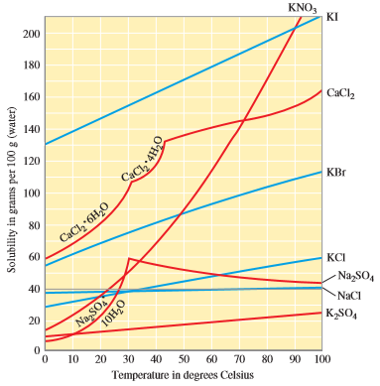
Effect of temperature on solubility
Liquids and solids generally are more soluble (or miscible) at higher temperatures
Gases, on the other hand, are less soluble at higher temperatures

Slide 9
Effect of pressure on solubility
No appreciable effect on solid and liquids dissolving in liquids
For gases, increasing the pressure will also increase the amount of dissolved gas in a liquid. This is governed by Henry’s Law

Slide 10
Expressing concentration of solutions
There are various ways on how to express the concentration of a solution, depending on the intended use of the concentration

Slide 11
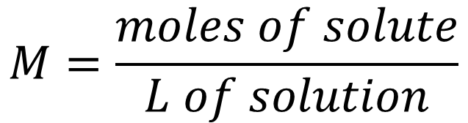
Molarity
Defined as the number of moles of the solute dissolved in a liter of the solution
$$M=\frac{moles of solute}{L of solution}$$

Slide 12
Examples
Calculate the molarity of a 5.0-L aqueous solution containing 374 g of glucose (C₆H₁₂O₆).
Calculate the molarity of a solution made by dissolving 2 grams of table salt in 1 liter of water. Assume that there is no volume change due to mixing.

Slide 13
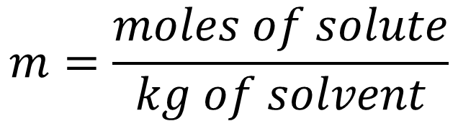
molality
Defined as the number of moles of the solute dissolved in a given mass of solvent
$$m=\frac{moles of solute}{kg of solvent}$$

Slide 14
Examples
What is the molality of a solution that contains 128 g of CH₃OH in 108 g of water?
How many grams of water must be used to dissolve 50 g of sucrose (C₁₂H₂₂O₁₁) to prepare a 1.25 m solution of sucrose?

Slide 15
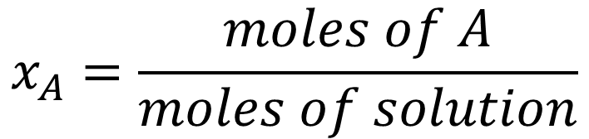
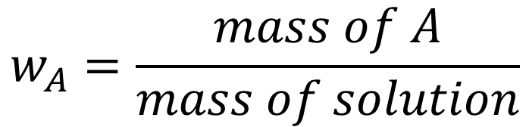
Mass and mole fractions
$$w_{A}=\frac{mass of A}{mass of solution}$$
$$x_{A}=\frac{moles of A}{moles of solution}$$

Slide 16
examples
What are the mass and mole fractions of CH₃OH and water in the previous example?

Slide 17
Colligative properties of solutions
These are the properties of a solution that DOES NOT DEPEND ON THE IDENTITY OF THE SOLUTE
It only depends on the NUMBER of solute molecules

Slide 18

Vapor pressure lowering
The vapor pressure of a solvent will decrease if a solute is dissolved in it
Governed by Raoult’s Law:
$$∆P_{solvent}=ix_{solute}P_{solvent}^{o}$$

Slide 19
Example
Sucrose is a nonvolatile, nonionizing solute in water. Determine the vapor pressure lowering, at 25°C, of a 1.25 m sucrose solution. Assume that the solution behaves ideally. The vapor pressure of pure water at 25°C is 23.8 torr.

Slide 20

Boiling point elevation
Due to the lowering of the vapor pressure of a solvent upon dissolving a solute, it would then boil at a higher temperature.
$$∆T_{b}=iK_{b}m$$

Slide 21
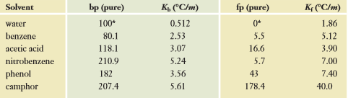
example
Predict the boiling point of a 1.25 m aqueous sucrose solution. Sucrose is a non-ionizing solute.

Slide 22

Freezing point depression
The lowering of the vapor pressure would also mean that the solution will freeze below its normal freezing point
$$∆T_{f}=iK_{f}m$$

Slide 23
example
Calculate the freezing point of a 1.25 m aqueous sucrose solution.
When 15.0 grams of ethyl alcohol, C₂H₅OH, is dissolved in 750 grams of formic acid, the freezing point of the solution is 7.20°C. The freezing point of pure formic acid is 8.40°C. Evaluate K_{f} for formic acid.

Slide 24
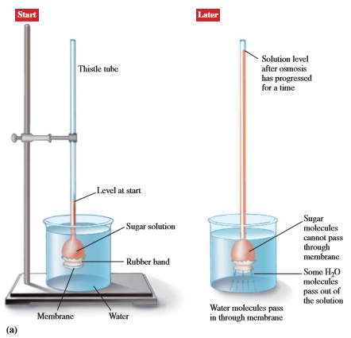

Osmotic pressure
The pressure needed to stop the flow of solute molecules through a membrane
$$π=iMRT$$

Slide 25

Example
What is the osmotic pressure of a 0.02 M aqueous solution of a nonvolatile nonelectrolyte solute at $75℃$?

Slide 26
More examples
The density of a 15.00% by mass aqueous solution of acetic acid, CH₃COOH, is 1.0187 g/mL. What is (a) the molarity? (b) the molality? (c) the mole fraction of each component?
(a) Calculate the vapor pressure lowering associated with dissolving 20.2 g of table sugar, C₁₂H₂₂O₁₁, in 400 g of water at 25.0°C. (b) What is the vapor pressure of the solution? Assume that the solution is ideal. The vapor pressure of pure water at 25.0°C is 23.76 torr. (c) What is the vapor pressure of the solution at 100.°C?

Slide 27
More examples
The normal boiling point of benzene is 80.1°C. A 0.72-gram sample of a nonvolatile compound with the molar mass of 185 g/mol is dissolved in 2.75 g of benzene. What is the expected boiling point of this solution?
Estimate the freezing point of an aqueous solution that contains 2.0 moles of CaCl₂ in 1000 grams of water.

Slide 28
Practice problems
A 0.10-m solution of NaCl has a boiling point of 100.089ºC at atmospheric pressure. What is the Van’t Hoff factor for NaCl? What is the percent ionization?
Lactic acid (C₂H₄(OH)COOH) is a weak monoprotic acid. The freezing point of a 0.010-m aqueous solution of lactic acid is -0.0206ºC. What is the Van’t Hoff factor and the percent ionization?

Slide 29
Practice problems
Pepsin is an enzyme present in the human digestive track. A solution of a 0.500 g sample of purified pepsin in 30 mL of aqueous solution exhibits an osmotic pressure of 8.92 torr at 27ºC. Estimate the molecular weight of pepsin.
Urea, (NH₂)₂CO, is a product of metabolism of proteins. An aqueous solution is 32.0% urea by mass and has a density of 1.087 g/mL. Calculate the molality of urea in the solution.

Slide 30
Practice problems
The “proof” of an alcoholic beverage is twice the volume percent of ethanol, C₂H₅OH, in water. The density of ethanol is 0.789 g/mL and that of water is 1.00 g/mL. A bottle of 100-proof rum is left outside on a cold winter day. (a) Will the rum freeze if the temperature drops to -18°C? (b) Rum is used in cooking and baking. At what temperature does 100-proof rum boil?

Slide 31
Practice problems
(a) Suppose we dissolve a 6.00-g sample of a mixture of naphthalene, C₁₀H₈, and anthracene, C₁₄H₁₀, in 360 g of benzene. The solution is observed to freeze at 4.85°C. Find the percent composition (by mass) of the sample. (b) At what temperature should the solution boil? Assume that naphthalene and anthracene are nonvolatile nonelectrolytes.

Slide 32
Practice problems
Four beakers contain 0.010 m aqueous solutions of CH₃OH, KClO₃, CaCl₂, and CH₃COOH, respectively. Without calculating the actual freezing points of each of these solutions, arrange them from lowest to highest freezing point

Slide 33
Practice problems
The ice fish lives under the polar ice cap where the water temperature is -4°C. This fish does not freeze at that temperature due to the solutes in its blood. The solute concentration of the fish’s blood can be related to a sodium chloride solution that would have the same freezing point. What is the minimum concentration of a sodium chloride solution that would not freeze at -4°C?

