Slide 1
Lesson 7 – Stoichiometry I
Engr. Kristopher Ray S. Pamintuan, M.Sc.

Slide 2
Stoichiometry
Coined from the Greek words “stoicheion” meaning element, and “metron” which means to measure.
Defines the mass-mole relationships in a chemical reaction, leading to a quantitative analysis of any chemical reaction.

Slide 3
List of Related Concepts
Atomic mass
The “mole”
Avogadro’s number
Chemical Formula
Percent compositions
Chemical equations

Slide 4
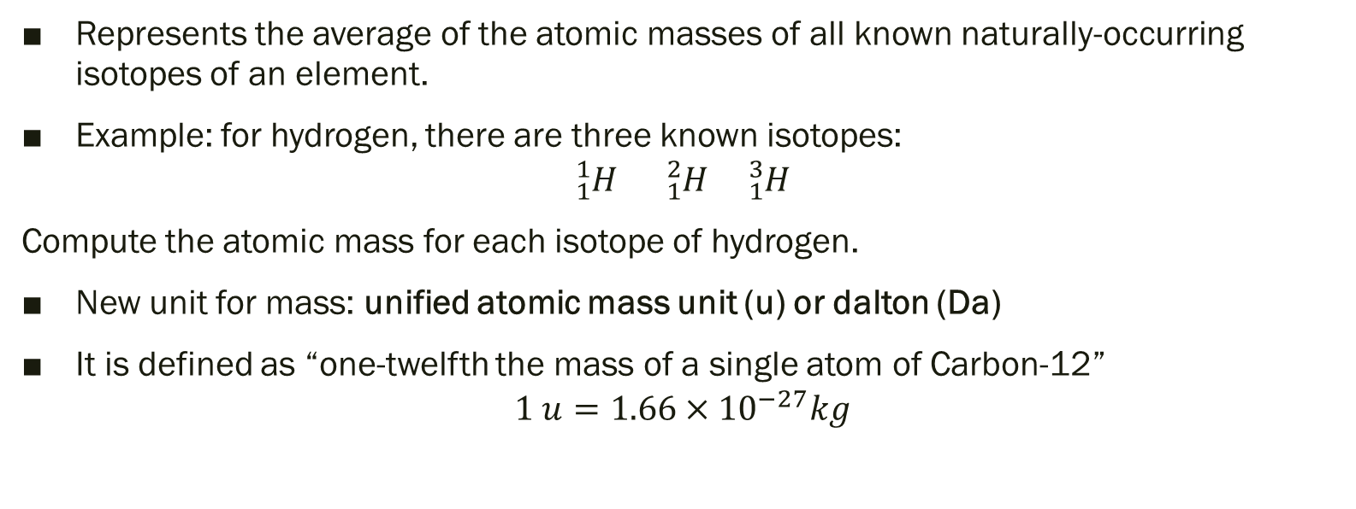
Atomic mass
Represents the average of the atomic masses of all known naturally-occurring isotopes of an element.
Example: for hydrogen, there are three known isotopes:
$${}_{1}^{1}H {}_{1}^{2}H {}_{1}^{3}H$$
Compute the atomic mass for each isotope of hydrogen.
New unit for mass: unified atomic mass unit (u) or dalton (Da)
It is defined as “one-twelfth the mass of a single atom of Carbon-12”
$$1 u=1.66×{10}^{−27}kg$$

Slide 5
Relative Abundance
The abundance of the naturally-occurring isotopes of a given element are the basis for the average atomic mass.
Example: Chlorine has two naturally-occurring isotopes, ³⁵Cl (34.9689 u) and ³⁷Cl (36.9659 u) with relative abundances of 75.76% and 24.24%, respectively. What is the average atomic mass of chlorine?
Do it yourself: Silicon has three naturally occurring isotopes with atomic masses and relative abundance listed on the table below. What is the average atomic mass of silicon?
Isotope | % abundane | Atomic mass
²⁸Si | 92.22% | 27.9769
²⁹Si | 4.69% | 28.9765
³⁰Si | 3.09% | 29.9738

Slide 6
The “mole”
A unit of measurement defined as an amount of substance with the same number of particles as there are in 0.012 kg of Carbon-12

Slide 7

Avogadro’s Number
Has a value of 6.022x10²³
$$1 mole=6.022×{10}^{23} particles$$
1 mole of eggs is equivalent to 6.022x10²³ pieces of eggs
1 mole of sodium is equivalent to 6.022x10²³ atoms of sodium

Slide 8

Molecular Weight
Can be used to convert from mass to mole or vice versa
$$MW=\frac{mass}{mole}$$
Numerically equivalent to daltons
$$1 Da=1 \frac{g}{mol}$$

Slide 9
Examples
How much does 3.5 mol of Al weigh?
How many moles are there in 200 g of Os?
How many atoms are there in 1 g of C?
How much does a single oxygen atom weigh?

Slide 10
Chemical Formula
These are used to represent elements and compounds in an equation.
These are governed by the Law of Definite Proportions
The molecular weight of a compound is the sum of the atomic masses of each atom in a compound.
Example: Determine the molecular weight of water, H₂O.
Do it yourself: Determine the molecular weight of sucrose, C₁₂H₂₂O₁₁

Slide 11
Percent Composition
Tells us the elemental composition of a compound, in terms of percentage by weight.
Example: Determine the percent composition of the elements in aluminum sulfate.
Do it yourself: Determine the percent composition of the elements in Ca₃(PO₄)₂

Slide 12
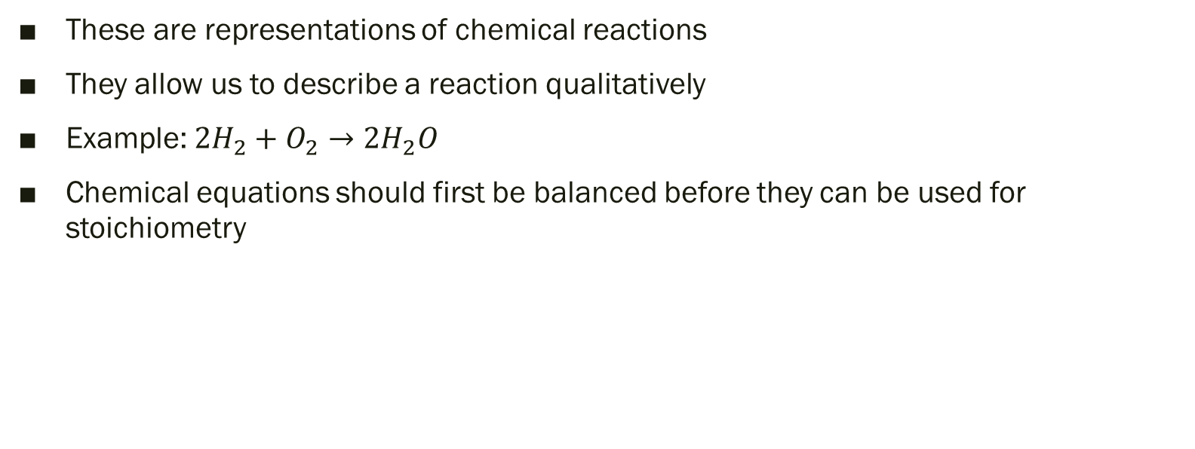
Chemical Equations
These are representations of chemical reactions
They allow us to describe a reaction qualitatively
Example: ${2H}_{2}+O_{2}→{2H}_{2}O$
Chemical equations should first be balanced before they can be used for stoichiometry

Slide 13
Examples
Balance the following reactions:
CH₄ + O₂ → CO₂ + H₂O
KClO₃ → KCl + O₂
P₄ + Cl₂ → PCl₅

Slide 14

The Balanced Equation
Once you have a balanced equation, you may now derive conversion factors
Example: $4NaCl + {2H}_{2}O →4NaOH+2Cl2+O2$

Slide 15
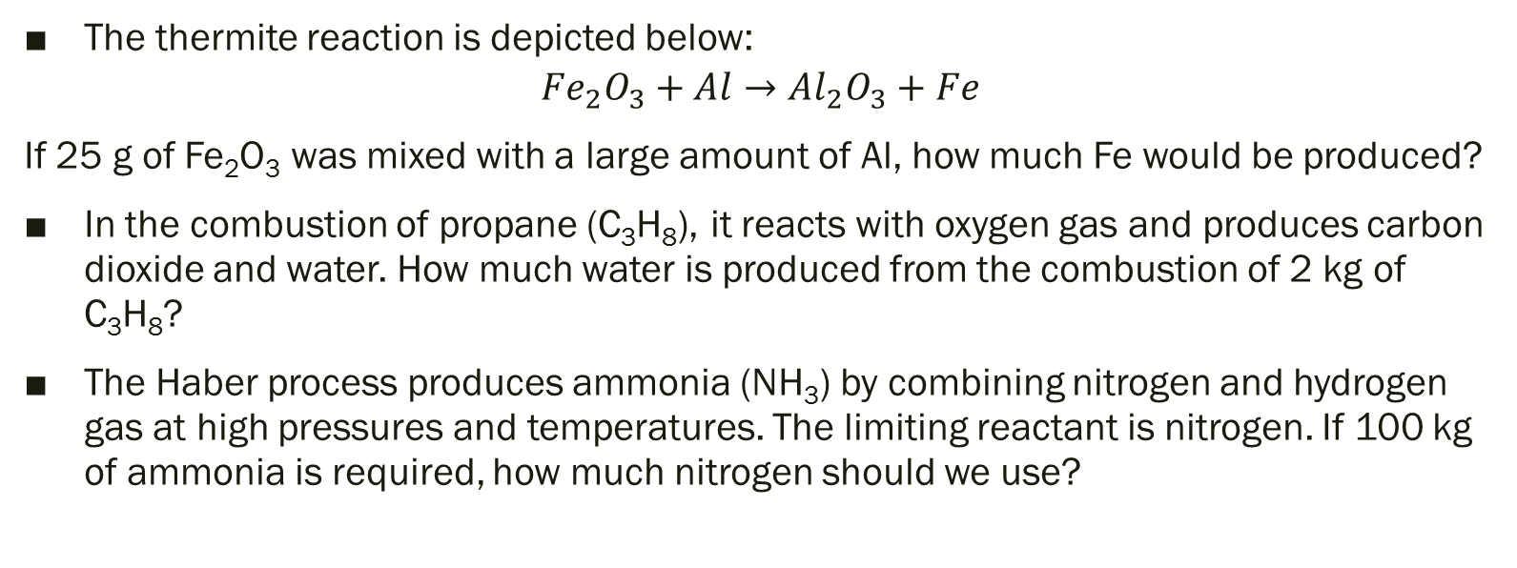
Practice Problems
The thermite reaction is depicted below:
$${Fe}_{2}O_{3}+Al→{Al}_{2}O_{3}+Fe$$
If 25 g of Fe₂O₃ was mixed with a large amount of Al, how much Fe would be produced?
In the combustion of propane (C₃H₈), it reacts with oxygen gas and produces carbon dioxide and water. How much water is produced from the combustion of 2 kg of C₃H₈?
The Haber process produces ammonia (NH₃) by combining nitrogen and hydrogen gas at high pressures and temperatures. The limiting reactant is nitrogen. If 100 kg of ammonia is required, how much nitrogen should we use?

