Slide 1
Lesson 5: The Atom
Engr. Kristopher Ray S. Pamintuan, M.Sc.

Slide 2
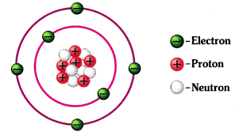
The Atom
The smallest unit of ordinary matter which dictates the properties of an element
Coined from the Greek word atomos, meaning “indivisible”
The Greek philosopher Democritus argues that you can divide matter as small as you can up to the atomic level only.

Slide 3
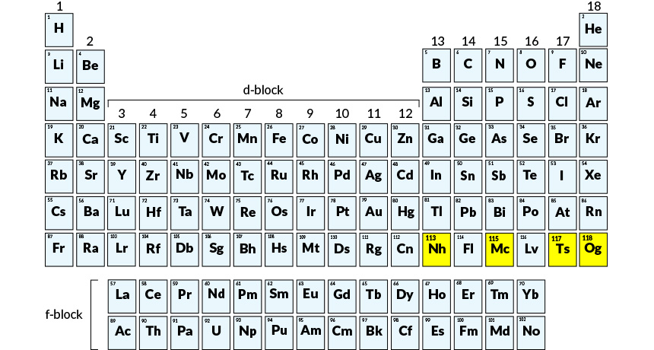
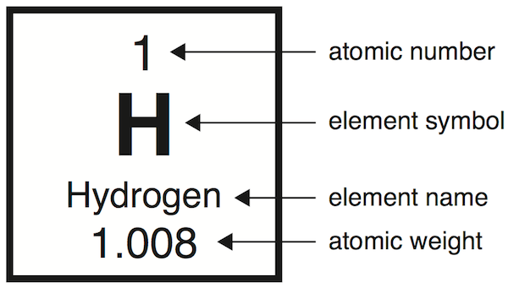
What you may already know
The Periodic Table of Elements

Slide 4
Subatomic Particles
These are what makes up an atom.
Protons (+)
Electrons (-)
Neutrons

Slide 5
The Electron
The lightest subatomic particle
Discovered by Joseph John Thomson in 1897 and were initially called “cathode rays”
J.J. Thomson was able to calculate the mass to charge ratio of electrons; however, without the known mass of electron, one could not know the charge or vice versa. (m/e = 5.60 x 10⁻⁹ g/C)
Robert Millikan performed the famous oil-drop experiment in 1911 to determine the charge of an electron. He got a value of 1.60 x 10⁻¹⁹ C
Can we determine the mass of an electron?

Slide 6
The Proton
The opposite of an electron
Numerically has the same charge as an electron, but with an opposite sign.
Based on experiments, it has a mass of 1.6726 x 10⁻²⁴ g
Discovered by Eugen Goldstein in 1886. He called them “canal rays”

Slide 7
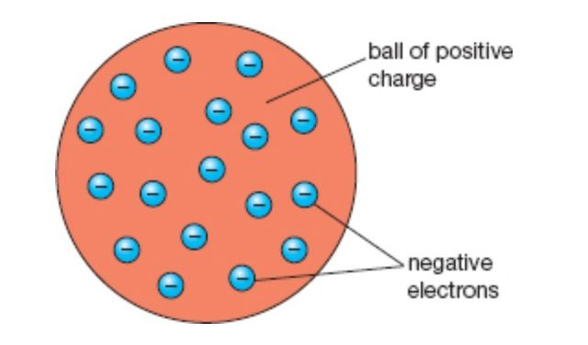
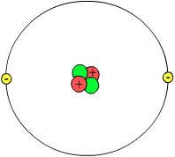
The Nucleus
J.J. Thomson earlier proposed the defunct “plum pudding” model of the atom wherein electrons re scattered on the surface of a proton.
Ernest Rutherford rejected the plum pudding model in 1911 when he performed the famous Gold Foil Experiment.
He concluded that in the center of an atom lies a very dense positively charged mass and that majority of the atom is just empty space.

Slide 8
The Neutron
For atoms to stay neutral, their protons must be equal to the number of electrons. If this is true, then the atom is composed of several protons and neutrons.
Consider this: a carbon atom has a mass of 1.99 x 10⁻²³ g, and has 6 protons and 6 electrons.
The missing mass indicates that there is still another particle inside the atom.
This particle is called the neutron, discovered by James Chadwick in 1932.
The neutron has no charge, and is slightly heavier than a proton (m = 1.6749 x 10-24 g)

Slide 9
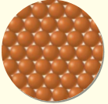
Dalton’s Atomic Theory
All matter are made up of atoms, which are indivisible.
All atoms in an element are all identical.
Compounds are combinations of two or more elements in definite proportions.
Compounds are formed by chemical reactions wherein atoms of different elements are joined, separated, or rearranged.

Slide 10
Basic Laws of Matter
Law of Conservation of Mass – mass is neither created nor destroyed in any physical or chemical change.
Melting of ice: Is this a physical change or a chemical change?
Burning paper: Is this a physical change or a chemical change?

Slide 11
Basic Laws of Matter
Law of Definite Proportions – a compound will always exist in a definite ratio of its constituent elements.
If the ratio is different, then that is already a different compound.

Slide 12
Basic Laws of Matter
Law of Multiple Proportions – different combination ratios of elements give different compounds.

Slide 13
The Chemical Elements

Slide 14
Types of Elements
Metals
Nonmetals
Metalloids or semimetals

Slide 15
Molecules
Strictly defined as a combination of two or more atoms.
All compounds are composed of molecules.
Can elements also consist of molecules?
Different forms of the same element are called allotropes

