Slide 1
React Router + Relay
* React & React [Relay] Router
*Relay

Slide 2

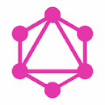
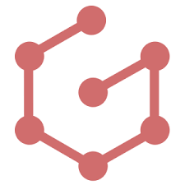
Wait, where were we?
Django ReST, better than nothing, but over fetching, and under fetching and yuk yuk yuk
Enter GraphQL to save the day
  Tidy
  Get what you want
  No under/over fetching
And then there is Graphene so now we can enjoy all the glory of Python

Slide 3
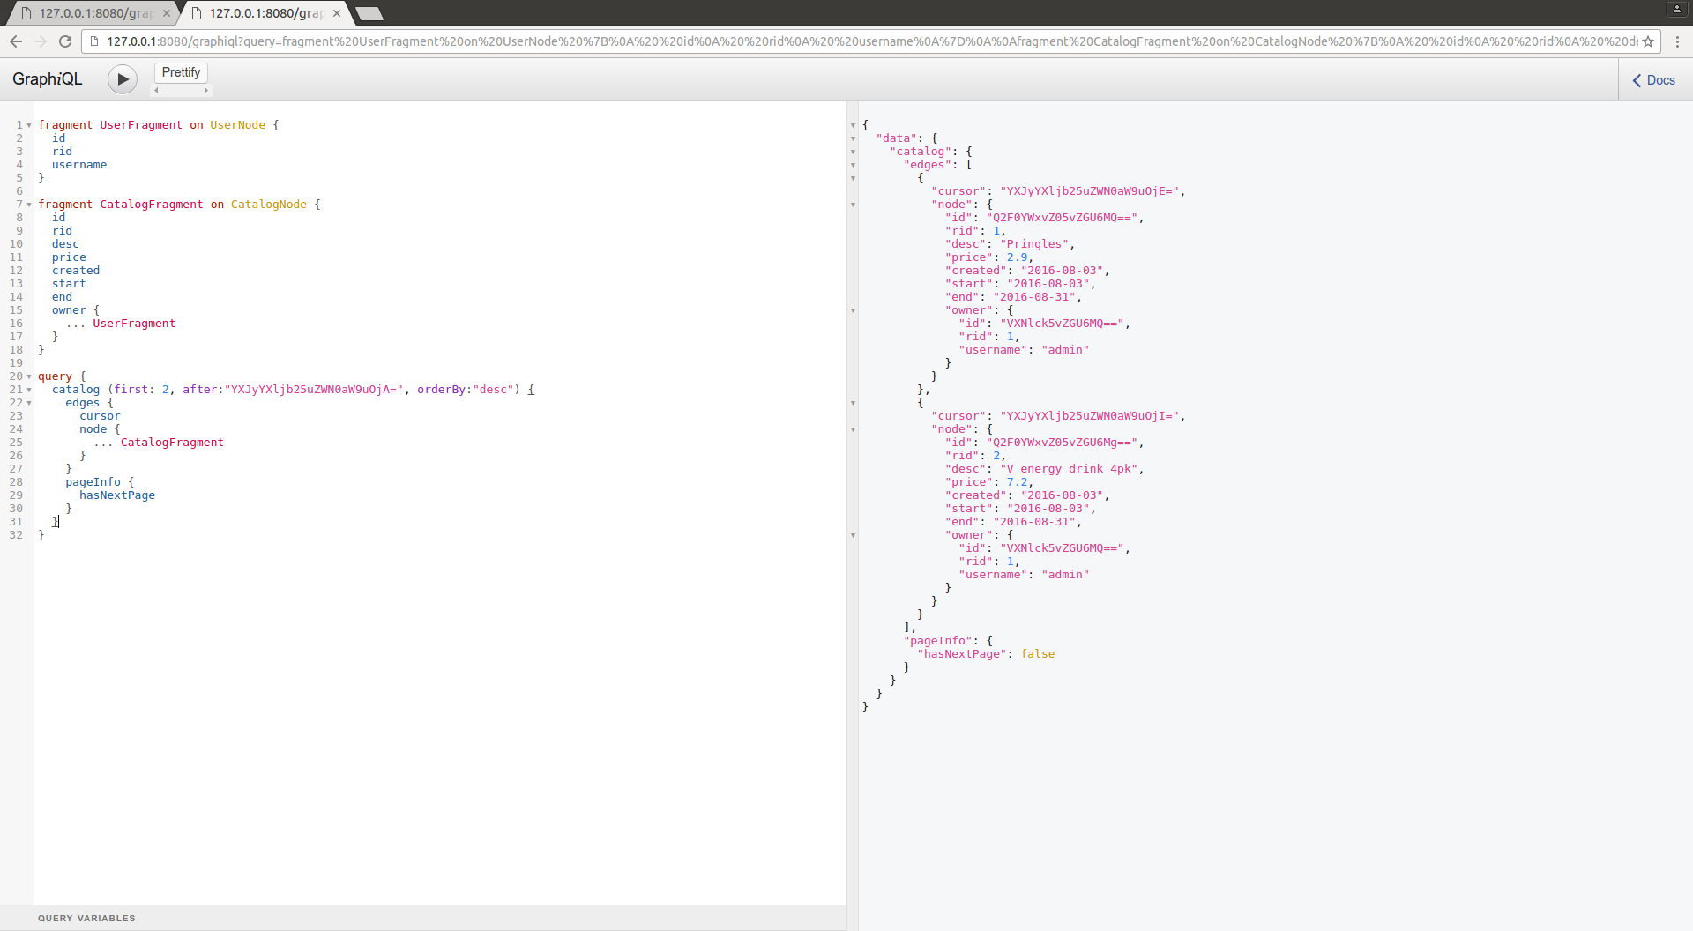
Remember this?

Slide 4

Lets make a React App Fast
Usage: create-react-app <project-directory> [--verbose]
git ls-tree -r --name-only ...
  README.md
  package.json
  public/favicon.ico
  public/index.html
  src/App.css
  src/App.js
  src/App.test.js
  src/index.css
  src/index.js
  src/logo.svg
npm start
Awsome source !

Slide 5
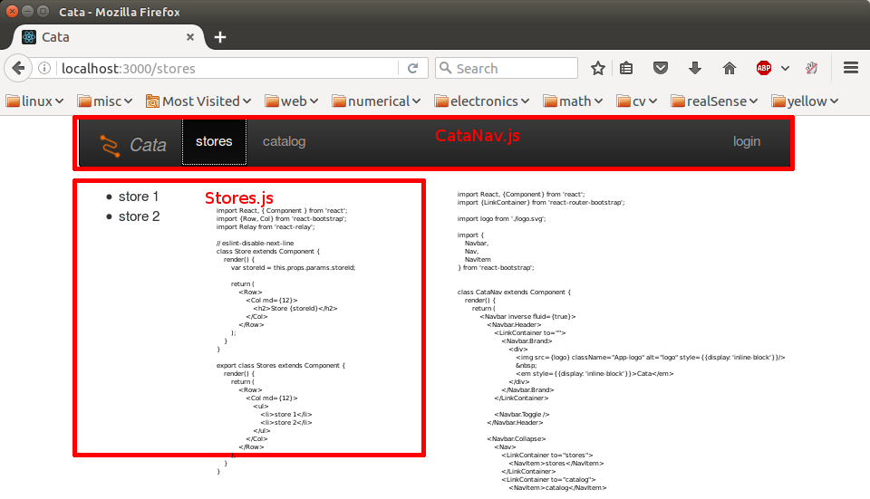
Lets make a React App Fast
// App.js
import React, { Component } from 'react';
import './App.css';
import CataNav from './CataNav'
class App extends Component {
render() {
return (
<div>
<CataNav></CataNav>
{this.props.children}
</div>
);
}
}
export default App;
Add bootstrap and
React Router
<!-- index.html -->
<!doctype html>
<html lang="en">
<head>
...
</head>
<body>
<div id="root"></div>
</body>
</html>
// index.js
import React from 'react';
import ReactDOM from 'react-dom';
import {Router, Route, IndexRoute, browserHistory} from 'react-router';
import App from './App';
import {Stores} from './Stores'
import NoMatch from './NoMatch';
import './index.css';
import 'bootstrap/dist/css/bootstrap.css';
import 'bootstrap/dist/css/bootstrap-theme.css';
ReactDOM.render(
<Router history={browserHistory}>
<Route path="/" component={App}>
<IndexRoute component={NoMatch}/>
<Route path="stores" component={Stores}/>
<Route path="*" component={NoMatch}/>
</Route>
</Router>,
document.getElementById('root')
);

Slide 6
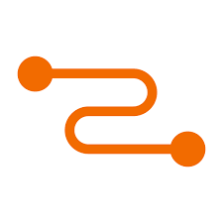

Add Relay & EJECT!
create-react-app is very nice and manages all the babel webpack painfulness
BUT it doesn’t work with relay :~( ... yet https://github.com/facebookincubator/create-react-app/issues/462
So we need to eject, ie use the hardwork create-react-app did up to here, but we’ll handle it from now on
Now we need to download the schema from graphene .... enter getSchema.js ... then call this from .babelrc so we can process Relay.QL`query {...}` etc

Slide 7
Basic React Relay &
React-Relay-Router
Use the react-router-relay
<Router history={browserHistory} render={applyRouterMiddleware(useRelay)} environment={Relay.Store}>
Add queries to all the routes
<Route path="/catalog" component={Catalog.ItemListContainer} queries={Catalog.ItemListQueries}/>
<Route path="/catalog/:itemId" component={Catalog.ItemContainer} queries={Catalog.ItemQueries}/>
Modules export wrapped container and queries
var StoresListContainer = Relay.createContainer(StoresList, {
fragments: {
stores: () => Relay.QL`
fragment on StoreNodeDefaultConnection {
edges {
node {
id,
desc,
address,
created,
website,
}
}
}`,
},
});
exports.StoresListContainer = StoresListContainer;
class StoresList extends Component {
render() {
var stores = this.props.stores;
// render out the stores
var StorePreviewElements = stores.edges.map((edge) => {
var store = edge.node;
return (
<StorePreview key={store.id} store={store} />
)
})
return (
<Grid>
{StorePreviewElements}
</Grid>
);
}
}
exports.StoresListQueries = {
stores: () => Relay.QL`
query {
stores
}`,
}
exports.StoreQueries = {
stores: () => Relay.QL`
query {
stores (id: $storeId)
}`,
}

Slide 8

Advanced React Relay &
React-Relay-Router
NEXT TIME
Super sweet pagination
Mutations

