Slide 1
ReST++
* DRF
*Graphene

Slide 2

ReST
ReST ~= Representational State Transfer
stateless, client-server, cacheable communications protocol
CRUDy => PUT, GET, PUT, DELETE
Do use JSON, maybe XML ... DONT return HTML
Be idempotent (no side effects)
ReST is mess, so document it

Slide 3

DRF
Quick Start
pip install djangorestframework django-filter
Install it
INSTALLED_APPS = (
...
'rest_framework',
)
Add settings
REST_FRAMEWORK = {
..
}

Slide 4
DRF
Models
Totally the same .....

Slide 5
DRF
Serializers
Serializers = Forms
serializers.Serializer is simple
Validation is same same, ie def validate() on the “form”, or validate_<field_name>() on the “field”
Add .create(self, validated_data) & .update(self, instance, validated_data) methods for CRUD and .save() will work
ModelSerializer = ModelForm
HyperlinkedModelSerializer, return URL instead of primary keys
etc

Slide 6
DRF
Views
APIView is same same, GET, POST, etc
Make your life easy and use ViewSets
ViewSets use .list(), .retreive(), .create(), .delete(); not GET, POST, etc ... but mostly you dont care
Just set .serializer_class & .queryset, and magic
Set .permission_classes and .authentication_classes as needed
Or use GenericViewSet and Mixins for more control

Slide 7
DRF
Routing
Make a router and register your ViewSets:
router = routers.DefaultRouter()
router.register(r'catalog', catalog_views.CatalogItemViewSet, base_name='catalog')
router.register(r'isearch', isearch_views.ISearchViewSet, base_name='isearch')
Add ONE url for it
urlpatterns = [
  ...
  url(r'^', include(router.urls)),
  ...
]
By default we get browsable API (yay)

Slide 8
DRF
Renders
Setup in setting (or views if you need),
REST_FRAMEWORK = {
'DEFAULT_RENDERER_CLASSES': (
'rest_framework.renderers.JSONRenderer', ...)
}
order = priority
Some Available Renders
  JSONRenderer (ofcourse)
  TemplateHTMLRenderer (yuk)
  BrowsableAPIRenderer (yay browse your api easy)
  XML, YAML, JSONP, CSV (Pandas), Latex, ofcourse are etc all available via 3rd party

Slide 9
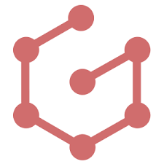
Graphene = ReST++
So now we see ReST sucks ... too many end points, too much over/under fetching (round and round the API) and those BE devs sure make some ugly data structures!
GraphQL = one endpoint, and you get what you want, how you want it
Graphene = GraphQL for python (Django, but also standalone or flask etc)
Graphene = Pretty Carbon = Fits in with our naming convention
Still a bit new though :(

Slide 10
GraphQL
Quick Start
pip install graphene[django] django-graphiql
Update settings.py
INSTALLED_APPS = [
...
'django_graphiql',
'graphene.contrib.django',
....
]
Update urls.py, note we add only ONE url again (for real this time)
urlpatterns = [
...
url(r'^graphql', csrf_exempt(GraphQLView.as_view(schema=schema))),
url(r'^graphiql', include('django_graphiql.urls')),
]

Slide 11
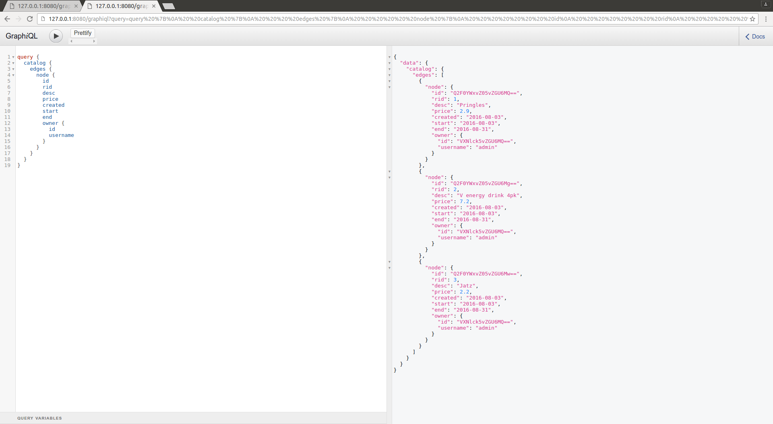
GraphQL language + Query’s

Slide 12
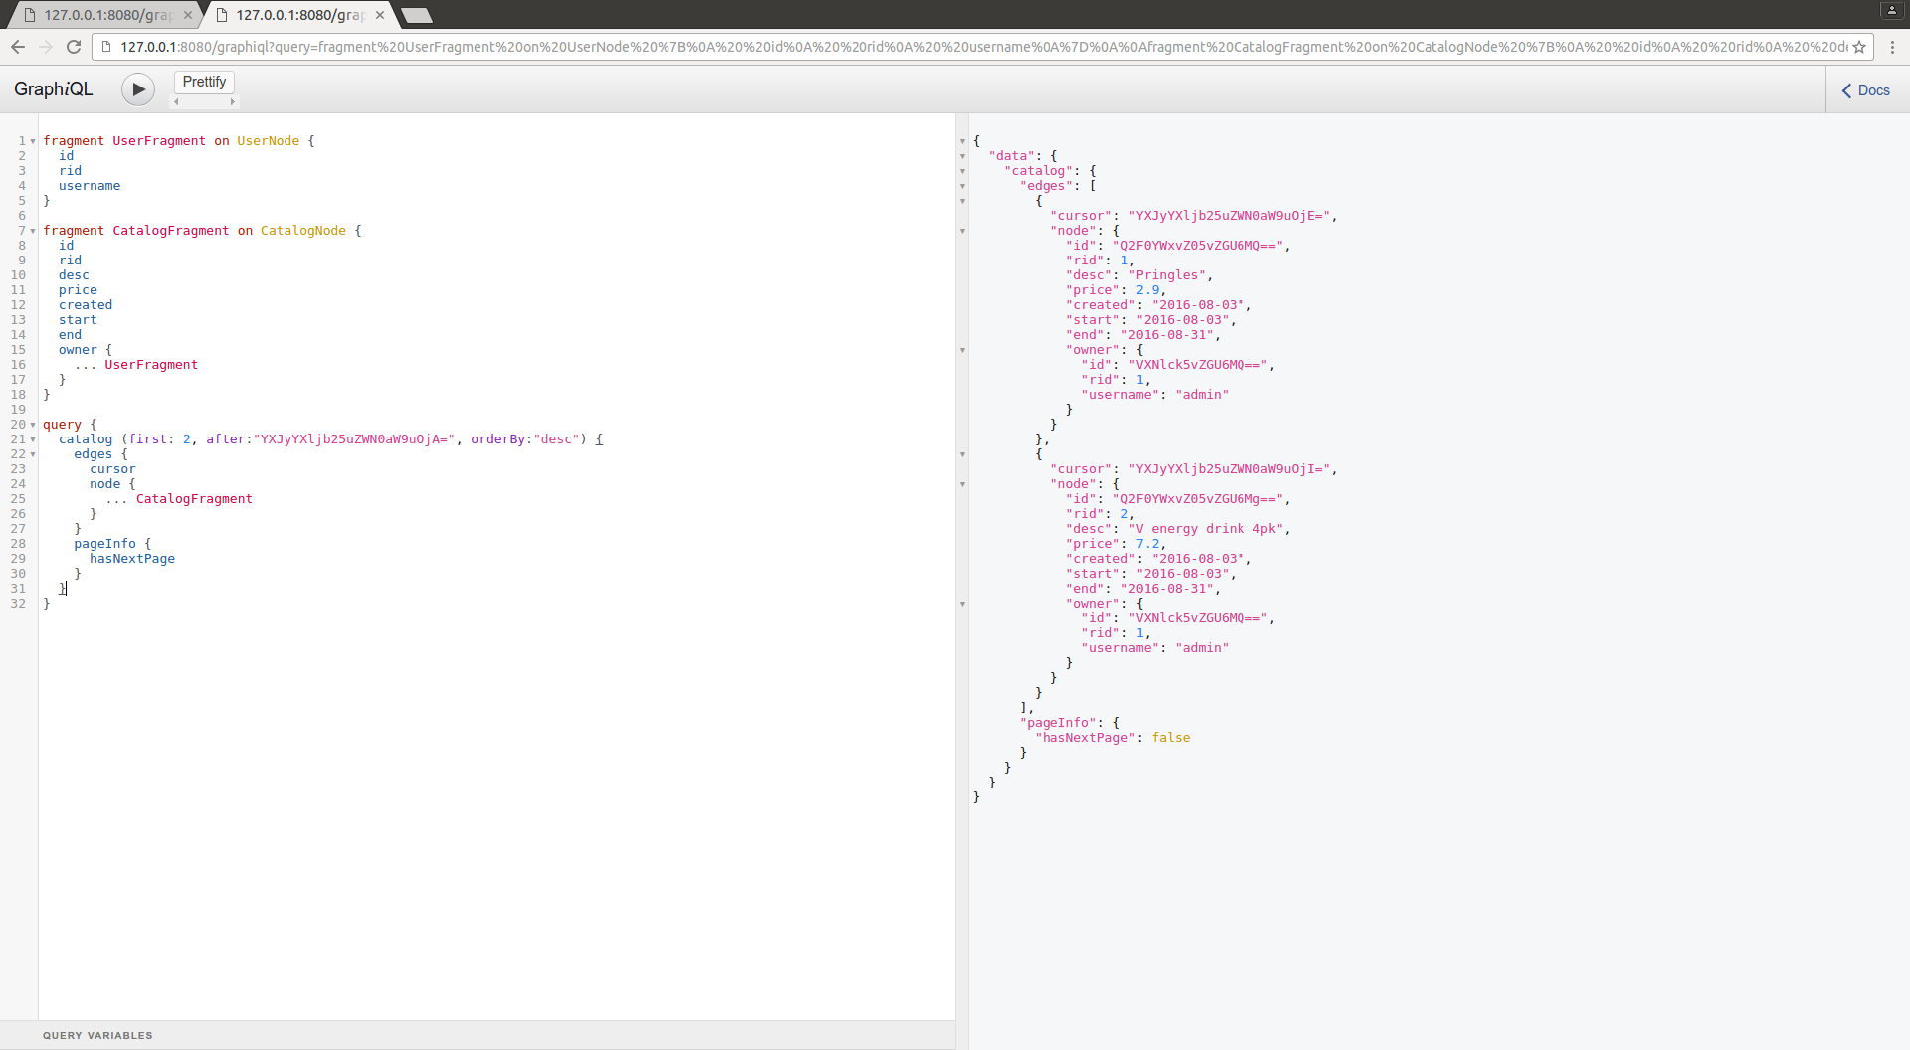
GraphQL language + Query’s

Slide 13
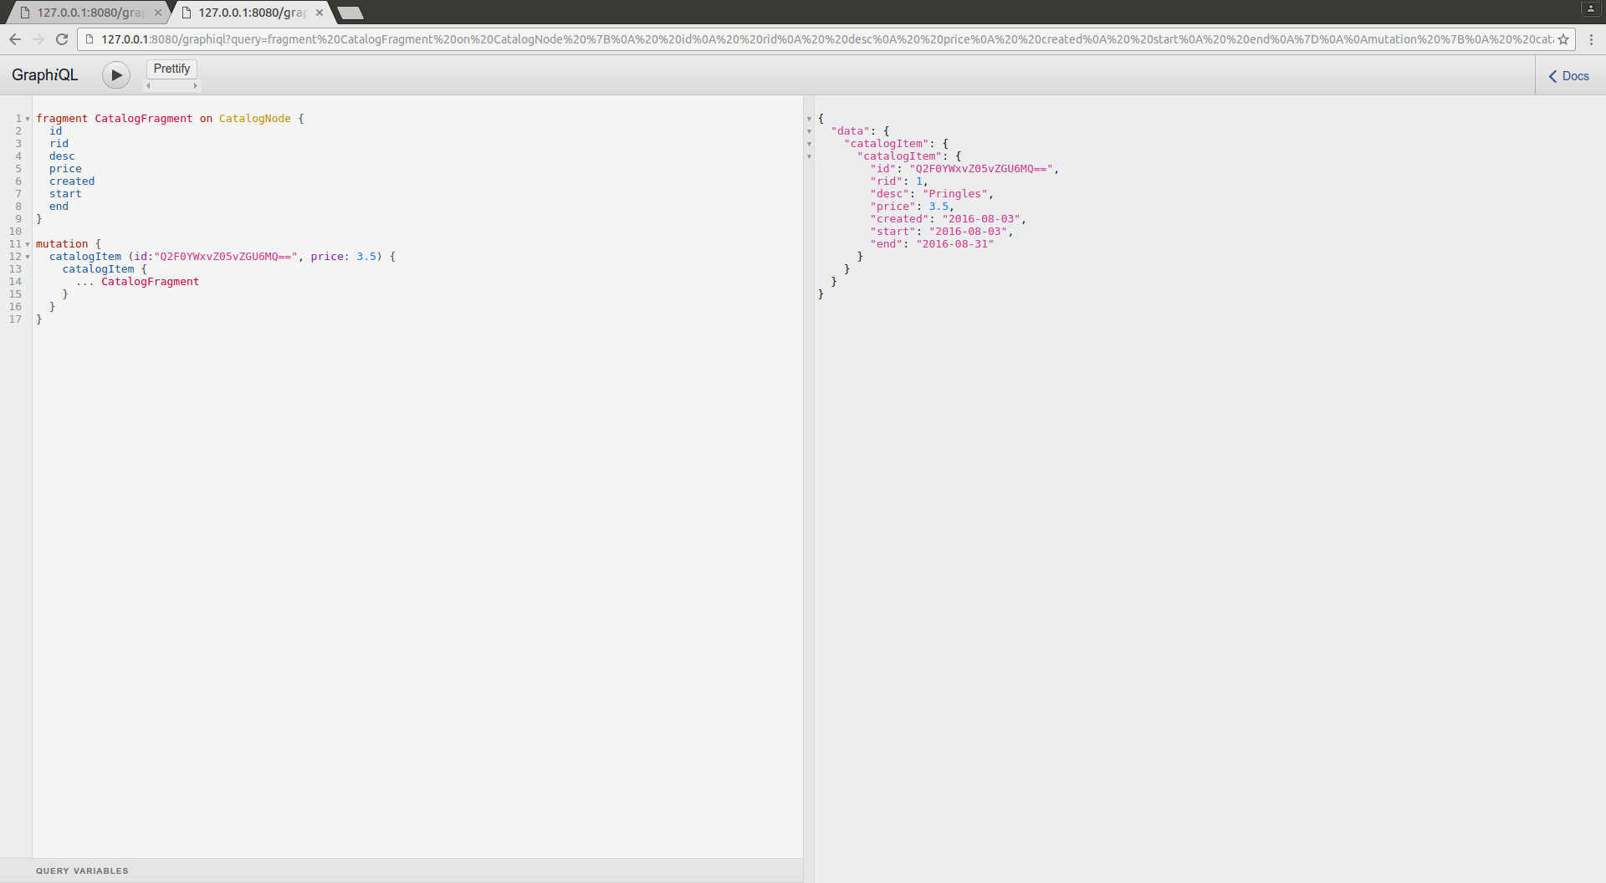
GraphQL language + Mutations

Slide 14
Graphene
Schema’s
Schema ~= Forms ~= Serializers
DjangoNode, DjangoFilterConnectionField
Query, Mutation (graphene.ObjectType)
Validation = Mutation(validation_errors=[str(e)])

Slide 15
Relay
Very cool way for React components to say “hey I need these parts of the schema” and then they get them without having to know anything else
basically this could replace 90% of Iron’s schema stuff :)
But, thats a story for another day.

