Slide 1
Class 1 – Intro, getting to know each other and setting things up
By Aaron E-J

Slide 2
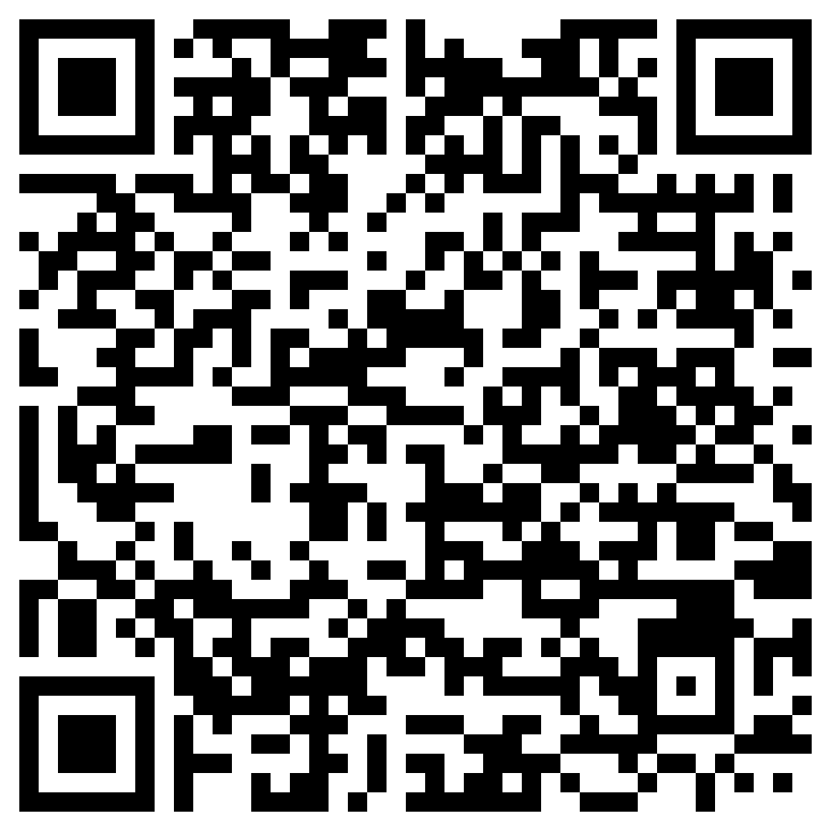

We are going to do a little experiment:
Stream of consciousness try to think of new, novel ideas
– what does "Idea" even mean to you? –
My hypothesis is that, out of context or prompting, coming up with novel ideas will be hard. However, given the context of a this being the first real week in school, your mind is probably overloaded with new experiences, so it will be interesting to see.
The first part is simple: everyone open the following URL or scan the QR code ( https://otherrealm.org/unprompted )
And, on a blank page write down all the ideas that pop into your head!
Link to Google Doc
for ideas, no context

Slide 3
Introductions
First, lets go around the room and interduce ourselves
Share:
Your name
What department you are in
Why you decided to take this class
Complete the sentence: “By the end of this class, I hope to know…”

Slide 4
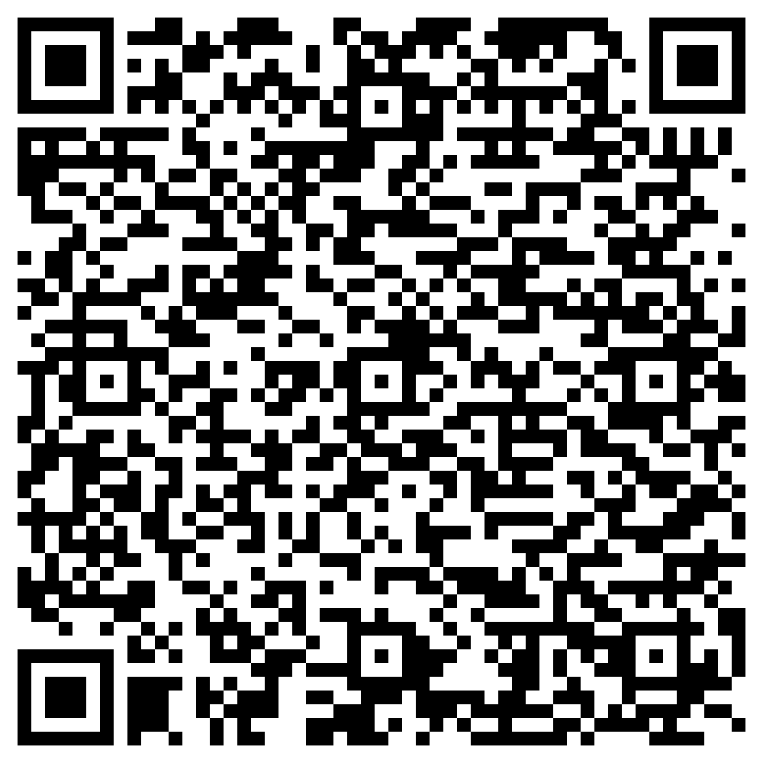
https://otherrealm.org/teamslink
https://otherrealm.org/teamslink

Slide 5

Does everyone have a GitHub account?
We will be using GitHub for several things throughout the semester
The class repository is here: https://github.com/other-realm/spark

Slide 6
Week 1 Assignment: Resources and setting things up
This week's assignment will be to finish getting set up the software/accounts we will be using during the rest of the semester and to read the syllabus. We will be using canvas.
Go to: https://umamherst.instructure.com/courses/4952
Submit:
A link to your GitHub account so that I can add you to our team.
Any questions, concerns, ideas, or other info you have
This is mainly to make sure everyone is squared away with Canvas

