Slide 1
Class 3 – The basics of breaking goals into bite-sized chucks: creating a plan for how to go from idea to ideation
Aaron E-J

Slide 2
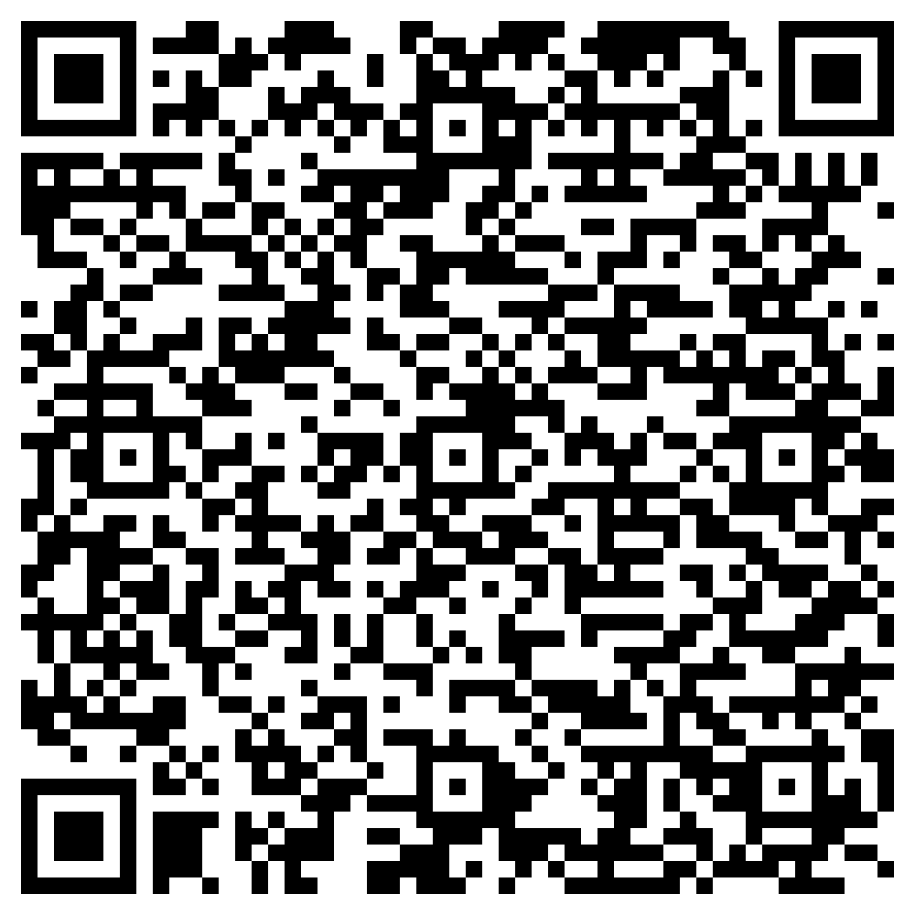
https://otherrealm.org/teamslink
https://otherrealm.org/teamslink

Slide 3
Assignment
This week's assignment will be to start to analyze the ideas everyone identified as to what they were interested in further researching and break them into actionable tasks, using their own projects as Kanban GitHub projects. To make this happen, each group should coordinate with each other in setting up a project in the 'Projects' tab in the spark repository. I will try to make discussion channels using the chat application we decided on for each project so that you can coordinate things.

