Slide 1
Part Time Jobs For Students
Prepared by
Nahada Rais 16.02.04.006
Nowshin Rumali 16.02.04.107
Fatema-Tuz-Zohora Salma 17.01.04.150

Slide 2
Part-Timers
Final Presentation

Slide 3
Introduction of project
This project is created for hiring part-time workers. User can add post and they can also search by categories and find suitable jobs. User can apply for jobs via mail.

Slide 4
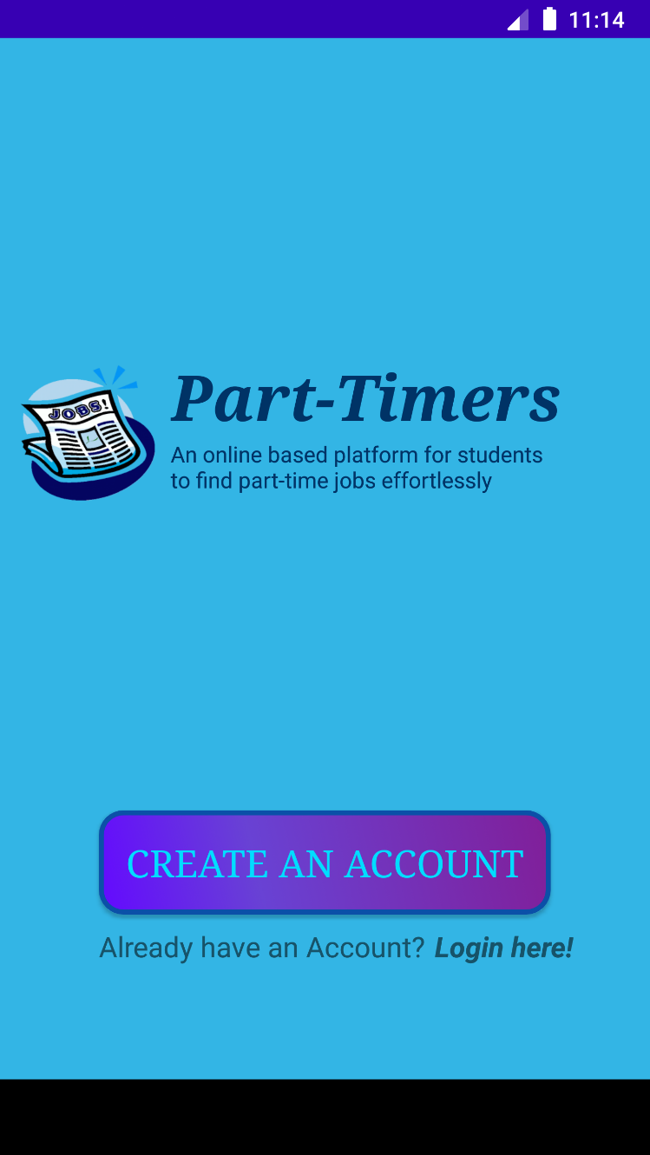
Features
In this page user can login and create an account into this project via login and sign up activity.

Slide 5
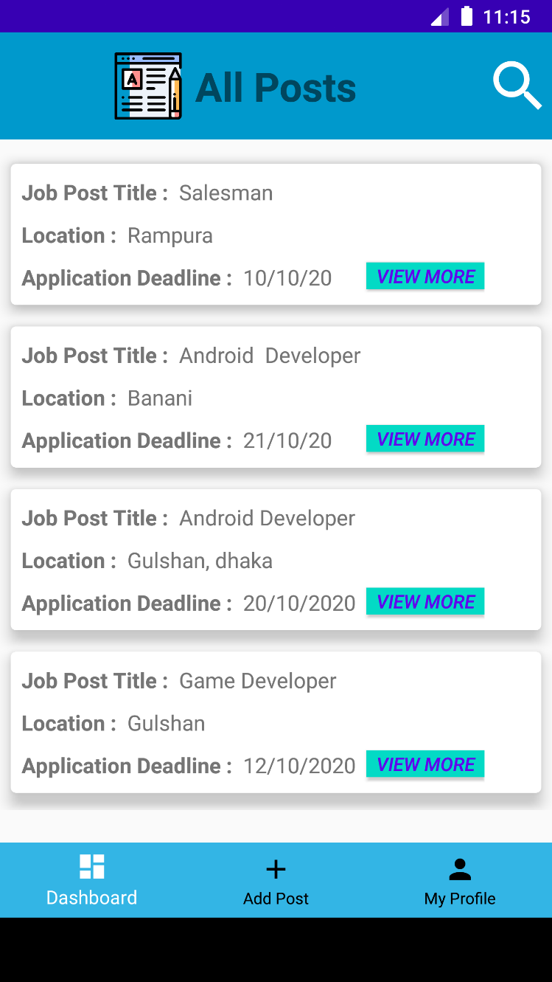
Features
After login and sign up user can see all job post via dashboard. And also search posts via category wise search.

Slide 6
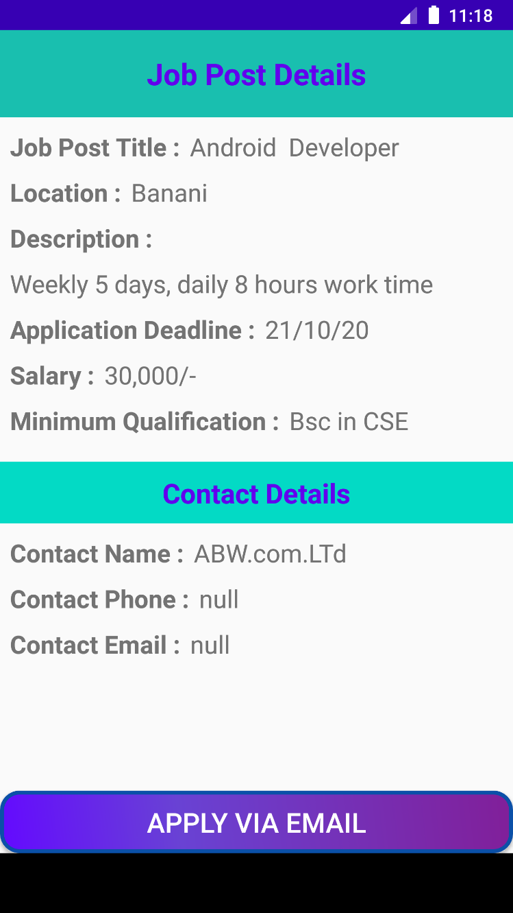
Features
By click on view more user can see the job post details in this page and user can apply for a job via email.

Slide 7
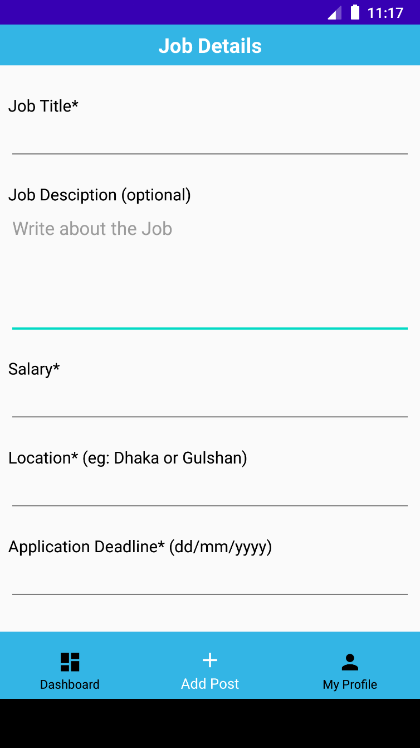
Features
In this page user can add job posts.

Slide 8
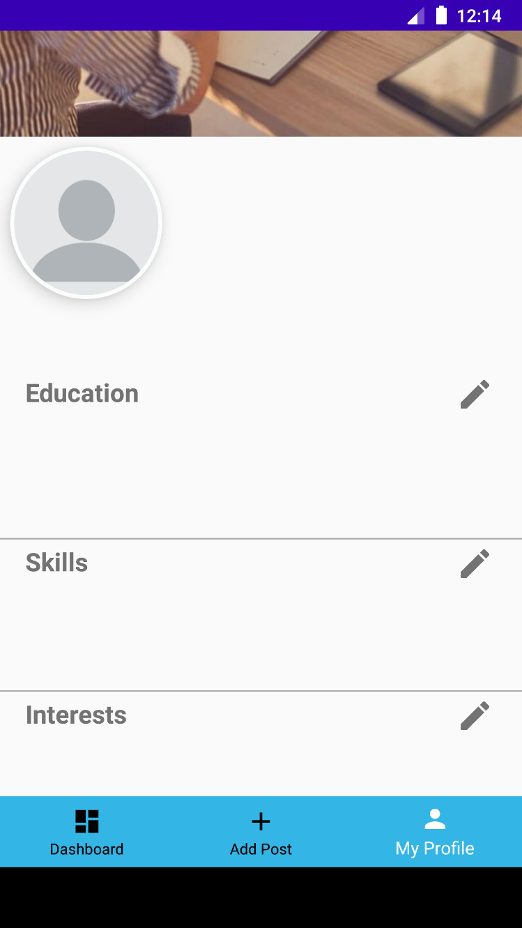
Features
In profile user can add and edit their education, skills, interests.

Slide 9
Thank You..

