Slide 1
IMPROVING PERFORMANCE OF HEART DISEASE PREDICTION THROUGH FEATURE DEPENDENCY EXTRACTION
By
Usman Abdullahi Musa
SPS/CSC/MSC/18/0006
Supervisor:
Dr. Muhammad Sirajo Aliyu (FNCS,MCPN)

Slide 2
INTRODUCTION
Cardiovascular diseases are conditions that affect the structures or function of your heart (Steinbaum, 2019).
CVD is responsible for 11% of over 2 million NCD deaths in Nigeria annually.
Risk factors
Modifiable e.g physical inactivity, tobacco and alcohol intake
nonmodifiable risk factors e.g age, family history(Emakhu et al., 2020; WHO, 2019). and
emerging risk factors e.g elevated homocysteine, small, dense lipoprotein (Lpa).(Ike & Onyema, 2020).

Slide 3
BACKGROUND OF THE STUDY
Electronic health record (EHR) systems makes the use of strong analysis tools necessary.
Increasing the efficiency of diagnosis and reducing the misclassification cost (Dandona et al., 2017).
enhancing the selection of features(attributes) (Jothi Prakash & Karthikeyan, 2021) and
relationship between certain factors to the presence of heart disease (Muibideen & Prasad, 2020)
Bayesian Network (Muibideen & Prasad, 2020)
AdaBoost, Bagging, Random Forest, and Voting Ensemble (Decision Trees, Logistic Regression and Support Vector Machines) ). (Emakhu et al., 2020)
High number of feature/attributes needs dimensionality reduction (Lidy & Rauber, 2008).

Slide 4
PROBLEM STATEMENT
There is need for further study in reduction of the dimensionality in heart disease dataset to achieve better performance

Slide 5
AIM AND OBJECTIVE OF THE STUDY
Aim
The aim of the study is to improve the performance of heart disease prediction through feature/dimension reduction.
Objectives:
The objectives are to
Review models use in heart disease prediction with the intention of providing a better model.
Perform Different feature reduction technique and measure performance on different models of each.
Compare the results with other related works.

Slide 6
SIGNIFICANCE OF THE STUDY
As heart disease has become is a silent epidemic, accurate and timely prediction of heart disease is important. This will help in reduction in the cost of treatment, loss of life and also increases the chances of recovery.

Slide 7
SCOPE AND LIMITATION OF THE STUDY
Scope
This study covers the use of structured tabular data on supervised machine learning algorithms to accurately predict the risk of the presence of heart disease in a person.
Limitation
The Study does not include the use of heart image data to make prediction on the presence of heart disease in a person

Slide 8
LITERATURE REVIEW
S/N | Title | Author | Method Used | Evaluation Metrics | Weakness
 | A fast algorithm for heart disease prediction using Bayesian network model | Mistura Muibideen and Rajesh Prasad -2020 | Bayesian network (BN) | Accuracy, Precision, Recall, F1 Score | Other models apart from Bayesian models were not investigated
2. | Coronary Artery Disease Diagnosis; Ranking the Significant Features Using Random Trees Model | Javad Hassannataj Joloudari , et al. -2020 | Random Trees, Decision Trees, support vector machine (SVM) | Accuracy, ROC curve, Gini, Gain and Confidence | Feature selection techniques could improve performance of prediction
3. | An Efficient Convolutional Neural Network for Coronary Heart Disease Prediction | Aniruddha Dutta, Tamal Batabyal, Meheli Basu, Scott T. Acton -2020 | Convolutional Neural Network (CNN) | Confusion matrix AUC Recall Specificity Accuracy | The training process takes a lot of time on non-GPU systems.
4. | Early Prediction of Heart Disease Using PCA and Hybrid Genetic Algorithm with k-Means | Md. Touhidul Islam, Sanjida Reza Rafa, Md. Golam Kibria -2021 | K-Means with PCA and Hybrid Genetic Algorithm | Accuracy, Clustering Error, Recall, Precision,F1 Score | Other feature selection techniques were not investigated

Slide 9
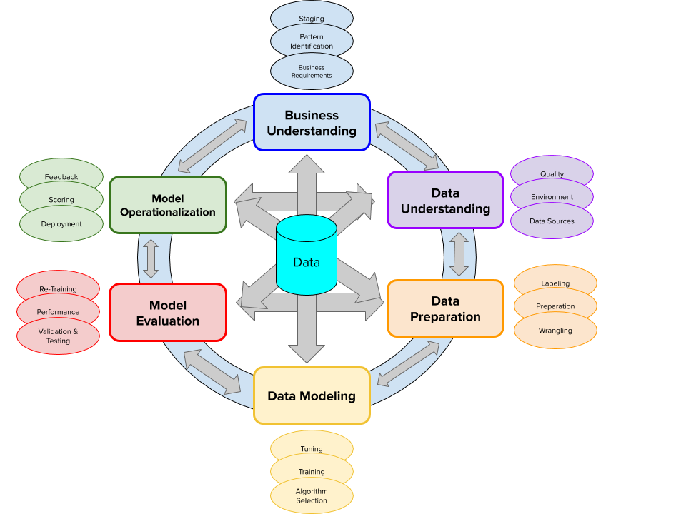
METHODOLOGY
Cognitive Project Management for Artificial Intelligence (CPMAI) Source: (Cognilytica, 2021)

Slide 10
METHODOLOGY cont..
Business Understanding
A good heart disease prediction system
Data Understanding
Data retrieval and Exploratory Data Analysis
This data set contains 14 total attributes of patient medical information for 303 patients.

Slide 11
METHODOLOGY cont..
Attribute | Description | Type of Attribute | Attribute Value Range
Age | Age in years | Numeric | 29 to 77
Sex | Gender | Nominal | 0 = female, 1 = male
cp | Chest pain type | Nominal | 1 = typical angina, 2 = atypical angina, 3 = non-angina pain, 4 = asymptomatic
trestbps | Resting blood pressure in mm Hg on admission to the hospital | Numeric | 94 to 200
chol | Serum cholesterol in mg/dL | Numeric | 126 to 564
fbs | Fasting blood sugar > 120 mg/dL | Nominal | 0 = false, 1 = true
restecg | Resting electrocardiographic results | Nominal | 0 = normal, 1 = ST-T wave abnormality, 2 = definite left ventricular hypertrophy by Estes’ criteria
thalach | Maximum heart rate achieved | Numeric | 71 to 202
exang | Exercise induces angina | Nominal | 0 = no 1 = yes
oldpeak | ST depression induced by exercise relative to rest | Numeric | 0 to 6.2
slope | The slope of the peak exercise ST segment | Nominal | 1 = upsloping, 2 = flat, 3 = down sloping
ca | Number of major vessels colored by fluoroscopy | Nominal | 0–3
thal | The heart status | Nominal | 3 = normal, 6 = fixed defect, 7 = reversible defect
num | Prediction attribute | Nominal | 0= Unlikely to obtain heart disease 1 = Likely to obtain heart disease

Slide 12
METHODOLOGY cont…
Data preparation
Handling missing values (Rows deletion, Mean/Mode etc)
Feature Selection (Wrapper Method)
Data discretization
Data Modeling
Naïve Bayes
Bayesian Network,
KNN, and
Logistic Regression.
Model Evaluation
Accuracy
Precision
Recall
F1 Score
MCC
Kappa Statistics
Model Operationalization
GitHub repository

Slide 13
Results and Discussion
Attribute Selection
Feature Subset Evaluation Result
Attribute Evaluator
Wrapper Subset Evaluation
Search Method
Best First
Evaluation mode
10-fold cross-validation
1( 10 %) 1 age
2( 20 %) 2 sex
9( 90 %) 3 cp
0( 0 %) 4 trestbps
0( 0 %) 5 chol
0( 0 %) 6 fbs
1( 10 %) 7 restecg
0( 0 %) 8 thalach
4( 40 %) 9 exang
1( 10 %) 10 oldpeak
4( 40 %) 11 slope
6( 60 %) 12 ca
7( 70 %) 13 thal

Slide 14
Comparative Result
Model |  | Accuracy (%) | Precision | Recall | F-Measure | MCC | ROC Area | Kappa statistic
Naïve Bayes | Dataset Before reduction | 85.2459 | 0.853 | 0.852 | 0.853 | 0.705 | 0.921 | 0.7047
 | Reduced Dataset | 85.2459 | 0.855 | 0.852 | 0.852 | 0.706 | 0.919 | 0.7028
Bayesian Network | Dataset Before reduction | 86.8852 | 0.869 | 0.869 | 0.869 | 0.737 | 0.927 | 0.7371
 | Reduced Dataset | 88.5246 | 0.888 | 0.885 | 0.885 | 0.773 | 0.920 | 0.7688
KNN | Dataset Before reduction | 81.9672 | 0.836 | 0.820 | 0.816 | 0.652 | 0.893 | 0.6343
 | Reduced Dataset | 80.3279 | 0.807 | 0.803 | 0.802 | 0.608 | 0.856 | 0.603
Logistic Regression | Dataset Before reduction | 85.2459 | 0.855 | 0.852 | 0.852 | 0.706 | 0.914 | 0.7028
 | Reduced Dataset | 83.6066 | 0.836 | 0.836 | 0.836 | 0.671 | 0.910 | 0.6713

Slide 15
RESULT AND DISCUSSION
ALGORITHMS | TRAINING/TESTING ACCURACY RATIO
 | 0.1 | 0.2 | 0.3 | 0.4 | 0.5 | 0.6 | 0.7 | 0.8 | 0.9
Naïve Bayes | 82.4176 | 83.8843 | 85.3774 | 84.0659 | 86.0927 | 87.6033 | 86.8132 | 86.8852 | 86.6667
Bayesian Network | 81.685 | 83.4711 | 86.3208 | 85.1648 | 87.4172 | 87.6033 | 86.8132 | 88.5246 | 86.6667
KNN | 79.8535 | 79.3388 | 79.717 | 80.2198 | 82.1192 | 80.1653 | 82.4176 | 80.3279 | 86.6667
Logistic Regression | 68.8645 | 65.2893 | 75.000 | 82.4176 | 86.0927 | 83.4711 | 81.3187 | 85.2459 | 83.3333
TRAINING/TESTING ACCURACY RATIO

Slide 16
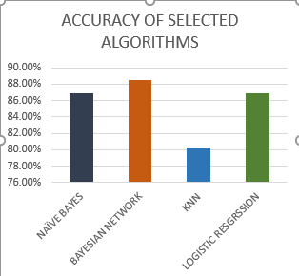

Slide 17
Model | Accuracy | Precision | Recall | F-Measure | MCC | ROC Area | Kappa statistic
Naïve Bayes | 86.8852 | 0.870 | 0.869 | 0.868 | 0.738 | 0.920 | 0.7362
Bayesian Network | 88.5246 | 0.888 | 0.885 | 0.885 | 0.773 | 0.920 | 0.7688
Logistic Regression | 86.8852 | 0.870 | 0.869 | 0.868 | 0.738 | 0.908 | 0.7362
KNN | 80.3279 | 0.804 | 0.803 | 0.803 | 0.606 | 0.873 | 0.6043

Slide 18
Comparison of Various Approaches with our Proposed Approach
S/N | Author and Year | Method | Dataset | Metrics
1. | Mistura Muibideen & Rajesh Prasad, 2020 | Bayesian Network | Cleveland dataset: 14 Attributes | Accuracy: 85% Precision: 86% Recall: 85% F1- Score: 85%
2. | Aniruddha Dutta, Tamal Batabyal, Meheli Basu, Scott T. Acton -2020 | 2-layer CNN | NHANES dataset: 7 attributes | Accuracy: 81.78% Recall: 77.3% Specificity: 81.8 % AUC: 76.78 %
3. | Sahithi Ankireddy -2020 | Deep Neural Network (DNN) | Cleveland dataset: 14 Attributes | Accuracy: 85.60%
4. | Ekta Maini, and Bondu Venkateswarlu -2021 | Ensembling techniques (Naïve Bayes, SVM, Logistic Regression and and Multilayer Perceptron) | Cleveland dataset: 14 Attributes | Accuracy: 87.5%
5. | Our proposed approach | Bayesian Network with Wrapper subset evaluation (For feature selection) | Cleveland dataset: 8 Attributes. Namely: age, sex, cp, exang, oldpeak, slope, ca, thal | Accuracy: 88.53% Precision: 88.8 % Recall: 88.5% F1- Score: 88.5 % ROC Area: 92.0%

Slide 19
REFERENCES
Almustafa, K. M. (2020). Prediction of heart disease and classifiers’ sensitivity analysis. BMC Bioinformatics, 21(1), 1–18. https://doi.org/10.1186/s12859-020-03626-y
Cognilytica. (2021). CPMAI Methodology - Cognilytica. https://www.cognilytica.com/cpmai/
Dandona, L., Dandona, R., Kumar, G. A., Shukla, D. K., Paul, V. K., Balakrishnan, K., Prabhakaran, D., Tandon, N., Salvi, S., Dash, A. P., Nandakumar, A., Patel, V., Agarwal, S. K., Gupta, P. C., Dhaliwal, R. S., Mathur, P., Laxmaiah, A., Dhillon, P. K., Dey, S., … Swaminathan, S. (2017). Nations within a nation: variations in epidemiological transition across the states of India, 1990–2016 in the Global Burden of Disease Study. The Lancet, 390(10111), 2437–2460. https://doi.org/10.1016/S0140-6736(17)32804-0
Dietterich, T. G. (2000). Ensemble methods in machine learning. Lecture Notes in Computer Science (Including Subseries Lecture Notes in Artificial Intelligence and Lecture Notes in Bioinformatics), 1857 LNCS, 1–15. https://doi.org/10.1007/3-540-45014-9_1
Emakhu, J., Shrestha, S., & Arslanturk, S. (2020). Prediction system for heart disease based on ensemble classifiers. Proceedings of the International Conference on Industrial Engineering and Operations Management, August, 2337–2347.
Gao, X. Y., Amin Ali, A., Shaban Hassan, H., & Anwar, E. M. (2021). Improving the Accuracy for Analyzing Heart Diseases Prediction Based on the Ensemble Method. Complexity, 2021. https://doi.org/10.1155/2021/6663455
Ivens, G. P. (1983). Chemical process dynamics. The Chemical Engineering Journal, 27(2), 120–121. https://doi.org/10.1016/0300-9467(83)80063-x
Jothi Prakash, V., & Karthikeyan, N. K. (2021). Enhanced Evolutionary Feature Selection and Ensemble Method for Cardiovascular Disease Prediction. Interdisciplinary Sciences: Computational Life Sciences, 0123456789. https://doi.org/10.1007/s12539-021-00430-x
Leon, F., Floria, S. A., & Badica, C. (2017). Evaluating the effect of voting methods on ensemble-based classification. Proceedings - 2017 IEEE International Conference on INnovations in Intelligent SysTems and Applications, INISTA 2017, July, 1–6. https://doi.org/10.1109/INISTA.2017.8001122

Slide 20
REFERENCES
Lidy, T., & Rauber, A. (2008). Machine Learning Techniques for Multimedia. Machine Learning Techniques for Multimedia, 11, 249–285. https://doi.org/10.1007/978-3-540-75171-7
Loyola-Gonzalez, O. (2019). Black-box vs. White-Box: Understanding their advantages and weaknesses from a practical point of view. IEEE Access, 7, 154096–154113. https://doi.org/10.1109/ACCESS.2019.2949286
Muibideen, M., & Prasad, R. (2020). A Fast Algorithm for Heart Disease Prediction using Bayesian Network Model. 1–11. http://arxiv.org/abs/2012.09429
Sai Shekhar, M., Mani Chand, Y., & Mary Gladence, L. (2021). Heart Disease Prediction Using Machine Learning. Lecture Notes in Electrical Engineering, 708(Inccst 20), 603–609. https://doi.org/10.1007/978-981-15-8685-9_63
Steinbaum, S. R. (2019). Cardiovascular (Heart) Diseases: Types and Treatments. https://www.webmd.com/heart-disease/guide/diseases-cardiovascular
Usha Sri, B. (2020). Effective Heart Disease Prediction Model Through Voting Technique. International Journal of Engineering Technology and Management Sciences, 4(5), 10–13. https://doi.org/10.46647/ijetms.2020.v04i05.003
WHO. (2019). WHO and Nigerian Government move to curb cardiovascular diseases | WHO | Regional Office for Africa. https://www.afro.who.int/news/who-and-nigerian-government-move-curb-cardiovascular-diseases

Slide 21
THANK YOU FOR LISTENING

