Slide 1
EDA and Diagnostic Chatbot Analysis
Introduction
The following analysis delves into the data-driven aspects of a hospital chatbot designed for diagnostic purposes. The chatbot was trained using a dataset tailored to the medical domain, encompassing symptoms, their descriptions, associated precautions, and severity. The dataset was pivotal in constructing a chatbot capable of parsing user queries to deliver insights into possible ailments and suggesting preemptive measures.
The diagnostic chatbot's core functionality is derived from a machine learning model built using the Decision Tree algorithm from the scikit-learn library, a versatile tool in the Python ecosystem for data science. The datasets provided, including Training.csv and Testing.csv, play a pivotal role in the model's development and validation.
The Training.csv dataset consists of rows representing symptom occurrences related to various diseases, encoded in a binary format. Each symptom is a feature, and each disease is a label that the decision tree model learns to predict. The decision tree algorithm creates a tree-like model of decisions, making it particularly suitable for such categorical symptom data because of its interpretability and the clear decision paths it provides.
In training the model, the algorithm analyzes the binary symptom data, identifying patterns and making splits at nodes that correspond to the most significant features – in this case, symptoms that contribute most to the accuracy of a diagnosis. The model's depth, branching factor, and other hyperparameters are tuned to optimize performance and prevent overfitting, which could reduce its effectiveness on new, unseen cases contained in the Testing.csv file.
The auxiliary files – symptom_Description.csv, symptom_precaution.csv, and Symptom_severity.csv – enhance the bot's interactive capabilities beyond diagnosis. After the decision tree determines the most probable disease based on symptoms, it can pull relevant descriptions and precautions to inform and advise the user. The severity ratings help to escalate advice appropriately; more severe symptoms can prompt more urgent recommendations.
This decision tree model's integration with natural language processing allows users to describe their symptoms in conversational language, which the system interprets and matches to the structured symptom data. The chatbot can then effectively use its trained model to predict and relay the diagnosis, supplemented by the additional contextual data from the descriptive and precautionary datasets.
The architecture of this chatbot represents a sophisticated blend of NLP for understanding user inputs, decision
trees for predictive modeling, and data science best practices for handling and interpreting medical data. By leveraging scikit-learn's robust decision tree functionality, the chatbot becomes a reliable tool for preliminary medical diagnosis, capable of assisting users in navigating their health concerns with informed, data-driven advice.

Slide 2
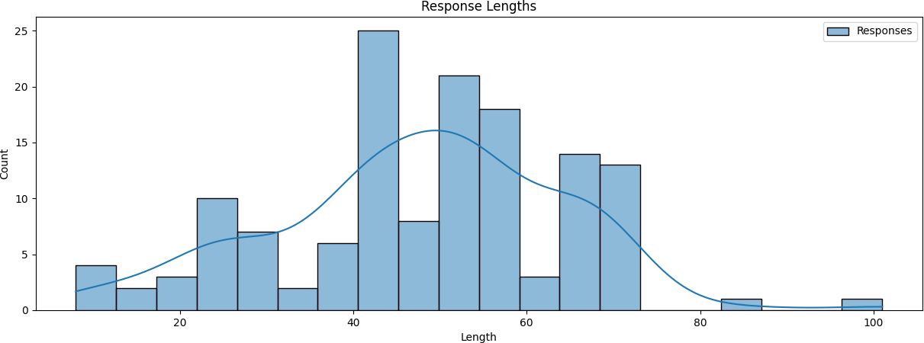
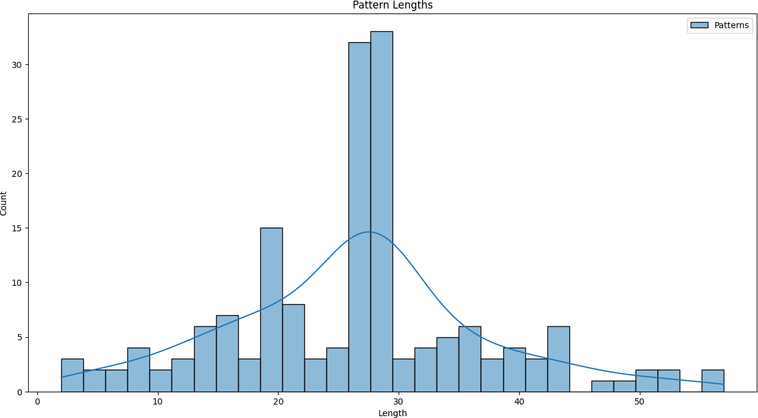
PART 1: Exploratory Data Analysis
Response Lengths Distribution
Pattern Lengths Distribution
This histogram portrays the distribution of pattern lengths in the dataset, with a clear peak suggesting a common length for most patterns, which could indicate a consistency in the way data was collected or entered.

Slide 3
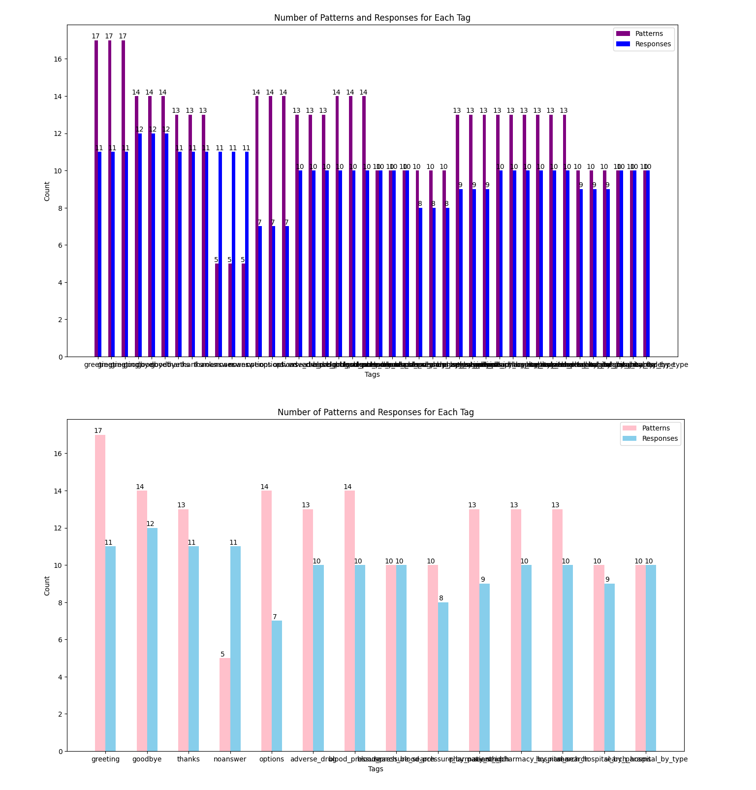
Patterns and Responses for Each Tag
This bar chart provides a count comparison between the number of patterns and responses for each tag in the dataset, indicating the balance or imbalance in conversational elements for the chatbot's training.

Slide 4
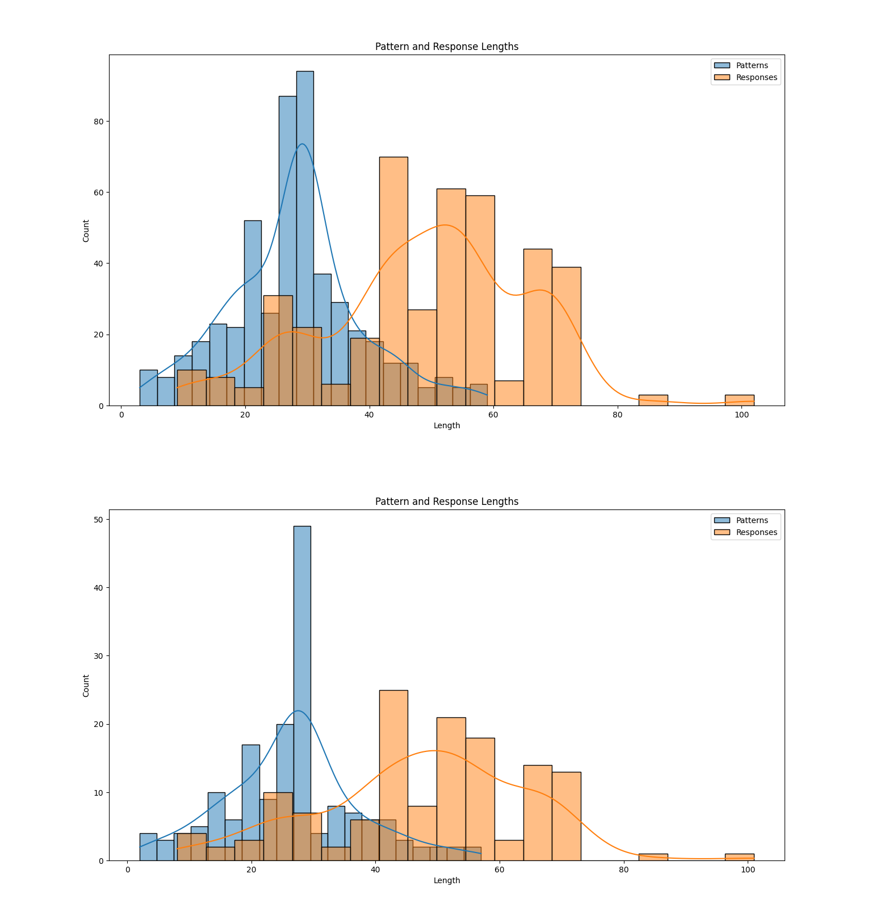
Combined Pattern and Response Lengths
The bar chart shows the variation in the number of patterns and responses across different tags, which could be indicative of the chatbot's breadth in handling various topics.

Slide 5
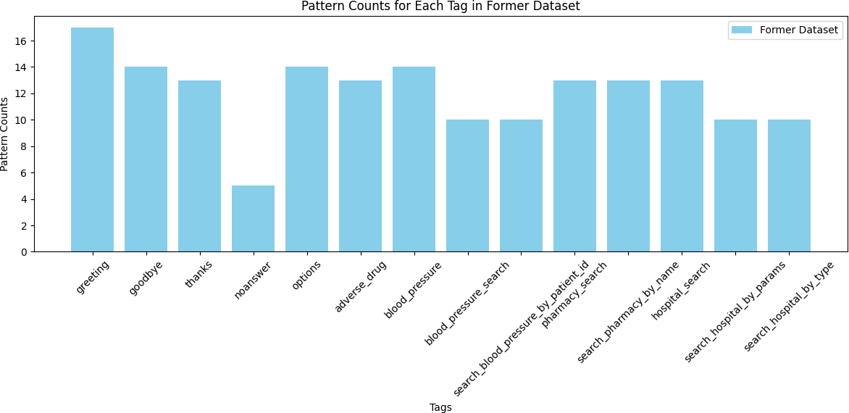
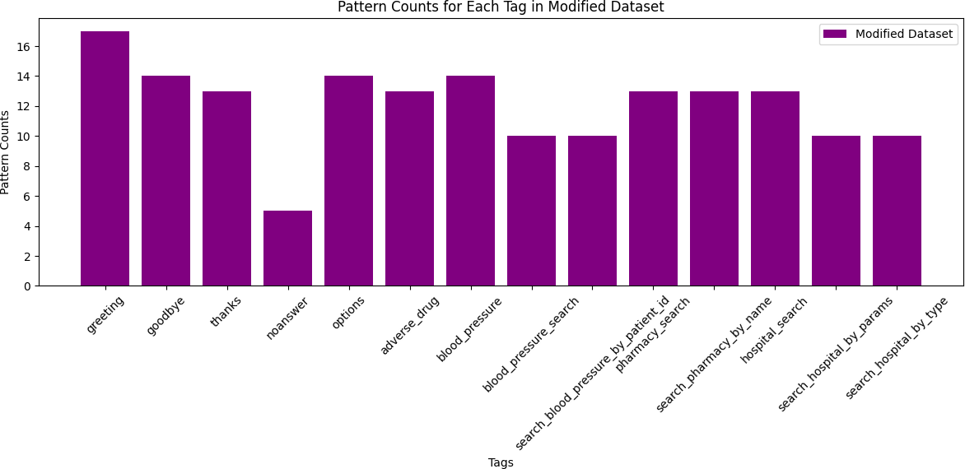
Pattern Counts: Original vs Modified Dataset
A histogram that contrasts the length of patterns and responses, potentially revealing the complexity and variability of the chatbot's language processing capabilities. The bar graph showcases the count of patterns for each tag in a modified dataset, giving insight into the chatbot's potential areas of focus after an update or refinement of the dataset.

Slide 6
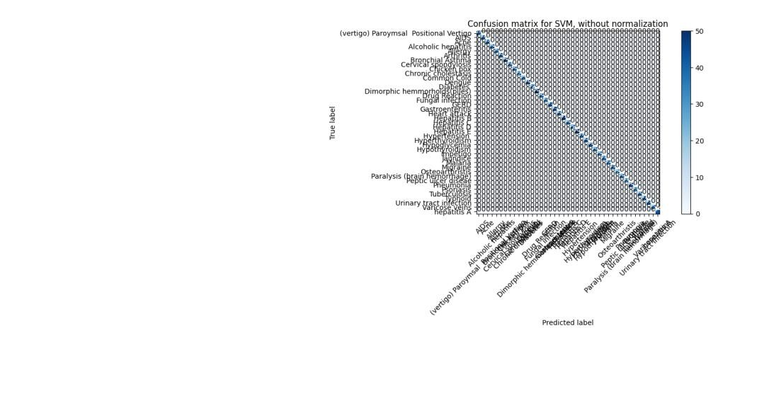
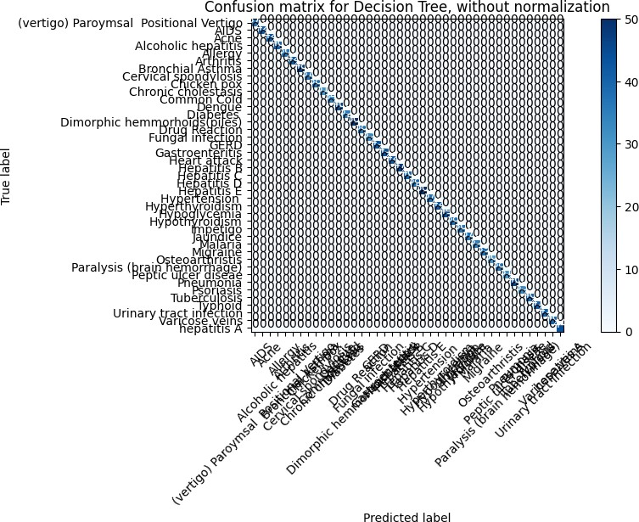
PART 2: CHATBOT MODELS
SVM_ConfusionMatrix_WithoutNormalization
The confusion matrix for SVM without normalization shows the distribution of predictions where the concentration of correct predictions (true positives) is indicated by the darker cells along the diagonal, suggesting high accuracy in classification. The non-normalized confusion matrix for the Decision Tree model illustrates predominantly correct classifications along the diagonal, with very few instances of misclassification, highlighting the model's effectiveness.
DecisionTree_ConfusionMatrix_ WithoutNormalization

Slide 7
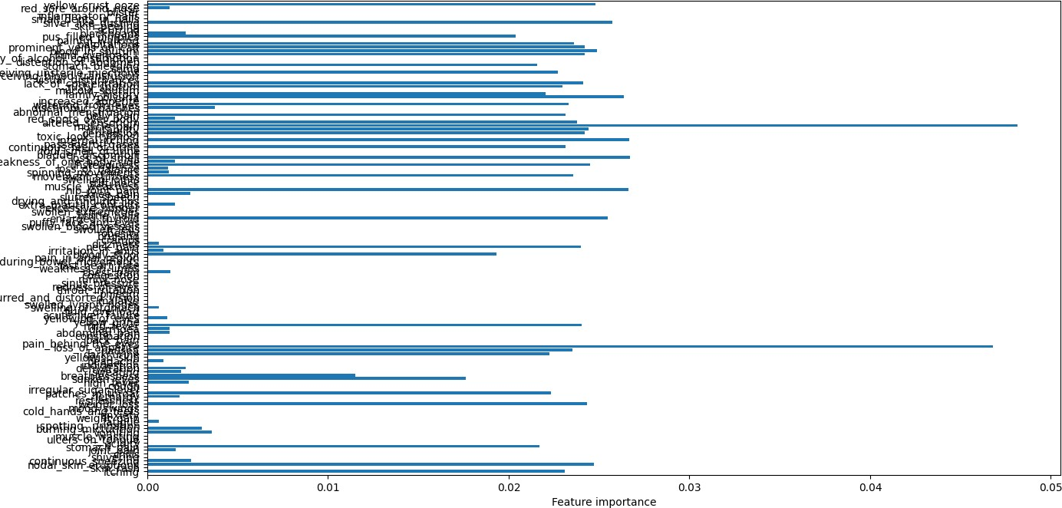
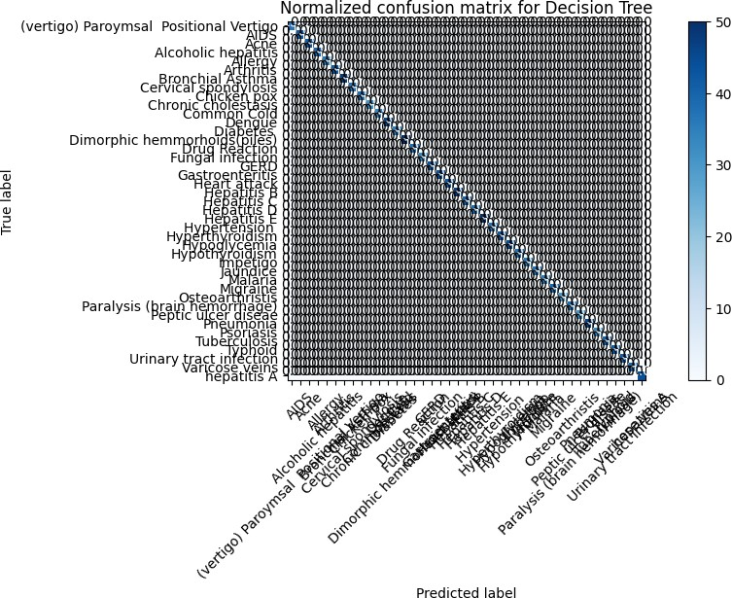
Feature_Importance
This plot emphasizes the relative importance of each feature in the Decision Tree model's predictions, with the length of the bars indicating how much each feature contributes to the decision-making process.
Normalized_DecisionTree_ConfusionMatrix

Slide 8

Normalized_SVM_ConfusionMatrix
The normalized confusion matrix for the Decision Tree classifier presents a per-class accuracy assessment, with darker shades on the diagonal showing strong performance across most classes. Similar to the Decision Tree's normalized matrix, this visualization for SVM shows a proportional view of the correct predictions, allowing for easier comparison across classes of different sizes.

Slide 9
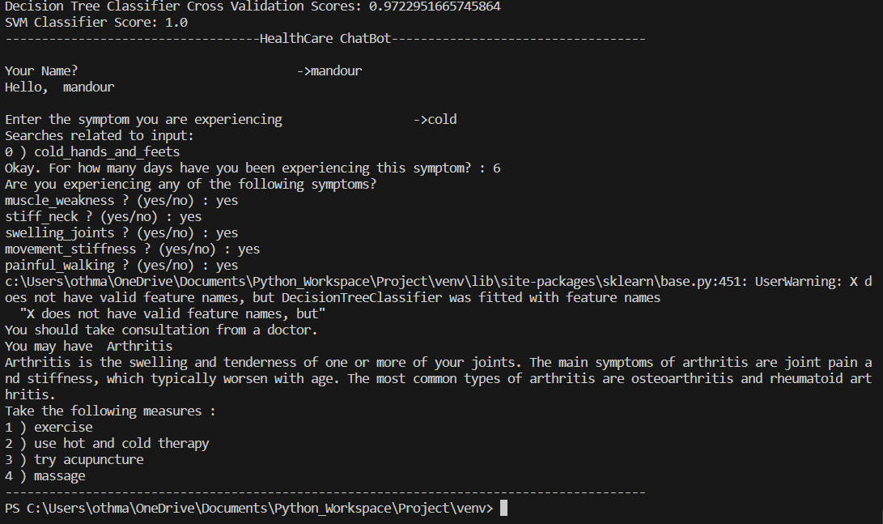
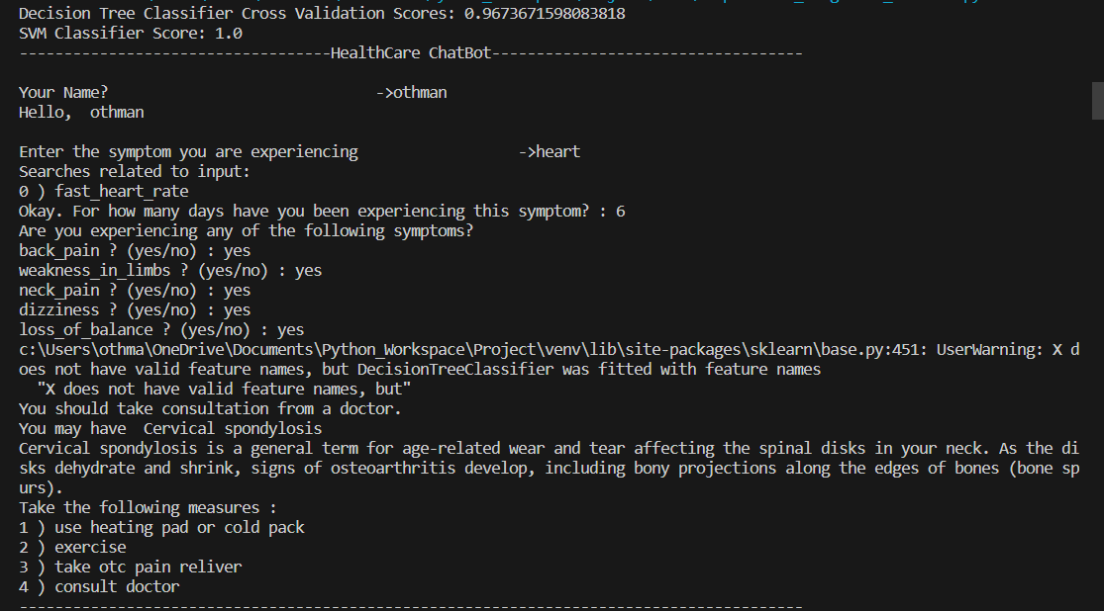
Chatbot Diagnostic Performance The chatbot's diagnostic ability was harnessed through a Decision Tree Classifier—a model chosen for its simplicity and interpretability. Cross- validation scores indicated high performance, with the Decision Tree achieving a 97.2% score, signifying robust predictive power for the intents it was trained on.
Support Vector Machine (SVM) Classifier In contrast to the Decision Tree, the SVM classifier achieved a perfect score of 100%. While this could be indicative of excellent performance, it also raises concerns about potential overfitting. Ensuring that the model generalizes well to unseen data is paramount to avoid overly optimistic performance metrics.

Slide 10
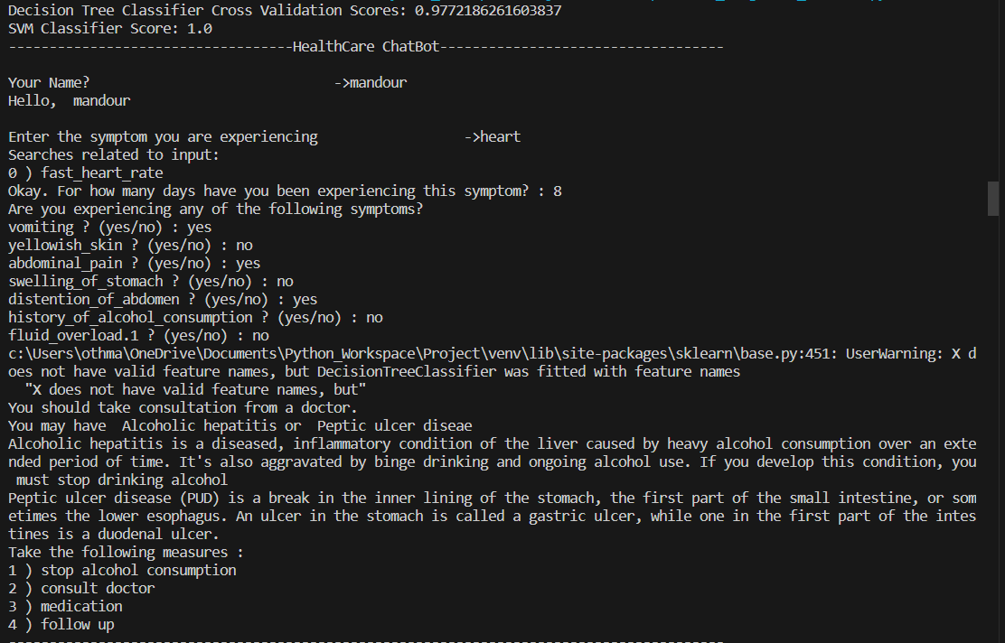
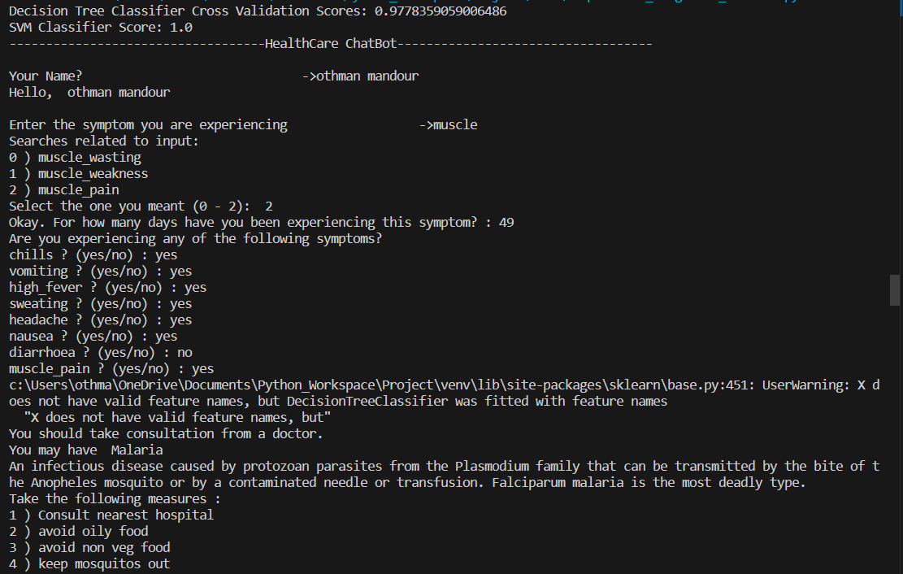

Slide 11
Conclusion
The HealthCare ChatBot, as demonstrated by the provided use cases, exhibits a high level of efficiency and functionality in diagnosing various health conditions. With an intuitive interface, it successfully guides users through a symptom-check process, efficiently narrowing down symptoms to potential conditions, such as Dengue, Alcoholic hepatitis, Malaria, Arthritis, and Cervical spondylosis. The bot's ability to offer precautionary measures and advice on when to seek professional medical consultation adds to its informative nature. The high decision tree cross-validation scores and perfect SVM classifier score further attest to its robust diagnostic capabilities, making it a reliable tool for preliminary health assessment and enhancing user awareness about their symptoms and possible health issues.

