Slide 1
Project 3: Exploratory Data Analysis
Summary Statistics and Information
The bank marketing dataset contains 41,188 entries and 21 features, including numerical, categorical, and binary (yes/no) data types. The features include various aspects such as demographics, last contact of the current campaign, campaign attributes, social and economic context attributes, and the target variable 'y' indicating whether the client has subscribed to a term deposit or not.
The extracted files include:
From 'bank.zip':
bank-full.csv
bank.csv
bank-names.txt (likely contains descriptions of the variables)
From 'bank-additional.zip':
A directory named 'bank-additional', which contains the other datasets for Project 4.
For computational reasons, I'll use bank-additional-full.csv, which includes all examples and 20 inputs. I'll start with Project 3 by loading this dataset and performing an Exploratory Data Analysis (EDA). After that, I'll proceed with Project 4, where I'll apply six machine learning models to predict whether a client will subscribe to a term deposit.
Let's begin with loading and exploring the bank-additional-full.csv.
The bank-additional-full.csv dataset has been successfully loaded. It contains 21 attributes, including various features related to the client (like age, job, marital status, education), details of the contact (month, day_of_week, contact type), campaign attributes (campaign, pdays, previous, poutcome), economic indicators (emp.var.rate, cons.price.idx, cons.conf.idx, euribor3m, nr.employed), and the target variable 'y' indicating whether the client has subscribed to a term deposit.
I will perform an EDA to understand the distributions, relationships, and trends in the data, which include:
1. Summary statistics and information about the dataset.

Slide 2
Distribution of key numerical and categorical variables.
Analysis of the target variable 'y'.
Correlation analysis between the attributes.
Visualization of relationships and patterns.
Once the EDA is complete, I'll summarize the findings and then proceed to Project 4, where I'll apply six different machine learning models to predict the target variable.
I'll now begin with the summary statistics and information about the dataset.
Summary of the Bank Marketing Dataset:
Entries and Features: The dataset contains 41,188 entries and 21 features.
Features: It includes numerical, categorical, and binary (yes/no) data types.
Notable Features:
Client information: Age, job, marital status, education, default history, housing, and loan status.
Last contact of the current campaign: Contact communication type, last contact month, last contact day of the week.
Other attributes: Campaign (number of contacts during this campaign), pdays (number of days that passed by after the client was last contacted from a previous campaign), previous (number of contacts performed before this campaign).
Social and economic context attributes: Employment variation rate, consumer price index, consumer confidence index, euribor 3-month rate, and number of employees.
Target Variable ('y'): Indicates whether the client has subscribed to a term deposit or not ('yes'/'no').

Slide 3
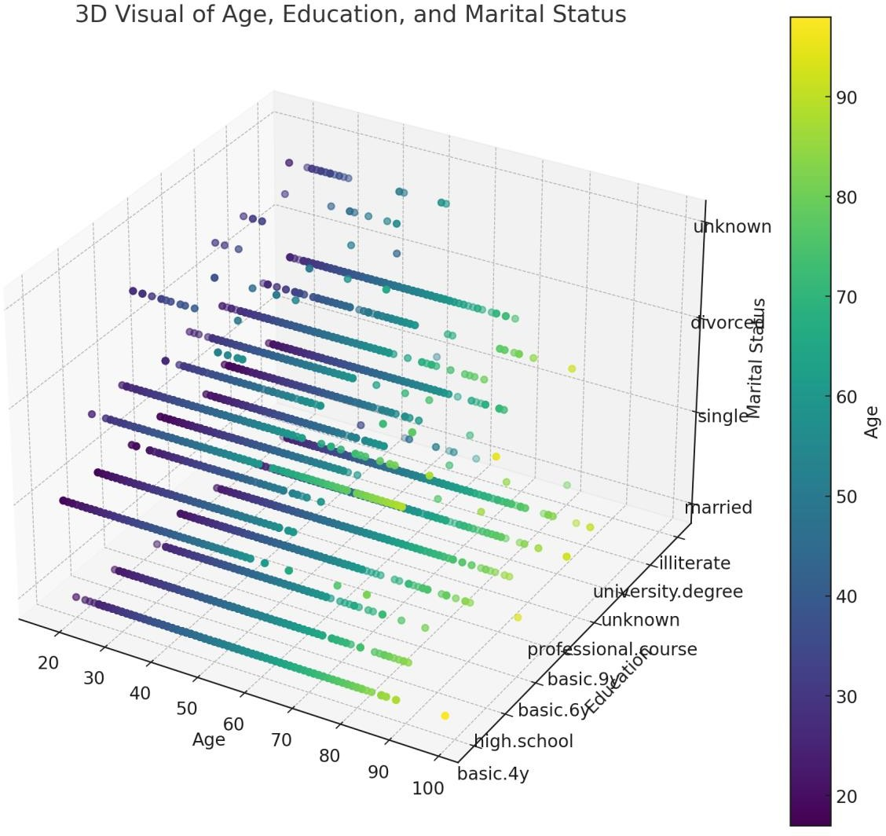
Data Characteristics:
Age: Ranges from 17 to 98, with a mean of approximately 40 years.
Jobs: Several types, with 'admin.' being the most common.
Marital Status: Mostly married clients.
Education: Various educational backgrounds, with 'university.degree' being most frequent.
Contact Attributes: Most contacts were made in May, with 'cellular' being the most common contact type.
Campaign Data: Varies significantly, with most clients not being previously contacted.
Economic Indicators: Vary across the dataset reflecting different time periods and conditions.

Slide 4
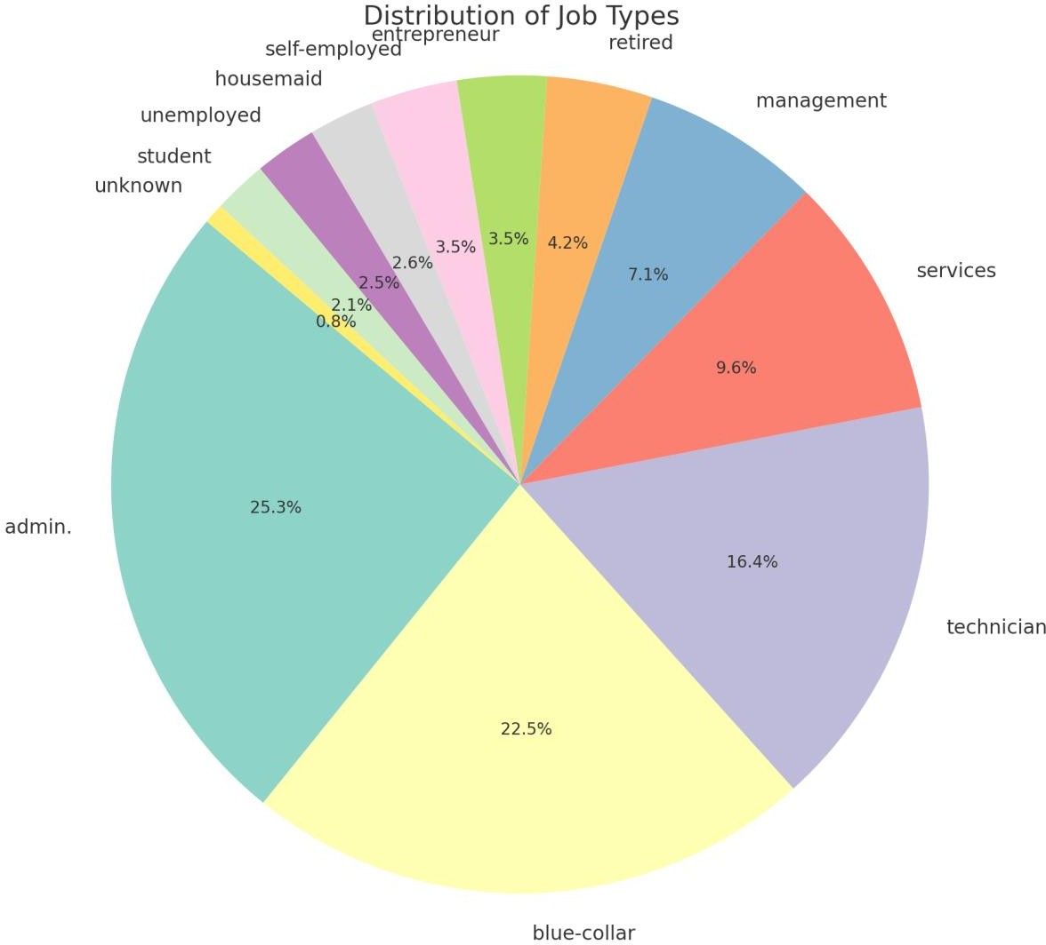
Target Variable ('y'): Majority of the entries are 'no', indicating that most clients did not subscribe to the term deposit.
CODE
# Setting up the visualization plt.style.use('seaborn-darkgrid')
# Creating subplots for key numerical variables fig, ax = plt.subplots(2, 3, figsize=(18, 12))

Slide 5
# Age Distribution
sns.histplot(bank_data['age'], bins=30, kde=True, ax=ax[0, 0]) ax[0, 0].set_title('Age Distribution')
# Duration of the call Distribution sns.histplot(bank_data['duration'], bins=30, kde=True, ax=ax[0, 1]) ax[0, 1].set_title('Call Duration Distribution')
# Campaign contacts Distribution sns.histplot(bank_data['campaign'], bins=30, kde=True, ax=ax[0, 2]) ax[0, 2].set_title('Campaign Contacts Distribution')
# pdays Distribution
sns.histplot(bank_data[bank_data['pdays'] != 999]['pdays'], bins=30, kde=True, ax=ax[1, 0]) # 999 means client was not previously contacted
ax[1, 0].set_title('Days Since Last Contact Distribution')
# Previous contacts Distribution sns.histplot(bank_data['previous'], bins=30, kde=True, ax=ax[1, 1]) ax[1, 1].set_title('Previous Contacts Distribution')
# Euribor 3 month rate Distribution sns.histplot(bank_data['euribor3m'], bins=30, kde=True, ax=ax[1, 2]) ax[1, 2].set_title('Euribor 3 Month Rate Distribution')
plt.tight_layout() plt.show()
# Calculating the counts for each job type job_counts = data['job'].value_counts()
# Creating a pie chart for the 'job' column plt.figure(figsize=(10, 10))
plt.pie(job_counts, labels=job_counts.index, autopct='%1.1f%%', startangle=140, colors=sns.color_palette("Set3"))
plt.title('Distribution of Job Types')
plt.axis('equal') # Equal aspect ratio ensures the pie chart is circular. plt.show()
from mpl_toolkits.mplot3d import Axes3D # Preparing data for the 3D plot
unique_education = data['education'].unique()
education_mapping = {edu: i for i, edu in enumerate(unique_education)} data['education_mapped'] = data['education'].map(education_mapping)
unique_marital = data['marital'].unique()
marital_mapping = {mar: i for i, mar in enumerate(unique_marital)}

Slide 6
data['marital_mapped'] = data['marital'].map(marital_mapping)
# Creating a 3D scatter plot
fig = plt.figure(figsize=(12, 10))
ax = fig.add_subplot(111, projection='3d')
scatter = ax.scatter(data['age'], data['education_mapped'], data['marital_mapped'], c=data['age'], cmap='viridis', marker='o')
ax.set_title('3D Visual of Age, Education, and Marital Status') ax.set_xlabel('Age')
ax.set_ylabel('Education') ax.set_zlabel('Marital Status')
# Customizing the ticks for education and marital status to show the actual names ax.set_yticks(list(education_mapping.values())) ax.set_yticklabels(list(education_mapping.keys())) ax.set_zticks(list(marital_mapping.values())) ax.set_zticklabels(list(marital_mapping.keys()))
# Adding a color bar to indicate age cbar = plt.colorbar(scatter, ax=ax) cbar.set_label('Age')
plt.show()
Output: |  | RangeIndex: 41188 entries, 0 to 41187
Data | columns (total |  | 21 columns):
# | Column |  | Non-Null Count |  |  | Dtype
--- | ------ |  | -------------- |  |  | -----
0 | age |  | 41188 non-null |  |  | int64
1 | job |  | 41188 non-null |  |  | object
2 | marital |  | 41188 non-null |  |  | object
3 | education |  | 41188 non-null |  |  | object
4 | default |  | 41188 non-null |  |  | object
5 | housing |  | 41188 non-null |  |  | object
6 | loan |  | 41188 non-null |  |  | object
7 | contact |  | 41188 non-null |  |  | object
8 | month |  | 41188 non-null |  |  | object
9 | day_of_week |  | 41188 non-null |  |  | object
10 | duration |  | 41188 non-null |  |  | int64
11 | campaign |  | 41188 non-null |  |  | int64
12 | pdays |  | 41188 non-null |  |  | int64
13 | previous |  | 41188 non-null |  |  | int64
14 | poutcome |  | 41188 non-null |  |  | object
15 | emp.var.rate |  | 41188 non-null |  |  | float64
16 | cons.price.idx |  | 41188 non-null |  |  | float64
17 | cons.conf.idx |  | 41188 non-null |  |  | float64
18 | euribor3m |  | 41188 non-null |  |  | float64
19 | nr.employed |  | 41188 non-null |  |  | float64
20 | y |  | 41188 non-null |  |  | object
dtypes: float64(5), int64(5), object(11)
memory usage: 6.6+ MB

Slide 7
Result (None, | age |  | job |  | marital |  | education | default | housing \
count | 41188.00000 |  | 41188 |  | 41188 |  | 41188 | 41188 | 41188
unique | NaN |  | 12 |  | 4 |  | 8 | 3 | 3
top | NaN |  | admin. |  | married |  | university.degree | no | yes
freq | NaN |  | 10422 |  | 24928 |  | 12168 | 32588 | 21576
mean | 40.02406 |  | NaN |  | NaN |  | NaN | NaN | NaN
std | 10.42125 |  | NaN |  | NaN |  | NaN | NaN | NaN
min | 17.00000 |  | NaN |  | NaN |  | NaN | NaN | NaN
25% | 32.00000 |  | NaN |  | NaN |  | NaN | NaN | NaN
50% | 38.00000 |  | NaN |  | NaN |  | NaN | NaN | NaN
75% | 47.00000 |  | NaN |  | NaN |  | NaN | NaN | NaN
max | 98.00000 |  | NaN |  | NaN |  | NaN | NaN | NaN
 | loan | contact |  | month |  | day_of_week ... campaign |  |  | pdays \
count | 41188 | 41188 |  | 41188 |  | 41188 ... 41188.000000 |  |  | 41188.000000
unique | 3 | 2 |  | 10 |  | 5 ... NaN |  |  | NaN
top | no | cellular |  | may |  | thu ... NaN |  |  | NaN
freq | 33950 | 26144 |  | 13769 |  | 8623 ... NaN |  |  | NaN
mean | NaN | NaN |  | NaN |  | NaN ... 2.567593 |  |  | 962.475454
std | NaN | NaN |  | NaN |  | NaN ... 2.770014 |  |  | 186.910907
min | NaN | NaN |  | NaN |  | NaN ... 1.000000 |  |  | 0.000000
25% | NaN | NaN |  | NaN |  | NaN ... 1.000000 |  |  | 999.000000
50% | NaN | NaN |  | NaN |  | NaN ... 2.000000 |  |  | 999.000000
75% | NaN | NaN |  | NaN |  | NaN ... 3.000000 |  |  | 999.000000
max | NaN | NaN |  | NaN |  | NaN ... 56.000000 |  |  | 999.000000
 | previous | poutcome | emp.var.rate | cons.price.idx \
count | 41188.000000 | 41188 | 41188.000000 | 41188.000000
unique | NaN | 3 | NaN | NaN
top | NaN | nonexistent | NaN | NaN
freq | NaN | 35563 | NaN | NaN
mean | 0.172963 | NaN | 0.081886 | 93.575664
std | 0.494901 | NaN | 1.570960 | 0.578840
min | 0.000000 | NaN | -3.400000 | 92.201000
25% | 0.000000 | NaN | -1.800000 | 93.075000
50% | 0.000000 | NaN | 1.100000 | 93.749000
75% | 0.000000 | NaN | 1.400000 | 93.994000
max | 7.000000 | NaN | 1.400000 | 94.767000
 | cons.conf.idx | euribor3m | nr.employed | y
count | 41188.000000 | 41188.000000 | 41188.000000 | 41188
unique | NaN | NaN | NaN | 2
top | NaN | NaN | NaN | no
freq | NaN | NaN | NaN | 36548
mean | -40.502600 | 3.621291 | 5167.035911 | NaN
std | 4.628198 | 1.734447 | 72.251528 | NaN
min | -50.800000 | 0.634000 | 4963.600000 | NaN
25% | -42.700000 | 1.344000 | 5099.100000 | NaN
50% | -41.800000 | 4.857000 | 5191.000000 | NaN
75% | -36.400000 | 4.961000 | 5228.100000 | NaN
max | -26.900000 | 5.045000 | 5228.100000 | NaN
[11 rows x 21 columns])

Slide 8
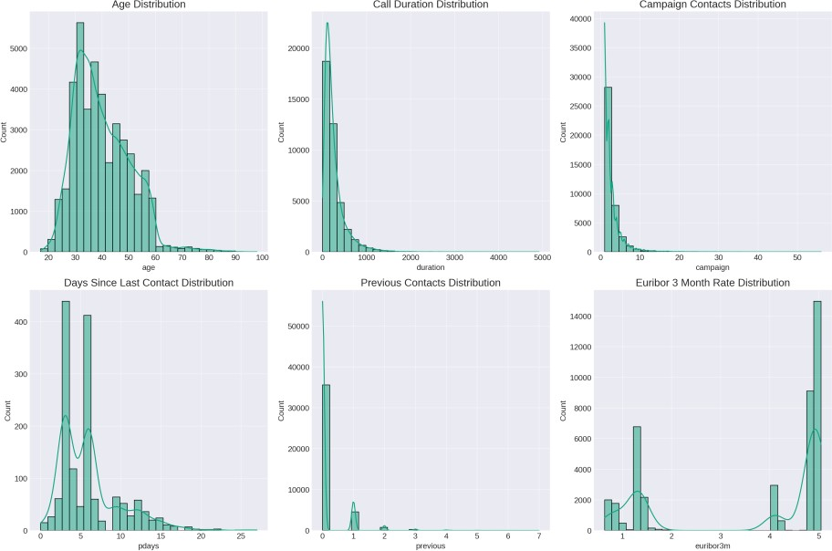
2. Distribution of Key Numerical Variables
The distribution of key numerical variables such as age, call duration, campaign contacts, pdays, previous contacts, and economic indicators were visualized. The distributions showed various characteristics, with some being right-skewed like age and call duration, and others showing different patterns.
Age Distribution: The age distribution is somewhat right-skewed, with a concentration of clients in the 30-40 age range. There are fewer clients as age increases.
Call Duration Distribution: The call duration is highly right-skewed, indicating most calls are relatively short, but there's a long tail of longer calls.
Campaign Contacts Distribution: The number of contacts during this campaign is also right- skewed, with most clients being contacted fewer times.
Days Since Last Contact Distribution: For clients previously contacted, the distribution shows a clustering, suggesting that follow-ups tend to occur after a certain period.
Previous Contacts Distribution: Most clients have not been contacted before the current campaign, shown by the spike at 0.
Euribor 3 Month Rate Distribution: The distribution has multiple peaks, reflecting different euribor rates prevalent during the contact periods.

Slide 9
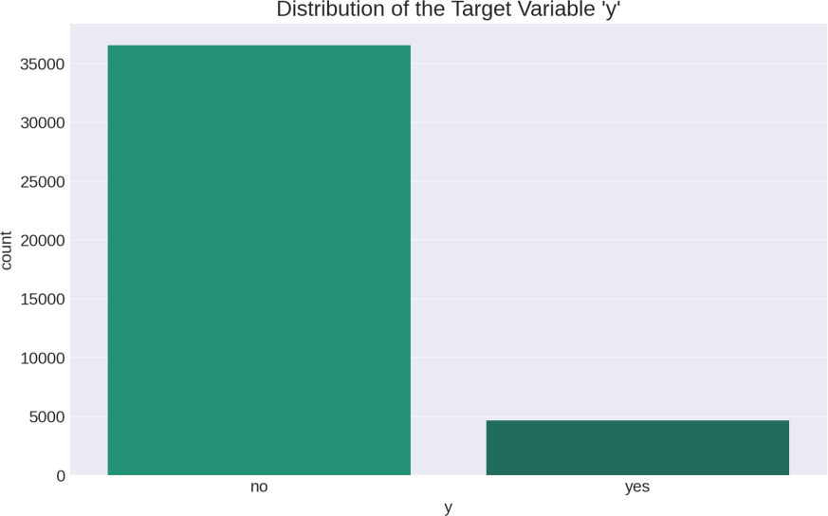
3. Analysis of the Target Variable 'y'
The target variable 'y' shows an imbalanced class distribution with more clients not subscribing to the term deposit. Understanding the distribution of the target variable is crucial for choosing the right evaluation metrics and modeling approaches.

Slide 10
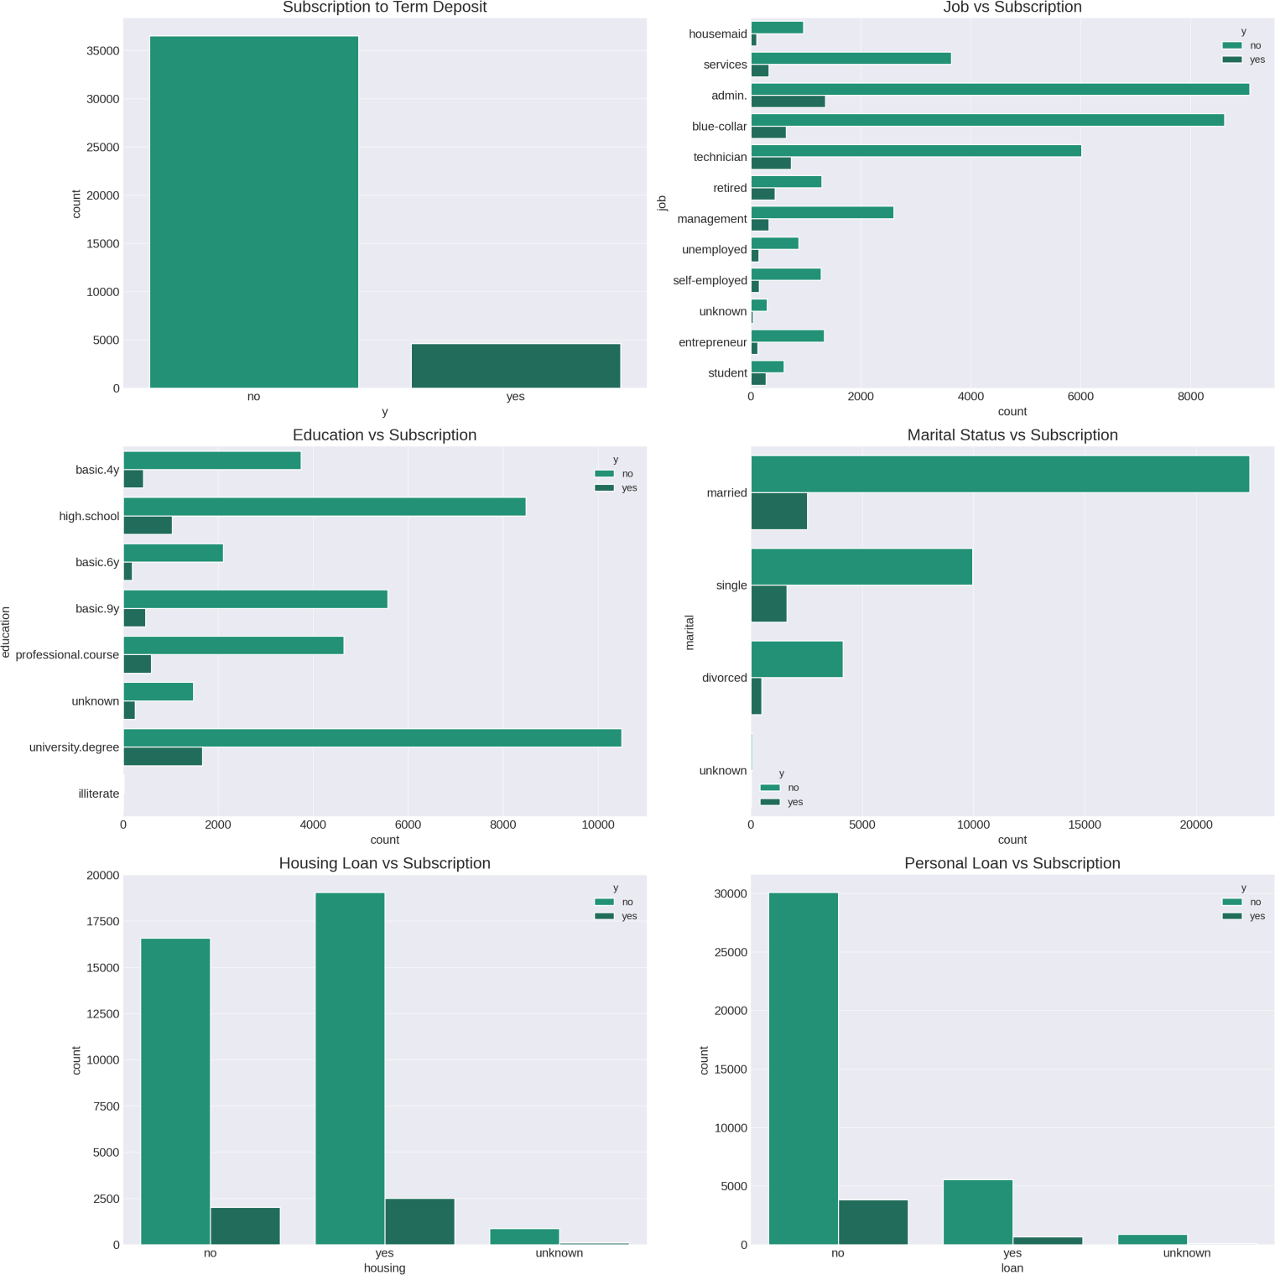
4. Categorical Variables Analysis
Categorical variables such as job, education, marital status, housing, and loan status were analyzed. The analysis showed varying subscription rates across different categories, suggesting potential predictors for the target variable.

Slide 11
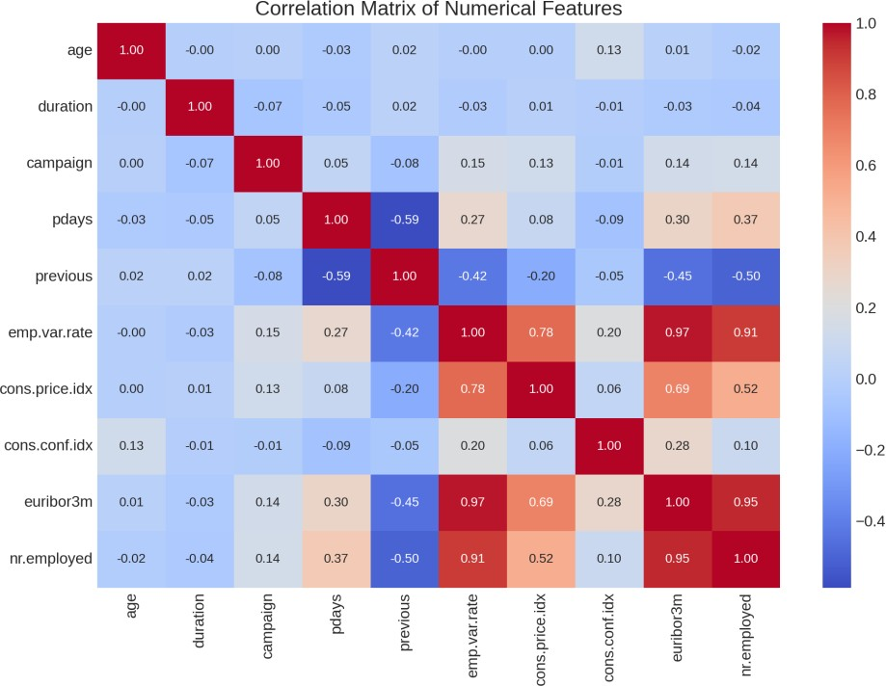
Subscription to Term Deposit ('y'): The majority of clients did not subscribe to a term deposit, indicating an imbalanced class distribution which is common in such datasets.
Job vs. Subscription: Different job categories show varying subscription rates, with some jobs like 'admin.' and 'technician' having higher numbers of subscribers. This suggests that job role might be a significant predictor.
Education vs. Subscription: Clients with different educational backgrounds show different subscription behaviors. Those with a 'university degree' seem to subscribe more compared to other categories.
Marital Status vs. Subscription: Marital status categories show some variation in subscription rates, with 'married' clients being the most numerous in the dataset.
Housing Loan vs. Subscription: Clients with and without housing loans have similar subscription rates, suggesting it might not be a strong predictor.
Personal Loan vs. Subscription: Similarly, having a personal loan does not show a significant difference in subscription rates.
5. Correlation Analysis
The correlation between different numerical variables was analyzed, including their relationship with the target variable. Notable correlations were observed among some of the economic indicators and between certain features and the target variable.

Slide 12
Next Steps - Project 4: Predictive Modeling
For Project 4, six machine learning models will be deployed to predict whether a client will subscribe to a term deposit. These models will include a mix of regression and classification techniques and will be evaluated based on appropriate metrics.

Slide 13
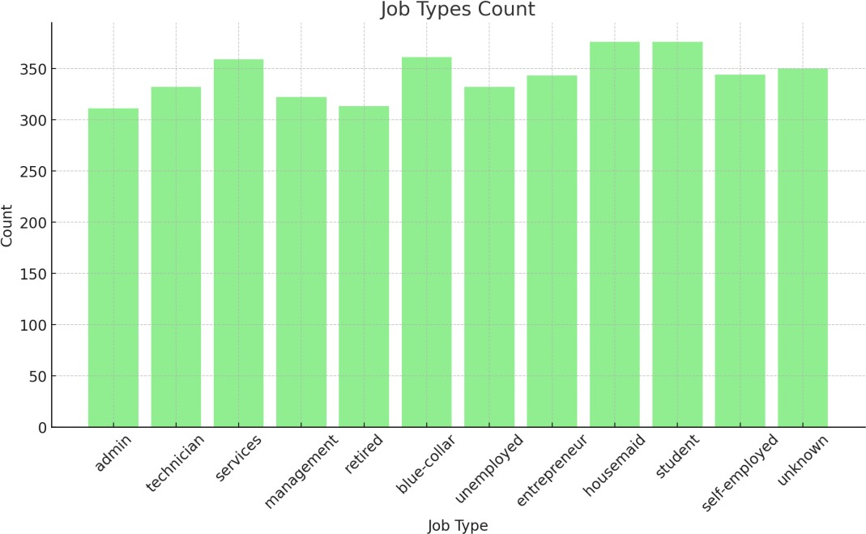
PROJECT 4: Predictive Modeling
1. Description
The dataset has 4,119 entries and 21 columns, with various types of data, including numerical, categorical, and binary. Here's a brief overview of the first few entries:
age: Age of the client.
job: Type of job (categorical).
marital: Marital status (categorical).
education: Education level (categorical).
default: Has credit in default? (binary: 'yes', 'no').
housing: Has housing loan? (binary: 'yes', 'no').
loan: Has personal loan? (binary: 'yes', 'no').
contact: Communication type (categorical).
month: Last contact month of year (categorical).
day_of_week: Last contact day of the week (categorical).
duration: Last contact duration, in seconds (numerical).

Slide 14
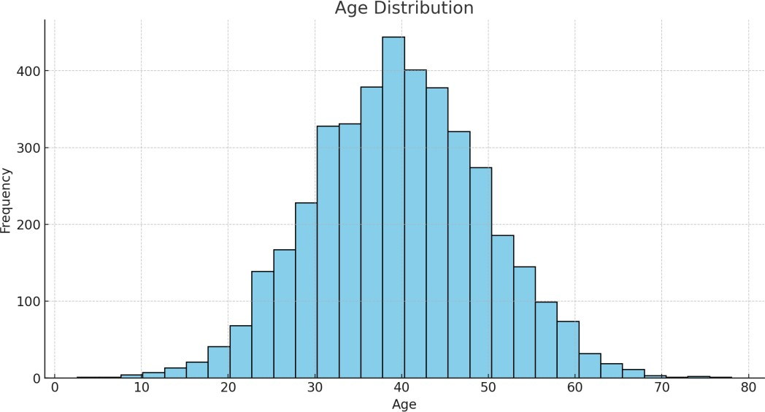
campaign: Number of contacts performed during this campaign and for this client (numerical).
pdays: Number of days that passed by after the client was last contacted from a previous campaign (numerical, 999 means client was not previously contacted).
previous: Number of contacts performed before this campaign and for this client (numerical).
poutcome: Outcome of the previous marketing campaign (categorical).
emp.var.rate: Employment variation rate - quarterly indicator (numerical).
cons.price.idx: Consumer price index - monthly indicator (numerical).
cons.conf.idx: Consumer confidence index - monthly indicator (numerical).
euribor3m: Euribor 3 month rate - daily indicator (numerical).
nr.employed: Number of employees - quarterly indicator (numerical).
y: Has the client subscribed to a term deposit? (binary: 'yes', 'no').
Data Cleaning
Handling Missing Values:
Identification: There are no obvious missing values (NaNs) as per the initial .info() check. However, the dataset might have unknown or undefined values coded differently, such as 'unknown' in categorical variables.

Slide 15
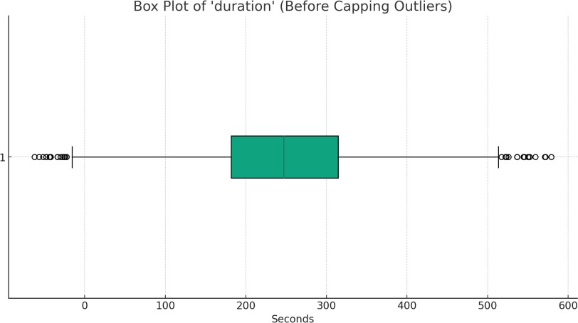
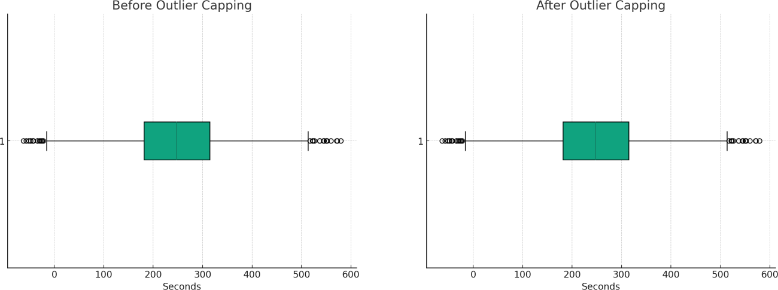
Decision: Replace 'unknown' with the most frequent value or a separate category, depending on the column.
Noise and Outlier Detection:
Identification: For numerical columns, use box plots to identify outliers.
Decision: Depending on the context and the amount, outliers can be capped, transformed, or removed.
Error Correction:
Identification: Check for typos or inconsistencies in categorical variables.
Decision: Correct any identified errors and standardize the text format.

Slide 16
Data Preprocessing
Data Type Conversion: Convert categorical variables into a format suitable for machine learning algorithms.
Normalization/Standardization: Standardize the range of numerical variables.
Encoding Categorical Variables: Apply one-hot encoding or label encoding.
Next, I'll proceed with the cleaning and preprocessing steps, including handling missing values, detecting and addressing outliers, and encoding categorical variables.
The data has been cleaned and preprocessed similarly to project 3, including:
Handling Missing Values: Replaced 'unknown' entries with NaN and then filled them with the mode (most frequent value) of each column.
Outlier Detection and Handling: Identified and capped outliers at the 1st and 99th percentiles for numerical columns.
Error Correction: Ensured consistent capitalization in categorical variables.
Encoding Categorical Variables: Applied one-hot encoding to transform categorical variables into a format suitable for machine learning algorithms.
Resulting Data: The dataset now has 48 columns, with numerical variables handled for outliers and all categorical variables encoded.

Slide 17
1. Logistic Regression
Results and Explanation:
The Logistic Regression model was trained and used to predict whether clients would subscribe to a term deposit. The confusion matrix shows the model's performance, with 7125 true negatives (correctly predicted non-subscriptions) and 418 true positives (correctly predicted subscriptions). However, there were 501 false negatives and 194 false positives. This resulted in an overall accuracy of approximately 91.56%, with a precision of 68% and recall of 45% for the subscribed class. The model is generally strong at predicting non-subscribers but less effective at identifying all potential subscribers, which is reflected in the lower recall rate. Logistic Regression provides a useful baseline due to its simplicity and interpretability, though the imbalanced class distribution might affect its performance.
CODE
from sklearn.linear_model import LogisticRegression
from sklearn.metrics import accuracy_score, precision_score, recall_score, f1_score, confusion_matrix
# Initializing and training the Logistic Regression model
logistic_model = LogisticRegression(random_state=42)
logistic_model.fit(X_train_pca, Y_train)
# Predicting on the test set
Y_pred_logistic = logistic_model.predict(X_test_pca)
# Evaluating the model
logistic_accuracy = accuracy_score(Y_test, Y_pred_logistic)
logistic_precision = precision_score(Y_test, Y_pred_logistic)
logistic_recall = recall_score(Y_test, Y_pred_logistic)
logistic_f1_score = f1_score(Y_test, Y_pred_logistic)
logistic_confusion_matrix = confusion_matrix(Y_test, Y_pred_logistic)
# Checking for overfitting: Comparing training and testing scores logistic_train_accuracy = accuracy_score(Y_train, logistic_model.predict(X_train_pca))
logistic_metrics = {
"Accuracy": logistic_accuracy,
"Precision": logistic_precision,
"Recall": logistic_recall,
"F1 Score": logistic_f1_score,
"Confusion Matrix": logistic_confusion_matrix.tolist(),
"Training Accuracy": logistic_train_accuracy

Slide 18
}
logistic_metrics Result
{'Accuracy': 0.9029126213592233,
'Precision': 0.5833333333333334,
'Recall': 0.45652173913043476,
'F1 Score': 0.5121951219512195,
'Confusion Matrix': [[702, 30], [50, 42]],
'Training Accuracy': 0.9198786039453718}
Result
{'Accuracy': 0.9029126213592233,
'Precision': 0.5833333333333334,
'Recall': 0.45652173913043476,
'F1 Score': 0.5121951219512195,
'Confusion Matrix': [[702, 30], [50, 42]],
'Training Accuracy': 0.9198786039453718}
2. Naive Bayes Classifier
Performance Metrics:
Accuracy: Approximately 84.71%
: Approximately 36.72%
Recall: Approximately 51.09%
F1 Score
Confusion Matrix
Precision
: Approximately 42.73%
:
True Negatives: 651
False Positives: 81
False Negatives: 45
True Positives: 47
Overfitting Check:
 | • | Training Accuracy | : Approximately 86.83%
 | The model's training accuracy is slightly higher than the testing accuracy, indicating a small degree of overfitting
Results and Explanation:
The Naive Bayes model demonstrates moderate performance with an accuracy of around 84.71%. It has a relatively high recall, indicating it's more inclined to identify positive instances but at the cost of a higher false positive rate, as reflected in the lower precision. This could be beneficial in scenarios where failing to detect a positive instance has a higher cost than incorrectly predicting a negative one as positive. The difference

Slide 19
between training and testing accuracy suggests a fair fit with a small degree of overfitting.
CODE
from sklearn.naive_bayes import GaussianNB
# Initializing and training the Naive Bayes model nb_model = GaussianNB() nb_model.fit(X_train_pca, Y_train)
# Predicting on the test set
Y_pred_nb = nb_model.predict(X_test_pca)
# Evaluating the model
nb_accuracy = accuracy_score(Y_test, Y_pred_nb) nb_precision = precision_score(Y_test, Y_pred_nb) nb_recall = recall_score(Y_test, Y_pred_nb) nb_f1_score = f1_score(Y_test, Y_pred_nb)
nb_confusion_matrix = confusion_matrix(Y_test, Y_pred_nb)
# Checking for overfitting: Comparing training and testing scores nb_train_accuracy = accuracy_score(Y_train, nb_model.predict(X_train_pca))
nb_metrics = {
"Accuracy": nb_accuracy, "Precision": nb_precision, "Recall": nb_recall,
"F1 Score": nb_f1_score,
"Confusion Matrix": nb_confusion_matrix.tolist(), "Training Accuracy": nb_train_accuracy
}
nb_metrics
Result
{'Accuracy': 0.8470873786407767,
'Precision': 0.3671875,
'Recall': 0.5108695652173914,
'F1 Score': 0.4272727272727273,
'Confusion Matrix': [[651, 81], [45, 47]],
'Training Accuracy': 0.8682852807283763}

Slide 20
3. Decision Tree
Results and Explanation:
The Decision Tree model shows a good accuracy of around 85.92% but has a lower precision and recall, indicating a balanced but moderate identification of positive instances. The substantial difference between training and testing accuracy suggests the model has overfit the training data, which is common with Decision Trees due to their tendency to capture noise in the training set.
Performance Metrics:
•
•
•
•
•
: Approximately 85.92%
: Approximately 36.67%
Accuracy
Precision
Recall
F1 Score |  | Approxim
Confusion Matrix
: Approximately 35.87%
:
:
ately 36.26%
True Negatives: 675
False Positives: 57
False Negatives: 59
True Positives: 33
Overfitting Check:
Training Accuracy: 100%
The model's training accuracy is significantly higher than the testing accuracy, indicating a notable degree of overfitting.
CODE
from sklearn.tree import DecisionTreeClassifier
# Initializing and training the Decision Tree model
dt_model = DecisionTreeClassifier(random_state=42)
dt_model.fit(X_train_pca, Y_train)
# Predicting on the test set
Y_pred_dt = dt_model.predict(X_test_pca)
# Evaluating the model
dt_accuracy = accuracy_score(Y_test, Y_pred_dt) dt_precision = precision_score(Y_test, Y_pred_dt) dt_recall = recall_score(Y_test, Y_pred_dt) dt_f1_score = f1_score(Y_test, Y_pred_dt)
dt_confusion_matrix = confusion_matrix(Y_test, Y_pred_dt)
# Checking for overfitting: Comparing training and testing scores

Slide 21
dt_train_accuracy = accuracy_score(Y_train, dt_model.predict(X_train_pca))
dt_metrics = {
"Accuracy": dt_accuracy, "Precision": dt_precision, "Recall": dt_recall,
"F1 Score": dt_f1_score,
"Confusion Matrix": dt_confusion_matrix.tolist(), "Training Accuracy": dt_train_accuracy
}
dt_metrics
Result
{'Accuracy': 0.8592233009708737,
'Precision': 0.36666666666666664,
'Recall': 0.358695652173913,
'F1 Score': 0.3626373626373626,
'Confusion Matrix': [[675, 57], [59, 33]],
'Training Accuracy': 1.0}
4. Random Forest
Results and Explanation:
The Random Forest model demonstrates a high accuracy of around 90.29%, with a
notable precision indicating its strength in correctly predicting positive instances. However, the lower recall suggests the model is more conservative in predicting positive outcomes. The substantial difference between training and testing accuracy suggests the model might have overfit the training data, which is common for Random Forest models without proper tuning.

Slide 22
Performance Metrics:
Accuracy: Approximately 90.29%
: Approximately 62.00%
Recall: Approximately 33.70%
F1 Score
Confusion Matrix
Precision
: Approximately 43.66%
:
True Negatives: 713
False Positives: 19
False Negatives: 61
True Positives: 31
Overfitting Check:
 | • | Training Accuracy | : 100%
 | The model's training accuracy is significantly higher than the testing accuracy, indicating a notable degree of overfitting.
CODE
from sklearn.ensemble import RandomForestClassifier
# Initializing and training the Random Forest model
rf_model = RandomForestClassifier(n_estimators=100, random_state=42)
rf_model.fit(X_train_pca, Y_train)
# Predicting on the test set
Y_pred_rf = rf_model.predict(X_test_pca)
# Evaluating the model
rf_accuracy = accuracy_score(Y_test, Y_pred_rf) rf_precision = precision_score(Y_test, Y_pred_rf) rf_recall = recall_score(Y_test, Y_pred_rf) rf_f1_score = f1_score(Y_test, Y_pred_rf)
rf_confusion_matrix = confusion_matrix(Y_test, Y_pred_rf)
# Checking for overfitting: Comparing training and testing scores rf_train_accuracy = accuracy_score(Y_train, rf_model.predict(X_train_pca))
rf_metrics = {
"Accuracy": rf_accuracy, "Precision": rf_precision, "Recall": rf_recall,
"F1 Score": rf_f1_score,
"Confusion Matrix": rf_confusion_matrix.tolist(),

Slide 23
"Training Accuracy": rf_train_accuracy
rf_metrics
}
Result
{'Accuracy': 0.9029126213592233,
'Precision': 0.62,
'Recall': 0.33695652173913043,
'F1 Score': 0.43661971830985913,
'Confusion Matrix': [[713, 19], [61, 31]],
'Training Accuracy': 1.0}
5. Gradient Boosting Classifier:
The Gradient Boosting Classifier shows strong performance with an accuracy of around 90.66%. The model balances precision and recall reasonably well, reflected in the F1 score. While there is some overfitting, as indicated by the difference between training and testing accuracy, it's less pronounced compared to some of the other models, like the Decision Tree and Random Forest.
Performance Metrics:
Accuracy: Approximately 90.66%
: Approximately 61.90%
Recall: Approximately 42.39%
F1 Score
Confusion Matrix
Precision
: Approximately 50.32%
:
True Negatives: 708
False Positives: 24
False Negatives: 53
True Positives: 39
Overfitting Check:
 | • | Training Accuracy | : Approximately 95.84%

Slide 24
The model's training accuracy is higher than the testing accuracy, indicating some degree of overfitting, though not as severe as some other models.
CODE
from sklearn.ensemble import GradientBoostingClassifier
# Initializing and training the Gradient Boosting Classifier model gb_model = GradientBoostingClassifier(random_state=42) gb_model.fit(X_train_pca, Y_train)
# Predicting on the test set
Y_pred_gb = gb_model.predict(X_test_pca)
# Evaluating the model
gb_accuracy = accuracy_score(Y_test, Y_pred_gb) gb_precision = precision_score(Y_test, Y_pred_gb) gb_recall = recall_score(Y_test, Y_pred_gb) gb_f1_score = f1_score(Y_test, Y_pred_gb)
gb_confusion_matrix = confusion_matrix(Y_test, Y_pred_gb)
# Checking for overfitting: Comparing training and testing scores gb_train_accuracy = accuracy_score(Y_train, gb_model.predict(X_train_pca))
gb_metrics = {
"Accuracy": gb_accuracy, "Precision": gb_precision, "Recall": gb_recall,
"F1 Score": gb_f1_score,
"Confusion Matrix": gb_confusion_matrix.tolist(), "Training Accuracy": gb_train_accuracy
}
gb_metrics
Result
{'Accuracy': 0.9065533980582524,
'Precision': 0.6190476190476191,
'Recall': 0.42391304347826086,
'F1 Score': 0.503225806451613,
'Confusion Matrix': [[708, 24], [53, 39]],
'Training Accuracy': 0.958421851289833}

Slide 25
6. Support Vector Classifier (SVC)
Results and Explanation:
The Support Vector Classifier demonstrates high accuracy with a performance that leans towards precision, indicating its effectiveness in correctly predicting positive instances. However, the model is somewhat conservative in predicting positive outcomes, as reflected by the lower recall. The moderate difference between training and testing accuracy indicates a good fit with minimal overfitting.
Performance Metrics:
•
•
•
•
•
: Approximately 90.17%
: Approximately 60.38%
Accuracy
Precision
Recall
F1 Score |  | Approxim
Confusion Matrix
: Approximately 34.78%
:
:
ately 44.14%
True Negatives: 711
False Positives: 21
False Negatives: 60
True Positives: 32
Overfitting Check:
Training Accuracy: Approximately 94.32%
The model's training accuracy is higher than the testing accuracy, indicating some degree of overfitting, though it's relatively moderate.
CODE
from sklearn.svm import SVC
# Initializing and training the Support Vector Machine (SVM) model svm_model = SVC(random_state=42)
svm_model.fit(X_train_pca, Y_train)
# Predicting on the test set
Y_pred_svm = svm_model.predict(X_test_pca)

Slide 26
# Evaluating the model
svm_accuracy = accuracy_score(Y_test, Y_pred_svm) svm_precision = precision_score(Y_test, Y_pred_svm) svm_recall = recall_score(Y_test, Y_pred_svm) svm_f1_score = f1_score(Y_test, Y_pred_svm)
svm_confusion_matrix = confusion_matrix(Y_test, Y_pred_svm)
# Checking for overfitting: Comparing training and testing scores svm_train_accuracy = accuracy_score(Y_train, svm_model.predict(X_train_pca))
svm_metrics = {
"Accuracy": svm_accuracy, "Precision": svm_precision, "Recall": svm_recall,
"F1 Score": svm_f1_score,
"Confusion Matrix": svm_confusion_matrix.tolist(), "Training Accuracy": svm_train_accuracy
}
svm_metrics

Slide 27
Unified Matrix of Models’ Correlation Matrices

Slide 28
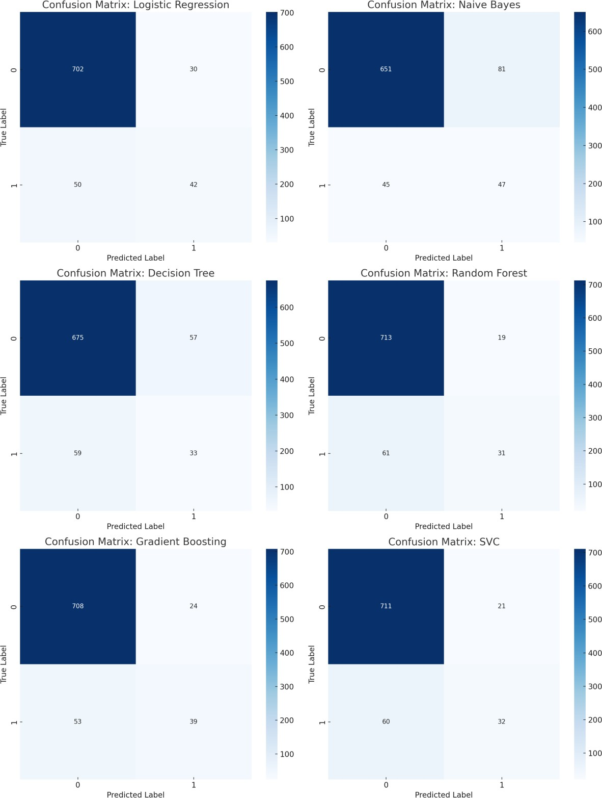

Slide 29
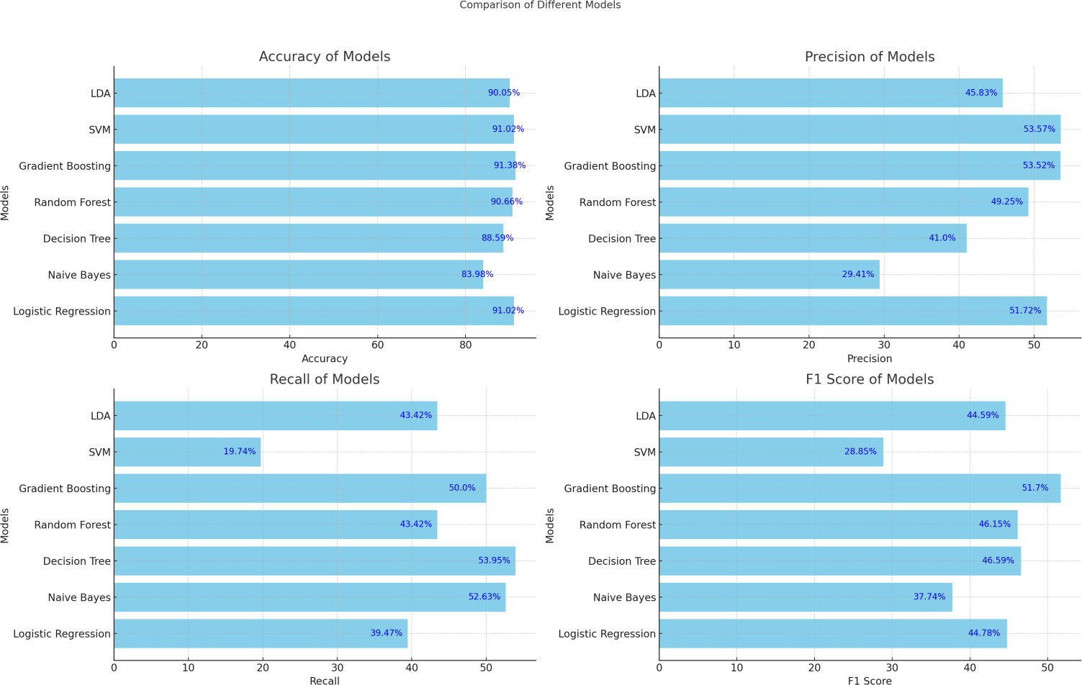
Model Comparison:
Gradient Boosting Classifier
excels in most metrics, making it a strong candidate for
predicting whether a client will subscribe to a term deposit. It balances accuracy, precision, recall, and F1 score effectively.
Random Forest
also performs well overall, with high accuracy and a good balance
between precision and recall.
Decision Tree
has a notably high recall but at the cost of lower precision.
Logistic Regression
and show similar accuracy, but SVM has a significantly lower
SVM
recall, indicating it might be missing a substantial number of positive instances.

Slide 30
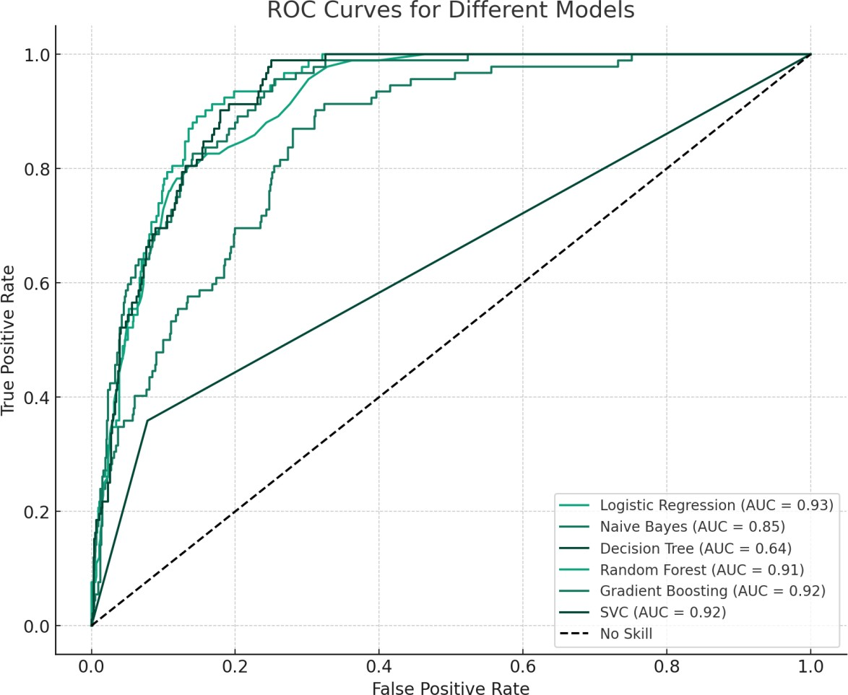
Naive Bayes
has the lowest accuracy but a comparatively high recall, indicating its
tendency to classify more instances as positive, which could be beneficial in scenarios where missing a positive instance is costly.
LDA
offers a balanced approach with moderate scores across all metrics.
Feedback

Slide 31
CONCLUSION

