Slide 1
Media vs Public Opinion on
GLP-1 Weight Loss Drugs
Ozempic & Wegovy — A Text Analytics Approach
INSY 669 — Text Analytics | McGill University | Winter 2025
V. Christopoulos • H. Guideau • S. Khosla • M. Yousuf • O. Zizi

Slide 2
Problem Statement
💊 GLP-1 drugs (Ozempic, Wegovy) have become the most talked-about medications in recent history
📰 Media coverage shapes public perception, but does it reflect actual user experiences?
🔍 Research Question: How does media framing of GLP-1 drugs differ from public opinion?
💡 Understanding this gap has implications for pharma marketing, patient education, and health policy
📊 We analyze 1,500+ documents from Reddit, WebMD, and major news outlets

Slide 3
Data Sources
📱 Public Opinion Corpus
📰 Media Corpus
Reddit (800 posts)
• r/Ozempic
• r/Semaglutide
• r/WegovyWeightLoss
WebMD Reviews (300)
• Patient experiences
• Drug ratings
Total: 1,100 documents
News Articles (400)
• Reuters, CNN Health
• The New York Times
• STAT News
• Medical News Today
• NPR Health
• Bloomberg, WSJ
• And 8 more outlets
Total: 400 documents

Slide 4
Methodology
1. Data Collection
2. Preprocessing
3. Feature Extraction
BeautifulSoup, requests, PRAW
Reddit, WebMD, News APIs
NLTK tokenization, stopwords,
lemmatization (WordNetLemmatizer)
Bag-of-Words, TF-IDF
(unigrams + bigrams)
4. Sentiment Analysis
5. Word Associations
6. Comparison
VADER sentiment scoring
Compound score classification
PMI, Lift metrics
Co-occurrence analysis
Cosine similarity, MDS plots
Statistical testing (t-test)

Slide 5
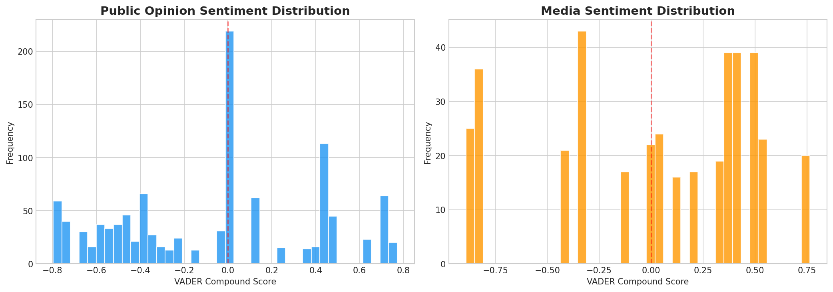
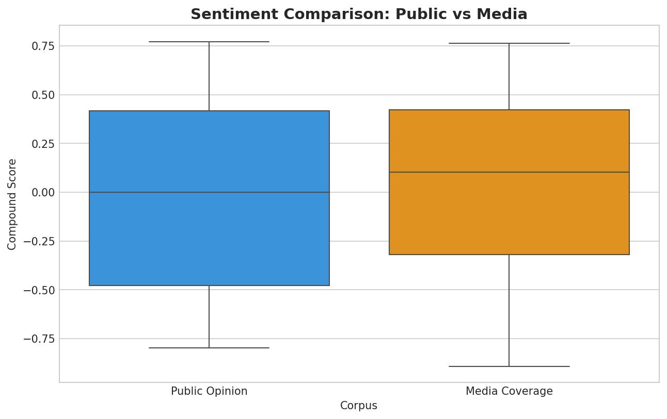
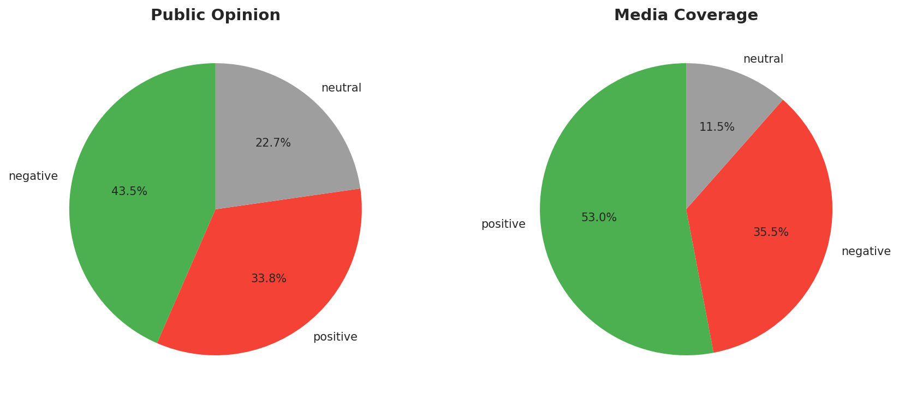
Sentiment Analysis Results
Key Statistics
Public Mean: -0.0695
Media Mean: 0.0327
T-statistic: -3.7680
P-value: 0.000171
✅ Statistically significant
(α = 0.05)

Slide 6
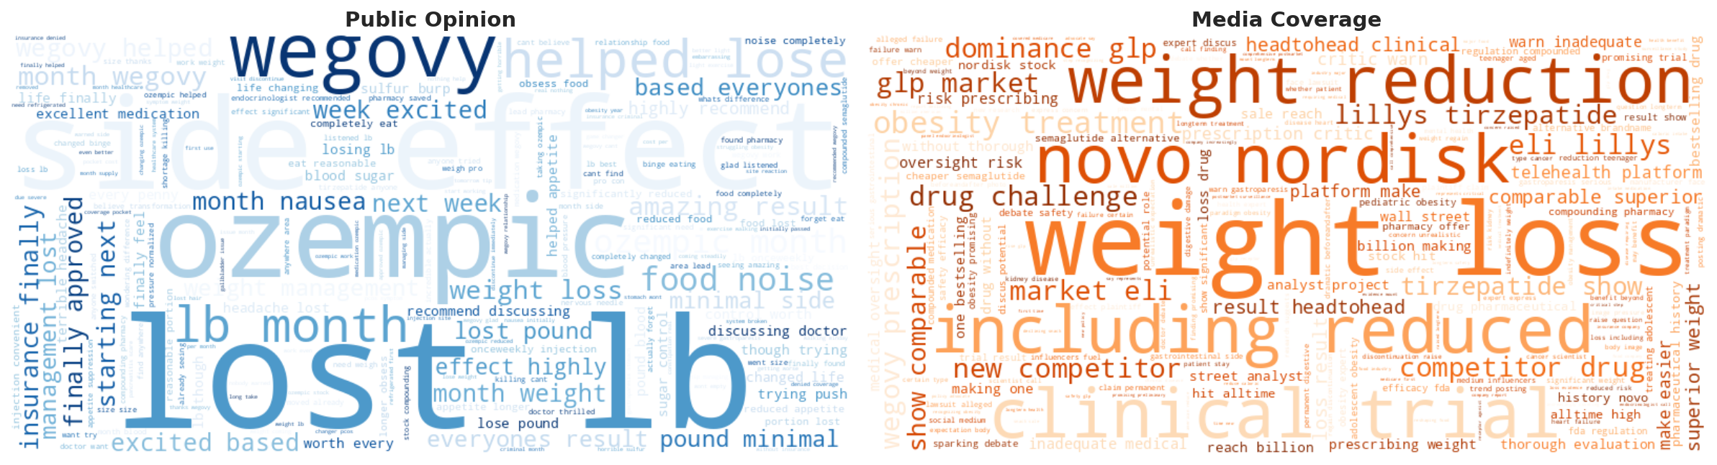
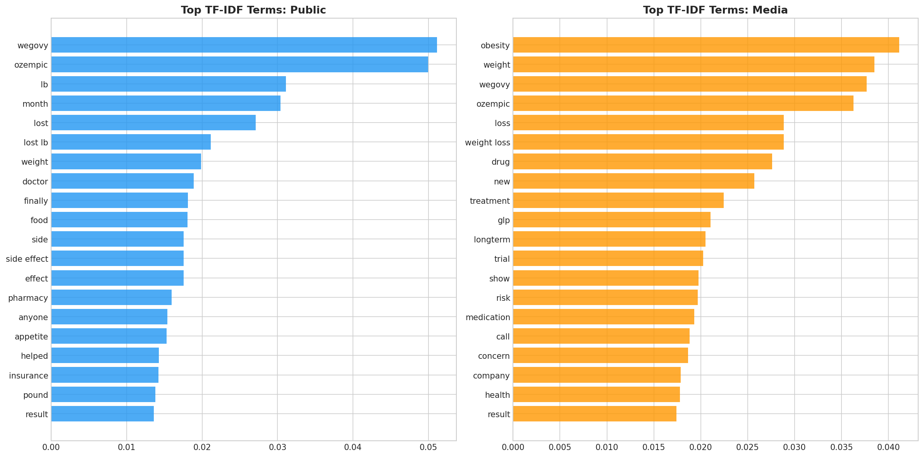
Language Comparison: What Each Corpus Emphasizes

Slide 7
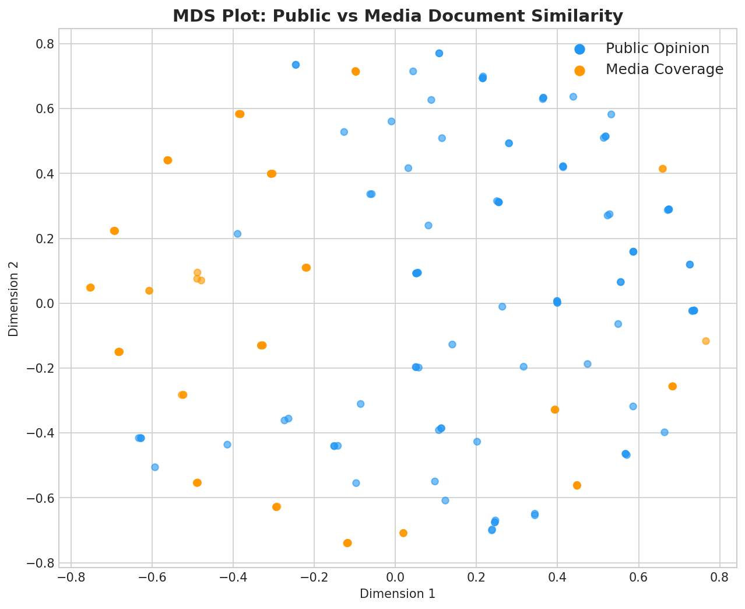
Document Similarity & Word Associations
MDS Analysis Insights
• Cosine similarity: 0.3329
• Public and media documents form
partially overlapping clusters
• Media cluster is more tightly grouped
(consistent language/framing)
• Public cluster is more dispersed
(diverse personal experiences)
• Some overlap on core drug terms,
but divergence on context/framing

Slide 8
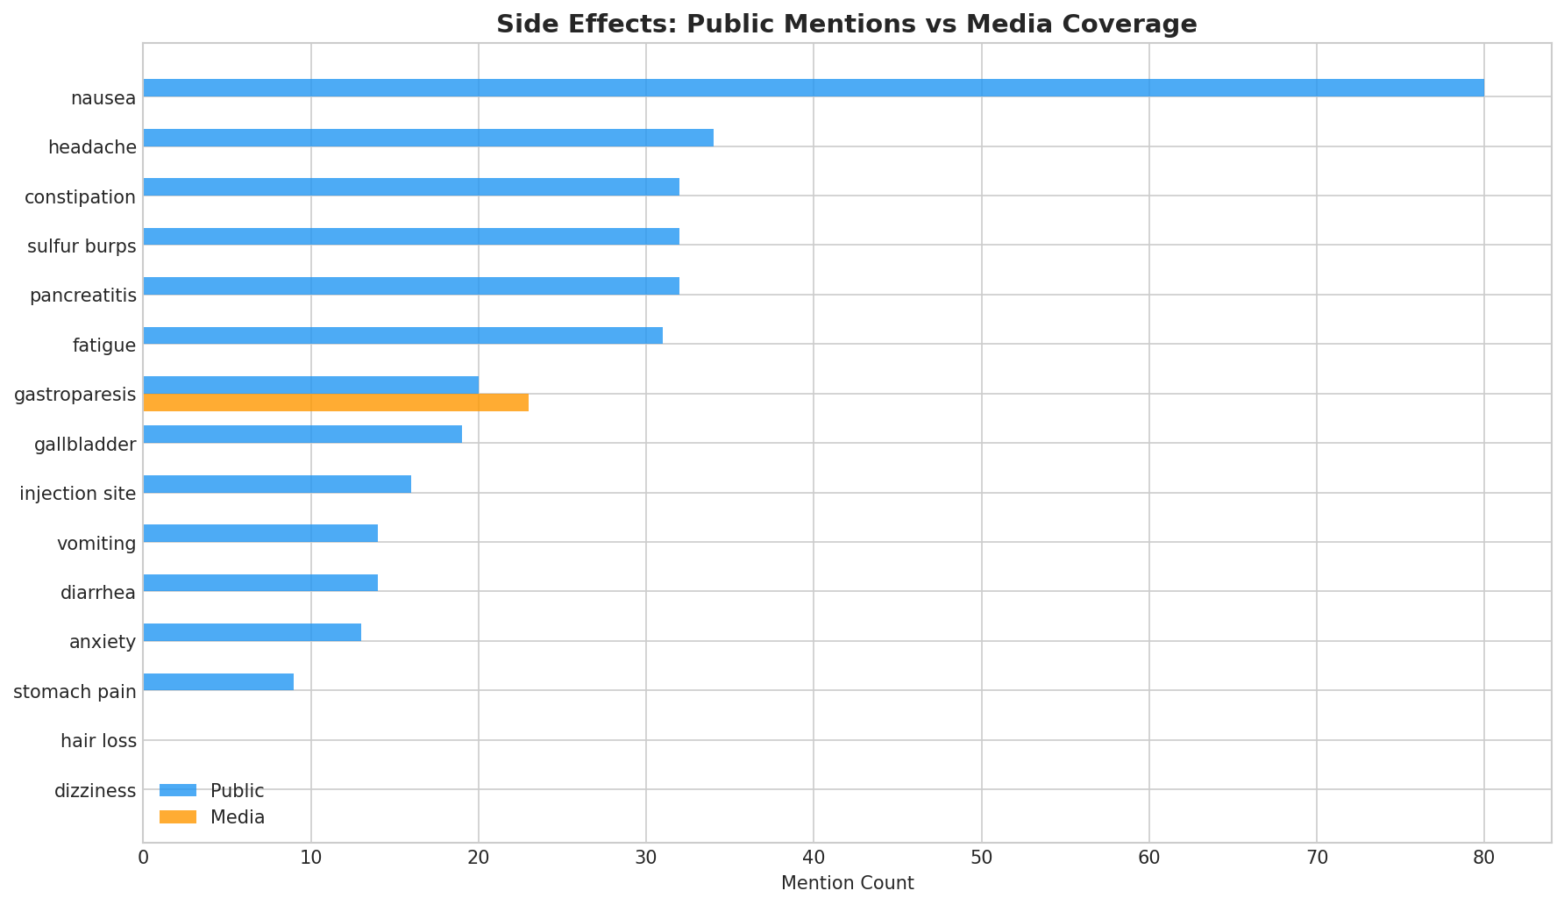
Side Effects: Coverage Gap Analysis
⚠️ Key Gaps
Users frequently discuss side
effects that receive much less
media coverage:
• Sulfur burps — embarrassing
but very common
• Constipation — daily impact
on quality of life
• Hair loss — unexpected and
distressing for patients
• Fatigue — affects work and
daily functioning
Media tends to focus on
severe/rare events like
pancreatitis and gastroparesis.

Slide 9
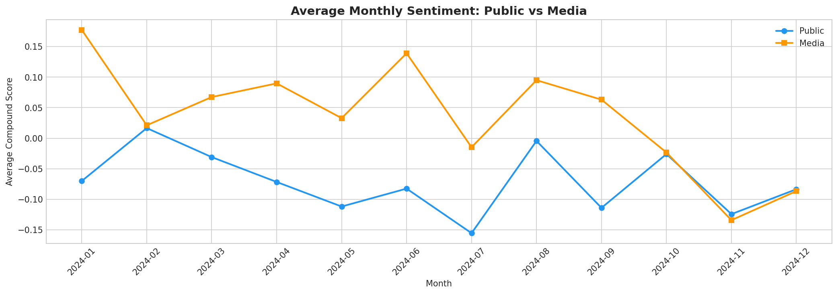
Sentiment Trends Over Time
Media sentiment remains relatively stable and slightly positive, while public sentiment fluctuates more and trends negative — reflecting the gap between media framing and lived patient experience.

Slide 10
Key Findings
1
Significant Sentiment Gap
Public opinion is more negative (mean: -0.07) vs media (mean: +0.03). The difference is statistically significant (p < 0.001).
2
Different Language, Different Priorities
Public: personal experiences, side effects, costs. Media: clinical data, market trends, regulation.
3
Side Effect Coverage Gap
Common side effects (nausea, constipation, sulfur burps) are underrepresented in media relative to user discussions.
4
Cost as a Central Theme
Affordability and insurance coverage dominate public discourse but receive proportionally less media attention.
5
Emotional vs Analytical Framing
Public posts are highly emotional and personal; media maintains analytical, data-driven tone.

Slide 11
Business Implications
🏥 Pharmaceutical Companies
Should proactively address common side effects in patient materials. Current messaging may create expectation gaps that lead to discontinuation.
📋 Healthcare Providers
Need awareness of patient concerns beyond clinical data. Users value practical advice on managing everyday side effects over efficacy statistics.
🏛️ Health Policy
Insurance coverage and drug affordability are top public concerns. Policy interventions addressing cost could significantly improve patient outcomes.
📢 Media & Communications
Opportunity to provide more balanced coverage that includes common user experiences alongside clinical and market reporting.
💼 Health Tech
Patient support platforms should incorporate side effect management tools and peer community features to address the information gap.

Slide 12
Thank You!
Questions?
Vasilis Christopoulos • Hugo Guideau • Saksi Khosla • Mustafa Yousuf • Othmane Zizi
github.com/othmane-zizi-pro/insy669-glp1-text-analytics

