Slide 1
INSY 674 Final Project
Customer Lifetime Value Prediction
Predictive modeling, explainability, causal inference, and monitoring for an end-to-end enterprise data science workflow.
Othmane Zizi (261255341) | Fares Joni (261254593) | Tanmay Giri (261272443) | https://github.com/othmane-zizi-pro/nwa

Slide 2
Context
Business Context and Objective (5.9.1)
Problem
Objective
Marketing budgets are often distributed uniformly across unequal customers.
High-value customers can churn without proactive intervention.
Revenue concentration means ranking quality drives business impact.
Predict 6-month CLV per customer from historical transaction behavior.
Use model output to prioritize retention and campaign spend.
Track value capture with lift and production monitoring.

Slide 3
Hypothesis
Hypotheses and Testing Framing (5.9.2)
H1: RFM + behavioral features can predict future CLV.
H2: Regularized linear models generalize better than tree models on this feature set.
H3: Causal uplift analysis identifies who should receive treatment.
Null framing: treatment has no measurable effect on log1p(CLV).

Slide 4
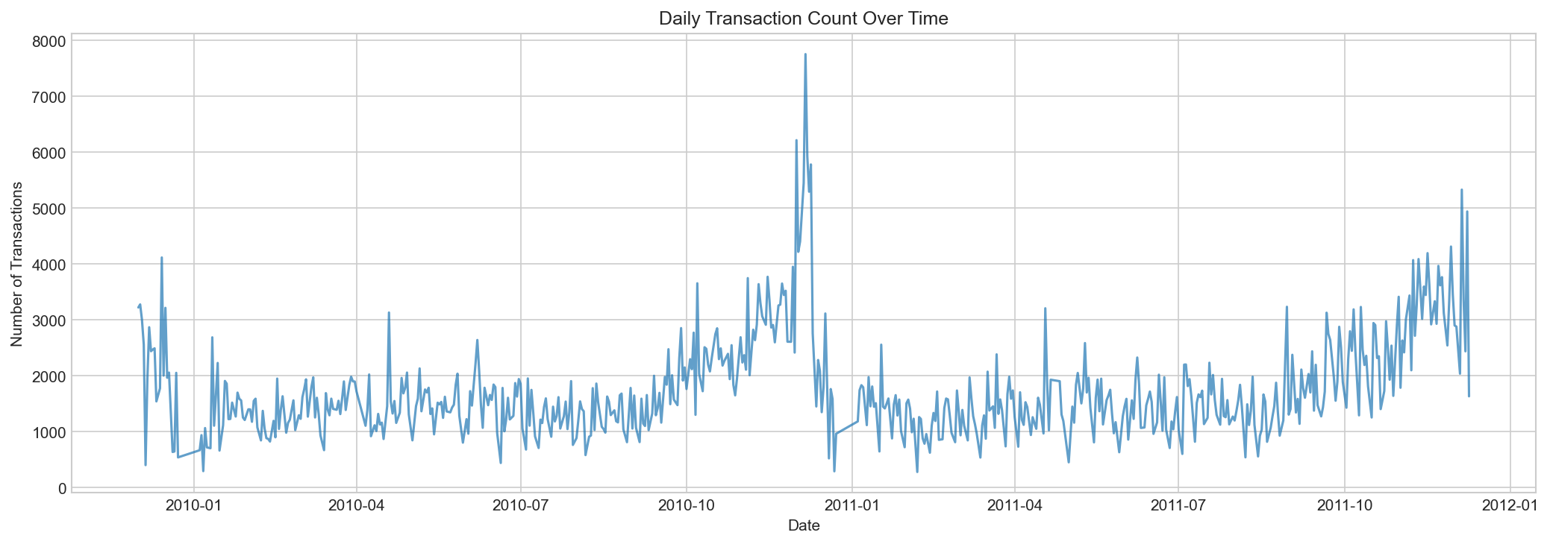
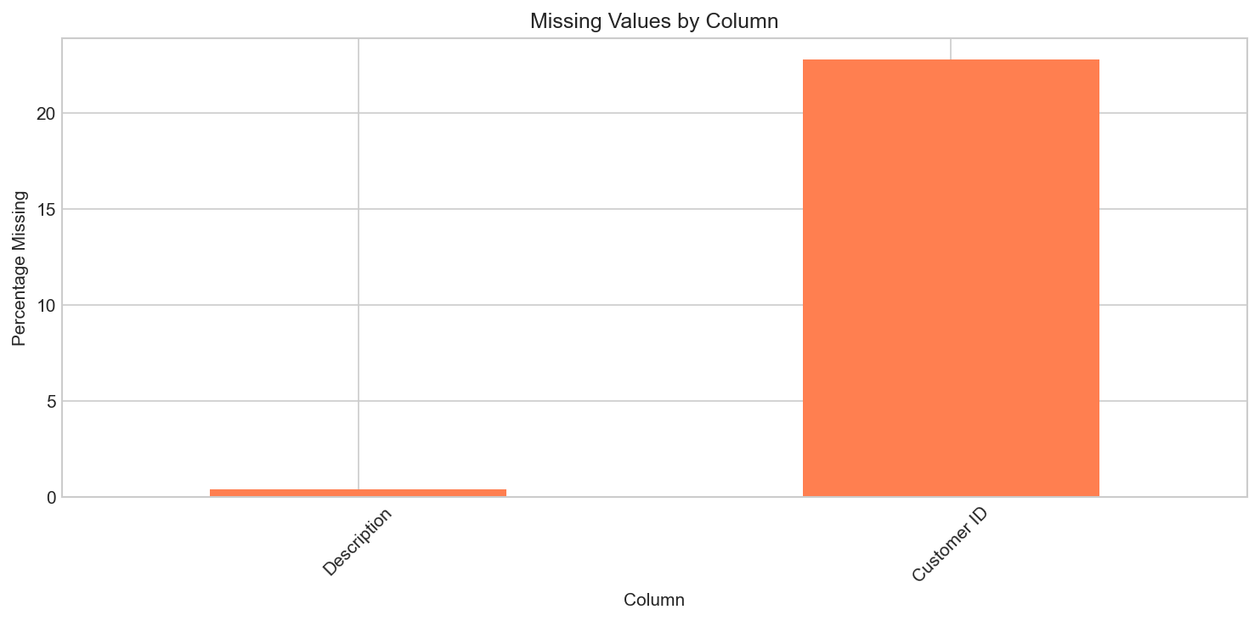
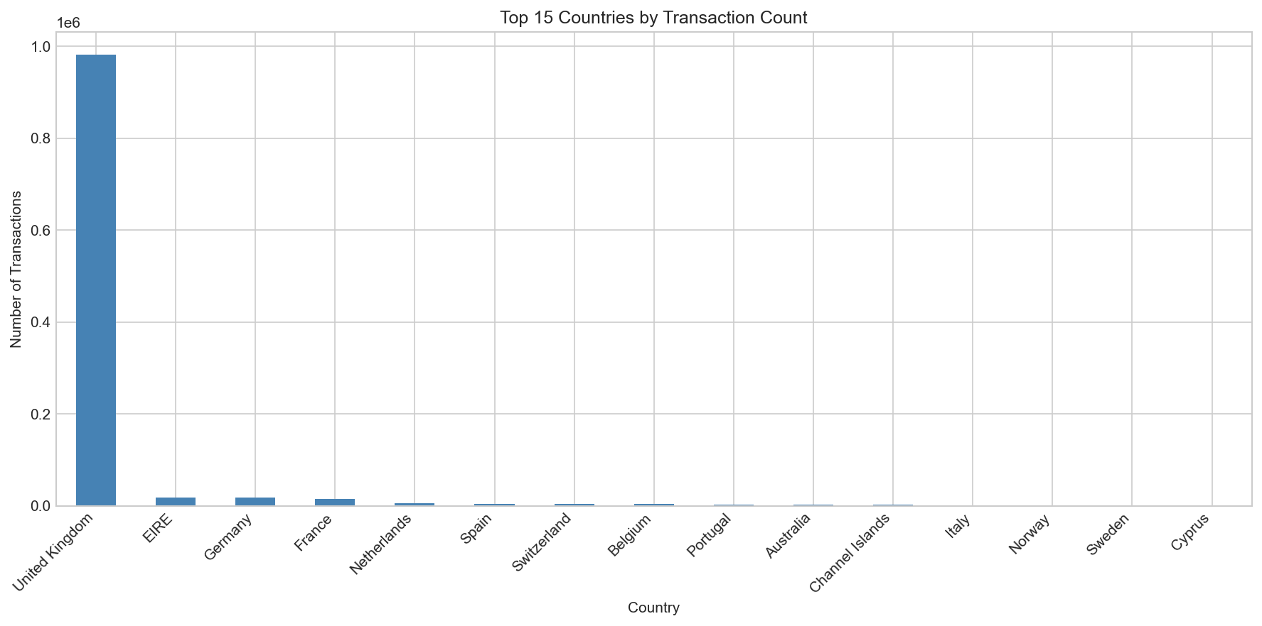
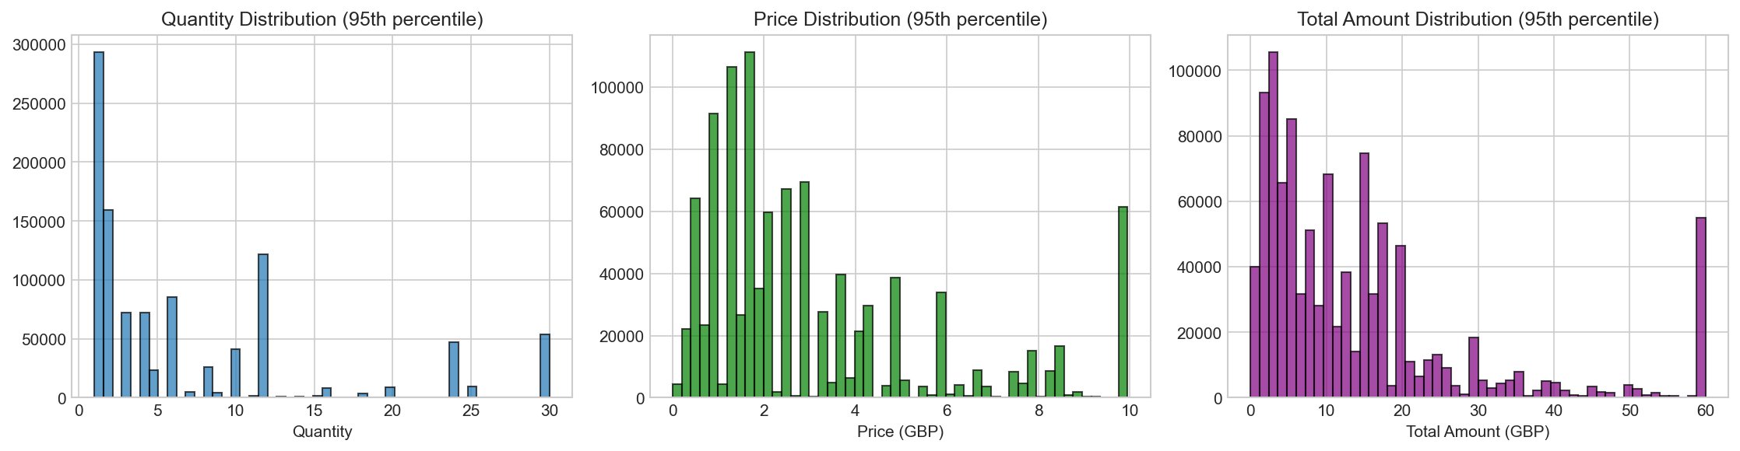
EDA
Exploration Visuals: Coverage and Quality (5.3)
• Initial EDA covered time trends, missingness, geography, and transactional behavior.
• These checks informed cleaning decisions before feature engineering.
Daily transaction volume
Missing values profile
Top purchasing countries
Price and quantity distribution

Slide 5
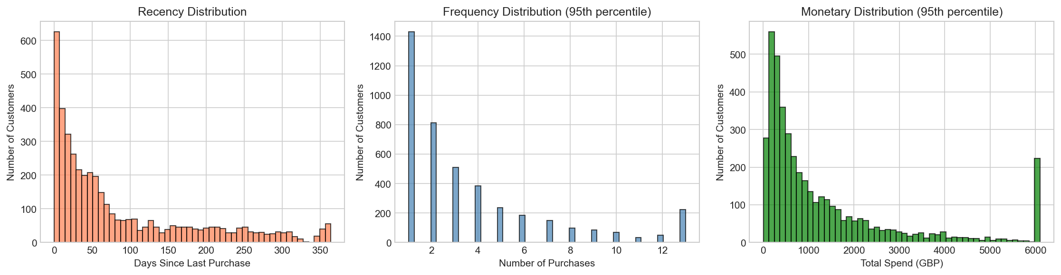
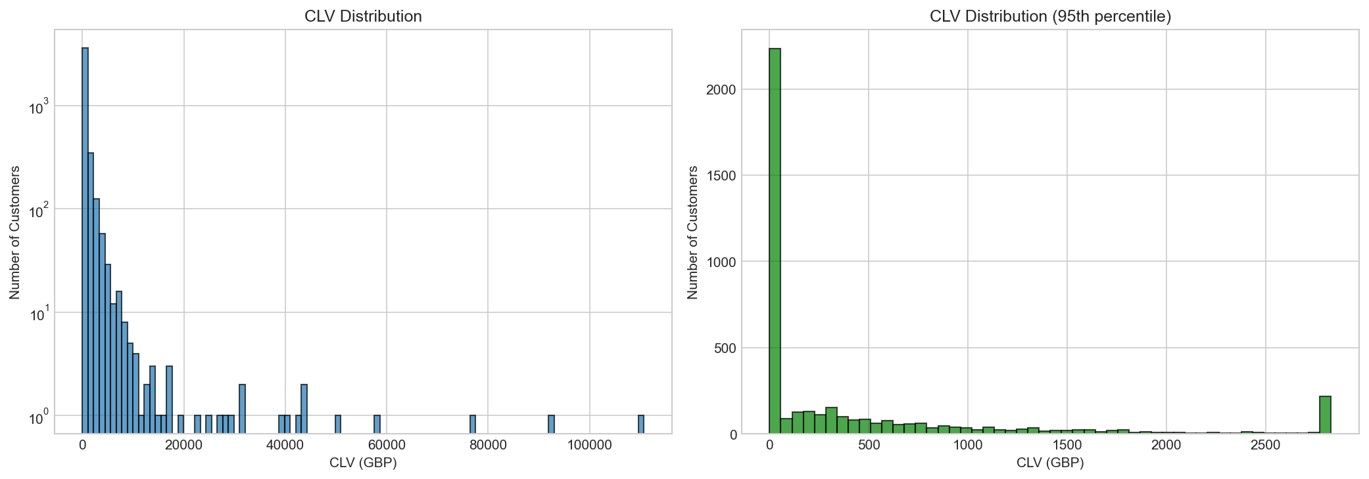
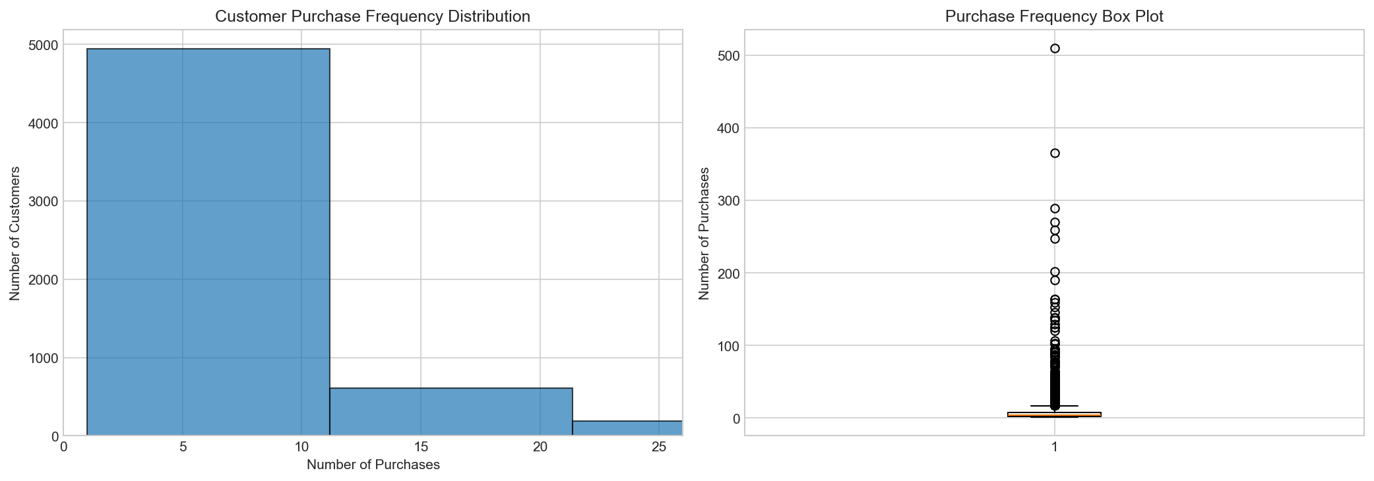
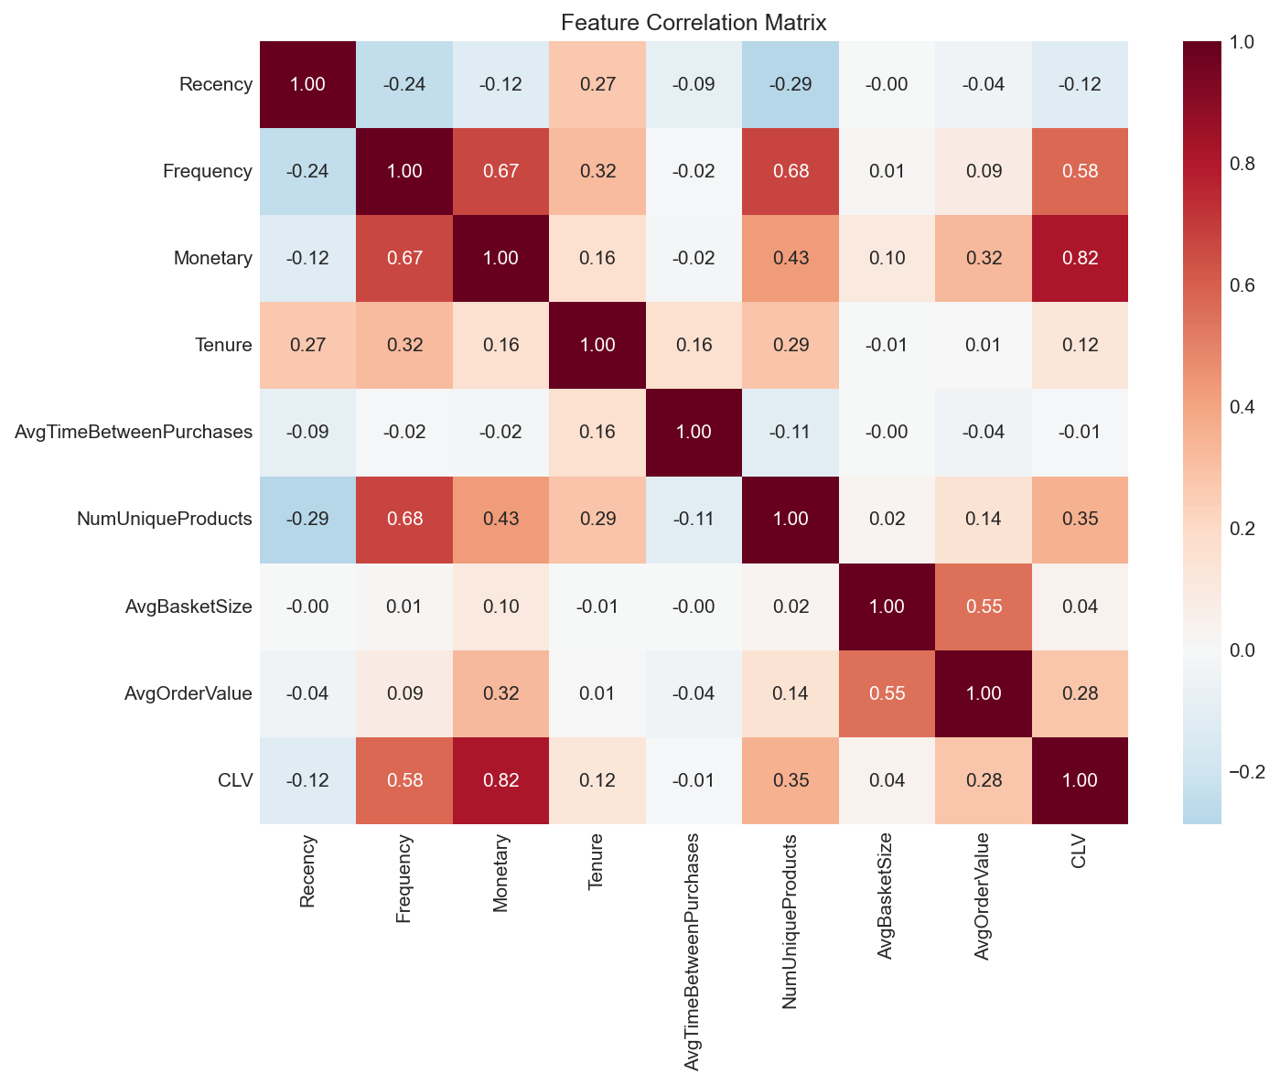
Features
Feature and Target Distributions (5.4)
• RFM and behavioral features show heavy skew and strong concentration effects.
• Correlation and distribution checks shaped model family and scaling decisions.
RFM feature distributions
Future CLV distribution
Customer purchase frequency
Feature correlation matrix

Slide 6
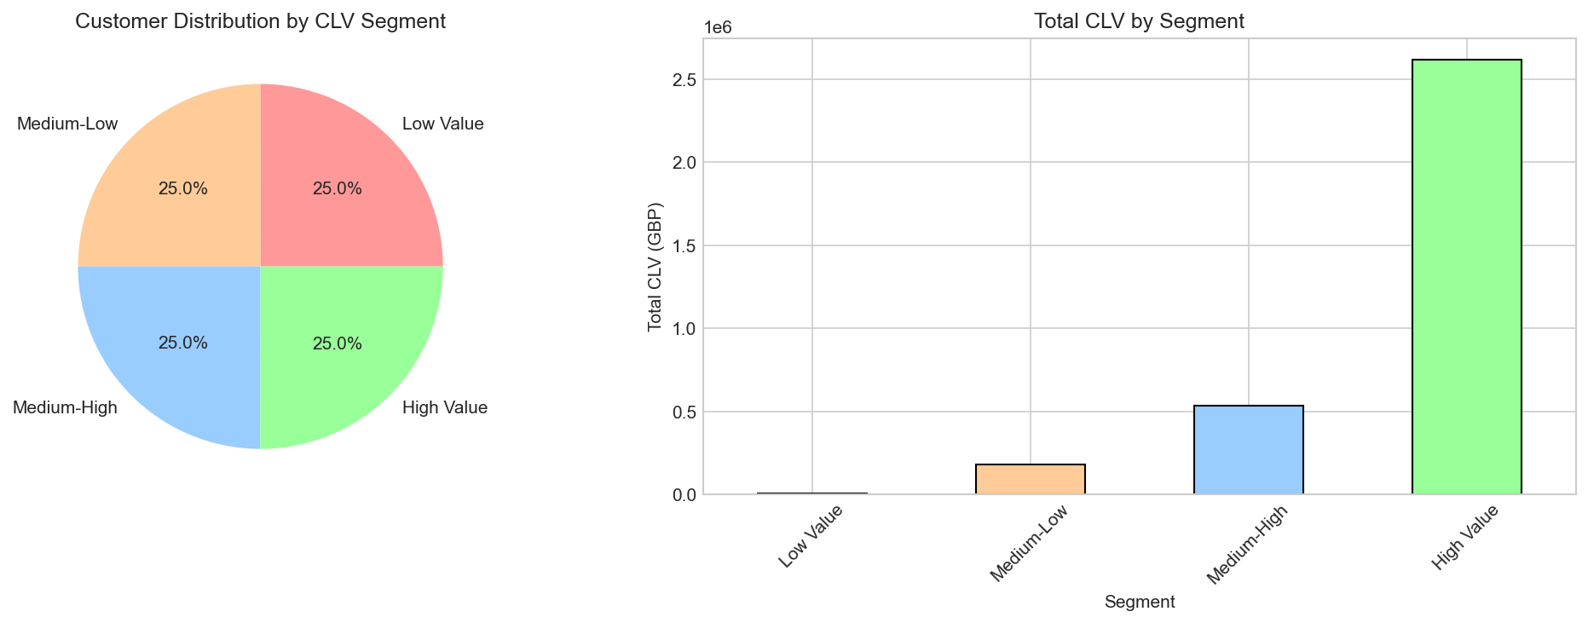
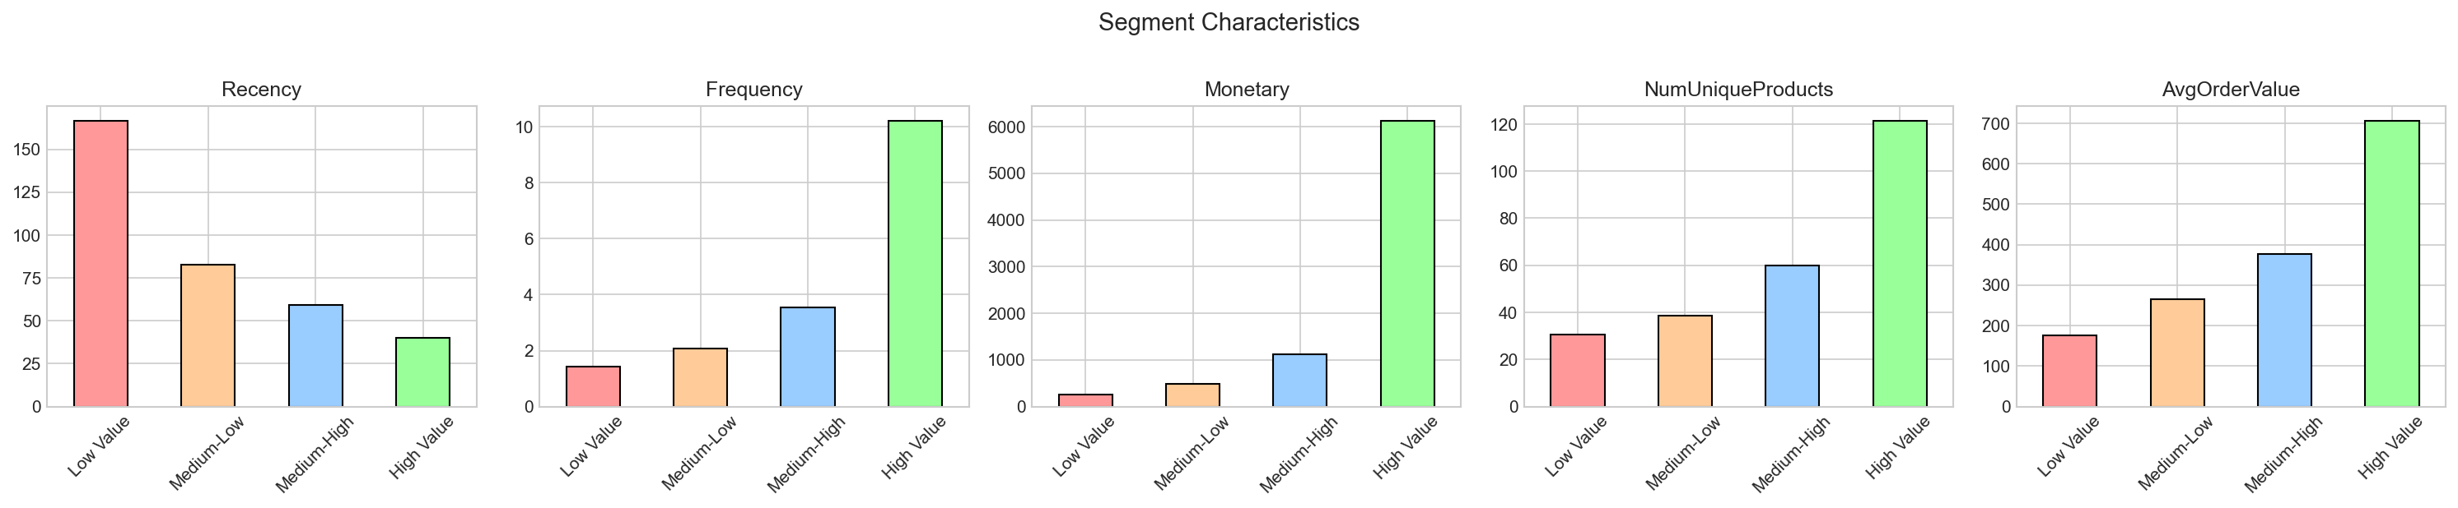
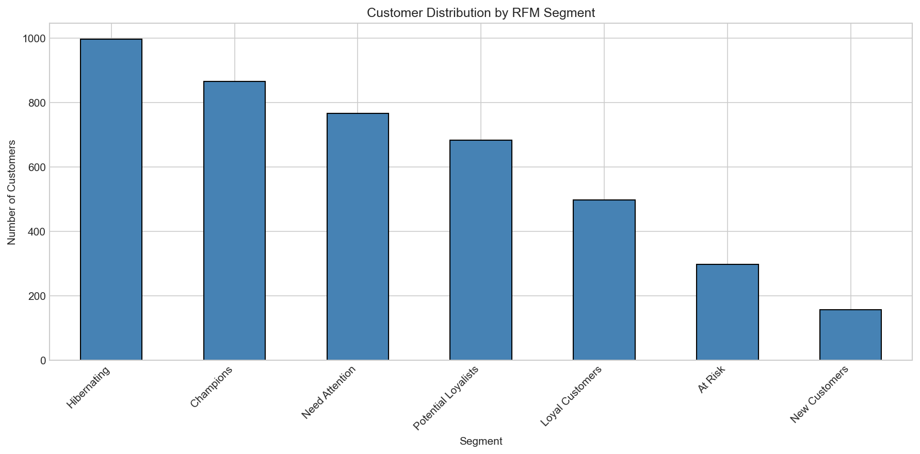
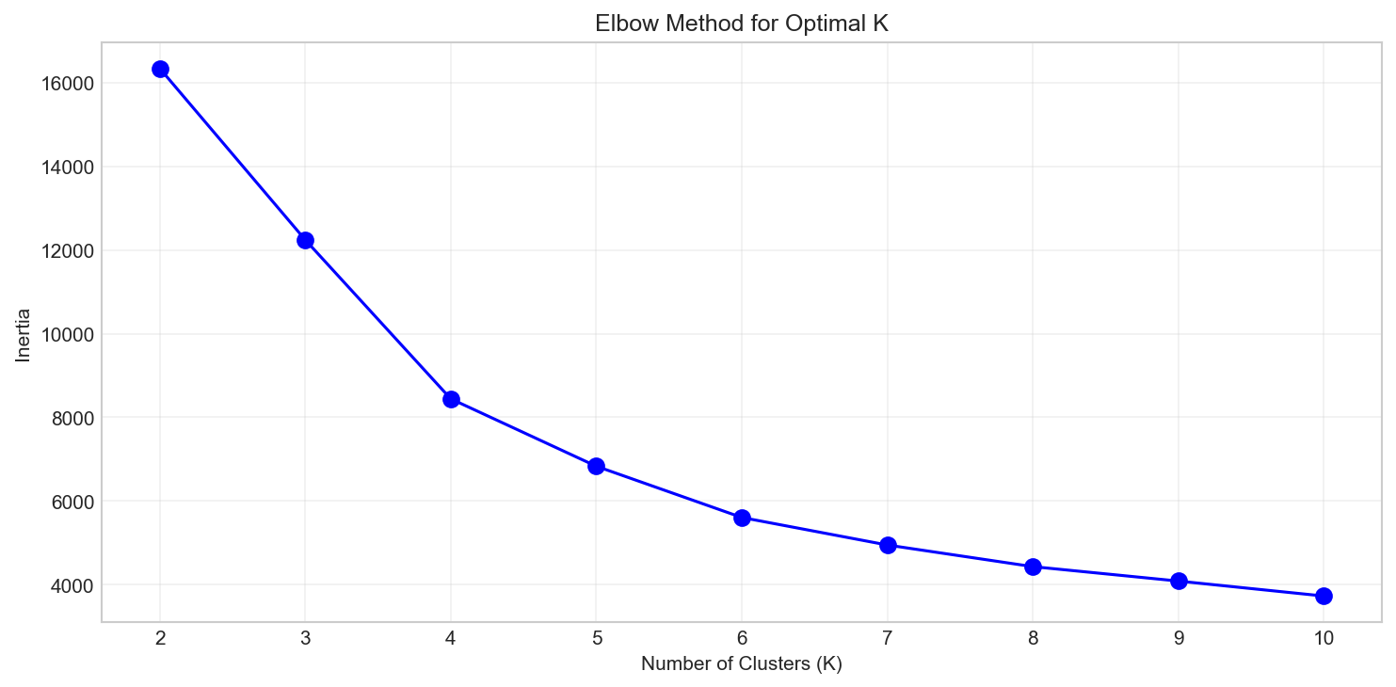
Segmentation
Segmentation and Behavioral Clusters
• Segmentation complements prediction by converting scores into action buckets.
• Profiles and cluster diagnostics guide campaign strategy design.
Segment size distribution
Segment profile comparison
RFM segment map
K-means elbow method

Slide 7
Modeling
Modeling Approach and Evaluation (5.5, 5.6)
Train/val/test split: 80/10/10 at customer level; validation for tuning, test as final holdout.
Compared Linear, Ridge, Lasso, Random Forest, Gradient Boosting, XGBoost.
Metrics: RMSE, MAE, R2, MAPE and lift for business prioritization.
Randomized search used for fine-tuning top candidates.

Slide 8
Results
Predictive Performance (5.9.5)
Model | RMSE | MAE | R2
Random Forest | 862.46 | 441.21 | 0.032
Lasso Regression | 1761.83 | 547.71 | 0.808
Linear Regression | 1762.46 | 547.99 | 0.808
Ridge Regression | 1762.94 | 547.98 | 0.808
XGBoost | 2387.82 | 534.66 | 0.648

Slide 9
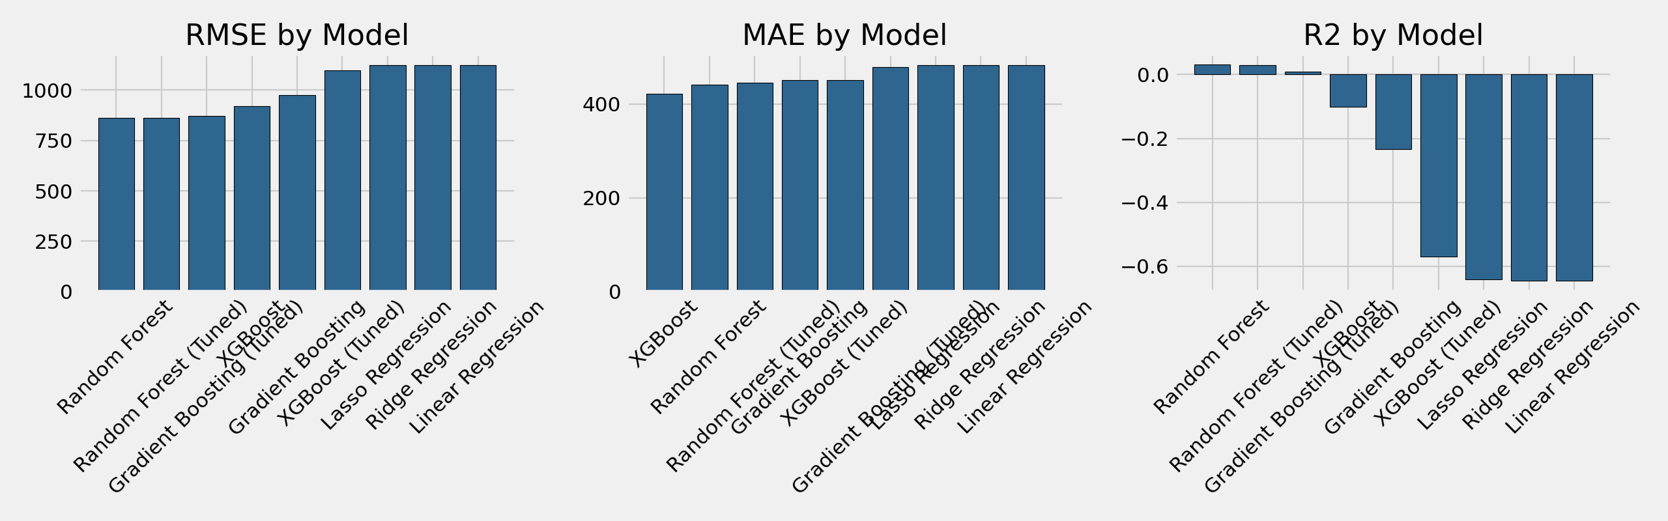
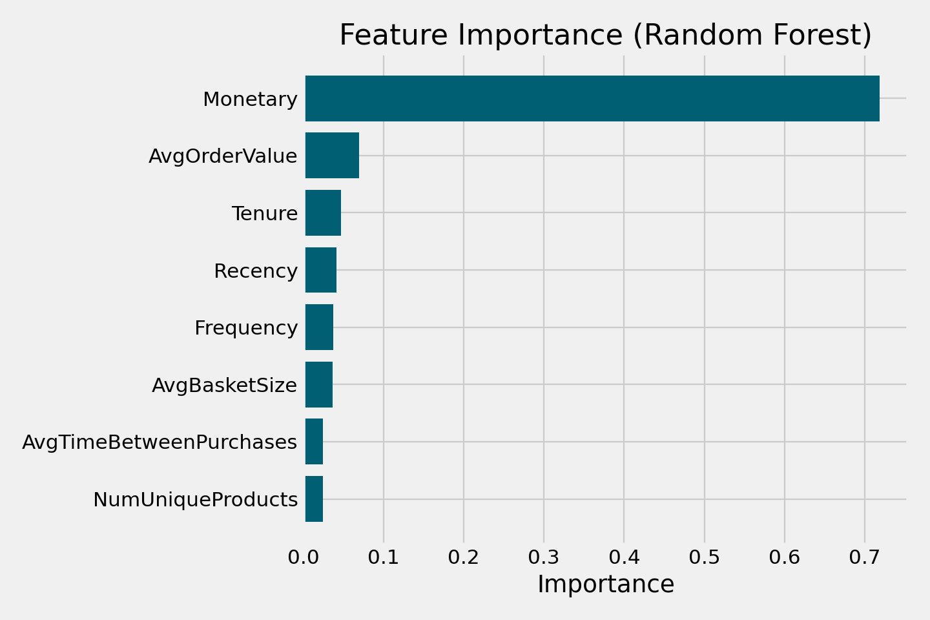
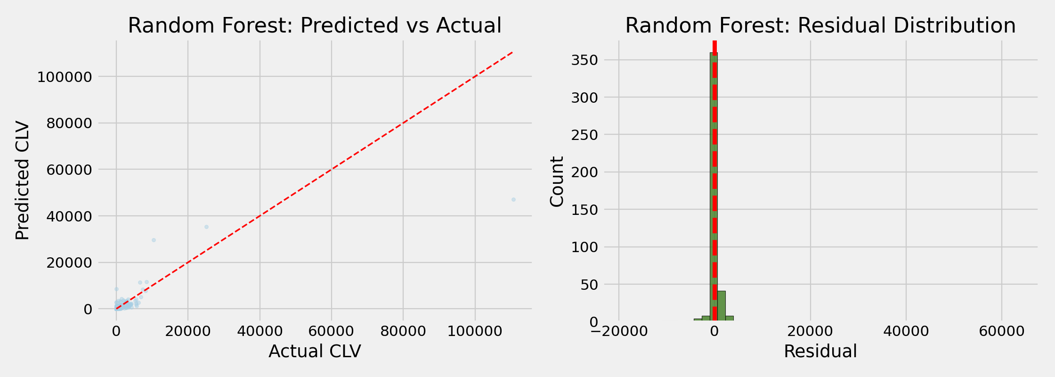
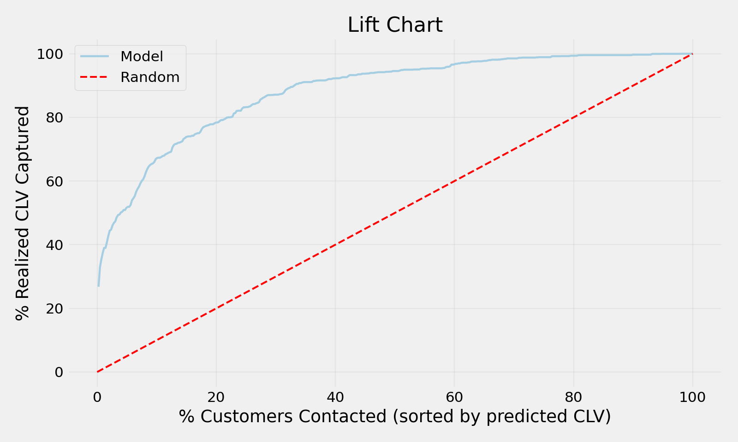
Model Diagnostics
Diagnostics and Business Utility (5.7, 5.8, 5.9.6)
• Model ranking, residual diagnostics, and lift all support selection of a tuned regularized model.
• The top-decile lift demonstrates strong practical targeting value.
Model metric comparison
Global feature importance
Residual and fit diagnostics
Lift chart (business impact)

Slide 10
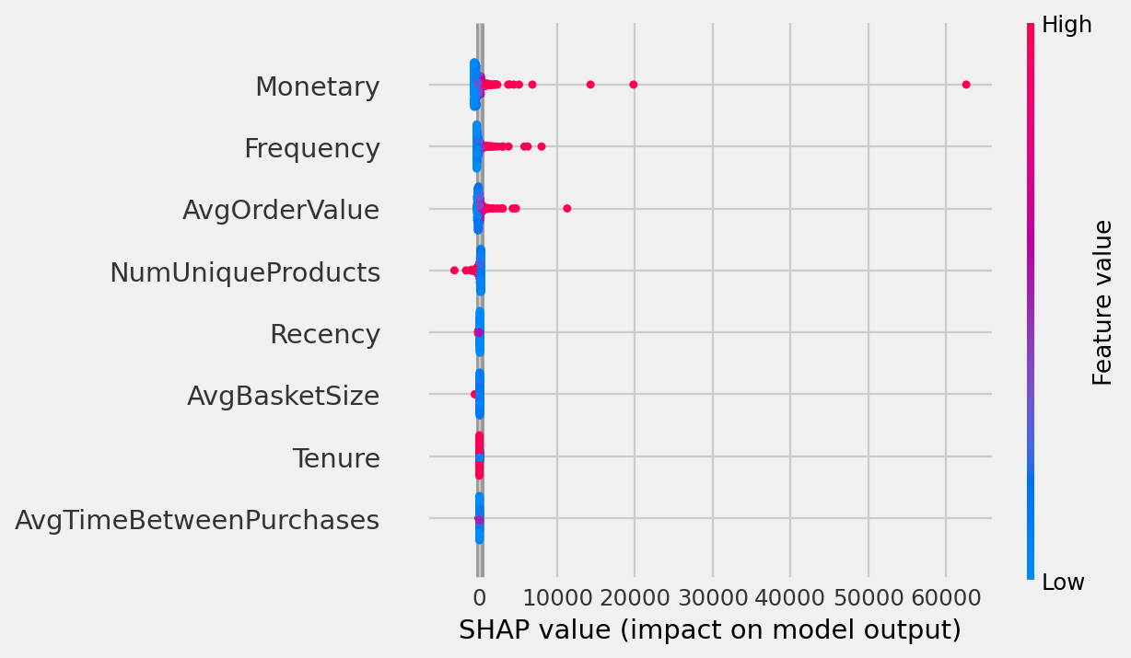
Explainability
SHAP Explainability (5.9.6)
SHAP confirms direction and magnitude of global drivers.
Monetary and frequency behavior dominate prediction contributions.
Interpretability supports stakeholder trust and campaign governance.
Lift@10% = 6.69x over random targeting.

Slide 11
Phase 2
CausalML Phase
From prediction to intervention impact estimation

Slide 12
Causal Setup
Target, Treatment, Controls
Definitions
Required Methods
Outcome: log1p(CLV).
Treatment: campaign vs control assignment.
Controls: RFM + behavioral features.
LRSRegressor (S-learner style).
XGBTRegressor (T-learner style).
Feature importance and CATE distribution analyzed in notebook 06.

Slide 13
Causal Results
Average Treatment Effects
Model | ATE (log1p CLV) | CI Lower | CI Upper
LRSRegressor | -0.1785 | -0.3783 | 0.0213
XGBTRegressor | -0.1673 | -0.2575 | -0.0770

Slide 14
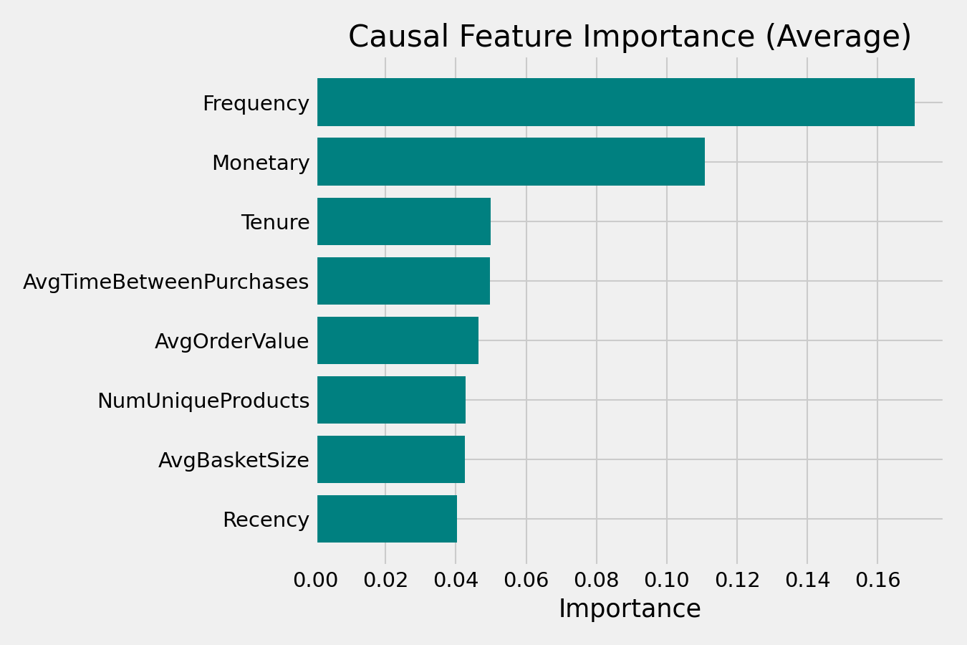
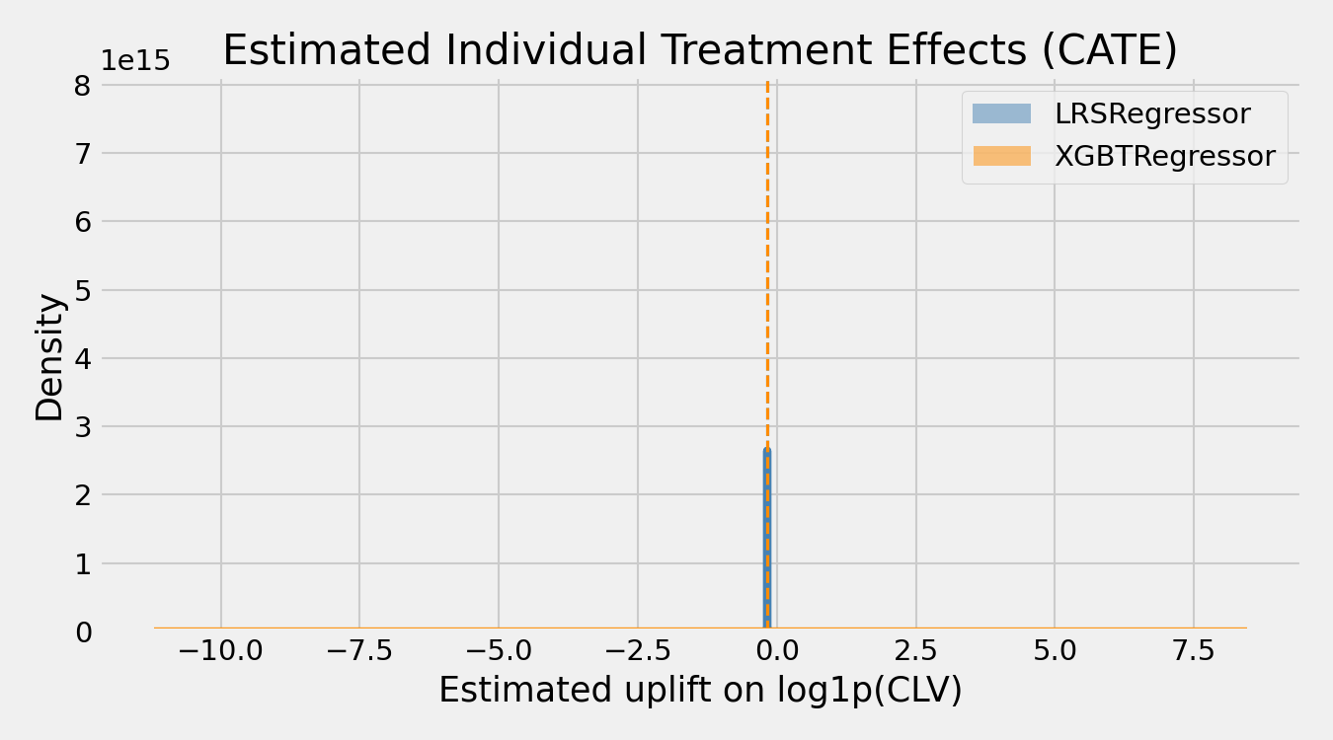
Causal Explainability
Uplift Distribution and Causal Importance
• Treatment effects vary substantially by customer profile (heterogeneous CATE).
• Causal importance supports policy targeting beyond raw CLV ranking.
CATE distribution
Causal feature importance

Slide 15
Validity
Threats to Validity (5.9.7)
Treatment assignment is observational/simulated, not randomized.
Potential unobserved confounding and temporal effects.
Outliers and historical policy effects can bias relationships.
External validity may differ across geographies and verticals.

Slide 16
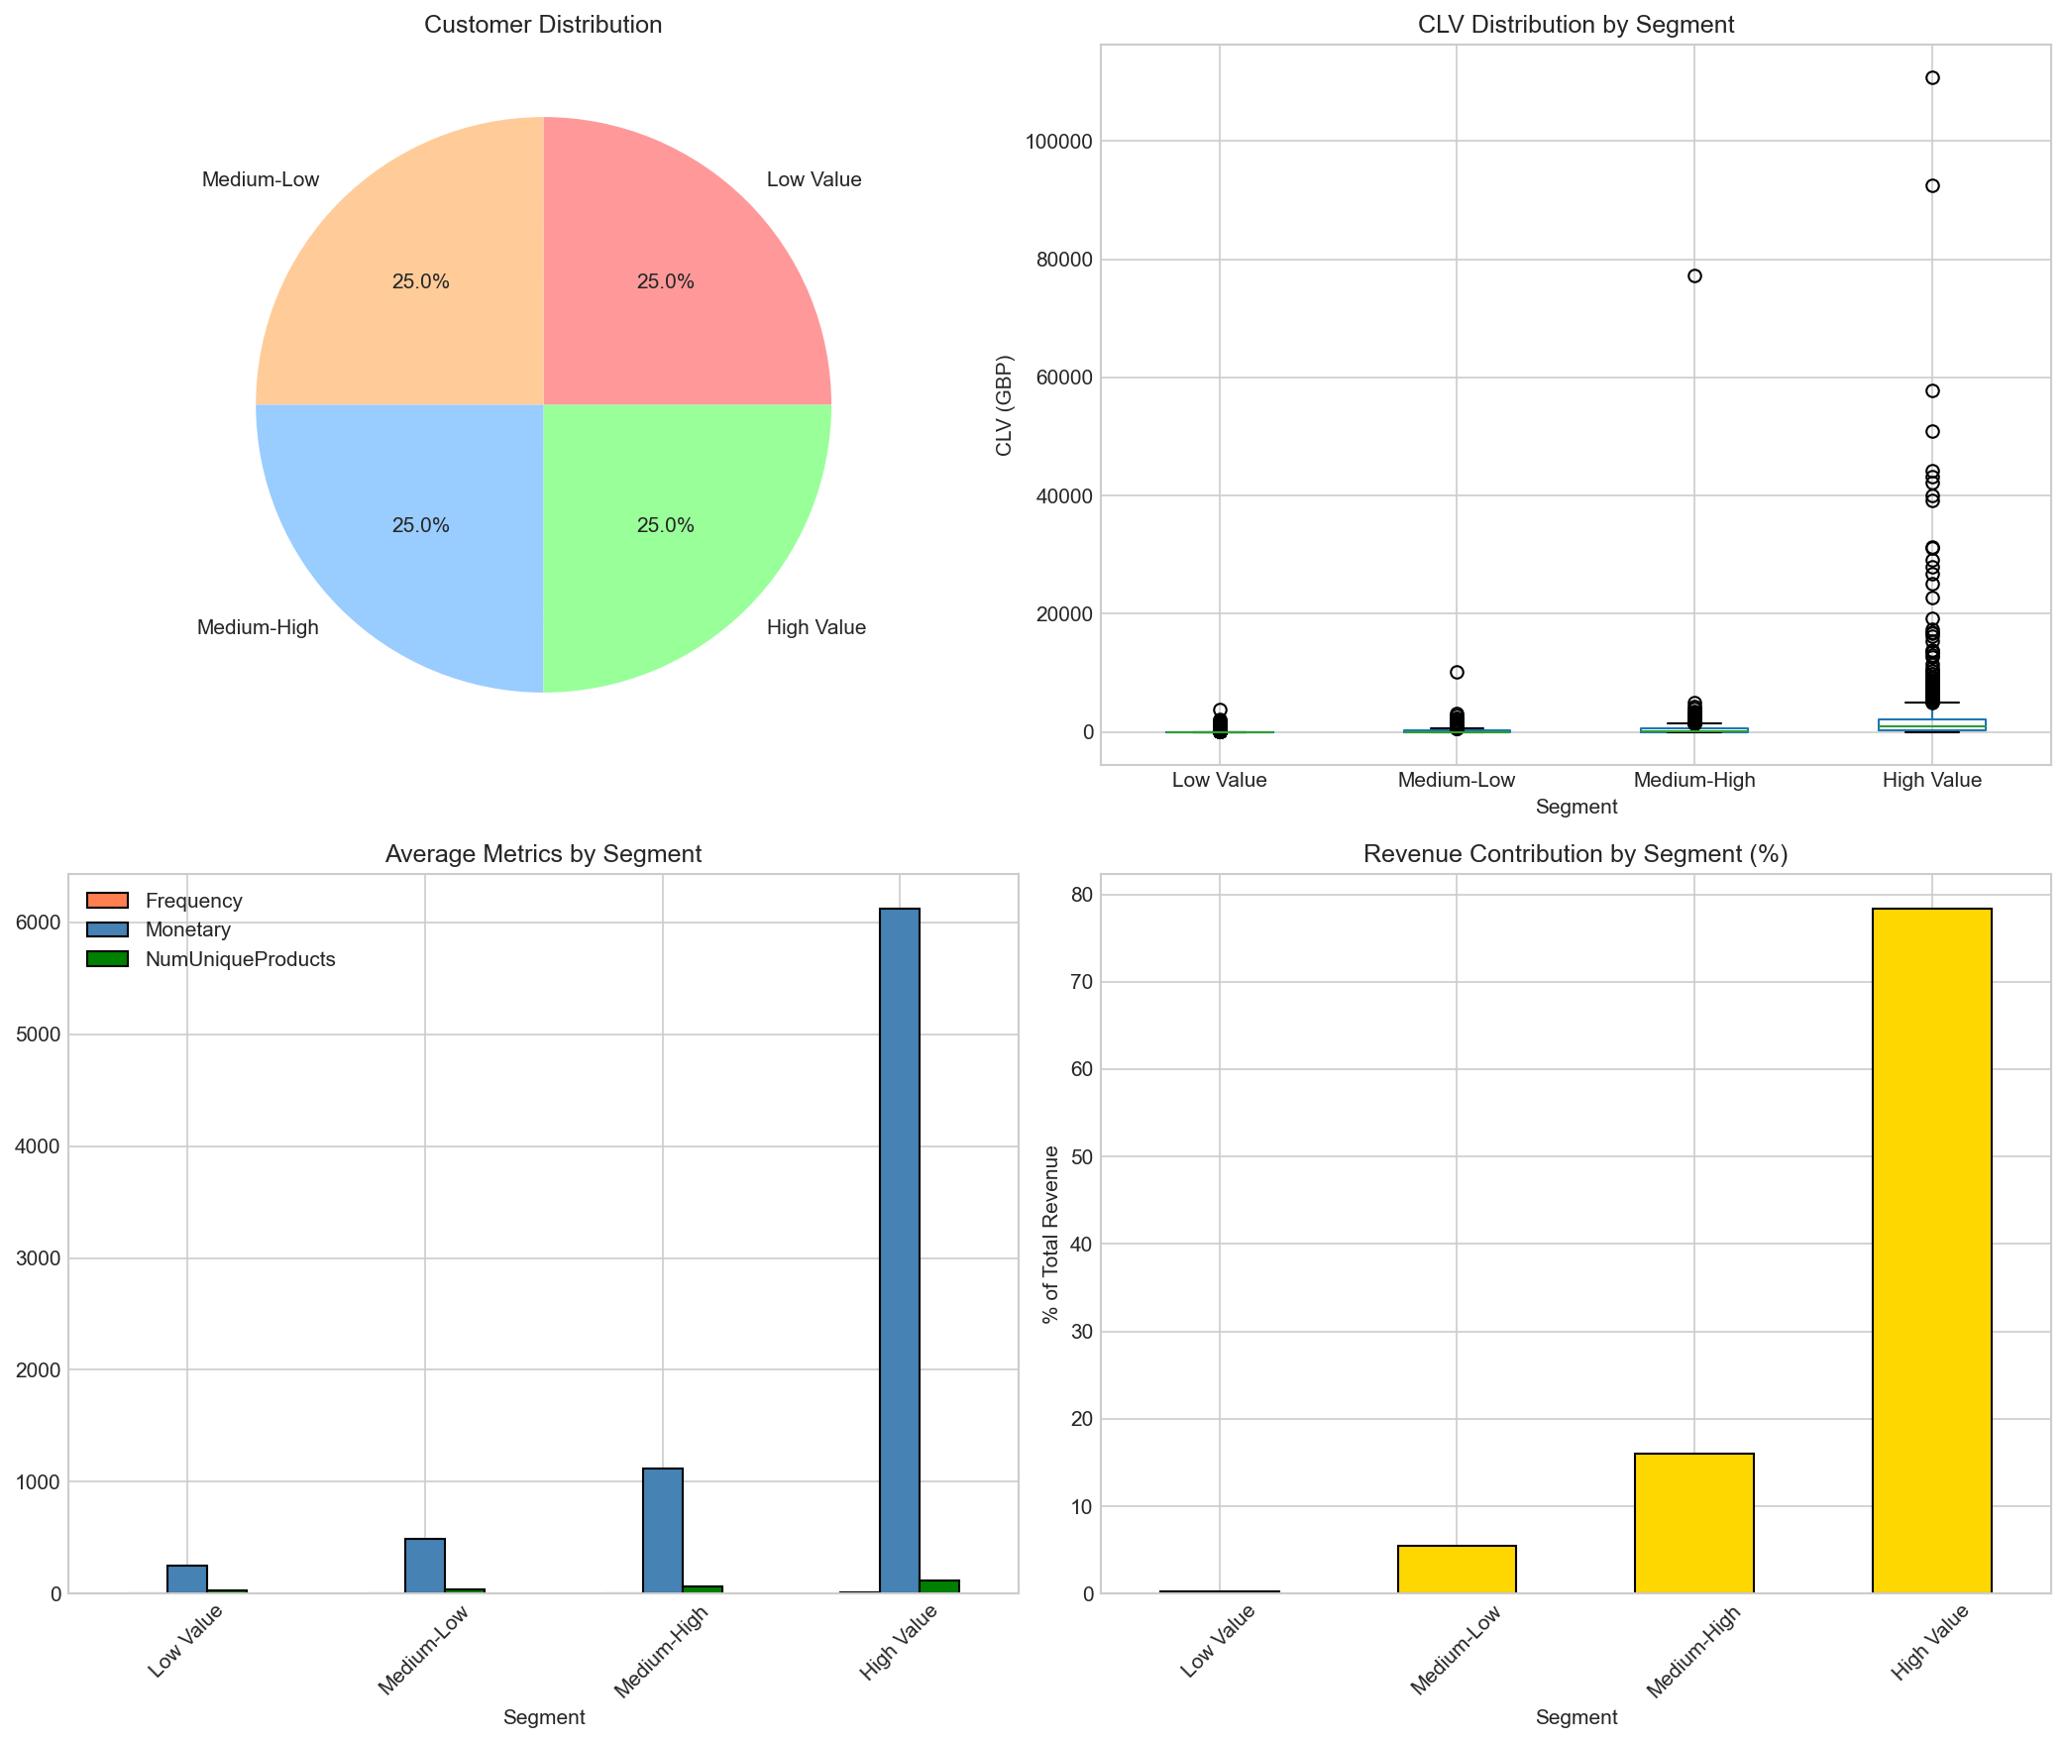
MLOps
Launching, Monitoring, Maintenance (5.10)
Production checks: schema validation, feature quality checks, artifact versioning.
Monitoring: RMSE drift, CLV capture@K, feature drift via PSI.
Alerting: warning at PSI >= 0.10, critical at PSI >= 0.25.
Observed max PSI in validation run: 0.036 (stable).

Slide 17
Conclusion
Conclusions, Lessons, and Next Steps (5.9.8, 5.9.9)
An end-to-end enterprise DS pipeline was implemented and validated.
Predictive + explainable + causal layers improve decision quality.
Next step: validate uplift on real campaign logs / A/B tests.
This repository is submission-ready with reproducible artifacts.

Slide 18
Thank You
Questions and Discussion
Repository: https://github.com/othmane-zizi-pro/nwa
Othmane Zizi (261255341) | Fares Joni (261254593) | Tanmay Giri (261272443)
Nerds With Attitude - INSY 674

