Slide 1


Language Models for Fact-Checking and Claim Assessment
Othman EL HOUFI
Pr. D. KOTZINOS – Research supervisor
M2 Research in Data Science & Machine Learning
6/7/22

Slide 2
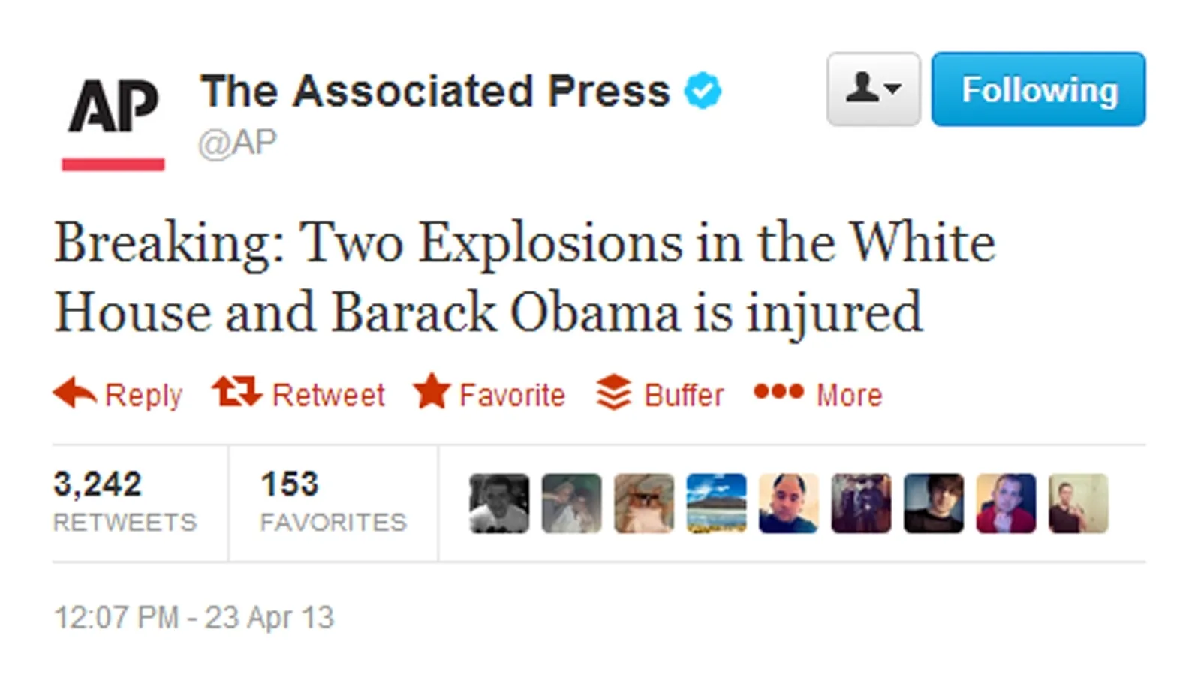
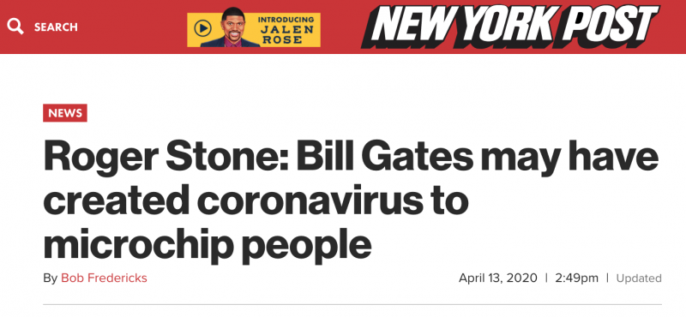
Fake news & NLP
This article affected COVID-19 vaccination decisions
This tweet caused $130 billion value drop in stock market!

Slide 3
Fake news & NLP
Fake news
false, often sensational, information disseminated under the guise of news reporting.
Collins English Dictionary
Humans
have been proven irrational and vulnerable when differentiating between real and fake news. Typical accuracy ranges between 55% and 58%.
Xinyi Zhou, Reza Zafarani, Kai Shu, and Huan Liu. Fake news: Fundamental theories, detection strategies and challenges.

Slide 4
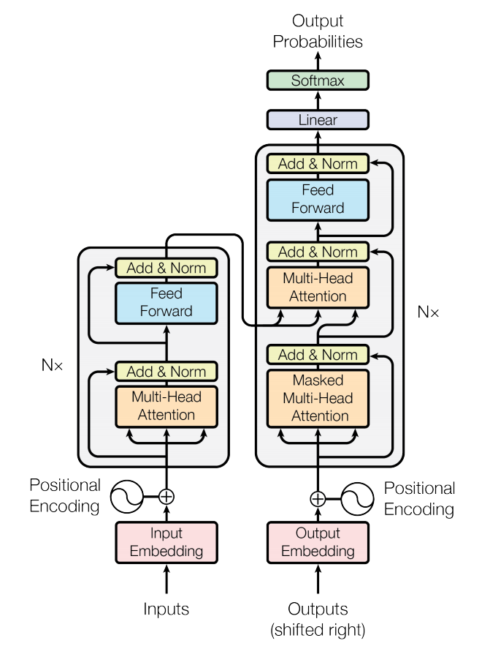
Language Models
A new Deep Neural Network Architecture,
Based on Attention mechanism,
Great for NLP tasks:
      Translation, Sentiment analysis, Text summarization...
Powerful, faster, stable than old architectures (RNNs, LSTMs)
Attention is all you need (2017).

Slide 5
Datasets
FEVER
The Apple Store first opened in 2001.
SUPPORTS
185K annotated claims
3-labels
Adventure Time won an Oscar.
REFUTES
Yamaha Corporation produces hardware.
NEI
Liar
FIFA pressured Brazil into passing a so-called Budweiser bill, allowing beer sales in soccer stadiums.
TRUE
12.8K annotated claims
6-labels
Says Barack Obama founded ISIS. I would say the co-founder would be crooked Hillary Clinton.
FALSE
Sixty-two percent of all personal bankruptcies are caused by medical problems.
HALF-TRUE
MultiFC
The government does not need a warrant to read your old emails.
TRUE
35K annotated claims
>30-labels reduced to 5-labels
About 99% of rape allegations are fabricated.
FALSE
Husbands rarely beat up their wives. Single women get beaten up more.
IN-BETWEEN
COVID-19
Holding your breath can let you test whether you may have COVID-19.
FAKE
6K annotated claims
2-labels
WHO: We recommend systemic corticosteroids for the treatment of patients with severe and critical
#COVID_19 which could be lifesaving. https://t.co/R4HNTnEEwD
REAL
ANTi-Vax
Just got my appointment to be vaccinated and I’m extremely nervous and slightly excited all in one. #vaccine
NOT_MISSINFO
15K annotated claims
2-labels
Disturbing and Mysterious #Death of 18yo #Camilla after #COVID #Vaccine. #AstraZeneca’s Jabs
stopped in #Italy for Young #People!#Experimental https://t.co/Ssz9kKkFDu
MISSINFO

Slide 6
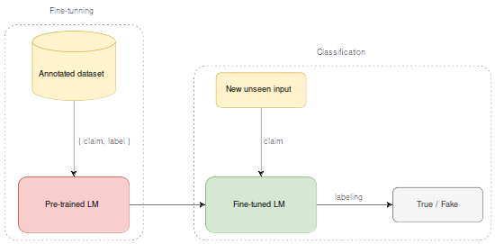
Proposed solution
Pre-process each dataset:
        FEVER, Liar, MultiFC, COVID-19, ANTi-Vax
Fine-tune a set of LMs:
        BERT, RoBerta, ALBERT, XLNET, DistilBERT, BigBird, ConvBERT
Deploy the best LM to assess the validity of new input claims

Slide 7
Results & Discussion
Dataset | Metric | 2-labels | 3-labels | 5-labels | 6-labels
FEVER | accuracy | 0.81 | 0.64 | -
 | macro f1 | 0.81 | 0.63 | -
MultiFC | accuracy | 0.72 | - | 0.50 | -
 | macro f1 | 0.64 | - | 0.40 | -
Liar | accuracy | 0.69 | - |  | 0.31
 | macro f1 | 0.61 | - |  | 0.30
COVID-19 | accuracy | 0.98 | -
 | macro f1 | 0.98 | -
ANTi-Vax | accuracy | 0.99 | -
 | macro f1 | 0.99 | -

Slide 8
Conclusion & Perspective
LMs have a great potential to solve different NLP problems,
LMs for fact-checking are good but not the best,
      Does not beat state-of-art traditional models.
Different paths can be explored
      We still have much to learn about LMs.
In the future we may exploit the structural features of Complex Networks in combination with LMs.

Slide 9
Bibliography

Slide 11
Fake news & NLP
Automatic fake news detection is a practical NLP problem useful to all online content providers.
Reduce the human time and effort to detect fake news,
Can sweep through huge data streams,
Capable of ceasing the spreading much faster.
How can we differentiate fake news from real news?
At what level of confidence can we do so?
What are the existing methods that solves this problem?

Slide 12
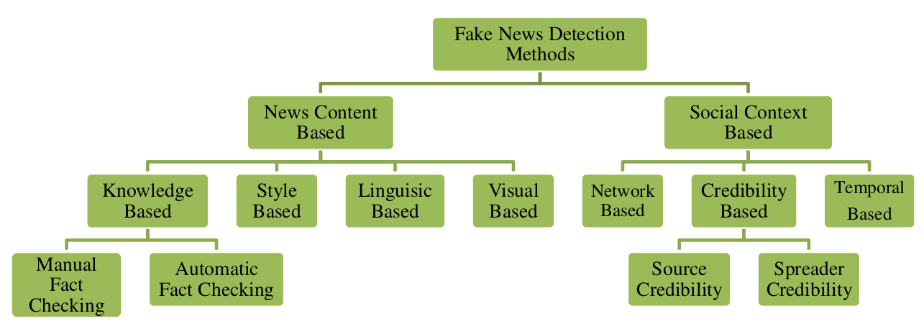
Related work
S Hangloo, B Arora. Fake News Detection Tools and Methods – A Review

Slide 13
Related work
Knowledge-based Fake News Detection
aims to assess news authenticity by comparing the knowledge extracted from to-be verified news content with known facts, also called fact-checking.
Anton Chernyavskiy, Dmitry Ilvovsky, and Preslav Nakov. Whatthewikifact: Fact-checking claims against wikipedia.
Style-based Fake News Detection
focuses on the style of writing, i.e. the form of a text rather than its meaning.
P. Przybyla. Capturing the style of fake news. In Proceedings of the AAAI Conference on Artificial Intelligence.

Slide 14
Related work
Language Model based Fact-Checking
a new approach that relies on fine-tuning state-of-art LMs like BERT that were pre-trained on Wikipedia’s articles in order to solve the claim classification problem.
Nayeon Lee, Belinda Z Li, Sinong Wang, Wen-tau Yih, Hao Ma, and Madian Khabsa. Language models as fact checkers?
What are Language Models?
How can they be employed as fact-checkers?

Slide 15
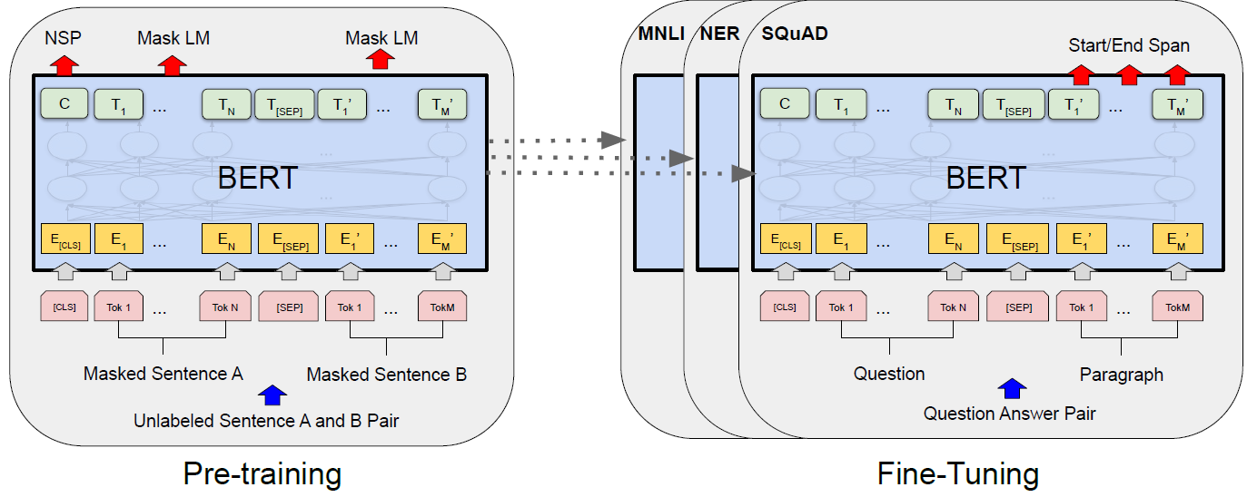
Language Models
Bert: Pre-training of deep bidirectional transformers for language understanding.
Attention is all you need.

Slide 16
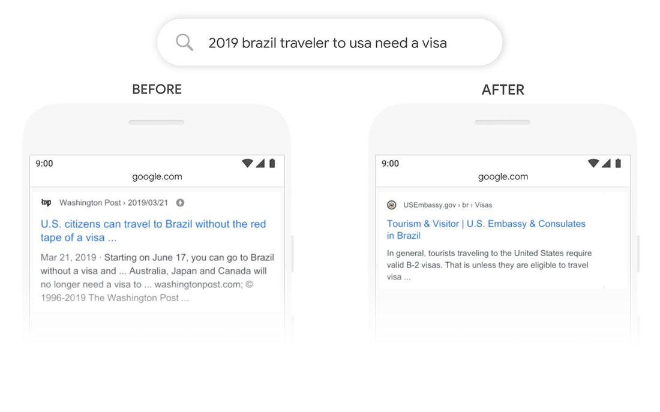
Language Models
BERT

Slide 17
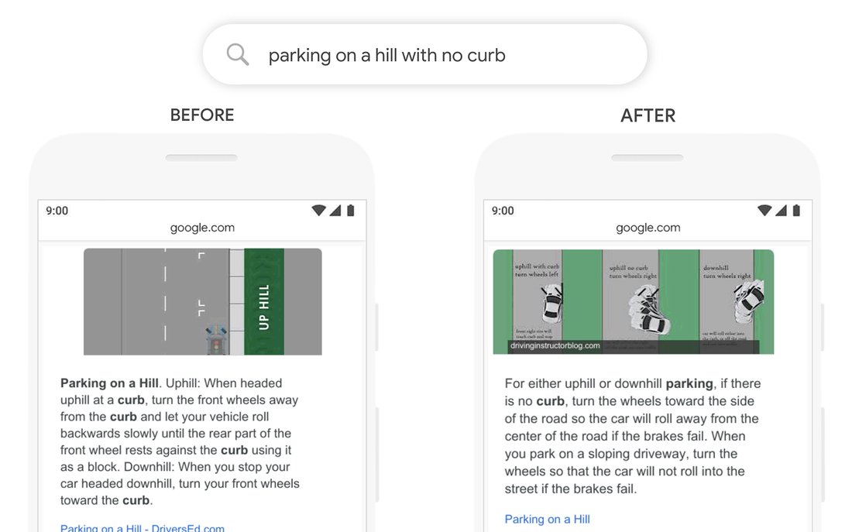
Language Models
BERT

Slide 18
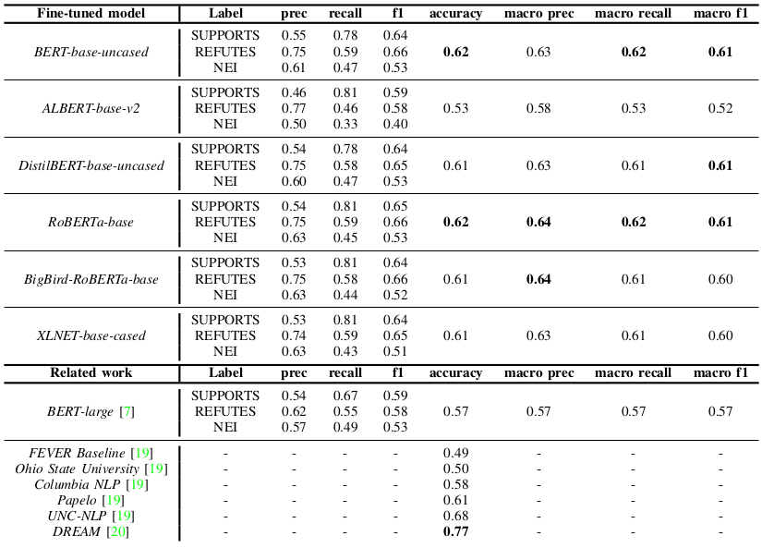
Results & Discussion

Slide 19
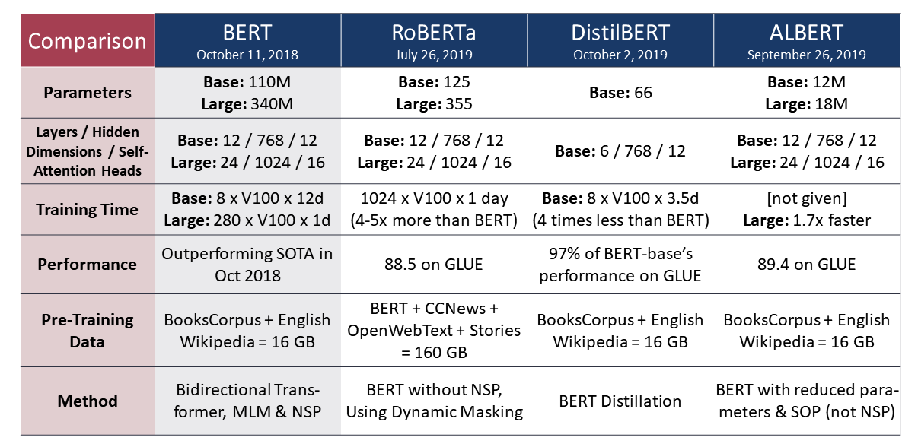
Proposed Method
Language Models for classification
https://humboldt-wi.github.io/blog/research/information_systems_1920/uncertainty_identification_transformers/

