Slide 1

NLP for Fact-Checking and Claim Assessment
A Language Model based approach
Othman EL HOUFI
Dimitris KOTZINOS
M2 Research in Data Science & Machine Learning
3/28/22

Slide 2
Overview
Fake news & NLP
Related work
Proposed method
    FEVER dataset
    Language Models for classification
Results & discussion
Conclusion & Perspective

Slide 3
AI and the misconception of fairness
AI algorithms
are used everyday to make accurate assessments based on some attributes,
are much faster,
and totally fair because it’s not a human that is making the assessments (Misconception)
Why algorithms are not totally fair?
Is fairness important? When is it important?
How can we know if a given algorithm is fair?

Slide 4
AI and the misconception of fairness
We all have been subject to a predictive machine learning model of the sort:
If you like Milk, you may like Cookies,
If you like Action Movies, you may like The Matrix,
If you are like Dimitris, you may not get a loan
If you are like Dimitris, you may not get a job
If you are like Dimitris, you may go to jail

Slide 5
COMPAS Algorithm
Correctional Offender Management Profiling for Alternative Sanctions
Developed and owned by Northpointe (now Equivant)
A defendant is compared with other profiles/criminals,
The COMPAS algorithm outputs a Risk Factor,
The Risk Factor quantifies the likelihood the defendant will commit another crime in the future (recidivist),
If you are assessed to be High Risk, the judge denies bail and send you to prison,
Otherwise bail is approved and you may go home and wait for trial.

Slide 6
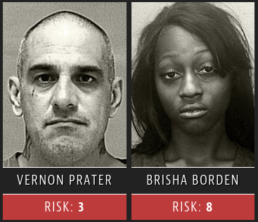
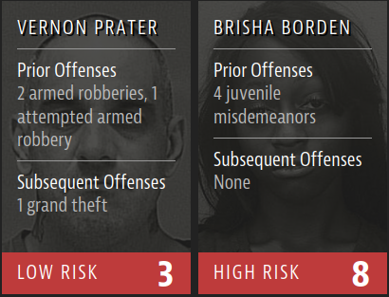
COMPAS and ProPublica’s involvement
ProPublica is a team of journalists,
They found that COMPAS is disadvantageous to black defendant
Borden was rated high risk for future crime after she and a friend took a kid’s bike and scooter that were sitting outside. She did not reoffend.
Source : www.propublica.org

Slide 7
COMPAS and ProPublica’s involvement
The COMPAS algorithm is proprietary
ProPublica generated thousands of classifiers in order to back-engineer the COMPAS algorithm with same accuracy and same bias
Only Age and Previous Crimes/Arrests that are used as attributes
If Race is excluded from the algorithm, why is there a racial bias?
African-American | Asian | Caucasian (White) | Hispanic | Native American | Other | TOTAL
3175 | 31 | 2103 | 509 | 11 | 343 | 6172
51.44 % |  | 34.07 %

Slide 8
The bias in COMPAS algorithm
Models are trained on data,
Often that data contains human decisions that reflect the effects of societal or historical inequities.
Using Previous Arrests is biased because arrest rates are greater in neighborhoods with more police patrols,
Black people get arrested more because of police racism,
Also, being arrested does not imply guilt
Previous Arrests is an Outcome proxy bias

Slide 9
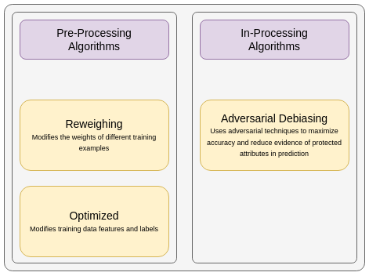
Detect and Mitigate the bias
We consider Race as a Protected Attribute
We use Fairness metrics to detect bias
We apply Mitigation algorithms in order to remove bias before or during learning

Slide 10
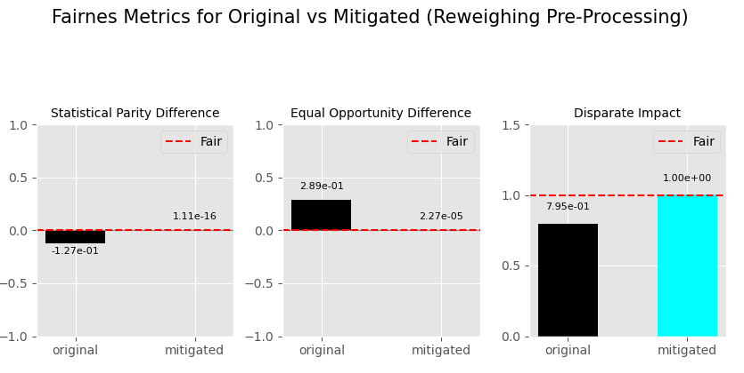
Detect and Mitigate the bias : Analysis
Reweighing Pre-Processing

Slide 11
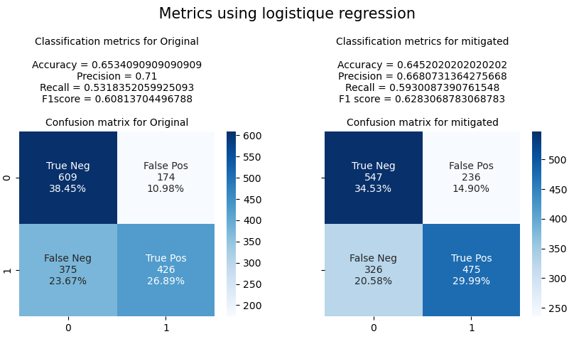
Detect and Mitigate the bias : Analysis
Reweighing Pre-Processing

Slide 12
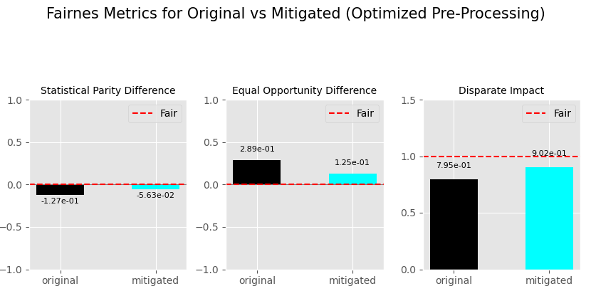
Detect and Mitigate the bias : Analysis
Optimized Pre-Processing

Slide 13
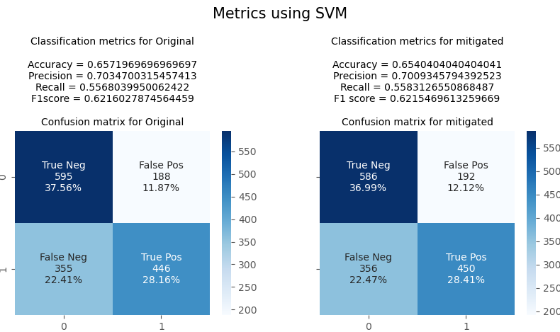
Detect and Mitigate the bias : Analysis
Optimized Pre-Processing

Slide 14
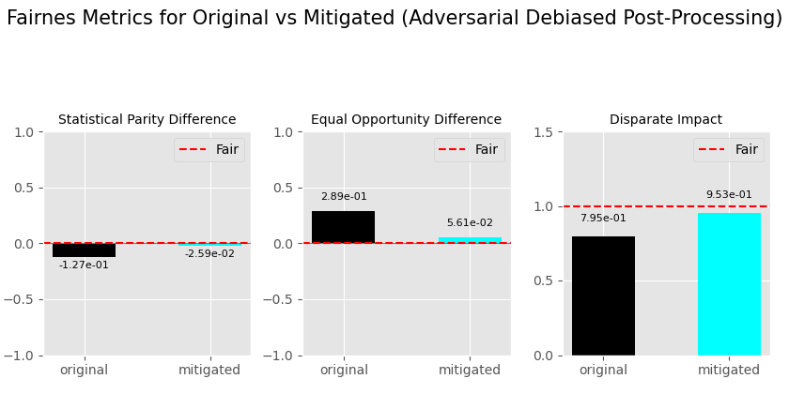
Detect and Mitigate the bias : Analysis
Adversarial Debiasing In-Processing

Slide 15
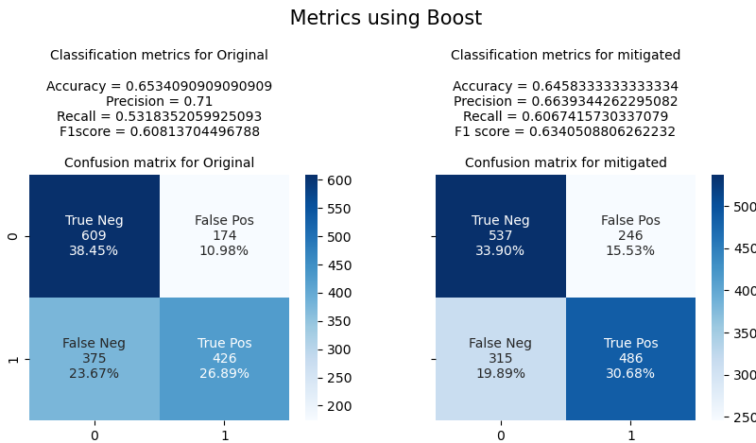
Detect and Mitigate the bias : Analysis
Adversarial Debiasing In-Processing

Slide 16
Further measures and perspectives
Raise awareness about AI and its flaws
Make fairness analysis mandatory when the damage is Human
Amend laws that targets computerized human classifications
    Ex. The GDPR rights made in Europe, to audit decisions
Creation of International Cyber Ethics Panel (ambitious but necessary)
As Data Scientist, we should not make the same mistakes.

