Slide 1

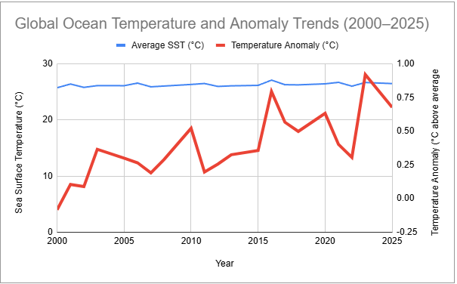
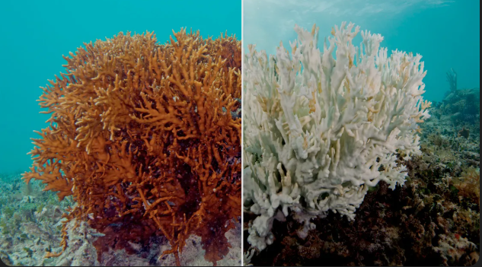
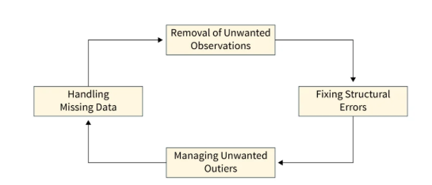
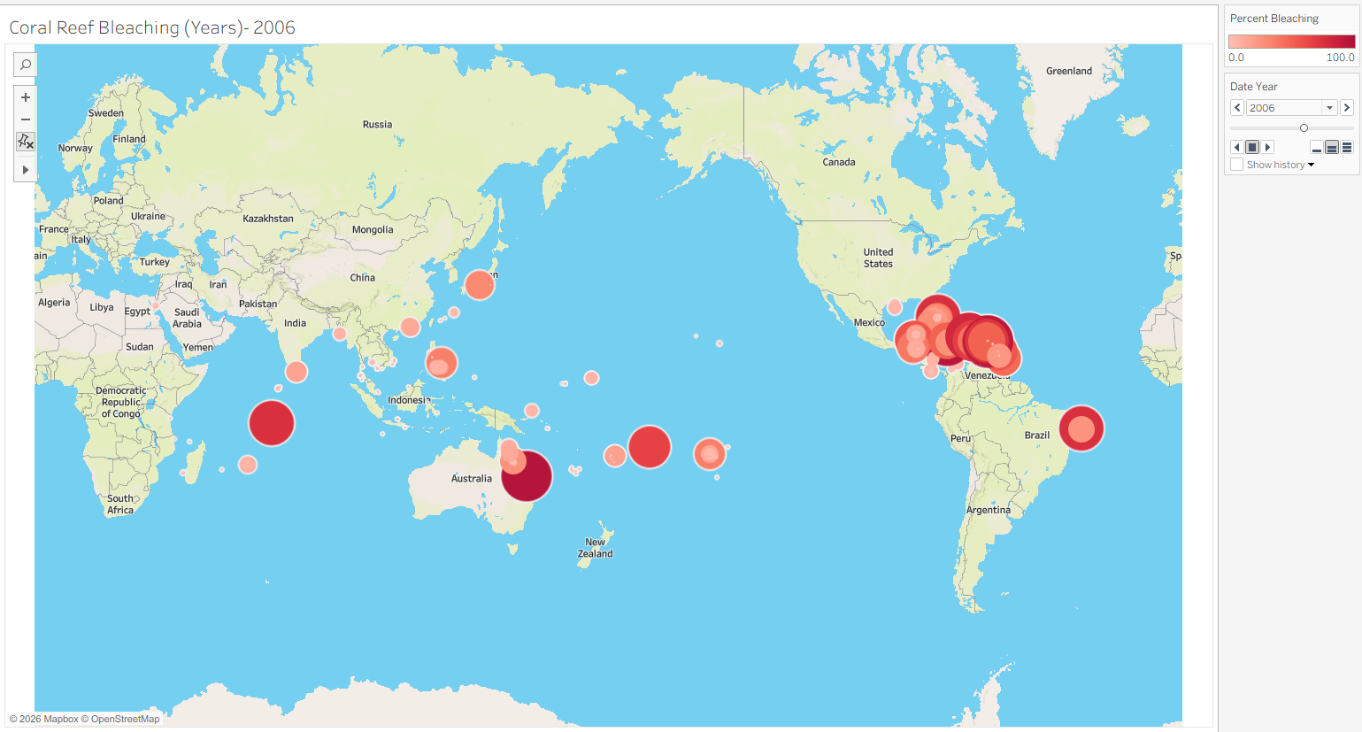
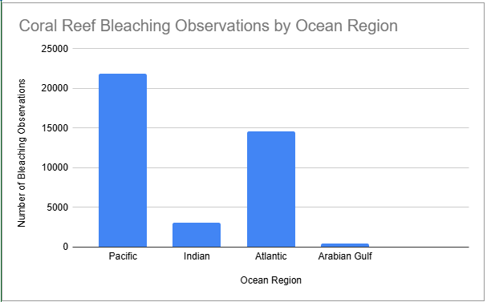


Coral Reef Bleaching and Ocean Temperature Trends: Predicting Future Risk
Othmane Kerfal
Department of Computational and Data Sciences, George Mason University, Fairfax, VA
Background or Abstract
Preprocessing
Results
Discussion
Coral reef bleaching has become one of the most urgent environmental issues due to rising ocean temperatures caused by climate change. Coral reefs support approximately 25% of marine life, making them critical to biodiversity and ocean ecosystems(NOAA, 2025).
My approach uses data cleaning, aggregation, and visualization techniques. Data was processed using Google Sheets and NOAA datasets, including calculating yearly averages of sea surface temperature and temperature anomalies. Google sheets was also used to remove missing or null values and converting all temperature to Celsius. Tableau was used to create an interactive geographic visualization of coral bleaching events.
The line graph shows increasing ocean temperatures and anomalies over time, while the interactive map highlights where these changes have the greatest impact. The bar chart identifies which ocean regions experience the most bleaching. Together, these results suggest that rising temperatures are a key driver of coral bleaching and can help predict vulnerable regions in the future.
They also act as natural, submerged breakwaters, meaning they absorb wave energy from storms which protects coastal communities from flooding and erosion.
Conclusion
Figure 1: Coral reef before and after bleaching.
Figure 4: Average sea surface temperature and temperature anomaly from 2000 to 2025. The anomaly is shown on a secondary axis to highlight deviations from normal conditions and increasing thermal stress. The temperature jumps after 2015 which shows a significant change in ocean temperatures..
The data shows a clear increase in ocean temperatures and heat stress over time. This rise aligns with higher coral bleaching in regions like the Pacific and Atlantic Oceans, indicating a strong link between warming and reef damage. Overall, continued ocean warming will likely lead to more widespread and severe coral bleaching in the future. These findings highlight the urgent need to monitor and reduce ocean warming to protect coral reef ecosystems.
Research Questions
Figure 2: The workflow to process data from collecting to transforming the data shown in this flow diagram.
Can historical coral bleaching and ocean heat-stress data be used to identify reef regions with the highest future bleaching risk?
Data
References
The first dataset comes from NOAA Coral Reef Watch and includes near real-time and historical ocean heat stress data, including sea surface temperature (SST) and temperature anomalies.
National Oceanic and Atmospheric Administration. (2025). Coral reef ecosystem studies and bleaching reports. https://www.noaa.gov
National Oceanic and Atmospheric Administration Coral Reef Watch. (2025). Coral reef temperature and bleaching data. https://coralreefwatch.noaa.gov
United Nations Environment Programme. (2023). Coral reef status and climate change impacts. https://www.unep.org
Global Coral Reef Monitoring Network. (2022). Status of coral reefs of the world report. https://gcrmn.net
Pacific Data Hub. (2024). Global distribution of coral reefs dataset. http://pacificdata.org
Kaggle. (2024). Coral reef global bleaching dataset. https://www.kaggle.com
Figure 3: Global distribution of coral reef bleaching events. Marker size and color represent bleaching severity across regions and over time. An interactive version of this visualization can be accessed here:
[Tableau Public Link] or scan the QR code.
Figure 5: Number of coral reef bleaching observations by ocean region, showing differences in the frequency of recorded bleaching events across global oceans. The graph shows that the Pacific Ocean has the highest number of bleaching observations, indicating that it is one of the most vulnerable regions.
The second dataset is the coral reef bleaching dataset available on Kaggle, which includes historical bleaching observations and environmental factors.

