Slide 1
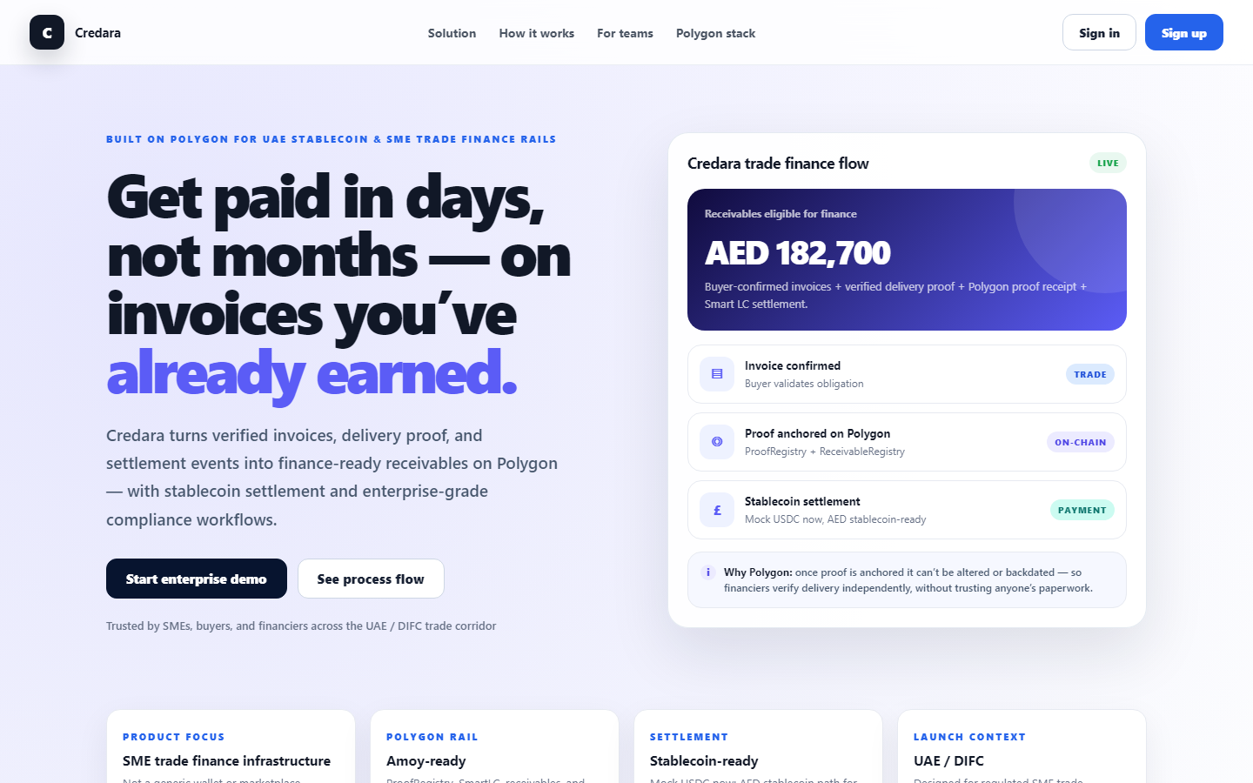
Credara
The LC layer banks can't ship fast enough — same-day financiable receivables on Polygon.
Verified B2B trade evidence → Smart LC stablecoin settlement · UAE corridor wedge
Othniel Obasi & Martins Nwanu · NOVTIA Ltd · credara-jet.vercel.app
Credara · Smart Commerce Infrastructure
credara-jet.vercel.app

Slide 2
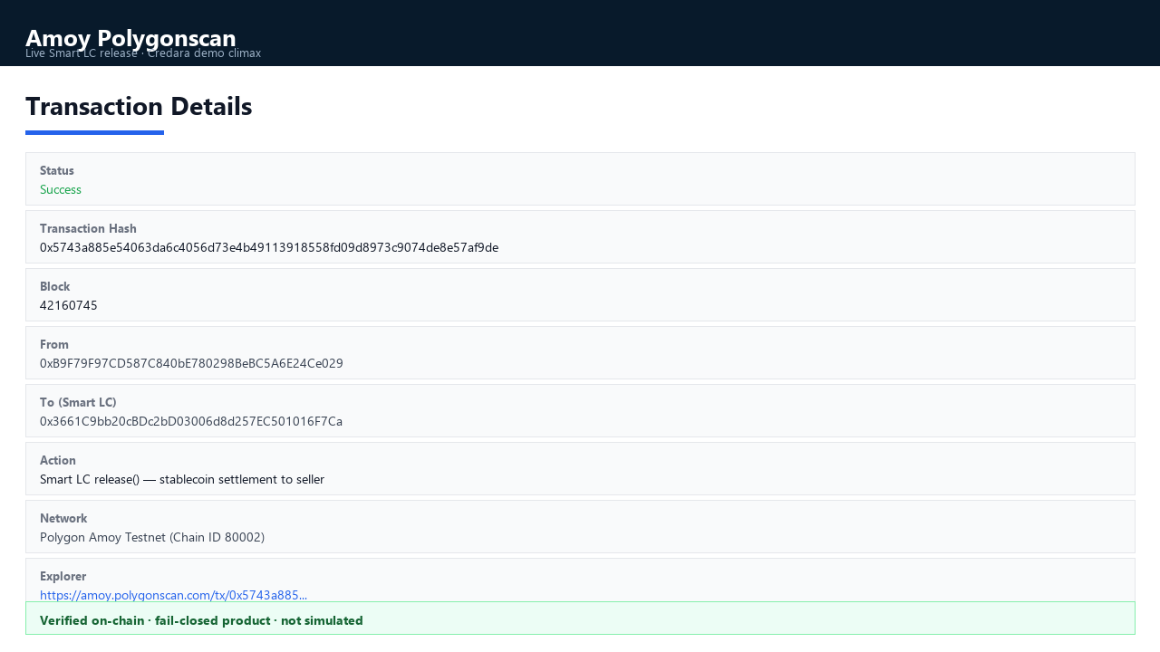
THE AHA MOMENT
Supplier paid after verified delivery — not after 45 days of paperwork
1,000 MockUSDC released on Polygon Amoy after Smart LC verified delivery. Bank LC would still be on day 3 of manual processing.
Example: AED 250k invoice → 80% advance → funded same afternoon → released after delivery verify.
Verified release tx: https://amoy.polygonscan.com/tx/0x5743a885e54063da6c4056d73e4b49113918558fd09d8973c9074de8e57af9de
Credara · Smart Commerce Infrastructure
credara-jet.vercel.app

Slide 3
BEFORE · AFTER
Collapse 7–10 day LC friction → same-day proof-to-funding
Traditional bank LC
Credara (live today)
✗ 7–10 days manual processing
✓ Buyer confirms + delivery proof verified
✗ Paper trails banks can't verify fast
✓ Proof hash anchored on Polygon
✗ ~40% SME applications rejected
✓ Financier funds Smart LC escrow
✗ Supplier waits 45–90 days to get paid
✓ Stablecoin released same day after verify
7–10 days
45–90 days
Same day
3 min
Bank LC
SME wait
Proof-to-fund
Judge Mode demo
Credara · Smart Commerce Infrastructure
credara-jet.vercel.app

Slide 4
PROBLEM
Suppliers finance the world's trade — and wait months to get paid
$2T+
~40%
7–10 days
45–90 days
Unfilled trade finance demand
SME applications rejected
Traditional LC processing
Typical SME payment wait
Banks reject SMEs with weak paper trails — not weak businesses
Invoice fraud and duplicate financing make lenders blind to real delivery
UAE/Jebel Ali corridor: massive volume, same friction for suppliers
Consumer remittance and POS are crowded — the SME trade-finance slice is underserved
Credara · Smart Commerce Infrastructure
credara-jet.vercel.app

Slide 5
SOLUTION
Turn delivery proof into finance-ready receivables — settle in hours, not months
Buyer confirms the invoice; delivery proof is verified — receivable becomes financiable
Proof anchored on Polygon (documents stay private; hashes are tamper-evident)
Financier funds programmable Smart LC escrow; release only after verified delivery
Four enterprise workspaces — SME, Buyer, Financier, Admin — one shared trust record
Outcome: collapse 7–10 day LC friction toward same-day proof-to-funding in one corridor
Credara · Smart Commerce Infrastructure
credara-jet.vercel.app

Slide 6
WHY NOW · WHY US
Regulation, market pain, and a shipped stack converge
Why now
Why Credara
UAE CBUAE PTSR opens regulated AED stablecoin B2B settlement
Polygon enterprise infra: low-cost escrow + proof anchoring at scale
SME trade-finance gap widening as corridors digitize faster than bank LC rails
Smart Commerce / DIFC ecosystem primed for corridor pilots
Live monorepo on Vercel + Amoy — not slideware (test today)
Fail-closed chain: no fake Polygonscan; honest simulated vs anchored
Token-agnostic Smart LC — swap MockUSDC for licensed AED without rebuild
Founder: regulated banking + utilities scale + cryptographic governance (AIRG)
Credara · Smart Commerce Infrastructure
credara-jet.vercel.app

Slide 7
HOW IT WORKS
One trade, five actors — ~3 minutes in Judge Mode
1
SME
Order → invoice → delivery proof
2
Buyer
Confirm trade obligation
3
SME
Create receivable · anchor proof on Polygon
4
Financier
Deal room review · fund Smart LC escrow
5
System
Verify delivery · release stablecoin to seller
Example trade: AED 250k invoice → 80% advance (AED 200k) → Smart LC funded → released same day after verified delivery
Credara · Smart Commerce Infrastructure
credara-jet.vercel.app

Slide 8
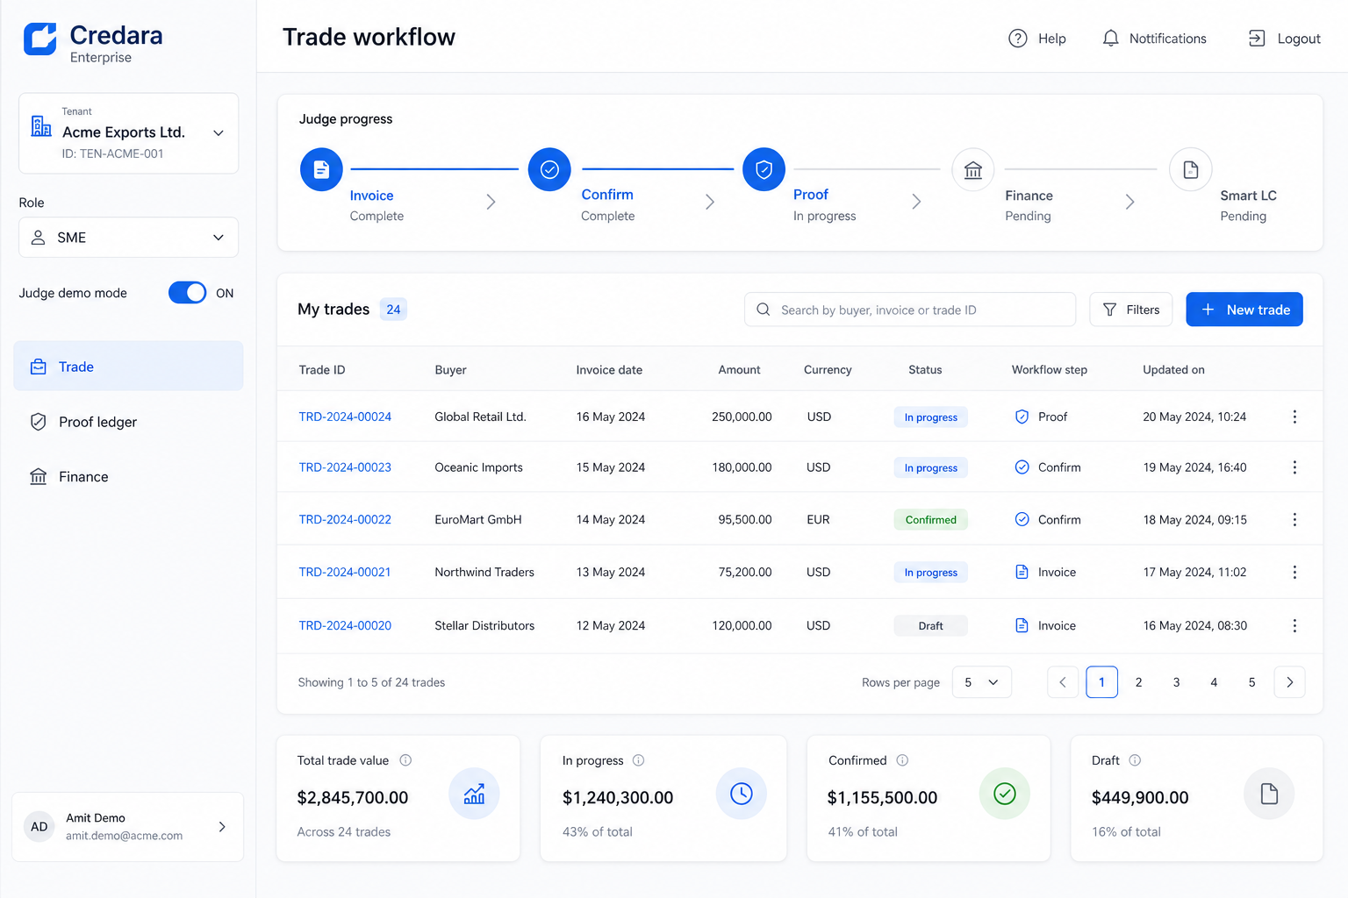
TRACTION & PROOF
Built, deployed, and testable — not a concept deck
Production deploy: credara-jet.vercel.app + credara-api.vercel.app
Smart LC factory wired: create → fund → verify → release on Amoy
Auth0 OAuth + password auth · Didit KYB abstraction · Postgres persistence
Slither + Hardhat in CI · role-separated escrow contracts
Judge Mode: guided 3-min demo for reviewers and investors
Proof moment (demo climax)
Live Amoy tx: proof anchor + Smart LC release
Enterprise workspace (live product)
Credara · Smart Commerce Infrastructure
credara-jet.vercel.app

Slide 9
COMPETITION & MOAT
Infrastructure wedge — not another hash-on-chain demo
Approach
Limitation
Credara edge
Manual bank LCs
7–10 days, paper-heavy, SME-unfriendly
Programmable escrow + verified delivery gate
Trade finance fintech
Off-chain docs; lenders still blind to delivery
Buyer-confirmed receivable + on-chain anchor
Generic RWA / trade chains
Hash demos; simulated chain links
Fail-closed product · live Amoy · four-role workspaces
Remittance / POS apps
Consumer wedge; not receivables finance
B2B settlement slice of UAE corridor
Moat compounds: corridor data + financier network + token-agnostic escrow + evidence governance IP
Credara · Smart Commerce Infrastructure
credara-jet.vercel.app

Slide 10
BUSINESS MODEL
Who pays: financiers and platform users — API expands TAM
Financing origination
Fee when receivable is funded via Smart LC marketplace
Platform / SaaS
Verification, deal room, reporting — tiered by volume
Settlement / escrow
Basis points per fund/release vs. multi-day bank LC cost
Credit scoring API
On-chain attestations for external lenders without full UI
Land financiers first — verified receivables pull SME supply onto the rail.
Credara · Smart Commerce Infrastructure
credara-jet.vercel.app

Slide 11
UNIT ECONOMICS & ASK
Illustrative pilot model — tighten with live pilot quotes
0.5%
80%
AED 1.25k
$15M
Platform fee (indicative)
Advance rate (indicative)
Fee on AED 250k invoice
Pilot receivables pipe (Y1 target)
Pilot cohort: 3 financiers + 50 UAE SMEs (Jebel Ali supply chains)
Revenue scales with financed volume, not headcount
API-first: third parties integrate rails without Credara UI
Path to $1M ARR: ~$200M annual financed volume at ~50 bps blended take
Raising (illustrative)
$500K pre-seed
UAE 3-financier pilot + GTM hire
Didit KYB production + Solidity audit
AED stablecoin issuer partnership
18-mo: mainnet + API ecosystem
Credara · Smart Commerce Infrastructure
credara-jet.vercel.app

Slide 12
GO-TO-MARKET
One corridor, prove it, then replicate
Roadmap
Wedge: UAE SME trade-finance slice — Jebel Ali suppliers
Beachhead: 1–2 non-bank financiers + SME cohort
DIFC / challenge ecosystem for intros and pilot design
KPI: 7–10 day LC → same-day proof-to-funding
Expand: new corridors = issuer + IERC20 config, not rebuild
Now: Amoy demo + Judge Mode (shipped)
Q1–Q2: Financier pilot LOIs + prod KYB
Phase 2: Licensed AED stablecoin partner
Phase 3: Polygon mainnet + partner APIs
Credara · Smart Commerce Infrastructure
credara-jet.vercel.app

Slide 13
SETTLEMENT ROADMAP
Today: MockUSDC on Amoy proves the escrow path. Tomorrow: regulated AED stablecoin on the same Smart LC rails.
Smart LC is token-agnostic — production is an issuer swap, not a rebuild
CBUAE PTSR-compliant AED from licensed partner when ready
B2B settlement along UAE corridors — not consumer remittance or POS
Credara is settlement-ready infrastructure; we do not issue AED
Credara · Smart Commerce Infrastructure
credara-jet.vercel.app

Slide 14
TEAM
Founder + banking engineering leadership — regulated delivery at scale
Othniel Obasi — Founder, NOVTIA Ltd (London)
Martins Nwanu — Head of IT, Creditville Group
Creditville MFBank 40K → 100K+ users
PHED utilities — 5M+ customers, $96M+ revenue growth
AIRG + SURGE v2 → Credara evidence model
Portfolio: NorthBridge, Kairos, ProofSource, Autonix
11-engineer leadership; core banking platform delivery
C Money 30K → 100K+ users; in-house mobile rebuild
Loan ops scaled to ₦800M–₦1B/month disbursements
Credara: production API, workspace UX, deploy discipline
Hiring with raise: UAE GTM / trade-finance partnerships · compliance advisor (DIFC)
Credara · Smart Commerce Infrastructure
credara-jet.vercel.app

Slide 15
TECH APPENDIX
For diligence — full architecture in repo README
Monorepo: Next.js · FastAPI · workers · Solidity 0.8.28
ProofRegistry · ReceivableRegistry · SmartLCFactory
CreditScoreAttestation · MockUSDC (IERC20-agnostic)
Outbox relayer · idempotency · AccessControl / Pausable
Non-goals: no remittance MVP · no POS · no AED issuance
Docs: README · SUBMISSION.md · PROCESS_FLOWS.md
API: credara-api.vercel.app/docs
Contracts: Slither CI + Hardhat test suite
Credara · Smart Commerce Infrastructure
credara-jet.vercel.app

Slide 16
Get paid in days, not months.
Verified invoices · Polygon proof · Smart LC settlement
Let's run the 3-minute Judge Mode demo — then talk UAE pilot.
credara-jet.vercel.app · othnielobasi@gmail.com
Credara · Smart Commerce Infrastructure
credara-jet.vercel.app

