Slide 1
Credara
Problem #1: SME trade finance on Polygon — tokenized receivables, Smart LC, on-chain credit scoring
Smart Commerce Infrastructure Challenge · Powered by Polygon · DIFC-ready UAE corridor
UAE: $50B+ payments corridor · PTSR live · 51.3% stablecoin activity — B2B settlement wedge
Othniel Obasi & Martins Nwanu · NOVTIA Ltd · credara-jet.vercel.app
Credara · Smart Commerce Infrastructure
credara-jet.vercel.app

Slide 2
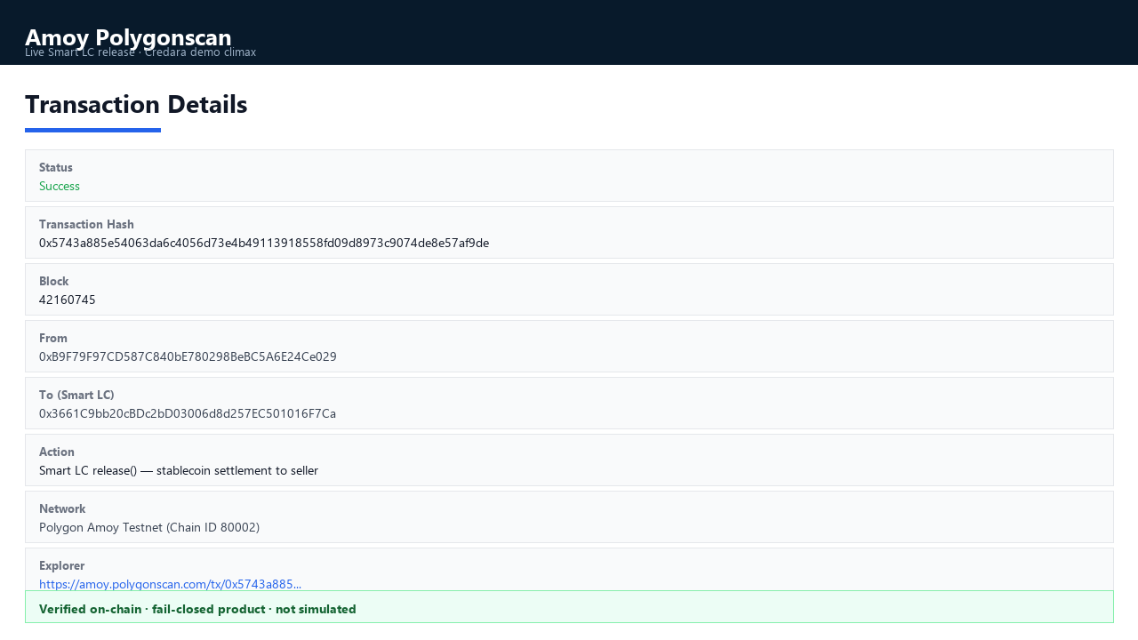
THE AHA MOMENT
Supplier paid after verified delivery — not after 45 days of paperwork
1,000 MockUSDC released on Polygon Amoy after Smart LC verified delivery. Bank LC would still be on day 3 of manual processing.
Live product: credara-jet.vercel.app/workspace
Judge Mode walks the flow in ~3 minutes
Fail-closed: Simulated vs Anchored — no fake links
Verified release tx: https://amoy.polygonscan.com/tx/0x5743a885e54063da6c4056d73e4b49113918558fd09d8973c9074de8e57af9de
Credara · Smart Commerce Infrastructure
credara-jet.vercel.app

Slide 3
BEFORE · AFTER
Collapse 7–10 day LC friction → same-day proof-to-funding
Traditional bank LC
Credara (live today)
✗ 7–10 days manual processing
✓ Buyer confirms + delivery proof verified
✗ Paper trails banks can't verify fast
✓ Proof hash anchored on Polygon
✗ ~40% SME applications rejected
✓ Financier funds Smart LC escrow
✗ Supplier waits 45–90 days to get paid
✓ Stablecoin released same day after verify
7–10 days
45–90 days
Same day
3 min
Bank LC
SME wait
Proof-to-fund
Judge Mode demo
Credara · Smart Commerce Infrastructure
credara-jet.vercel.app

Slide 4
CHALLENGE FIT
Built exactly what Problem #1 asks for — on Polygon, live today
Hackathon requirement
Credara (shipped)
✓ Tokenized receivables
ReceivableRegistry + buyer-confirmed invoices → finance-ready receivables
✓ Smart contract letters of credit
SmartLCFactory / SmartLC escrow lifecycle on Amoy
✓ On-chain trade credit scoring
CreditScoreAttestation + scoring workers
✓ Unlock SME capital · reduce friction
Judge Mode: proof anchor → fund LC → release in stablecoin
Problem #2 (POS / tourist wallets) is out of MVP scope — same settlement rails are PTSR-ready for licensed AED stablecoin B2B use.
Credara · Smart Commerce Infrastructure
credara-jet.vercel.app

Slide 5
JUDGING CRITERIA
How Credara maps to what the panel scores
Innovation
Technical excellence
Smart LC + proof anchoring + receivables in one UAE corridor stack
Slither CI, fail-closed chain, live deploy, role-separated contracts
User experience
Real-world impact
4 enterprise workspaces + 3-min Judge Mode guided demo
$2T gap · 40% SME rejection · Jebel Ali 15M+ TEUs — suppliers paid faster
Credara · Smart Commerce Infrastructure
credara-jet.vercel.app

Slide 6
PROBLEM
SMEs wait months to get paid on goods already delivered
$2T+ global trade finance gap — demand unfilled or priced out
~40% of SME trade-finance applications rejected (weak evidence, not weak fundamentals)
Traditional LCs: 7–10 days of manual bank coordination and paper
Invoice fraud & duplicate financing — lenders can't verify delivery independently
UAE corridor: Jebel Ali 15M+ TEUs/yr — high volume, high friction for suppliers
Credara · Smart Commerce Infrastructure
credara-jet.vercel.app

Slide 7
SOLUTION
Verified trade evidence → finance-ready receivables → Smart LC settlement
Buyer-confirmed invoices + delivery proof become finance-ready receivables
Proof hashes anchored on Polygon — tamper-evident, documents stay off-chain
Programmable Smart LC escrow: fund → verify delivery → release in stablecoin
Four workspaces (SME, Buyer, Financier, Admin) on one shared trust layer
Wedge: SME trade-finance slice of UAE corridor — not consumer remittance or POS
Credara · Smart Commerce Infrastructure
credara-jet.vercel.app

Slide 8
HOW IT WORKS
End-to-end flow (~3 min Judge Mode)
1
SME
Order → invoice → delivery proof
2
Buyer
Confirm trade obligation
3
SME
Create receivable · anchor proof on Polygon
4
Financier
Deal room review · fund Smart LC
5
System
Verify delivery · release settlement to seller
Live: credara-jet.vercel.app/workspace
Credara · Smart Commerce Infrastructure
credara-jet.vercel.app

Slide 9
WHY CREDARA
Institutional-grade infrastructure, not a hash-on-chain demo
Fail-closed chain — No fake Polygonscan links. Simulated only when tx isn't on-chain.
Real persistence — Postgres-backed workspaces — no canned seed data for judges.
Role-separated LC — Verifier, dispute-resolver, pauser — not one key for every escrow.
Evidence-first — AIRG/SURGE discipline: cryptographic receipts, deterministic hashing.
Production path — Auth0, Didit KYB, Slither CI, Vercel deploy — shipped today.
Credara · Smart Commerce Infrastructure
credara-jet.vercel.app

Slide 10
ARCHITECTURE
Monorepo: web · API · workers · contracts
apps/web — Next.js enterprise dashboard
apps/api — FastAPI, Postgres, JWT, Auth0
apps/workers — relayer, indexer, scoring
contracts — Solidity 0.8.28, Amoy / PoS-ready
ProofRegistry — anchor proof hashes
ReceivableRegistry — finance-ready state
SmartLCFactory / SmartLC — escrow lifecycle
CreditScoreAttestation — trade credit on-chain
MockUSDC — demo settlement (IERC20-agnostic)
Credara · Smart Commerce Infrastructure
credara-jet.vercel.app

Slide 11
SETTLEMENT ROADMAP
Today: MockUSDC on Amoy. Tomorrow: regulated AED stablecoin — same Smart LC rails.
Demo proves create → fund → verify → release without claiming AED issuance
UAE CBUAE PTSR: regulated AED stablecoin partner — same Smart LC rails
Smart LC is token-agnostic — factory and proof conditions unchanged
Do say: settlement-ready · Don't say: we issue AED or we are remittance
Credara · Smart Commerce Infrastructure
credara-jet.vercel.app

Slide 12
GO-TO-MARKET
Pilot one corridor, then expand
Roadmap
Target: UAE SMEs, buyers, financiers — Jebel Ali supply chains
Land financiers first — verified receivables pull SME supply
DIFC ecosystem: 5,000+ VCs, 289 banks, 400+ mentors for pilot cohort
Prove 7–10 day LC friction → same-day proof-to-funding
Now: Amoy demo + Judge Mode (shipped)
Near-term: Didit KYB prod, Solidity audit
Phase 2: AED stablecoin partner
Phase 3: Mainnet + API ecosystem
Credara · Smart Commerce Infrastructure
credara-jet.vercel.app

Slide 13
BUSINESS MODEL
Infrastructure economics — multiple revenue lines
Origination fee
Per receivable financed via Smart LC marketplace
Platform / SaaS
Verification, deal room, reporting — tiered by volume
Settlement fee
Basis points per LC fund/release vs. days of bank LC
Credit scoring API
Attestations for external lenders without full workspace
API-first: third parties integrate proof, receivable, and LC rails without Credara UI.
Credara · Smart Commerce Infrastructure
credara-jet.vercel.app

Slide 14
TEAM
Banking operators + engineering leadership — built to win financier trust
Othniel Obasi — Founder, NOVTIA Ltd (London)
Martins Nwanu — Head of IT, Creditville Group
Digital banking: Creditville MFBank 40K → 100K+ users
Utilities: PHED — 5M+ customers, $96M+ revenue growth
AI governance: AIRG + SURGE v2 cryptographic receipt chain
Credara: evidence-first, fail-closed on-chain settlement
Led 11-engineer team; core banking & loan platform delivery
C Money app: 30K → 100K+ users; CI/CD and Agile at scale
Loan disbursement volumes scaled to ₦800M–₦1B/month
Credara: enterprise workspace, API, and production deploy rigor
Credara · Smart Commerce Infrastructure
credara-jet.vercel.app

Slide 15
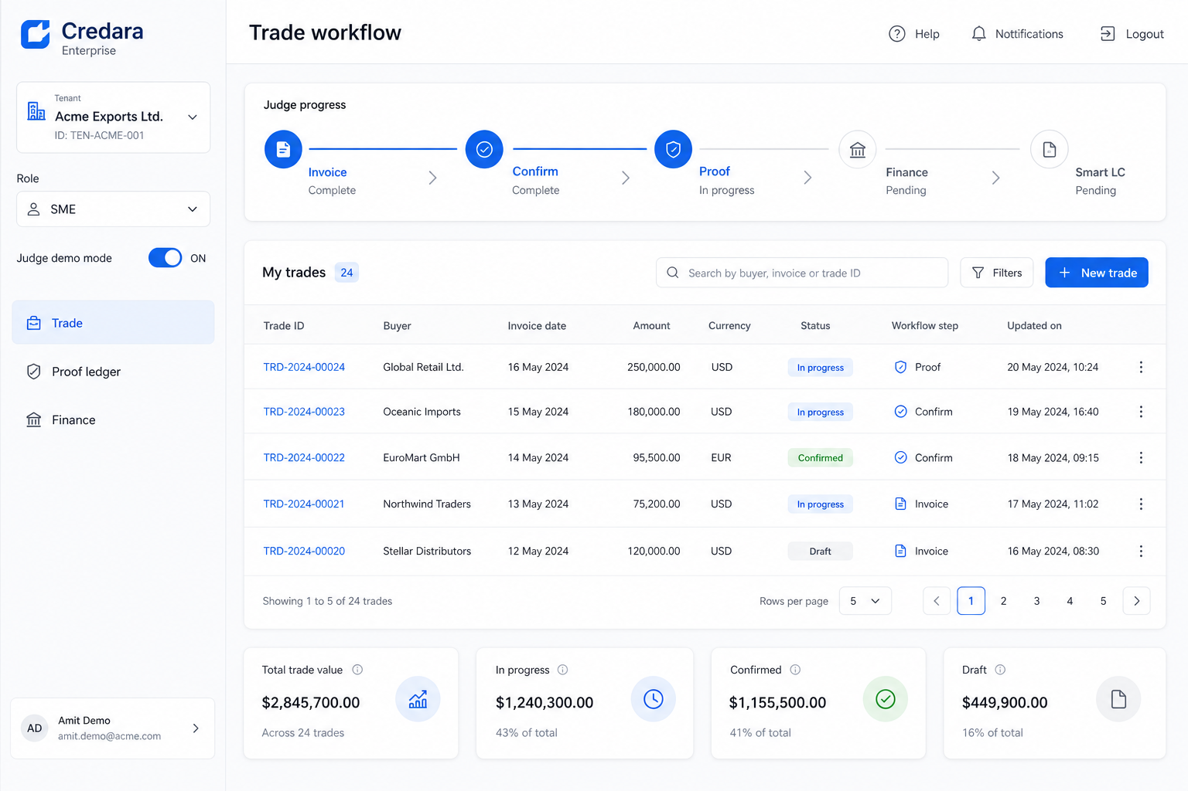
MVP — LIVE TODAY
Test it now
credara-jet.vercel.app/workspace
credara-api.vercel.app/docs
Judge demo mode in sidebar
Polygon Amoy contracts deployed
Slither + Hardhat tests in CI
Non-goals: no remittance MVP · no POS · no AED issuance claim
Demo climax: Polygonscan proof anchor + Smart LC settlement
Enterprise workspace (Judge Mode)
Credara · Smart Commerce Infrastructure
credara-jet.vercel.app

Slide 16
Get paid in days, not months.
Verified invoices. Polygon proof. Smart LC settlement.
credara-jet.vercel.app · othnielobasi@gmail.com
Credara · Smart Commerce Infrastructure
credara-jet.vercel.app

