Slide 1



Reverberation Mapping of AGN with Maximum Likelihood in Optical Bands
Otho Ulrich^{1,2}, Dr. Edward Cackett²
¹Department of Physics, Western Michigan University
²Department of Physics and Astronomy, Wayne State University

Slide 2
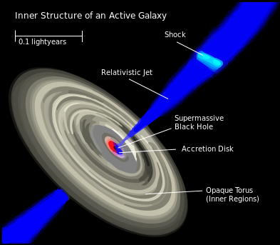
Active Galactic Nuclei
Systems surrounding supermassive black holes at the center of active galaxies: 10^{6 –} 10⁹ M_{sun}.
Some of the most luminous objects in the universe.
Power is generated by accretion of matter by the central black hole.
Cannot be resolved directly; configurations are inferred using reverberation mapping.
Notes:
An active nucleus outshines the rest of its host galaxy.

Slide 3
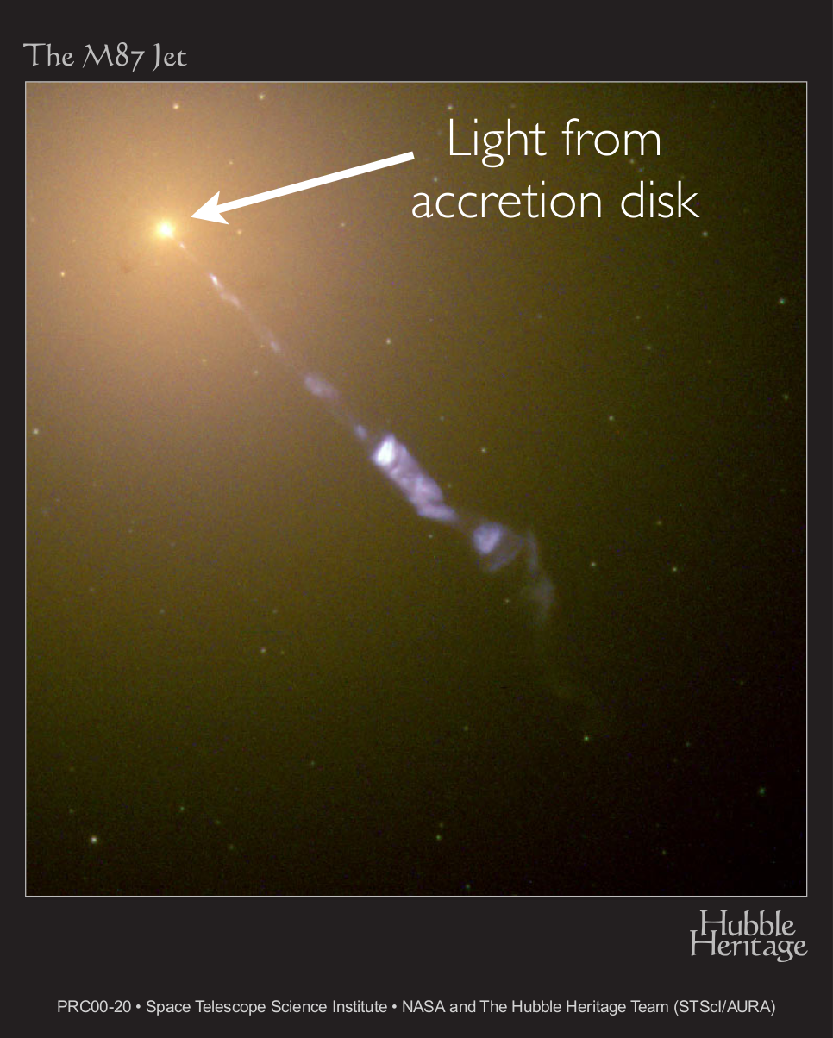
Local Group Active Galaxy Caught in Action

Slide 4
Reverberation Mapping
Some photons are reprocessed in gas clouds surrounding the black hole.
The observer sees these photons as having a time lag and frequency shift.
A transfer function predicts the time-delay distribution and spectrum for an assumed geometry.
Particles scatter photons in
the surrounding matter

Slide 5
Motivation
AGN can be used as a standard candle and cosmological probe.
  Collier et al. (1999), and later Cackett et al. (2007), have calculated Hubble's constant using this standard, but issues remain.
  Friedmann–Lemaître–Robertson–Walker curvature constants (Calculated some other cosmic quantities in Cackett et al. 2007).
Optical Band Reverberation Mapping has thus-far involved time-domain analyses.
  Requires data that are evenly distributed in time.
  Provides only the average time lag.
  Limited because many data are not evenly distributed.
X-Ray Reverberation Mapping has developed a technique to deal with unevenly distributed data.
Notes:
Why do we care about AGN?
Believed to be an integral component of galactic evolution.
Standard candle that goes beyond the supernova horizon.

Slide 6
Fourier Techniques
Standard Techniques
Maximum Likelihood
  Technique
Talk to Dr. Cackett about this

Slide 7
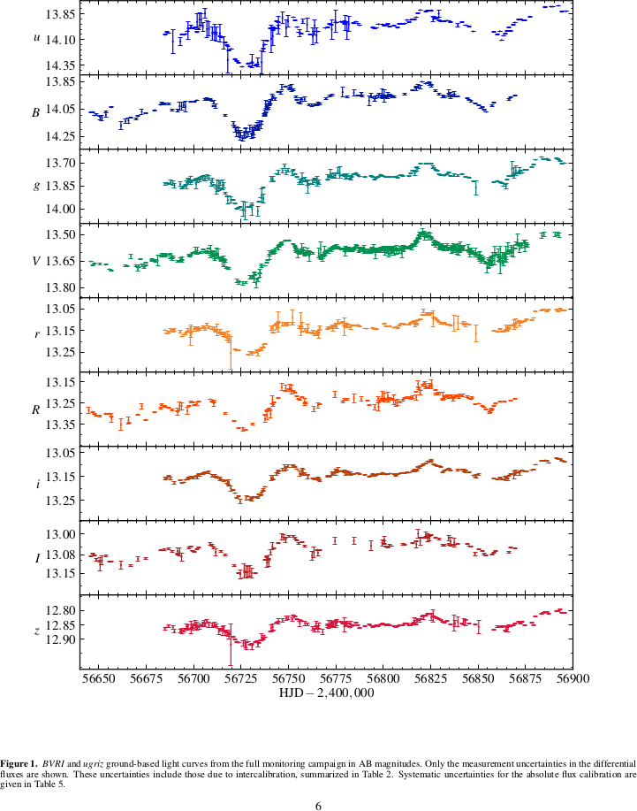
Data from Fausnaugh et al. (2016)

Slide 8
Reverberation Mapping
Causal relationship between identical spectral variations in different frequency bands due to thermal reprocessing.
Spectral variation is “repeated” after some time, assumed to be the light travel-time across some part of the system.
(Show Transfer Function, possibly also bright and dim spectrum functions, or equation for determining Hubble's constant.)

Slide 9
Project Goals
Using Fourier techniques compute frequency-resolved timelags found in data published in Fausnaugh et al. (2016).
  Maximum Likelihood technique especially should be useful for unevenly distributed data.
Compute Fourier power spectrum for Fausnaugh et al. data.

Slide 10
Thank You

