Slide 1



UV/Optical Band Reverberation Mapping of NGC 5548 with Frequency-Resolved Techniques
Otho Ulrich^{1,2}, Edward Cackett¹
¹Department of Physics and Astronomy, Wayne State University
²Department of Physics, Western Michigan University

Slide 2
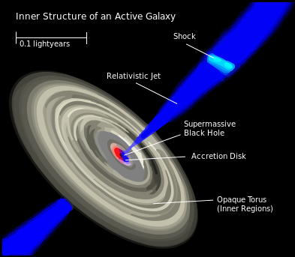
Active Galactic Nuclei
Systems surrounding supermassive black holes at the center of active galaxies: 10^{6 –} 10⁹ M_{sun}.
Some of the most luminous objects in the universe.
Power is generated by accretion of matter by the central black hole.
Cannot be resolved directly; geometry is inferred using reverberation mapping.
Notes:
An active nucleus outshines the rest of its host galaxy.

Slide 3
Reverberation Mapping
Some photons are reprocessed in gas clouds surrounding the black hole.
The observer sees these photons as having a time lag and frequency shift.
A transfer function predicts the time-delay distribution and spectrum for an assumed geometry.
Particles scatter photons in
the surrounding matter

Slide 4
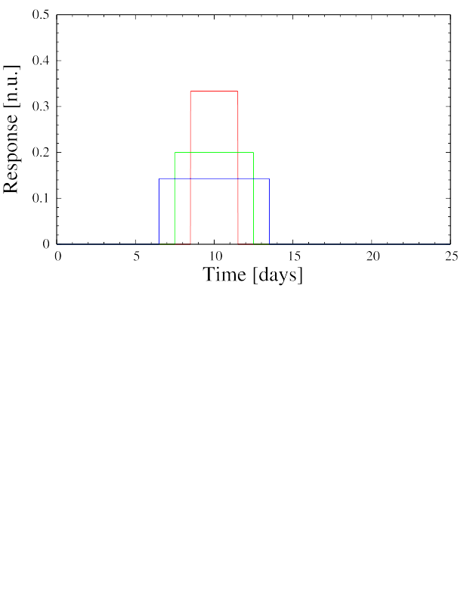
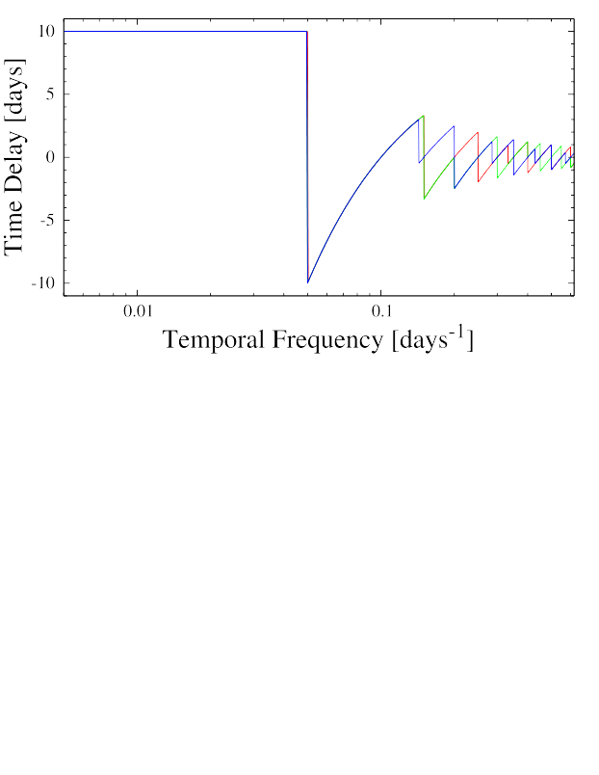
Recovering the Transfer Function

Slide 5
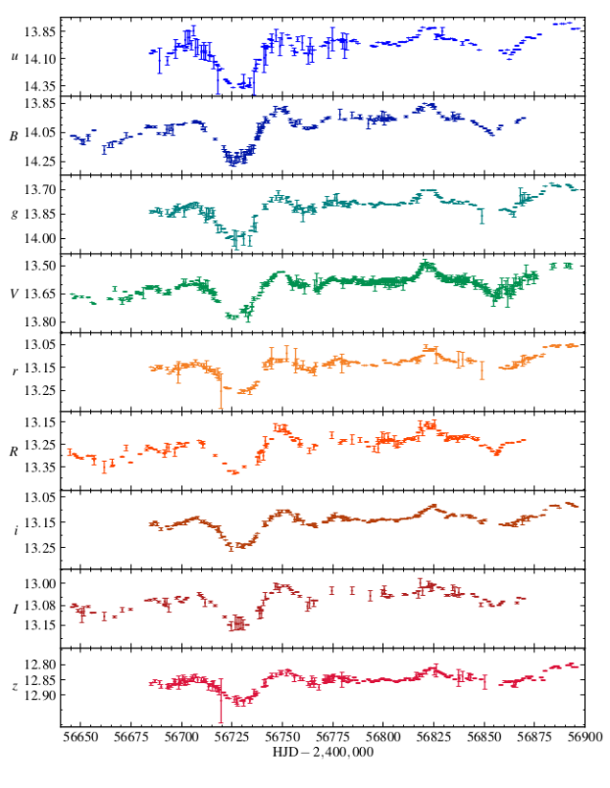
NGC 5548 Light Curves from STORM III
Flux
260 Days
Fausnaugh et al. (2016)

Slide 6
Reverberation Geometry
UV
Optical

Slide 7
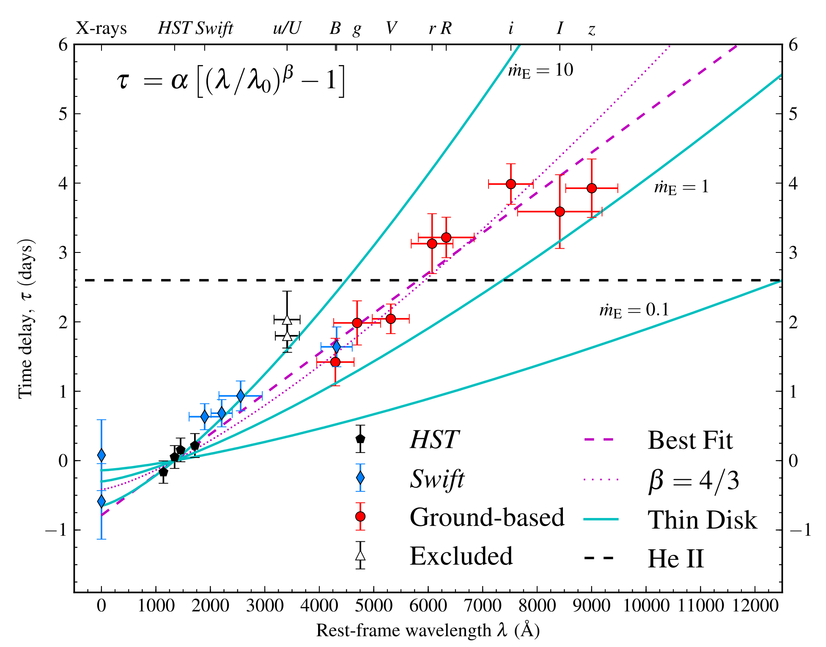
Time-Domain Delay Analysis from STORM III
Fausnaugh et al. (2016)

Slide 8
Motivation
Optical Band Reverberation Mapping has thus-far involved time-domain techniques that reveal only average time lags.
More information is retained using frequency-domain analyses.
X-ray reverberation mapping has developed a technique to extract frequency-domain information from unevenly sampled data.
Notes:
Why do we care about AGN?
Believed to be an integral component of galactic evolution.
Standard candle that goes beyond the supernova horizon.
Light Curves contain more information than just the average time lag
Repulsive cosmological constant vs. attractive mass

Slide 9
Project Goals
Use maximum likelihood method to compute temporal frequency-dependent power spectral densities and time lags from STORM III light curves.
Recover transfer function for NGC 5548's continuum emission.

Slide 10
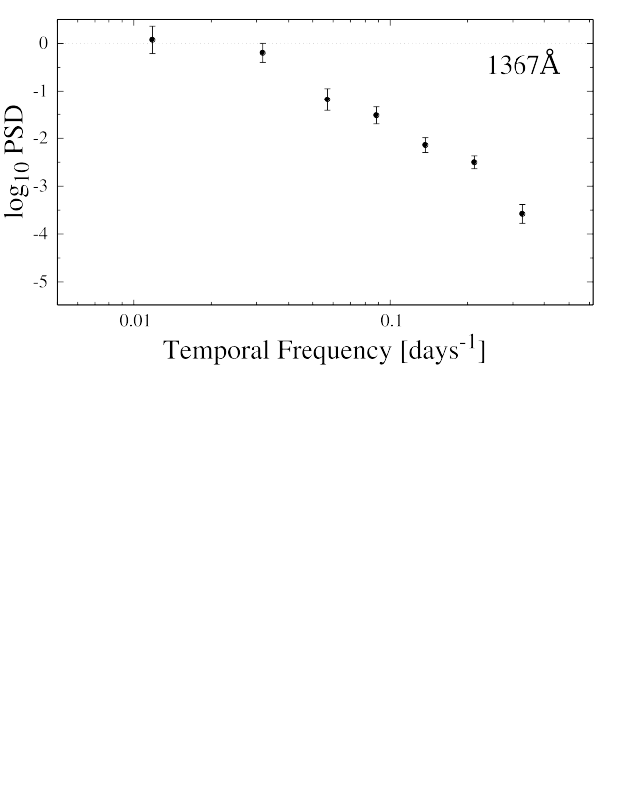
Power Spectral Density

Slide 11
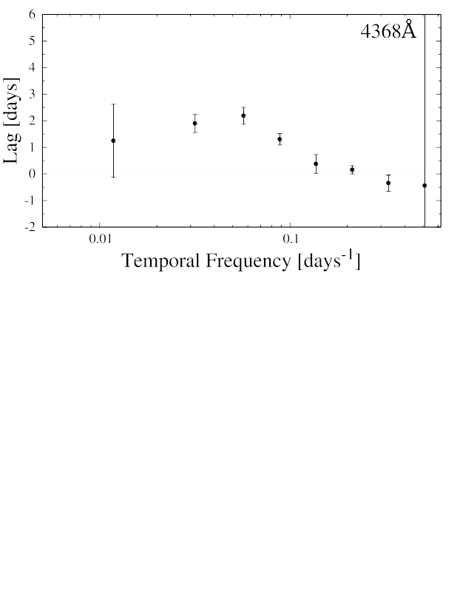
Frequency-Dependent Time Delay

Slide 12
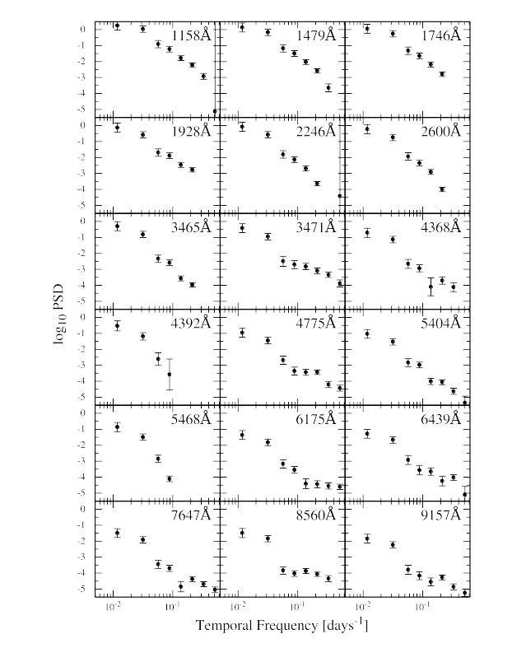
PSD for Bands in STORM III

Slide 13
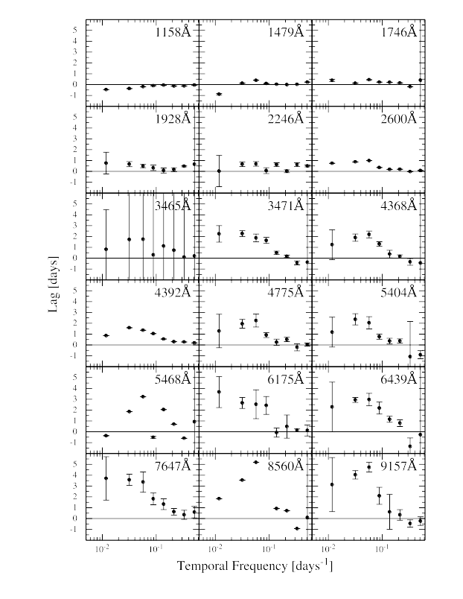
Time Delays for Bands in STORM III

Slide 14
Conclusions
Method works with quality of optical AGN data available.
PSD is wavelength dependent.
Time lags show frequency dependence; average lag follows trend shown by time-domain analysis.

Slide 15
Next Steps
Improve error analysis using Monte Carlo or Likelihood Function.
Fit top hat and log-Gaussian transfer functions to time lags.
Confirm average time lags reported in STORM III.

Slide 16
Acknowledgements
Dr. Cackett – The best, thank you many times
Dr. Zoghbi
Fausnaugh et al.
Dr. Korista
Dr. Cinabro and Dr. Petrov
Dept. of Physics, Wayne State University
NSF

Slide 17
Thank You
Notes:
Very excited!
Modelling work at WMU provides theoretical exploration
First chance to ask the universe directly

Slide 18
Questions

Slide 19
Additional Slides
Notes:
Very excited!
Modelling work at WMU provides theoretical exploration
First chance to ask the universe directly

Slide 20
Fourier Techniques
Fourier analysis provides time-delay distribution as a function of frequency.
Standard techniques are restricted to evenly distributed data.
Zoghbi et al. (2013), with Dr. Cackett, developed a maximum likelihood method to predict time lags across light curve gaps.
Technique should apply nicely to optical data that exhibit gaps.

Slide 21
AGN as Cosmological Probe
AGN can be used as a standard candle and cosmological probe.
  Collier et al. (1999), and later Cackett et al. (2007), have calculated Hubble's constant using this standard, but issues remain.
  Cackett et al. (2007) also indicates promise for constraining cosmological parameters Ω_{Λ} and Ω_{m} .
Optical Band Reverberation Mapping has thus-far involved cross-correlation analysis in the time domain.
  Requires data that are evenly distributed in time, but many data in the optical bands are not.
  Provides only the average time lag.
X-Ray Reverberation Mapping has developed a technique to deal with unevenly distributed data.
Notes:
Why do we care about AGN?
Believed to be an integral component of galactic evolution.
Standard candle that goes beyond the supernova horizon.
Light Curves contain more information than just the average time lag
Repulsive cosmological constant vs. attractive mass

Slide 22
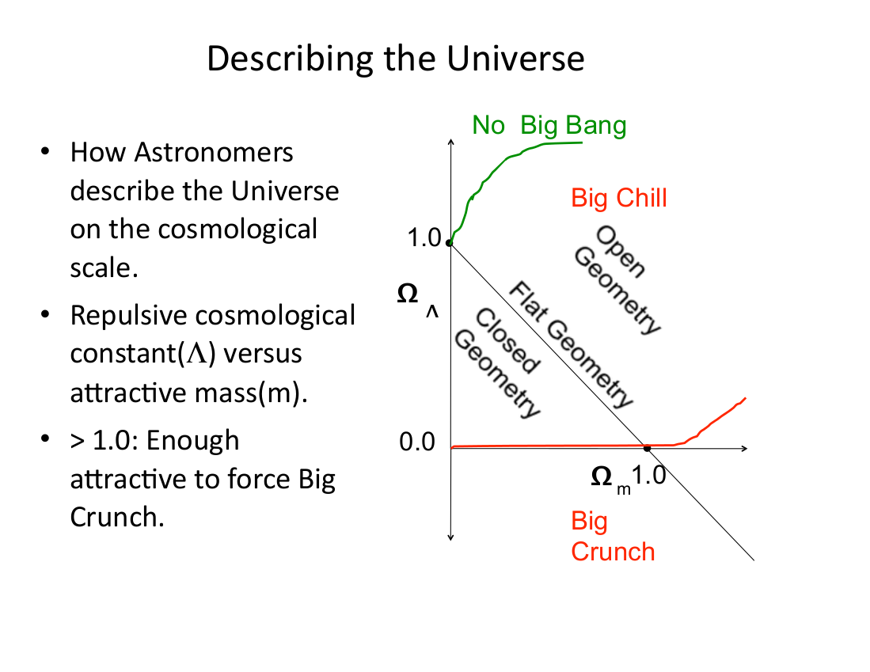

Slide 23
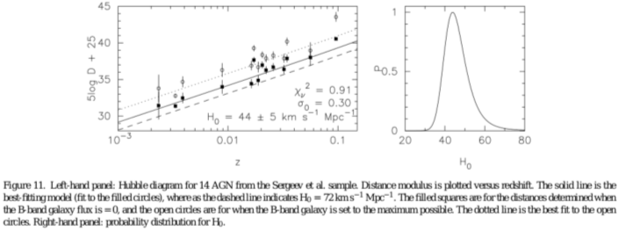
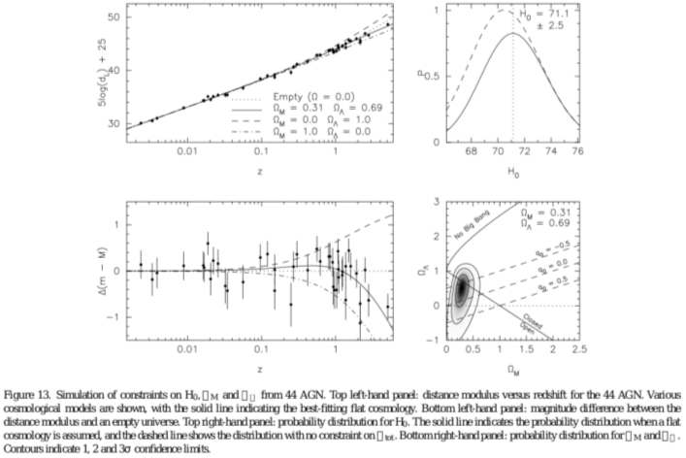

Slide 24
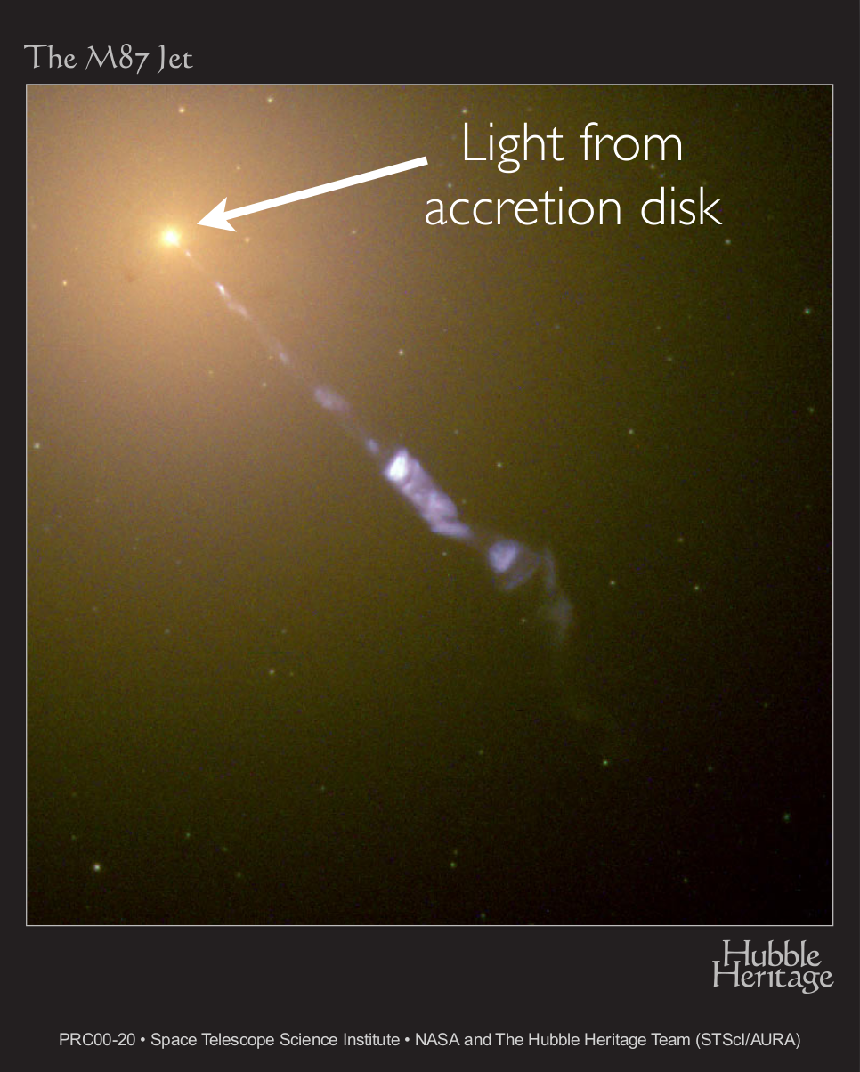
Local Group Active Galaxy Caught in Action

