Slide 1



Optical Band Reverberation Mapping of NGC 5548 with Maximum Likelihood
Otho Ulrich^{1,2}, Edward M. Cackett²
¹Department of Physics, Western Michigan University
²Department of Physics and Astronomy, Wayne State University

Slide 2
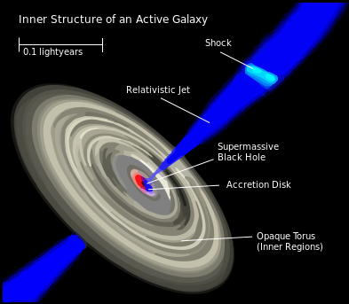
Active Galactic Nuclei
Systems surrounding supermassive black holes at the center of active galaxies: 10^{6 –} 10⁹ M_{sun}.
Some of the most luminous objects in the universe.
Power is generated by accretion of matter by the central black hole.
Cannot be resolved directly; configurations are inferred using reverberation mapping.
Notes:
An active nucleus outshines the rest of its host galaxy.

Slide 3
Reverberation Mapping
Some photons are reprocessed in gas clouds surrounding the black hole.
The observer sees these photons as having a time lag and frequency shift.
A transfer function predicts the time-delay distribution and spectrum for an assumed geometry.
Particles scatter photons in
the surrounding matter

Slide 5
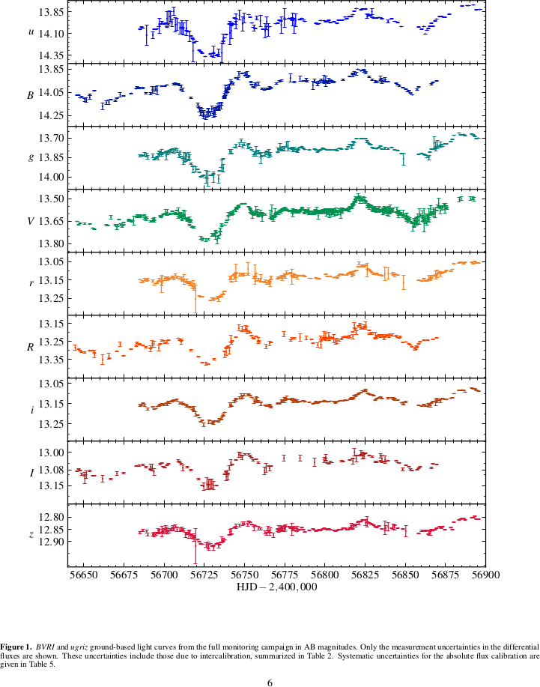
NGC 5548 Light Curves from STORM III

Slide 6
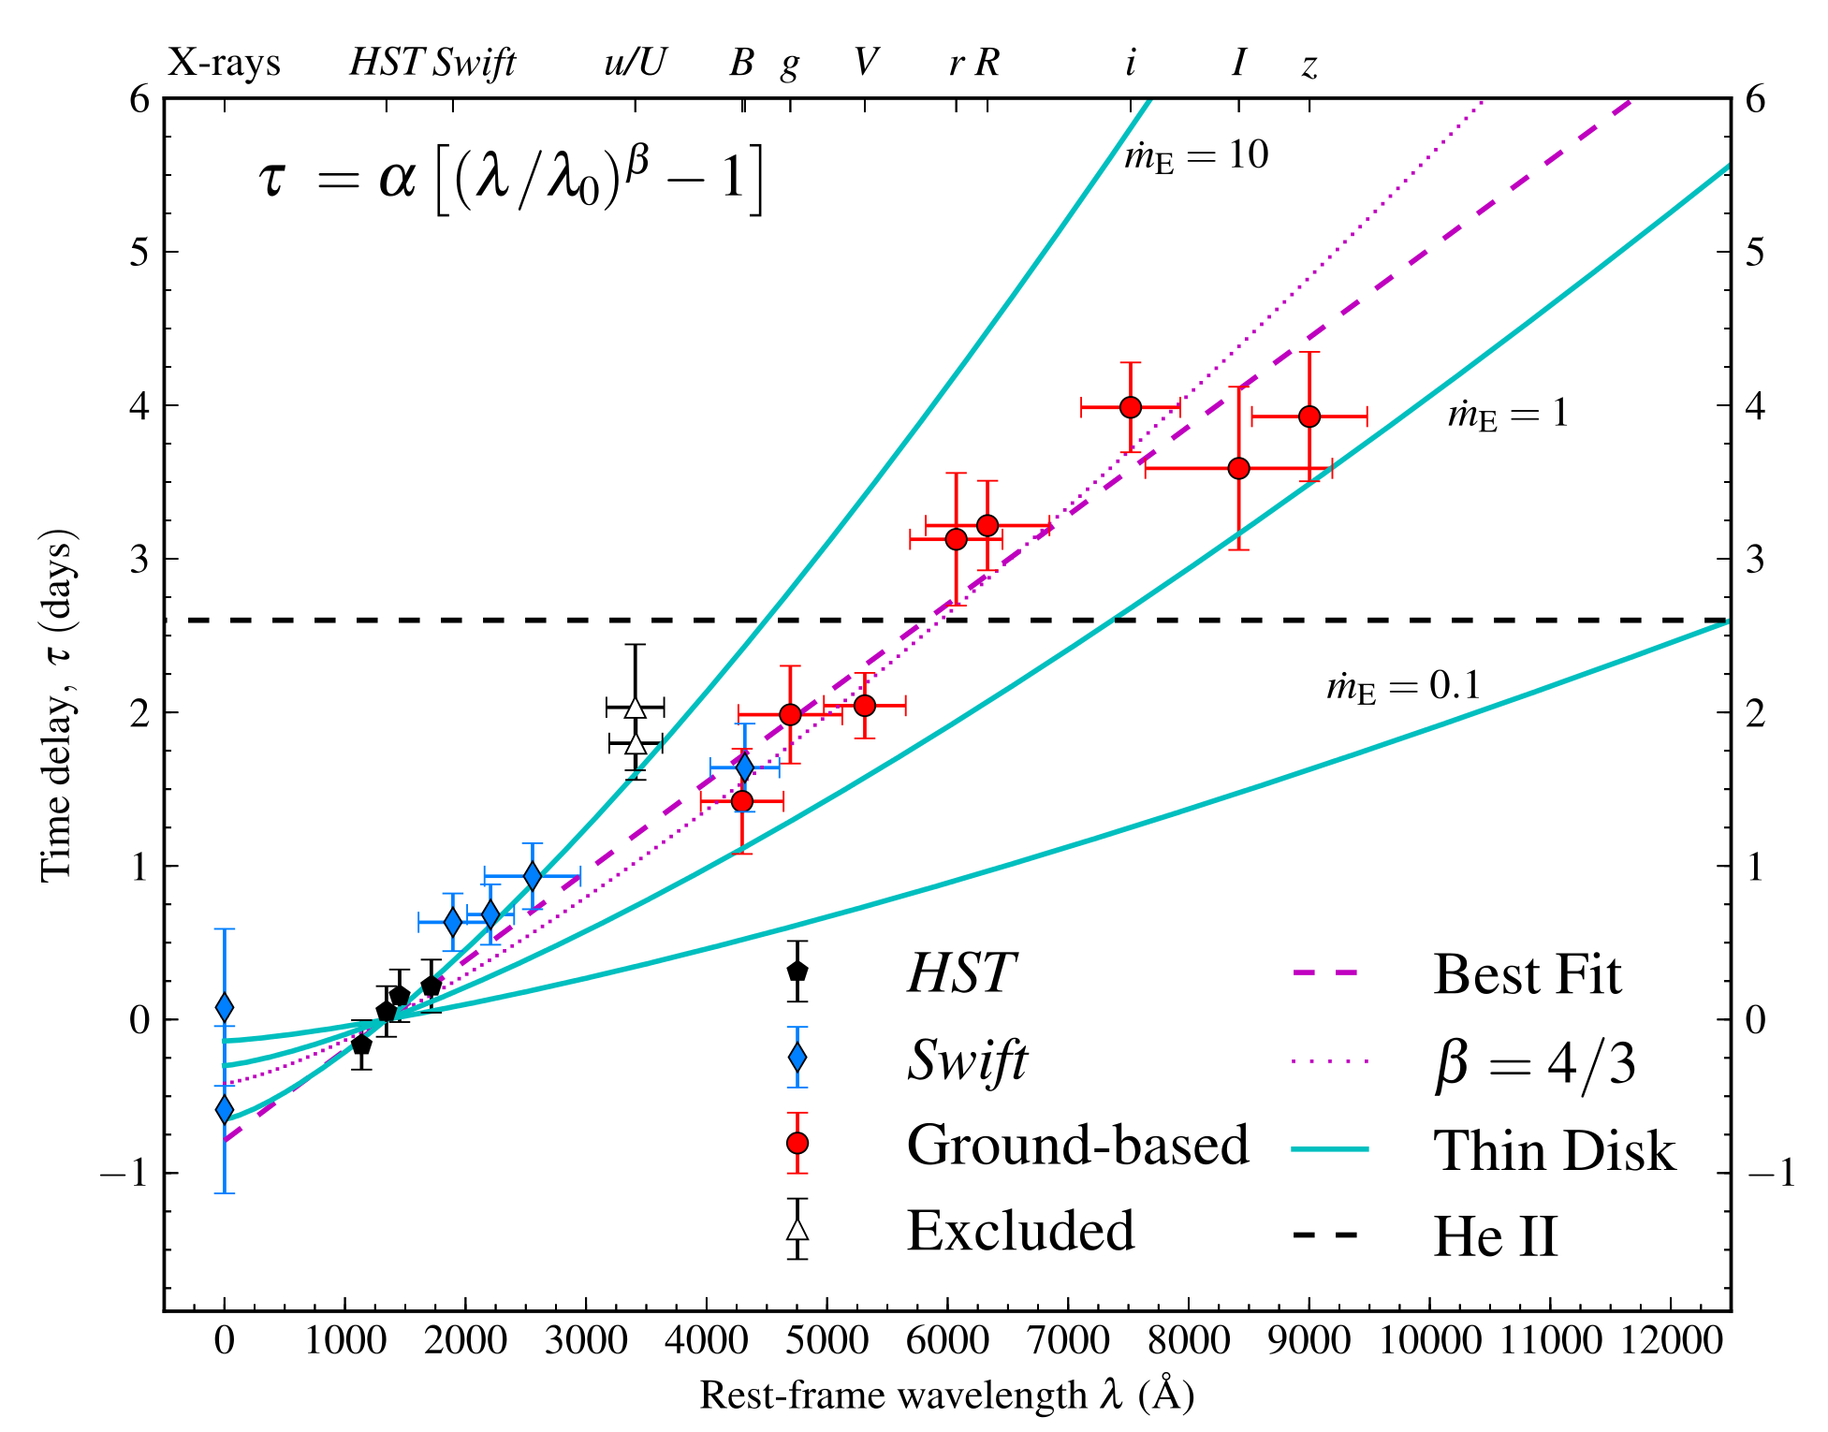
Time Delay Analysis from STORM III

Slide 7
Motivation
Optical Band Reverberation Mapping has thus-far involved time-domain techniques.
X-Ray Reverberation Mapping has developed a technique to extract frequency-domain information from unevenly sampled data.
Notes:
Why do we care about AGN?
Believed to be an integral component of galactic evolution.
Standard candle that goes beyond the supernova horizon.
Light Curves contain more information than just the average time lag
Repulsive cosmological constant vs. attractive mass

Slide 8
Project Goals
Using Fourier techniques compute frequency-resolved timelags found in data published in Fausnaugh et al. (2016).
  Maximum Likelihood technique especially should be useful for unevenly distributed data.
Compute Fourier power spectrum for Fausnaugh et al. data.

Slide 9
Thank You
Notes:
Very excited!
Modelling work at WMU provides theoretical exploration
First chance to ask the universe directly

Slide 10
Additional Slides
Notes:
Very excited!
Modelling work at WMU provides theoretical exploration
First chance to ask the universe directly

Slide 11
Fourier Techniques
Fourier analysis provides time-delay distribution as a function of frequency.
Standard techniques are restricted to evenly distributed data.
Zoghbi et al. (2013), with Dr. Cackett, developed a maximum likelihood method to predict time lags across light curve gaps.
Technique should apply nicely to optical data that exhibit gaps.

Slide 12
AGN as Cosmological Probe
AGN can be used as a standard candle and cosmological probe.
  Collier et al. (1999), and later Cackett et al. (2007), have calculated Hubble's constant using this standard, but issues remain.
  Cackett et al. (2007) also indicates promise for constraining cosmological parameters Ω_{Λ} and Ω_{m} .
Optical Band Reverberation Mapping has thus-far involved cross-correlation analysis in the time domain.
  Requires data that are evenly distributed in time, but many data in the optical bands are not.
  Provides only the average time lag.
X-Ray Reverberation Mapping has developed a technique to deal with unevenly distributed data.
Notes:
Why do we care about AGN?
Believed to be an integral component of galactic evolution.
Standard candle that goes beyond the supernova horizon.
Light Curves contain more information than just the average time lag
Repulsive cosmological constant vs. attractive mass

Slide 13
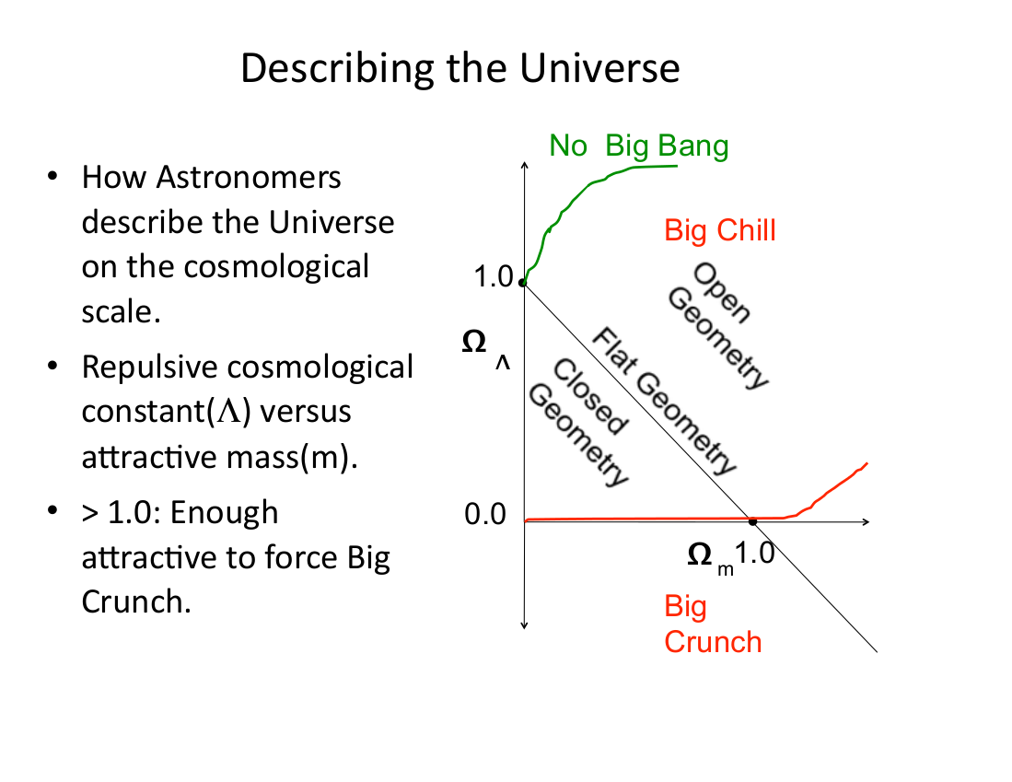

Slide 14
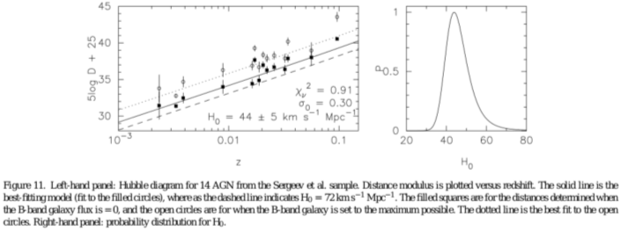
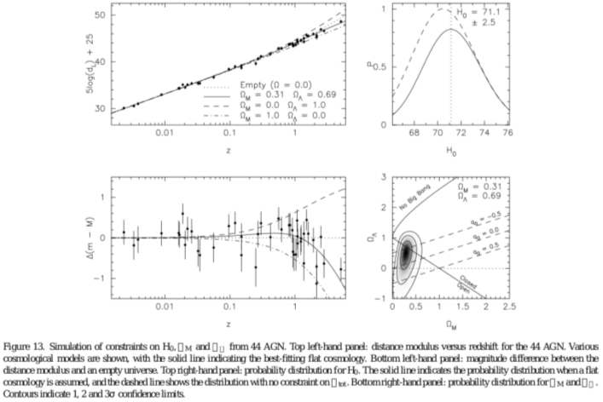

Slide 15
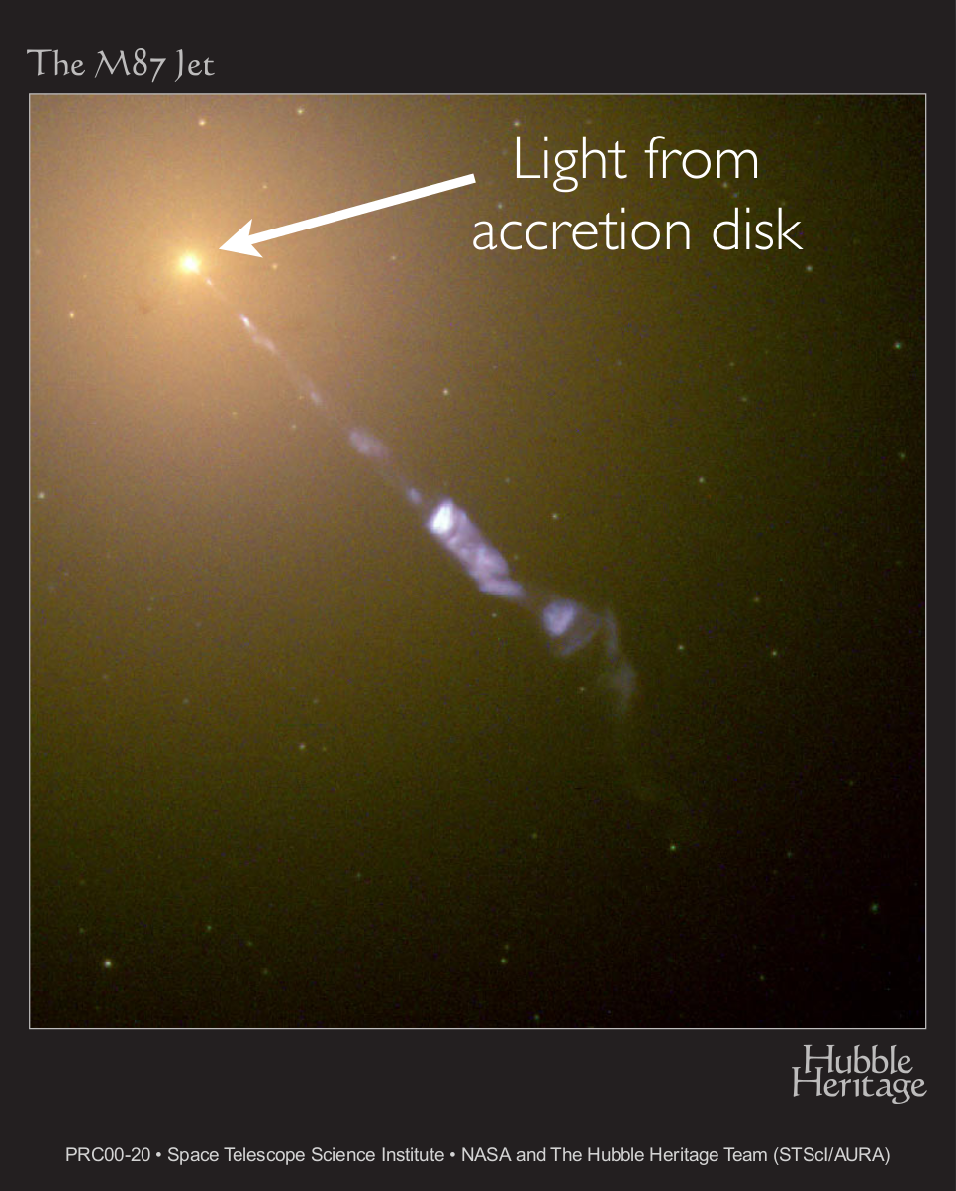
Local Group Active Galaxy Caught in Action

